Slide 1
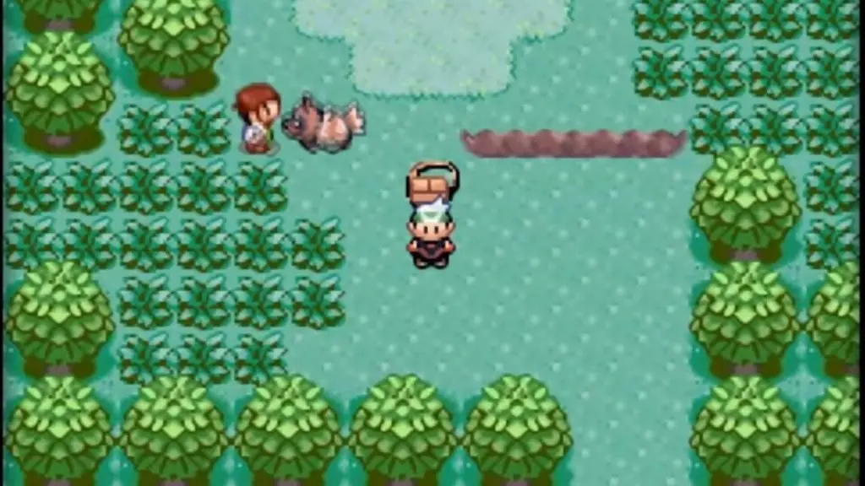
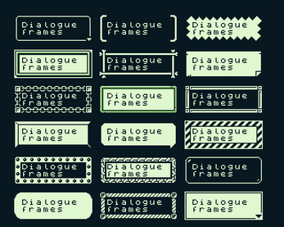
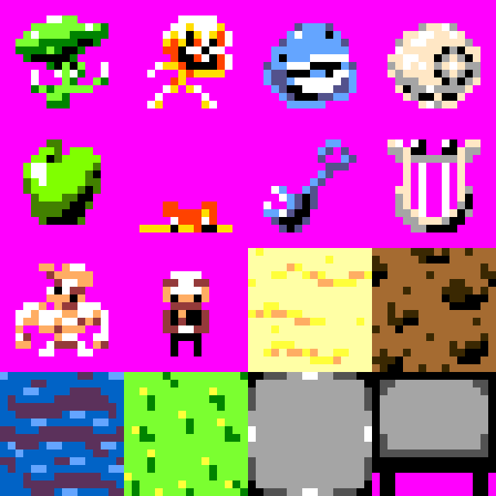
References and resources

Slide 2
How the game will play
Character follows the mouse, and punch the closest enemy. Rampage through everything in your way to the end of the map. (Aim for 1-2 minutes of gameplay, a single level.)
Enemies follow the player, some just tackle you (Flameaton), some tackle you and don’t even harm you (Firat), some run away (people), some panick in place (Snack),
Most enemies dying will just… die, and some may heal you (Snack), or some may give you gold (shopkeepers) f.e. They will be knocked away with physics. No Blood.
Move mouse to move your character.
Left click to punch the closest enemy.
(I will not implement these valid control schemes: Gamepad, keyboard. This makes it very accessible, because just about every itch.io user has a mouse. Also, I can test it easily, without worrying about my ‘s’, ‘w’ and ‘r’ keys.)

Slide 3
Things to do, but oversimplify for now.
Main menu.
Victory scene/screen.

Slide 4
Things to worry about later
Animating the PUNCH.
Death physics.
Intro cutscene.

Slide 5
Things to probably not do
Settings.

Slide 6
Tilemap initialization speedrun
Before timing: A blank Unity project with sprites imported, and basic player that moves around the scene, and appropriate folders.
Target: A paintable pixel scene (based on a ref image), in which the player can roam. 10x10 tile map.
After timing: No need to build anything.

Slide 7
Tilemap creation strats
Tiled. A great tilemap editor, that has a very costly (for me) integration.
Unity’s tile system. A great pain in the ass. But great nonetheless.
Aseprite. Similar to Tiled, But not quite there yet. No tilemap integration.
Super Tilemap Editor. NO. Costly.

Slide 8
Tilemap creation results
Went with the Unity tilemap editor, using an exact ref image of the tilemap I want. Accidentally went with 30x20 tiles. Took me 9:06.
Now the colliders. 15:24.5. Not bad. Not brilliant, but not bad. Because some issues were left.
The colliders are very limited – all of them are squares. I could certainly make half sprites to accommodate for that (8x16 rectangle as a 16x16 tile, f.e), like redsti did.
You show above the roofs. Cool layering was obviously neglected. Because of the issue, I had trees have FULL (and unfun) colliders.
IF you want the cool layering, then the default tile brush is not sufficient for the task. Either manually place things like lampposts, or use a gameobject/prefab brush.

Slide 9
Enemy Object Structure
Enemy (Rigidbody2D, Collider2D, Knockable, NPCBehaviour)
Graphics (SpriteRenderer, Animator) // All enemies share the same set of animations (animator controller), with some exceptions. (Rayquaza)
Hurtbox (Collider2D, EnemyTrigger) // This is how it gets attacked by the punch.
Knockable.cs
_rb : Rigidbody2D
GetKnocked(Vector2 knockDirection, float force = 1) // This uses _rb’s mass, and/or AddForce.
NPCBehaviour.cs
_targetPlayer : Player // Initialized on Start(), via _target.GetComponent<Player>().
_isAlive : bool
[Serializable] _speed : float
[Serializable] _attackDamage : int
[Serializable] _target : Transform
[Serializable] _behaviourType : BehaviourType // =Enum{Dummy /*(animationless)*/, Stand, Chase, RunAway, Rayquaza} [Serializable] _onHit : UnityAction // This may change _behaviourType, _isAlive and _onHit itself!! (See Rayquaza)
Move() //Called in Update(), if _isAlive. Switch-cases the behaviour type.
GetHit() // Uses _onHit (which matters mostly for the professor, and red and/or Rayquaza). Sent by the OnTriggerEnter2D() of the player’s fist with the enemy’s Trigger Collider.
Die() //Changes _isAlive and uses _onDeath (which matters mostly for the professor, and red and/or Rayquaza). Sent by the OnTriggerEnter2D() of the player’s fist with the enemy’s Hurtbox.
Attack() // Calls _targetPlayer.GetAttacked(). Sent by the OnCollisionEnter2D() of the enemy’s main collider with the player body.

Slide 10
Post-Mortem
This went incredibly well!
No, I haven’t made the whole map and I’ve only made the professor’s lab and the hometown, but it plays very funly!
The enemies get knocked nearly perfectly, and I find it very satisfying, especially thanks to the SFX, and thanks to the “knocked” animation.
The dialogue was nearly fully cut, and I’m so glad about that. That was not worth the very limited time.
The tilesets took a bit of time, but they were worth it! Game looked great, and I learnt some!
Wish I had that meme scream though D:

