Slide 2
Summary of Target variables
Metric | left_eye _center_x | left_eye _center_y | right_eye _center_x | right_eye _center_y | nose_tip_x | nose_tip_y | mouth_left _corner_x | mouth_left _corner_y | ...
count | 7039 | 7039 | 7036 | 7036 | 7049 | 7049 | 2269 | 2269 | ...
mean | 66.359021 | 37.651234 | 30.306102 | 37.976943 | 48.374186 | 62.715884 | 63.285735 | 75.970714 | ...
std | 3.448233 | 3.152926 | 3.083230 | 3.033621 | 4.280038 | 5.720567 | 4.079063 | 4.579724 | ...
min | 22.763345 | 1.616512 | 0.686592 | 4.091264 | 12.944699 | 17.932414 | 22.923362 | 57.023258 | ...
25% | 65.082895 | 35.900451 | 28.783339 | 36.327681 | 46.602370 | 59.292697 | 61.257143 | 72.875707 | ...
50% | 66.497566 | 37.528055 | 30.251378 | 37.813273 | 48.424713 | 63.451421 | 63.178286 | 75.778689 | ...
75% | 68.024752 | 39.258449 | 31.768334 | 39.566729 | 50.330437 | 66.492686 | 65.376243 | 78.879123 | ...
max | 94.689280 | 80.502649 | 85.039381 | 81.270911 | 89.438592 | 95.935644 | 84.767123 | 94.673637 | ...

Slide 3
How do the predictors look like?
Row number | Image (as string of 9216 (96x96) pixels
0 | 238 236 237 238 240 240 239 241 241 243 240 23...
1 | 219 215 204 196 204 211 212 200 180 168 178 19...
2 | 144 142 159 180 188 188 184 180 167 132 84 59 ...
Reshaping into an array
Row number | Image (as string of 9216 (96x96) pixels
7046 | [[74, 74, 74, 78, 79, 79, 79, 81, 77, 78, 80, ...
7047 | [[254, 254, 254, 254, 254, 238, 193, 145, 121,...
7048 | [[53, 62, 67, 76, 86, 91, 97, 105, 105, 106, 1...

Slide 4
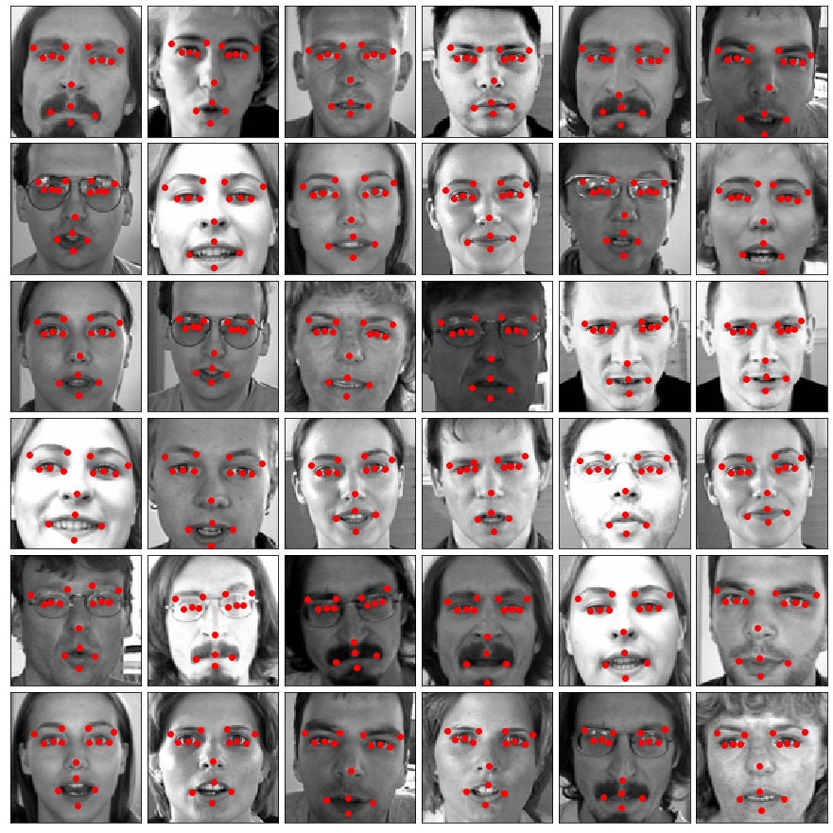
Our dataset - visualized

Slide 5
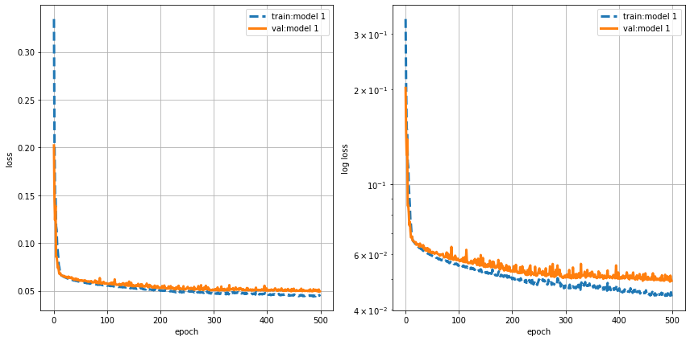
Multilayer Perceptron learning curve

Slide 6
Convolutional Neural Network learning curve

Slide 7
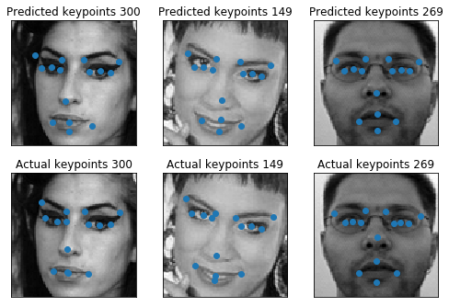
CNN results visualized
Predicted:
Actual:

Slide 8
Model comparison
Model | Test set RMSE (in pixels) | Computing time (in seconds)
Linear Regression | 2.585 | 177.50
Decision Tree | 2.974 | 525.88
Tuned Decision Tree | 2.676
XGBoost
Multilayer Perceptron | 2.262 | 43.07
Convolutional Neural Network | 2.067 | 597.56
CNN with Transfer Learning

