Slide 1

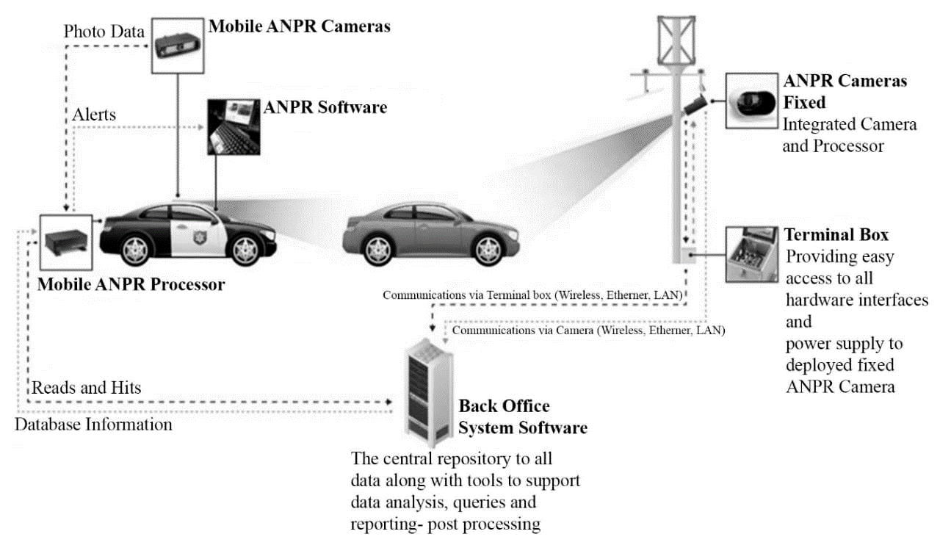

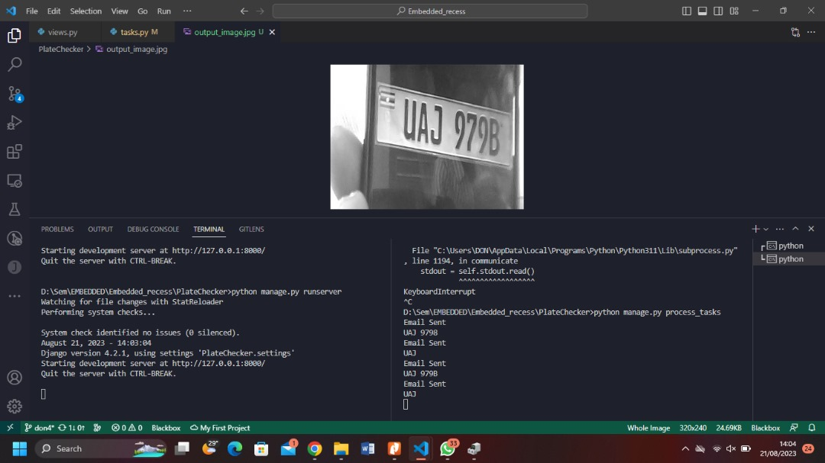
Automatic Number Plate Recognition
Mukisa Don Joeph | Anslem | Arinda
Problem
Project Design
Results
The project is addressing the problem of theft of automobiles with number plates such as cars and motor bikes. This mainly targets owners of automobiles
Project Objectives
The objective of the project is to come up with a system that can enable an automobile owner be in position to know the exact place their automobile has been spotted when they require to.
Project Requirements
Results
Conclusion
Arduino Nano
OV7675 camera
Computer
TinyMLSheild Kit
It is possible to know the exact location of an automobile using machine learning and embedded systems.
Through Automatic Number Plate recognition its possible to detect an automoblie
References
Target Users
Future Work
M. Rhead, R. Gurney, S. Ramalingam and N. Cohen, "Accuracy of automatic number plate recognition (ANPR) and real world UK number plate problems," 2012 IEEE International Carnahan Conference on Security Technology (ICCST), Newton, MA, USA, 2012, pp. 286-291, doi: 10.1109/CCST.2012.6393574.
Car Owners
Get notified where their car has been spotted when they require to
Motor bike Owners
Get notified where their motor bike has been spotted when they require to
Police
Be notified where a certain automobile has been spotted when required
Implement wireless connection between the board and computer

