Slide 1
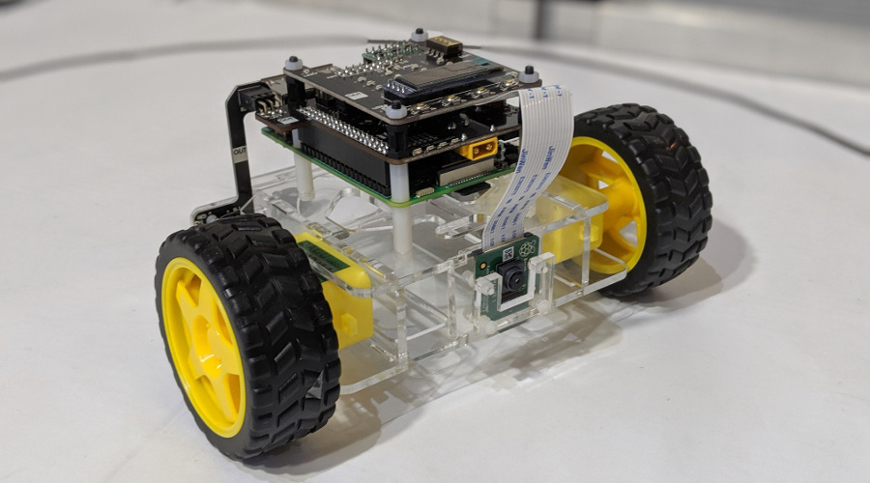
ECE4078 Intelligent robotics
Lab 2-2: Kal Backman & Tina Wu

Slide 2
Milestone 2
Milestone is all about SLAM
Your task is to estimate the position of all ArUco markers within the arena
Task 1: Wheel calibration (Week 3)
- Objective is to calculate the wheel radius and the distance between both wheels
Task 2: Camera calibration (Week 3)
- Objective is to calculate the intrinsic parameters of the camera
Task 3: SLAM (Week 4)
- Estimate the position of ArUco markers in the environment using an extended Kalman filter (EKF)
- Have to modify 2 main files:
- “robot.py”: “predict()” and “update()” functions
- “ekf.py”: “derivative_drive()” and “covariance_drive()” functions
- Your solution should automatically generate “slam_map.txt” to evaluate your estimates

Slide 3
Extended Kalman filter
When to use a Kalman filter:
- Sensor fusion
- Want to apply dynamics + sensor measurements
There are two main steps
1: Prediction step – We apply a dynamic model to estimate what the state should look like
given our previous state. Eg: Knowing the velocity of an object, we can guess what it’s position will be 1 second into the future
2: Update step – Correcting / updating the estimate of the current state with observations from sensor readings
Eg: We use a GPS to get a direct observation of what the position actually is
But how much should we “update” our state given an observation?
What if we have multiple sensors (Camera/GPS/LIDAR) which one should we use?
Kalman filters are a probabilistic algorithm to estimate a given state (i.e. mean and covariance)
- If we are confident in our dynamic model, then we shouldn’t rely heavily on noisy observations
- If we have a noisy sensor (GPS), then we should weight it less than an accurate one (LIDAR)

Slide 4

Extended Kalman filter example
We want to track the position of an object that has an accelerometer and a GPS attached
Accelerometer: - High update rate
- Prone to drift after successive time integrations
GPS:
- Slow update rate
- Immune to drift
- Not accurate
3 states:
$X= \left[\begin{matrix}x \\ \dot{x} \\ \ddot{x}\end{matrix}\right]=\left[\begin{matrix}Position \\ Velocity \\ Acceleration\end{matrix}\right]$

Slide 5




Extended Kalman filter example
Prediction step:
Step 1: Apply dynamics
$\left[\begin{matrix}x_{t} \\ {\dot{x}}_{t} \\ {\ddot{x}}_{t}\end{matrix}\right]=\left[\begin{matrix}x_{t−1}+dt∗{\dot{x}}_{t−1}+{dt}^{2}∗\frac{{\ddot{x}}_{t−1}}{2} \\ {\dot{x}}_{t−1}+dt∗{\ddot{x}}_{t−1} \\ {\ddot{x}}_{t−1}\end{matrix}\right]$
Step 2: Calculate Jacobian of dynamics
$\left[\begin{matrix}1 & dt & \frac{{dt}^{2}}{2} \\ 0 & 1 & dt \\ 0 & 0 & 1\end{matrix}\right]$
Step 3: Estimate uncertainty
${\overline{∑}}_{K}=A ∑_{K−1}A^{T}+∑_{Q}$
$$\begin{matrix}dx & d\dot{x} & d\ddot{x}\end{matrix}$$
$$\begin{matrix}x \\ \dot{x} \\ \ddot{x}\end{matrix}$$
This matrix is denoted as “A” in the lecture slides however many other people may denote this as “F”
This matrix represents your uncertainty in the process / dynamics.
Commonly referred to as “Q”, and is normally tuned. There is an alternate form which uses $∑_{Q}=VQV^{T}$ where V is the Jacobian of the states with respect to “$ε_{Q}$” from the lecture slides.
Covariance matrix of the states, this is also commonly denoted as “P”

Slide 6






Extended Kalman filter example
Observation / correction / update step:
Step 1: Calculate error of observation and prediction
$Y= \left[\begin{matrix}GPS −x_{t} \\ Accelerometer −{\ddot{x}}_{t}\end{matrix} \right]$
Step 2: Calculate Jacobian of error (multiply by -1)
$\left[\begin{matrix}1 & 0 & 0 \\ 0 & 0 & 1\end{matrix}\right]$
Step 3: Update Kalman gain and states
$K={\overline{\sum{ }}}_{K}C^{T}{(C{\overline{\sum{ }}}_{K}C^{T}+∑_{R})}^{−1}$
X = $\left[\begin{matrix}x_{t} \\ {\dot{x}}_{t} \\ {\ddot{x}}_{t}\end{matrix}\right]$ + K Y
$∑_{K}=(I −KC){\overline{∑}}_{K}$
The error term Y is more generally denoted as$Y=z−h(x)$ where z is the sensor measurement and h( ) is a function that allows you to compare the state with the sensor measurement
$$\begin{matrix}dx & d\dot{x} & d\ddot{x}\end{matrix}$$
This matrix is denoted as “C” in the lecture slides however many other people may denote this as “H”.
For extended Kalman it is calculated as $H= \frac{dh}{dx}$
$$\begin{matrix}x_{t} \\ {\ddot{x}}_{t}\end{matrix}$$
This matrix represents your uncertainty in the observation
and is normally tuned. “$C{\overline{\sum{ }}}_{K}C^{T}+∑_{R}$” is also denoted as “S”
Is the Kalman gain and it acts as a step size as to how much you should update your states based on an observation

Slide 7
Milestone 2 submission
M2 deadline has been extended an extra week to accommodate Kalman filters not being covered in the lectures before the final M2 lab sessions
M2 due before: Monday 30th August 12:00 PM
Submission guidelines:
When submitting your milestones, the demonstrators should only have to download your .zip file, extract the contents and run a script
When submitting your milestones please include:
- All files that are essential to run your solution
- This includes the pibot.py / images for the GUI / any other scripts provided to you
- A ReadMe.txt file that should include:
- Information on how to setup your solution (additional libraries to install)
- How to run your solution (What command should we run? What are the controls?)
- If you have implemented any additional features please explain them
Please do not include any other file that is not required to run your solution
e.g. default ReadMe.md / images associated with the default ReadMe.md

