Slide 1
WRF-Python
Leah Campbell
September 11, 2017

Slide 2
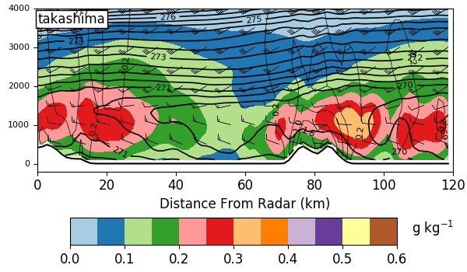
**Interpolation to cross-sections, height, and pressure levels**
**Diagnostics like vorticity, CAPE, and precipitable water**
http://wrf-python.readthedocs.io/en/latest/

Slide 3
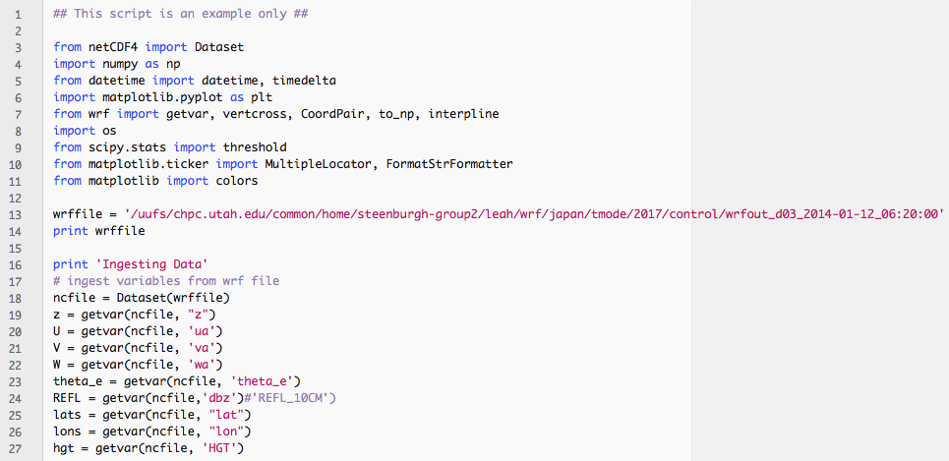
Example Cross Section Script Part I

Slide 4
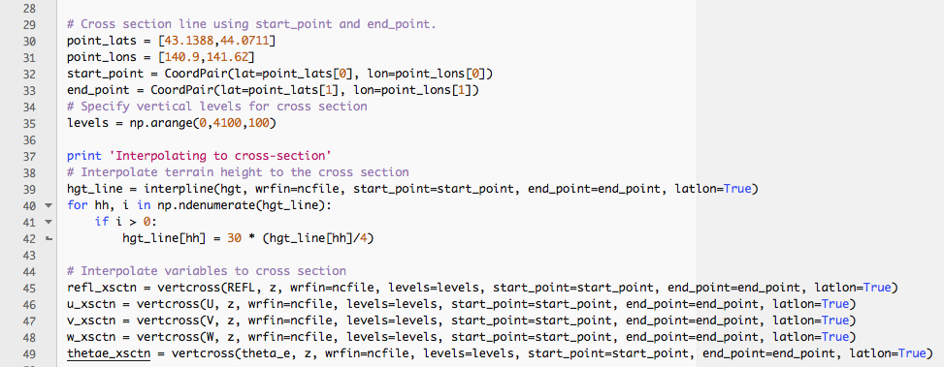
Example Cross Section Script Part II

Slide 5
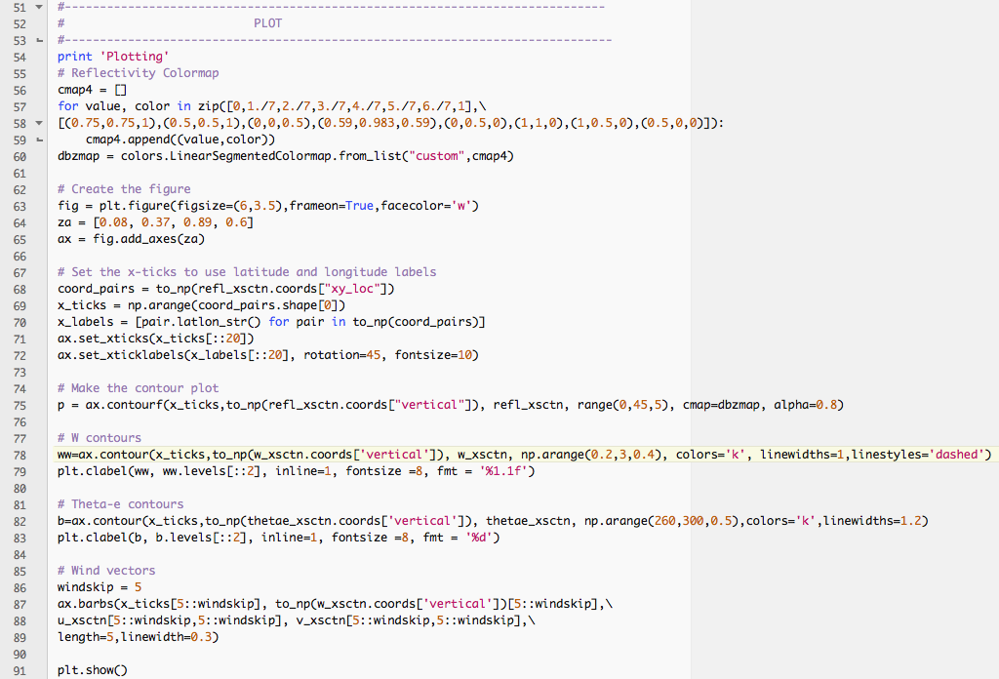
Example Cross Section Script Part III

Slide 6
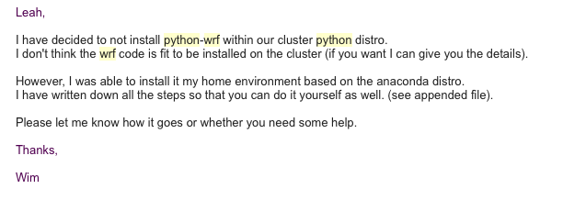
Setting up on CHPC System
* Have to set up your own Anaconda build

Slide 7
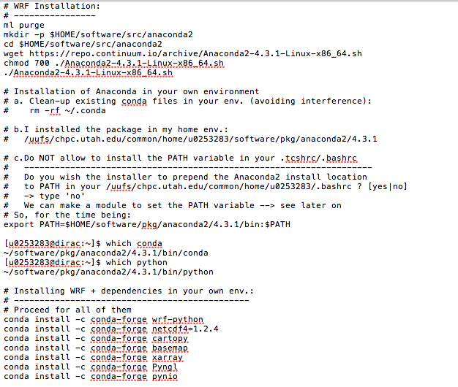
Setting up on CHPC System (from Wim Cardoen)

Slide 8
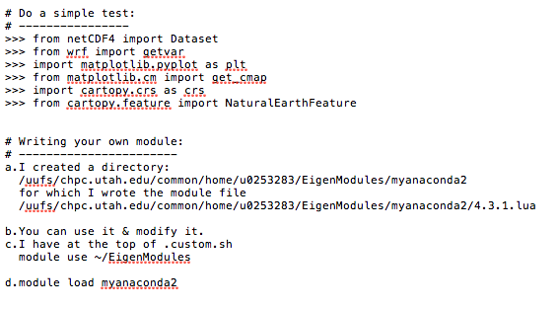
Setting up on CHPC System (from Wim Cardoen)

Slide 9
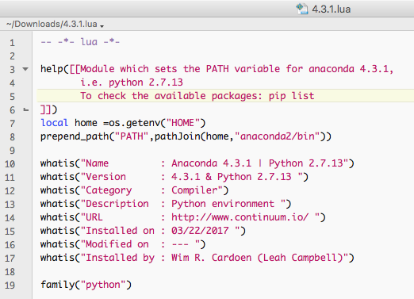
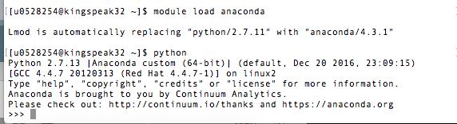
Setting up on CHPC System (from Wim Cardoen)

