Slide 1
Building Apps with AI Agents
Lab companion · two modules · NestJS 12 · drizzle · SQLite · MCP
$ npm run verify
Notes:
Keep this deck on screen during lab work. Each module has: a divider (goal + time), PROMPT slides (what the proctor says and the exact prompt learners paste into their agent), CHECK IT (what learners run to check the agent's work), CHECKPOINT (what correct looks like) and WHEN THE AGENT GOES WRONG (mistakes agents actually made). The full explanations are in the chapter documents.

Slide 2

How every lab works
1
2
3
4
5
Proctor
Instruct
Agent
Check
Review
the goal, where the requirements are, when it is done
you give that to your agent, never the steps
works out how from the repo, builds it, then stops
npm run verify + npm run lab NN: read the counts
ask it to show, not tell: the red run, the SQL
Repeatable work → tools. Judgement → the agent, fenced in.
Notes:
The AI does the building and the planning; the learner directs and checks. The instruction says what and when it is done, never how: the repo (CLAUDE.md, its skills, the specs) tells the agent how, and watching it find that out is part of the lab. Measured: fresh agents given only these instructions got every module's lab green. Hold the agent to evidence: counts, a failing run, the generated SQL.

Slide 3
NestJS: request flow
Request
Middleware
Controller
Service
Database
from the client
runs first
the route
the rules
SQLite
Notes:
Every request passes middleware first, then reaches a controller. The controller does no business logic: it calls a service. The service holds the rules and reads or writes the database (through a repository). The answer travels back the same way.

Slide 4
NestJS: who calls whom
Module
Middleware
Controller
Service
Repository
Database
Notes:
A module groups one feature: its controller, its service and its repository. The controller calls the service; the service calls the repository; Nest connects them (dependency injection). Middleware sits outside the feature and runs before the controller. In module 1 your agent builds one module for users and one for notes.

Slide 5



Three rules for the lab
Windows, PowerShell, Node 24
Every command runs in boilerplate\nest-ai-starter, one per line. npm ships with Node; scripts run as npm run <name>.
Counts, not exit codes
Read "Tests N passed" AND "Test Files": a failed beforeAll shows 0 failures in the Tests line and exit 1.
The data is yours to break
data/app.db ships seeded. Change it freely while you try things; npm run db:seed puts it back, byte for byte.
Notes:
The audience is on Windows. Windows PowerShell 5.1 has no && (PowerShell 7 does), so every command is on its own line. Nobody needs curl: the playground page sends the requests. The base starts its tools with node and their JS entry, because the node_modules\.bin shims are .cmd files on Windows; measured on Linux, not yet on a Windows machine.

Slide 6



Try it in the browser: /playground
One page, every request
With the app running, open http://localhost:3000/playground. It lists every module 1 request: health, users, notes and sharing.
Click to send
Each Send calls the real controller and shows the status, a ✓ when it is the one the specs expect, and the body. Run all in order chains the ids.
It writes to your data
Requests create, change and delete rows in data/app.db. npm run db:seed restores the seeded data.
Notes:
Before module 1 is built, health is the only green row: the rest answer 404 or wait for an id. Module 2 has no playground: its client is Claude Desktop, over stdio. The Postman collection stays in the starter (postman/) for anyone who prefers it; the labs do not use it.

Slide 7



Lab checks: is my lab done?
One check per lab
npm run lab 01 runs the check for lab 01, npm run lab all of them. Done means Test Files 1 passed and every test green.
Red until built
Every lab check fails on the starter, because its feature is not there yet. It turns green when your agent has built it, and stays green after.
Fell behind?
Start the next module from its checkpoint (docs/ai-agent-training/checkpoints/), not by patching your own copy.
Notes:
The checks drive the app over HTTP (lab 01, empty in-memory database) and the MCP server over stdio (lab 02, a copy of the seeded file), and never import learner code. The contracts are the specs; test/labs/README.md summarises them. Each module's reference result is a patch in docs/ai-agent-training/checkpoints/.

Slide 8
The track (draft lab times)
1 Users and notes
15'
2 An MCP server on your data
15'
Notes:
Two modules, about 15 minutes each for Claude Code to build, so about 30 minutes of labs. Times are ESTIMATES: nobody has run these labs with an audience yet. Adjust after the first session.

Slide 9

Users and notes
MODULE 1
Your agent sets the project up, then builds the users and notes resources (notes shareable between users) on the seeded tables.
15 min
lab (draft)
Notes:
Covers chapters 00 + 01 + 02. Left out for time: nothing: the two stretch exercises of chapter 01 are for fast groups.

Slide 10

Instruction 1/3: set the project up
Proctor: The data is already there. Have your agent set the project up, prove it works, and show you what is in the database.
steps/01-set-up.md · give it to your agent
Watch its approach
> Read steps/01-set-up.md and do what it says.
# steps/01-set-up.md says:
Set this project up on this machine: install it, and
create your local .env by copying .env.example (on Windows
PowerShell: Copy-Item .env.example .env). Then prove it
works: counts, not "it works". Then show me what is in the
database. Then stop and wait for my next instruction.
reads CLAUDE.md before running anything
copies .env.example to .env (git ignores it)
counts: 21 unit, 5 e2e, a red lab 01
data: 25 users, 200 notes, 120 shares
Notes:
Measured: a fresh agent given only this instruction installed, built, started the app, and reported 20 unit / 2 e2e (5 e2e now, with the playground's test), lab 01 red, and the table counts (115 open and 85 done notes, 120 shares, none with its owner). If port 3000 is busy, PORT in .env (chapter 00).

Slide 11
Instruction 2/3: the users resource
Proctor: Do not tell your agent how. The repo says how resources are built; watch whether it finds that out.
steps/02-users.md · give it to your agent
Watch its approach
> Read steps/02-users.md and do what it says.
# steps/02-users.md says:
Build the users resource on the provided users table:
specs/users.md. Done when npm run verify is green. Then
stop and wait for my next instruction.
finds the steps: generate, template, fill
keeps the provided table, 14 markers
no migration for a provided table
409s left to the database, not re-coded
Notes:
Measured: a fresh agent found the resource-spec and nest-resource-scaffold skills from CLAUDE.md on its own; the template kept users.table.ts and left 14 markers; verify went to 29 unit / 18 e2e. Lab 01 stays red until notes exist. Ask: which instruction told it to use the skill? None did.

Slide 12
Instruction 3/3: notes, with sharing
Proctor: A user owns many notes; a note can be shared with many users. The rules decide where each piece goes.
steps/03-notes.md · give it to your agent
Watch its approach
> Read steps/03-notes.md and do what it says.
# steps/03-notes.md says:
Now the notes resource, with sharing: specs/notes.md. Done
when npm run lab 01 and npm run verify are green. Then
stop and wait for my next instruction.
stored-state rules in the service (422)
filters and /shares routes, with e2e tests
a bad dueAt is 400, not 500
every rule broken once to see red
Notes:
Measured: a fresh agent got lab 01 15/15 and verify 43 unit / 46 e2e. Its first dueAt answered 500 for "next tuesday" (it converted with .overwrite(), a zod 4 check that still runs after the format check failed); it found and fixed it. The filters and share routes go outside the markers, on purpose.

Slide 13

Check it: module 1
module 1 · run this
In the playground
# 1. the tests first
npm run verify # read both Tests lines
npm run lab 01 # the lab check: all green?
# 2. then the app on the seeded data
# (port taken? the last line says so: PORT= in .env)
npm run build
npm start
# 3. open localhost:3000/playground (or your PORT)
# and click Run all in order
localhost:3000/playground
1. Health
2. List users (seeded)
3. Create user
4. Create note
5. Mark done
6. Edit a done note → 422 (R2)
7. Share with a friend
Notes:
Tests first: verify and the lab check run on an empty in-memory database, so a green result there is the proof the code works. Only then start the app and open the playground: it sends every module 1 request to the running app with one click and shows each answer, proving the resources also serve the seeded rows. Nobody needs curl. The playground writes to data/app.db; npm run db:seed puts the data back.

Slide 14
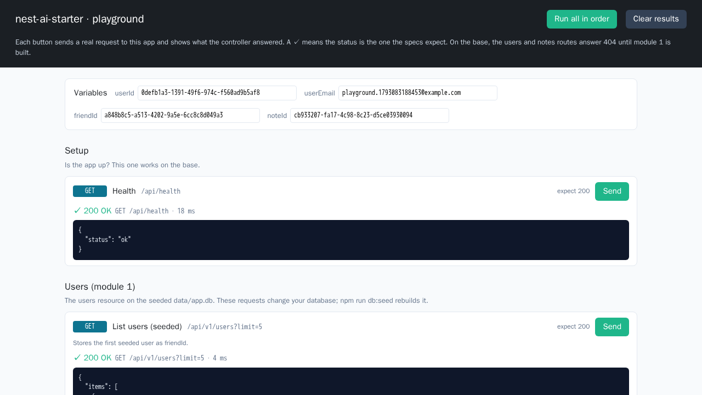
What to expect: the playground after Run all
Look for
19 of 19 cards ✓ in our dry run
Variables filled: the ids carry over
409 and 422 cards ✓ too: the rule said no
Red in DevTools for those: expected
List users shows the 25 seeded users
Notes:
Captured in a dry run of the previous slide, in Chromium at 1280x720: base plus the module 1 checkpoint and no .env, verify 44 unit / 49 e2e, lab 01 15/15, then Run all in order: 19 of 19 cards green, no page errors, List users showing the 25 seeded users. With DevTools open the two 409 and three 422 requests show in red as failed loads; that is expected, they are the rule checks. If port 3000 is taken, npm start prints "successfully started" and THEN fails: the last line says the port is in use. Set PORT in .env and use that port in the URL. A missing .env does not matter: in development the app uses data/app.db by default. npm run db:seed puts the data back afterwards.

Slide 15
Checkpoint: two MVCs on real data
output: captured
Done when
# npm run verify (base: 21 unit, 5 e2e)
Tests 44 passed (44)
Tests 49 passed (49)
# npm run lab 01
Tests 15 passed (15)
# /playground on the seeded file
users total=25 notes total=200
notes?status=done total=85
npm run lab 01: every test passes
deleting a rule turns a test red
the app lists the seeded rows
your agent stopped: no MCP server yet, lab 02 still red

Slide 16

When the agent goes wrong: module 1
It runs db:generate for users
The table is provided: there is nothing to generate. npm run verify (check:migrations) proves it.
A bad dueAt answers 500
An .overwrite() still runs after the date check failed and throws. Use .transform(), or guard first; the scaffold skill lists it.
It counts notes before deleting a user
A second copy of a rule the foreign key already enforces. Let the database refuse; map the error.

Slide 17
An MCP server on your data
MODULE 2
Your agent builds an MCP server that queries and changes the database; you connect it to Claude Desktop and have Claude read and write your data.
15 min
lab (draft)
Notes:
Covers chapters 03 + 04. Left out for time: the stdio framing lab (chapter 03): reading one exchange covers it.

Slide 18
MCP next to REST: a second front door
REST · module 1
MCP · module 2
Browser · /playground
Claude Desktop
HTTP: GET /api/v1/notes
JSON-RPC over stdio: tools/call
Controller (routes)
MCP server (tools)
Same services, same rules: MCP replaces the controller, not the app. MCP messages are JSON-RPC; the transport is stdio here (Claude Desktop starts the server) or Streamable HTTP for a remote server.
Services: the rules (module 1)
query · execute: SQL straight to the database, guarded by the server
Repository → data/app.db
Notes:
Module 1 built the REST front door: an HTTP request reaches a controller, the controller calls a service, the service holds the rules. Module 2 adds a second front door for an AI client. The MCP server takes the controller's place: each tool parses its input and calls the SAME UsersService and NotesService, so the rules exist once. Measured: removing the never-shared-with-the-owner rule from NotesService turns both the REST tests and the MCP checks red. Two tools are the exception: query and execute run SQL a model wrote, straight on the database, so the server guards them itself. On the wire, MCP is JSON-RPC messages, not REST routes. They travel over a transport: stdio when Claude Desktop starts the server on your machine (what we build), or Streamable HTTP for a server you reach over the network. So MCP can ride on HTTP, but it is not built on REST.

Slide 19
Instruction: an MCP server on your data
Proctor: The goal: your Claude Desktop app queries and changes this database. The model writes the SQL, so the server decides what may run.
steps/04-mcp-server.md · give it to your agent
Watch its approach
> Read steps/04-mcp-server.md and do what it says.
# steps/04-mcp-server.md says:
I want to use this data from Claude Desktop. Build the MCP
server in specs/mcp.md. Done when npm run lab 02 and npm
run verify are green. Then connect it to my Claude Desktop
(keep any MCP servers I already have there), tell me to
quit and reopen Claude Desktop so it picks the server up,
and give me one question I could ask it and one change I
could ask it to make. Then stop and wait for my next
instruction.
reads the installed SDK, not its memory
typed write tools call the module 1 services
query and execute each guarded in layers
connects it to Claude Desktop, keeps your other servers
Notes:
Measured: a fresh agent got labs 31/31 and verify 46 unit / 58 e2e. Five SQL guards, each removed once and caught by lab 02: query is one SELECT/WITH statement (libSQL silently drops a second) run under PRAGMA query_only (a WITH can hide a delete); execute is one statement, only INSERT/UPDATE/DELETE, and UPDATE/DELETE need a WHERE. Its own e2e test missed two of the five: the lab checks come from the spec, not the code. The typed write tools call UsersService and NotesService, so removing a rule there turns the MCP checks red too. execute keeps foreign keys on but does not apply the service rules; its description says so.

Slide 20
Check it: module 2
module 2 · run this
npm run verify
npm run lab 02 # the lab check: all green?
# your agent connected it: claude-desktop-config.mjs
# --install (your other servers are kept)
# YOU: quit Claude Desktop completely (tray too)
# and reopen it: notes-db is in the tools menu
# then ask: "Which open notes are shared with more
# than one person?"
# "Add a user Ada, ada@example.com, with
# a note due next Friday"
Notes:
Claude Desktop starts the server from its own folder with a minimal PATH, so the entry needs absolute paths for node, the server and the database. The agent connects it with node scripts/claude-desktop-config.mjs --install, which backs the config file up, keeps every other server in it and adds only notes-db; it refuses a file it cannot parse. The one step the agent cannot do is the restart: each learner quits Claude Desktop completely (not just the window; on Windows also from the tray) and reopens it. The lab runs on a COPY of data/app.db; Claude Desktop writes to the real one, and npm run db:seed puts it back.

Slide 21
Checkpoint: Claude Desktop, your data
output: captured
Done when
# npm run verify; npm run lab
Tests 47 passed (47) · 58 passed (58)
Tests 31 passed (31)
# started as Claude Desktop does it
create-user · create-note · share-note
execute update … where id = … → 1 row
# execute: delete from notes
NOT_ALLOWED: DELETE without a WHERE …
npm run lab 02: every test passes
query refuses a write, execute an unbounded one
Claude Desktop answers a question and makes a change
your agent stopped and is waiting

Slide 22
When the agent goes wrong: module 2
query checks the SQL string only
A write can hide inside a WITH. Ask for PRAGMA query_only too, and a test that tries it.
execute runs any SQL it is given
One statement, INSERT/UPDATE/DELETE only, a WHERE on UPDATE and DELETE. Ask for a test per refusal.
Claude sees no tables
The server started in another folder and got an empty database. Use absolute paths; the server should exit when the file is missing.
Claude Desktop shows no notes-db tools
A relative path or a bare node in the entry. Use the script's absolute paths, then quit Claude Desktop fully and reopen.

Slide 23
What you built
Seeded SQLite
Users
Notes + sharing
MCP server
Claude Desktop
Next: authentication before anyone else can reach it · an HTTP transport for a shared server · your own tables and tools
Notes:
Close by asking each learner for one thing their agent got wrong, and how they found out: a count, a red test, the SQL.

