Slide 1

Machine Learning Hackathon CG 2022
Team Name- DTUites
Team Leader Name- Krishan Singh
Team Leader Email Address- krishansingh_2k19ee138@dtu.ac.in

Slide 2
Brief description of the problem at hand:
The data set consists of 30 features (like URL_Length, Shortining_Service) of a phishing website. The value of attributes can be [1, 0, -1] which mean the following:
1 represents the legitimate
0 represents suspicious
-1 represents phishing
The problem is straightforward, given these features we have to predict whether a given website is legitimate or phishing website.

Slide 3
Solution proposed and description:
The given problem is a binary classification problem where the target variables are 1, -1 (1 if website is legitimate and -1 for phishing website)
So first, we will modify target variables as 0(for phishing), 1 (legitimate), so for models for binary classification, and then we train and fine tune several models on the dataset starting from simple models like GaussianNB, logistic regression and ridge-classifier to more complex ensemble models and at the end a deep neural network also.

Slide 4
Technology/Tool Stack Used:
Python
Google Colab
Libraries Used:
Sklearn
XGBoost
LightGBM
CatBoost
Keras
Rapids CUML

Slide 5
Approach:
Firstly, formulated cross-tabulation b/w different columns with target column to check the relation with the target column.
Then chose 6 models: LogisticRegression, RidgeClassifier, GaussianNB, SVC, DecisionTreeClassifier, KNeighborsClassifier and fine-tuned the models and performed submissions on them.
Also, fine-tuned a CUML RandomForestClassifier,
Many ensemble models were also trained like XGBoost, LightGBM and CatBoost.
Of all the models fine-tuned LightGBM performed the best.
Also, trained a single - layer neural network and fine-tuned it using GridSearch by wrapping it in KerasClassifier.
For more details refer the ipynb notebook

Slide 6
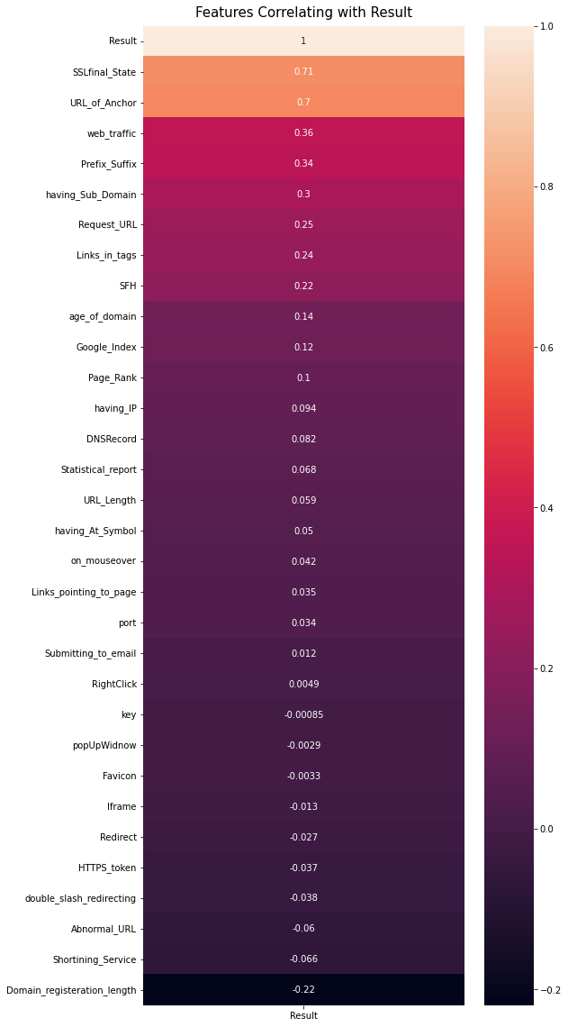
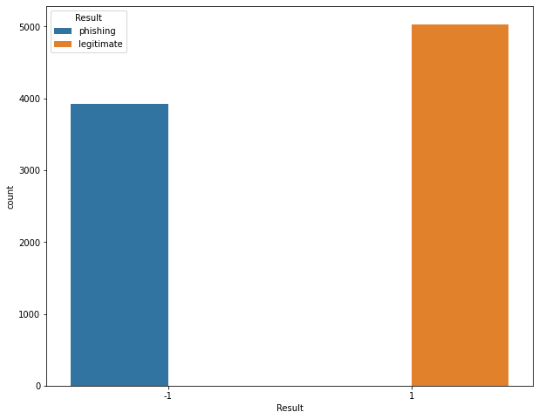
Execution Demo(Video/Screenshots) of the solution:

Slide 7
Source code as ZIP or Github URL:
Github Repository: https://github.com/blaze-fire/hp-ml-challenge

Slide 8
THANK YOU

