Slide 1
Motivation
Organisations want to collaborate on ML — but cannot share raw data
Hospital / Healthcare
Cannot share
raw data directly
Financial Institution
Patient Age
Credit Score
Diagnosis Code
Annual Income
✕
Blood Pressure
Loan History
Medication History
Vertical Federated
Learning (VFL)
Asset Value
LABELS ✓ Treatment Outcomes
No Labels ✗
Train jointly • No raw data shared
⚠ VFL Itself Has a Hidden Vulnerability
A malicious participant can observe gradients and embedding geometry to infer
the other party's private labels — without accessing raw data at all.

Slide 2
What is Vertical Federated Learning (VFL)?
Feature-split collaborative training — no raw data leaves each organisation
SERVER — Top Model
(Aggregates embeddings, holds labels)
z_A
(embedding)
z_B
(embedding)
Party A (Adversary)
Party B (Server-side)
grad_A
grad_B
Features 0 – 15
Features 16 – 31
feature_0
feature_16
feature_1
feature_17
feature_2
✕ No Raw Data Shared
feature_18
feature_3
feature_19
feature_4
feature_20
Bottom Model A
Bottom Model B + LABELS
No labels
Owns training labels
Embeddings (z) flow UP • Gradients flow DOWN • Labels stay with owner • Raw features NEVER leave each party

Slide 3
Label Inference Attacks in VFL
Passive vs Active — both recover private labels without seeing raw data
PASSIVE ATTACK
ACTIVE ATTACK (MaliciousSGD)
Party A
(Attacker)
Party B
(Labels owner)
Party A
(ACTIVE Attacker)
Party B
(Labels owner)
Standard SGD
(unmodified)
MaliciousSGD
p.grad × ratio (up to ×5)
VFL trains normally
ratio = clamp(1 + γ·(g_t / g_{t-1}), 1, 5)
VS
Stage 2 — Model Completion
Stage 2 — Amplified Completion
① Load saved Party A bottom model (.pth)
② Attach small inference head (FC layer)
③ Train via MixMatch SSL
④ Only 40 labeled samples needed
① Embeddings are tightly clustered by class
② MixMatch exploits cluster geometry
③ Same 40 labeled samples
④ Far higher label recovery
Result: 84.61% label recovery (CIFAR-10, 100 ep)
Result: 94.99% (+10.4 pp over passive)
Baseline threat — VFL design flaw, no optimizer changes
Amplified embeddings → MixMatch exploits class structure

Slide 4
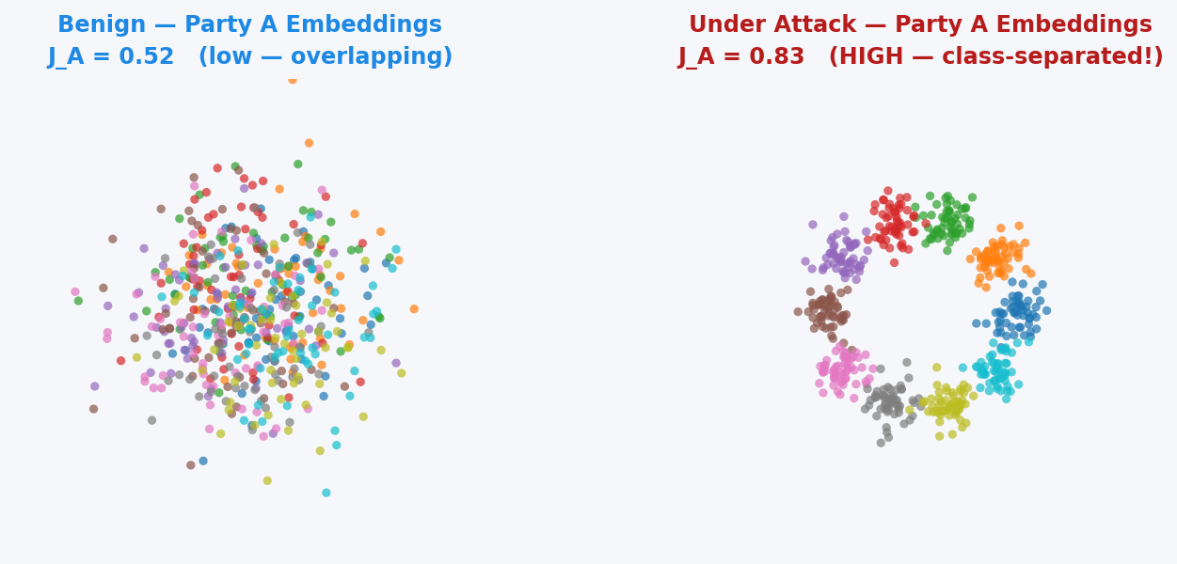
Fisher-Based Detection Mechanism
Server detects asymmetric embedding geometry — no access to Party A's model
Detection Pipeline
STEP 1 — Receive Embeddings
Server receives z_A and z_B each epoch
No access to model weights or raw data
STEP 2 — Compute Fisher Score
J = Tr(S_between) / Tr(S_within)
Computed independently for each party
STEP 3 — Compute Divergence
Δ_F = J_A − J_B
> 0 → Party A is asymmetrically separable
Party B always looks like 'Benign' (J_B stays low)
Server computes Δ_F = J_A − J_B each epoch — detects asymmetry!
STEP 4 — Threshold Comparison
If Δ_F > τ (0.10) after burn-in (8 ep):
Attack DETECTED → Defense fires ⚠
J = Tr(S_between) / Tr(S_within) | Δ_F = J_A − J_B
CIFAR-10: Gap = 0.564 | CIFAR-100: Gap = 0.129
Zero false positives on benign training ✓

Slide 5
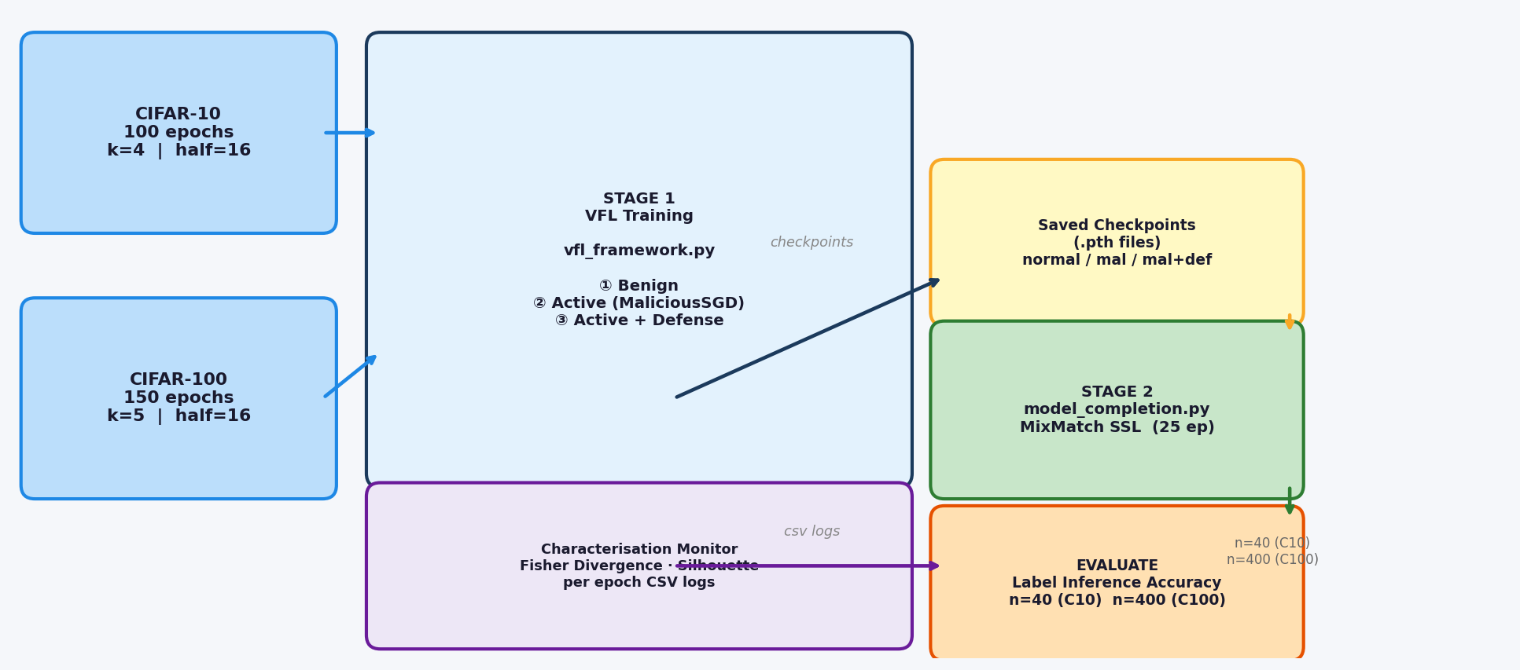
Experimental Methodology
Two-stage pipeline — 3 conditions per dataset — 6 characterisation conditions

Slide 6
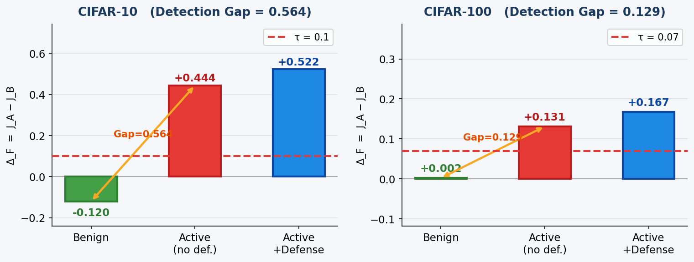
Detection Results
Fisher divergence cleanly separates attack from benign on both datasets
✓ Reliable Signal
Benign ≈ 0
Active >> 0
Signal from epoch 4 (C10)
or epoch 8 (C100)
✓ Zero False Positives
Defense never fires
on benign training
on either dataset
✓ Attack-Proof Signal
Gradient Compression
amplifies signal further
(0.444 → 0.521)
Threshold τ = 0.10 (CIFAR-10) | τ = 0.07 (CIFAR-100)
Burn-in of 8 epochs prevents false alarms during noisy initialisation. Signal stays stable for all remaining epochs.

Slide 7
Conclusion & Next Steps
What is confirmed — what is running right now — what comes next
CONFIRMED ✓
IN PROGRESS ⏳
FUTURE WORK →
Fisher divergence reliably
detects MaliciousSGD attack
100-epoch CIFAR-10
validation (running now)
Stage 2 for GC & Laplace DP
baselines (checkpoints ready)
Signal from epoch 4–8,
stable for all epochs
Expected: active ~94%
Defended: target < 70%
t-SNE: visualise semantic
misalignment under defense
Zero false positives on
benign training (both datasets)
Multi-seed runs (×3)
for statistical confidence
Dataset extensions:
CINIC-10, TinyImageNet
GC does not hide signal
→ detection still works
CIFAR-100 at 150-epoch
budget
Adaptive threshold
(mean + 2σ during burn-in)
VFL utility cost minimal:
only −1.77pp (CIFAR-10)
Ablation (α, τ sweep)
at correct epoch count
Theoretical bound:
grad suppression → alignment gap
Novel finding:
Semantic misalignment mechanism

Slide 8
Backup — Defense Architecture
How detection triggers asymmetric gradient perturbation (server-side only)
Detection fires:
Δ_F = J_A − J_B > τ
after epoch 8
Compute scale factor:
s = max(0, 1 − α(Δ_F − τ))
α = 1.0, τ = 0.10
Scale Party A's gradient:
grad_A ← grad_A × s
grad_B UNCHANGED
What the defense does vs what it cannot do
✓ Scales grad_output_A (server → Party A communication tensor)
✓ Party B's gradient is completely untouched — zero collateral by design
✓ Only fires when Δ_F > τ — correct silence on benign training
✗ Cannot touch p.grad inside Party A — MaliciousSGD re-amplifies internally
✗ Does NOT reduce geometric cluster structure — Fisher divergence stays high
Key Discovery — Semantic Misalignment:
Fisher divergence INCREASES under defense (0.444 → 0.522). Clusters stay geometrically separated but lose label correspondence.
MixMatch SSL fails because cluster geometry no longer reflects class identity — a richer contribution than the original hypothesis.

