Slide 1

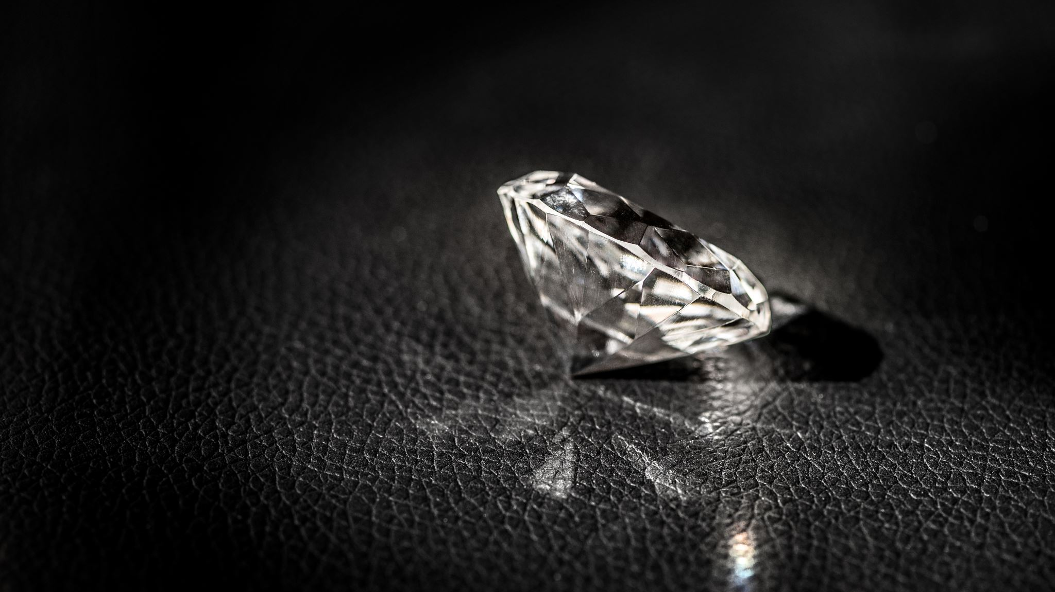
Diamond K Designs
By Kristoffer Krueger

Slide 2
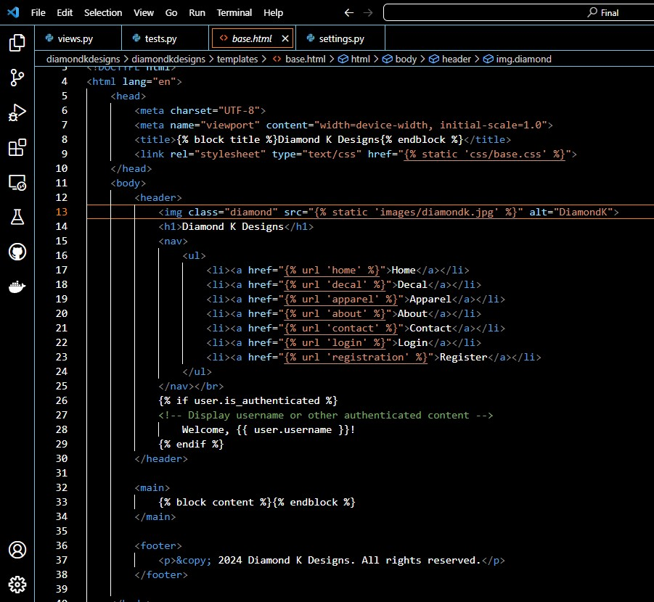
Base HTML

Slide 3

Home

Slide 4
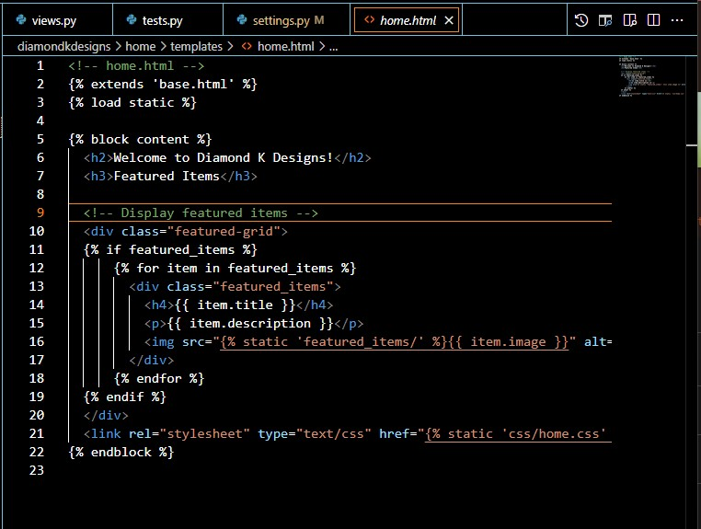
HTML

Slide 5
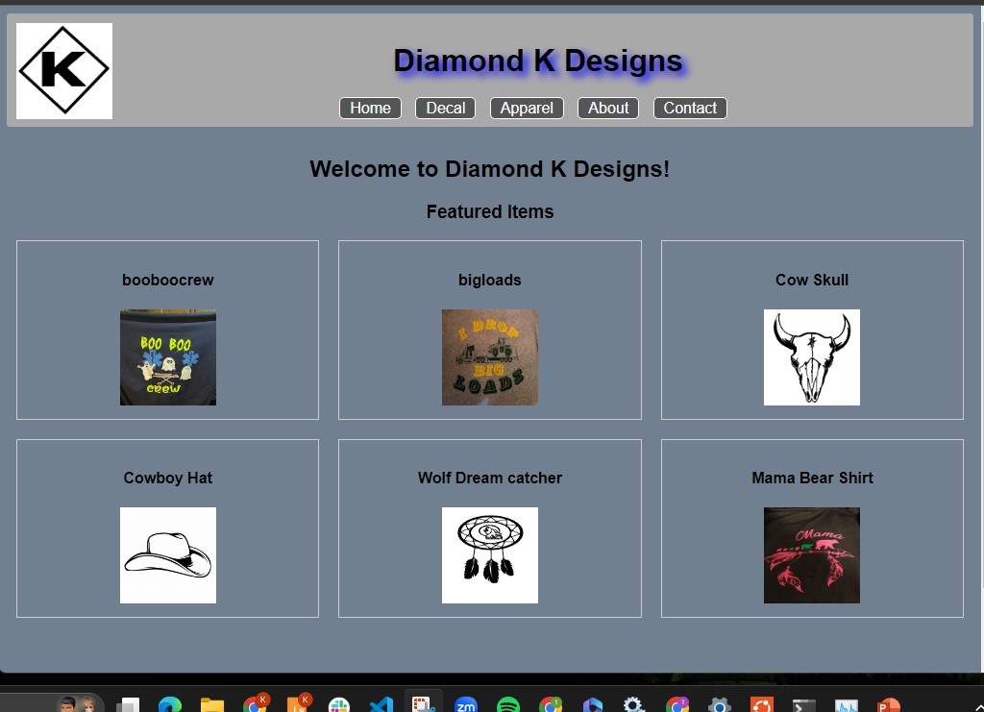
Web Page

Slide 6
Decal

Slide 7
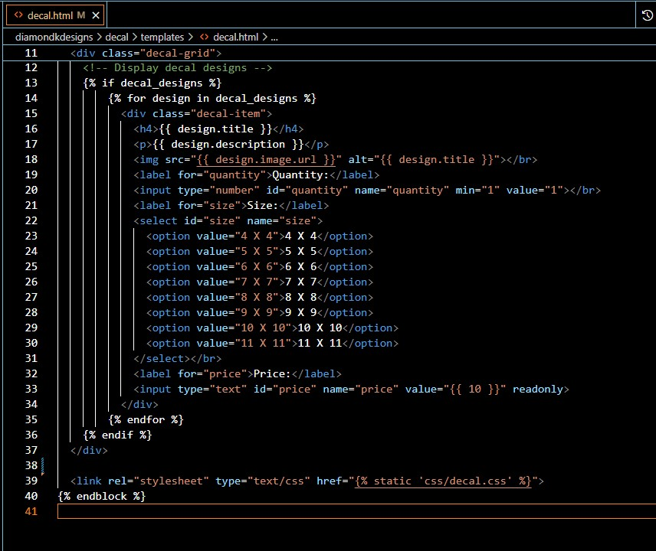
HTML

Slide 8
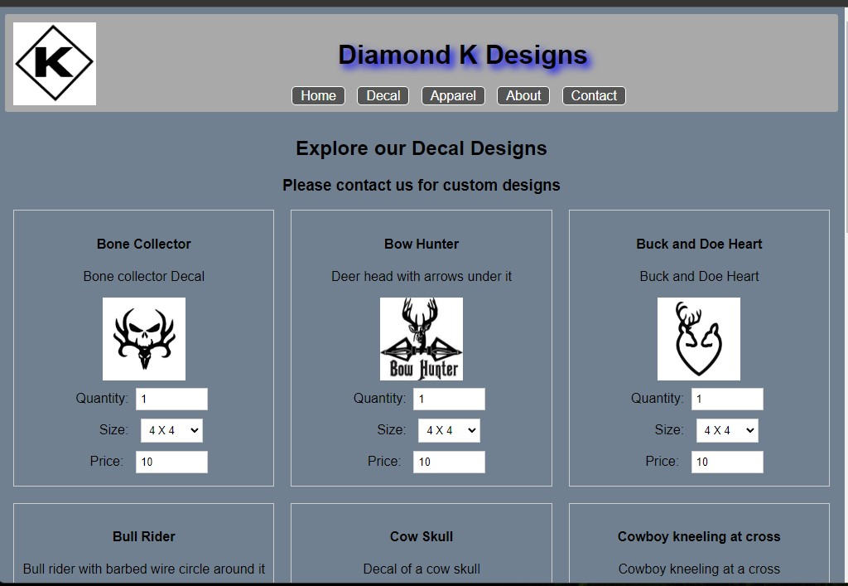
Web page

Slide 9
Apparel

Slide 10
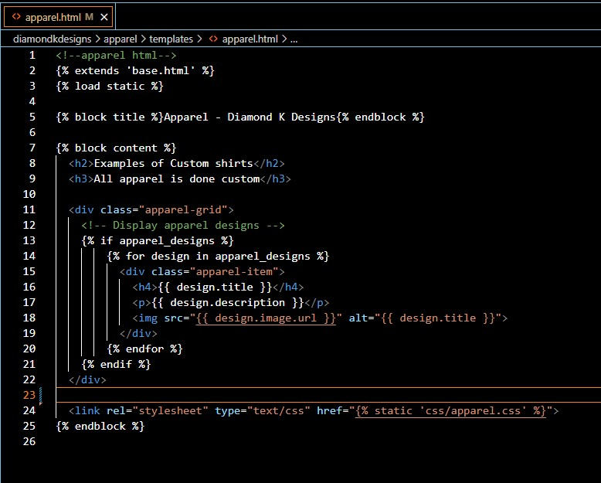
html

Slide 11
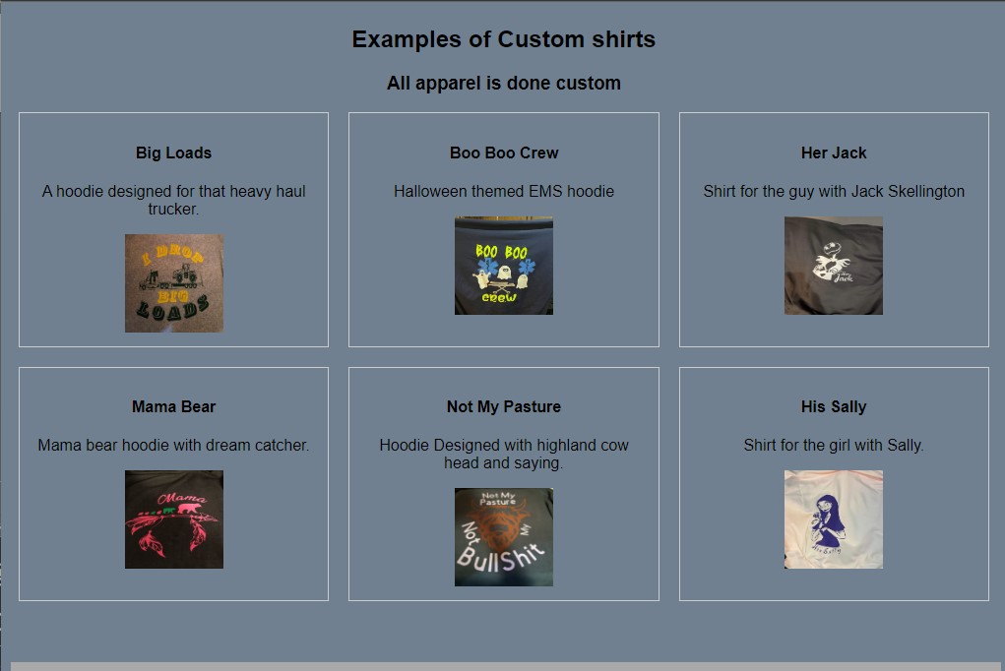
WEB PAGE

Slide 13
THANK YOU

