Slide 1
Mugiesshan Anandarajah
Toronto Film School
Video Game Design and Development

Slide 2
Brief Summary
I’m a recent graduate of the Toronto Film School – Video Game Design & Development. I loved playing games growing up and have developed a passion for them. I wanted to enter into the game development world to help make some killer games. The game I have made is a never ending survival game where you have to stay alive as long as possible while enduring waves of enemy ships coming to destroy you.

Slide 3

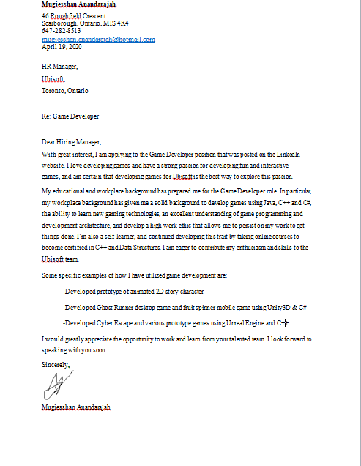
Resume & Cover Letter

Slide 4



Instructions
Move the character around the game using the left joy stick. Press Up on the gamepad to grow, and down on the gamepad to shrink. Press the x button on the gamepad to shoot standard bullets, and press the y button to shoot special bullets.
*Pro tip: The smaller you
are, the faster you run.
the bigger you are, the
tlower you run.
This is the shock pickup. n collecting them, you will have 8 bullets. When you hit a ship with them, you will stun the ships for 5 seconds while it deals lasting damage.
A very rare pickup, the Insta Kill. It takes just one hit to completely
obliterate a ship. You will be equipped with 3 bullets.
Enemy ships. These ships will range from size. If the ships are
smaller, you need to shrink in order to attack. If they’re larger,
then you need to grow in order to attack.

Slide 5
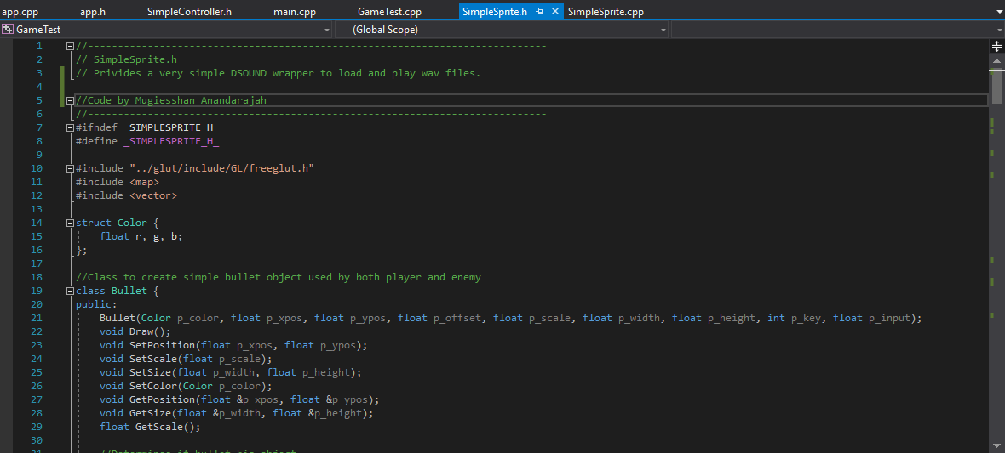
My code - Headers

Slide 6
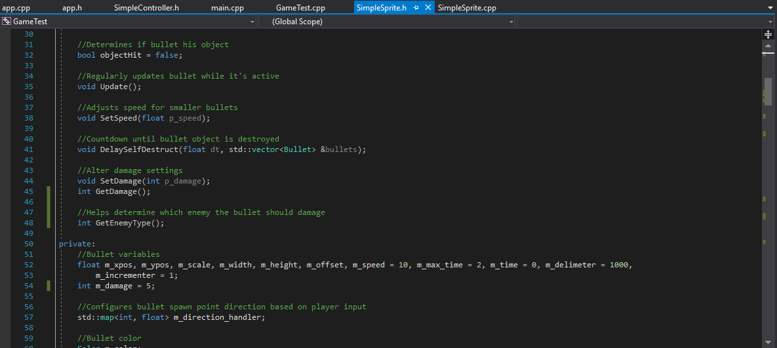
My code – Headers (Con’t)

Slide 7
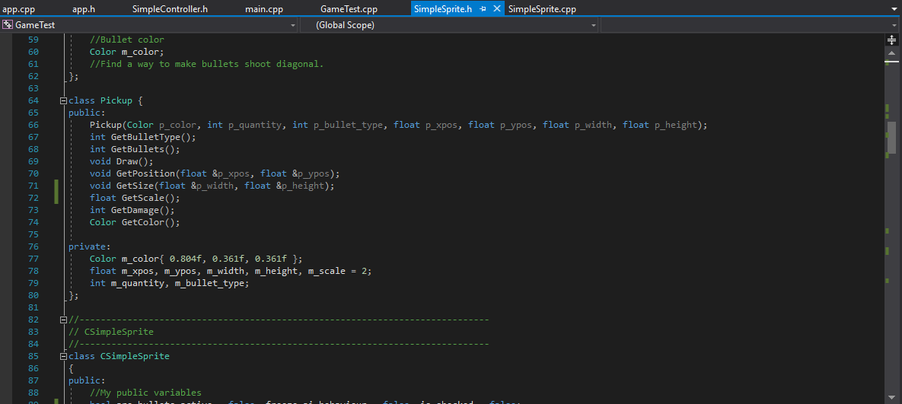
My code – Headers (Con’t)

Slide 8
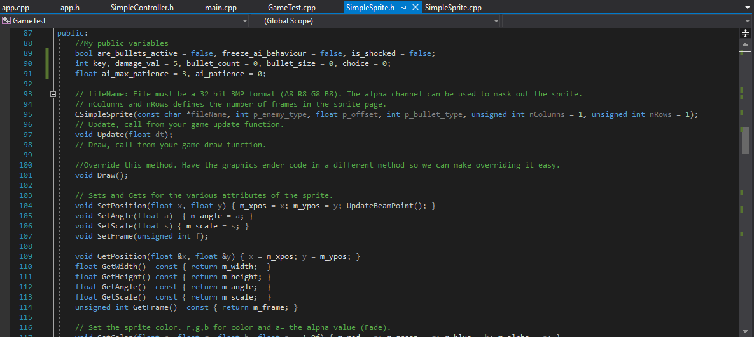
My code – Headers (Con’t)

Slide 9
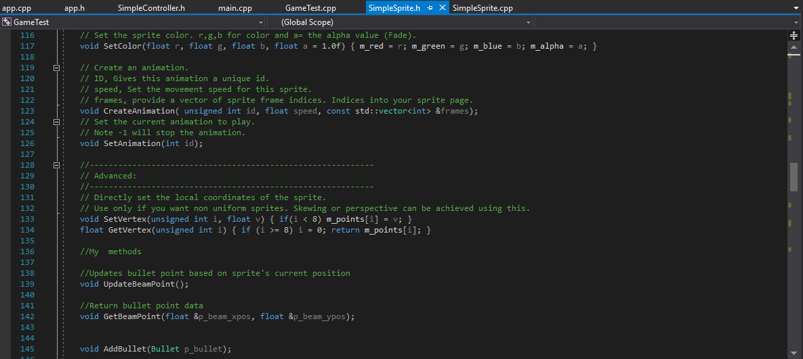
My code – Headers (Con’t)

Slide 10
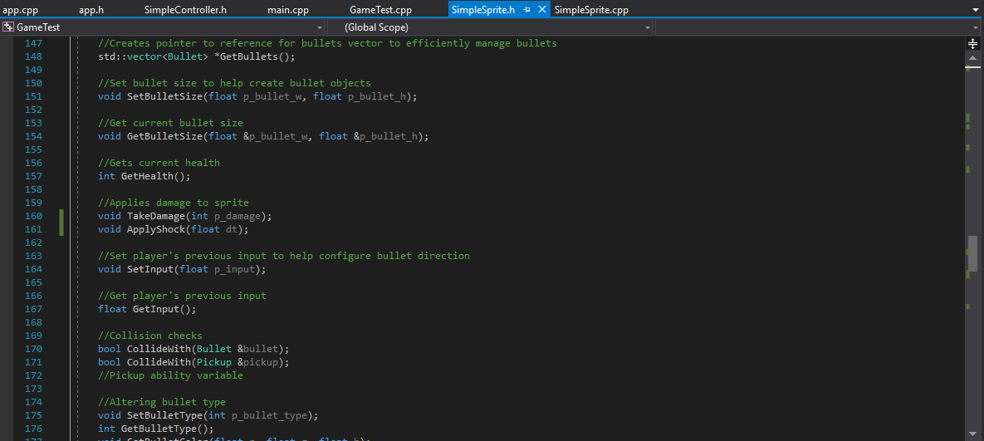
My code – Headers (Con’t)

Slide 11
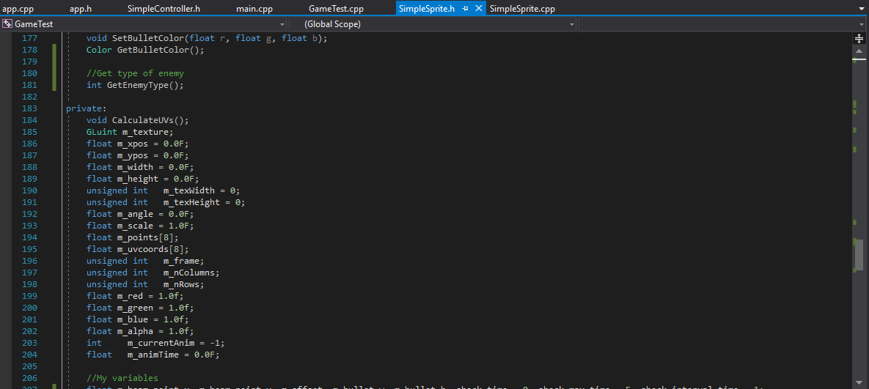
My code – Headers (Con’t)

Slide 12
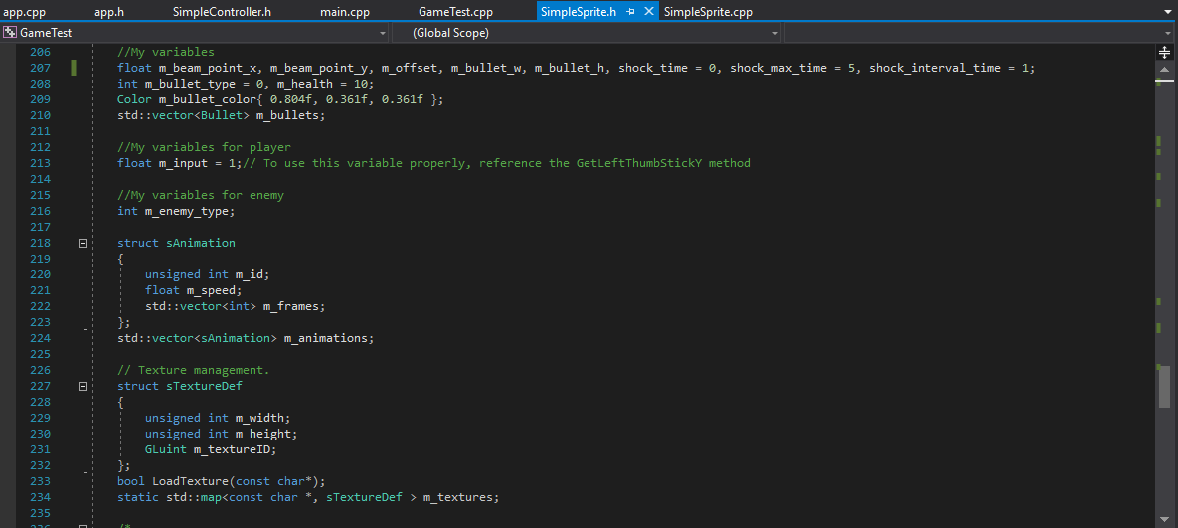
My code – Headers (Con’t)

Slide 13
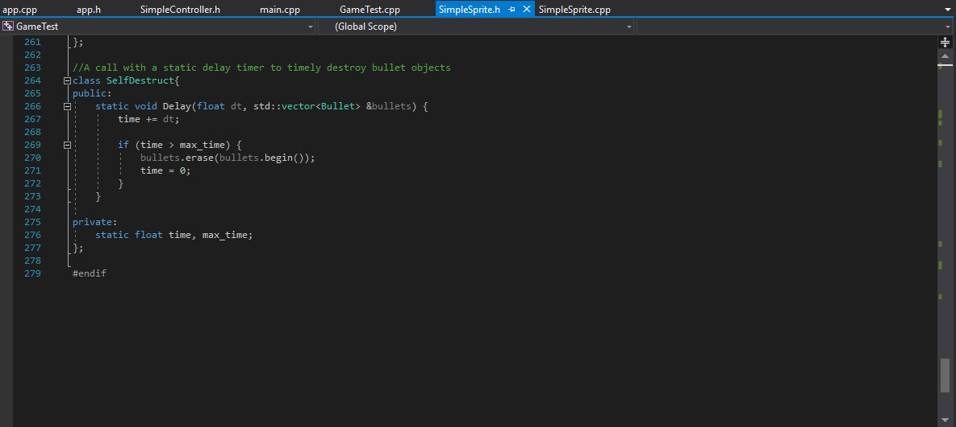
My code – Headers (Con’t)

Slide 14
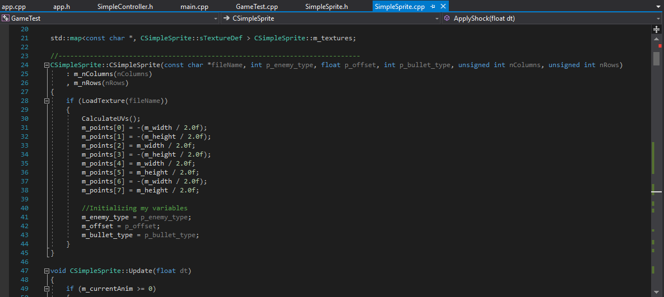
My code – CPP

Slide 15
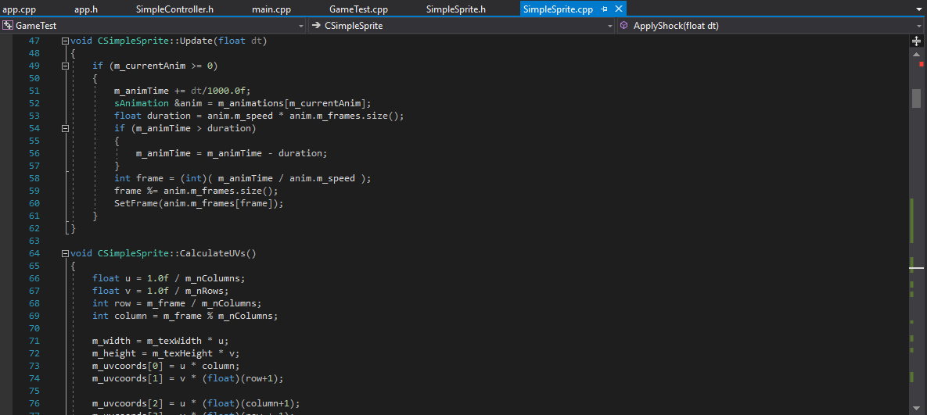
My code – CPP (Con’t)

Slide 16
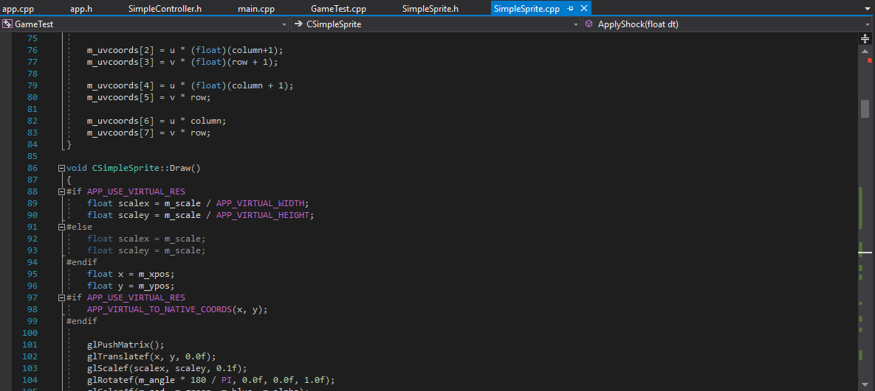
My code – CPP (Con’t)

Slide 17
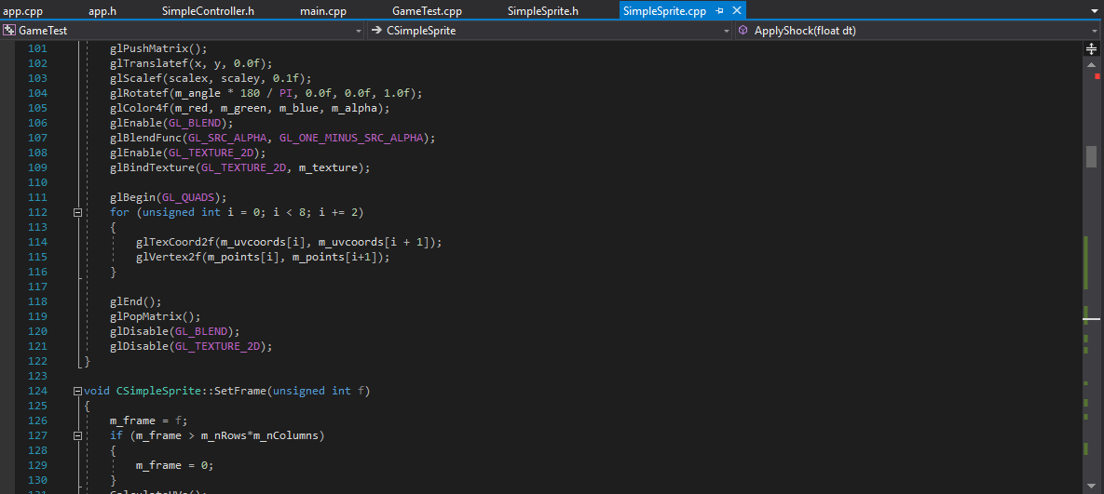
My code – CPP (Con’t)

Slide 18
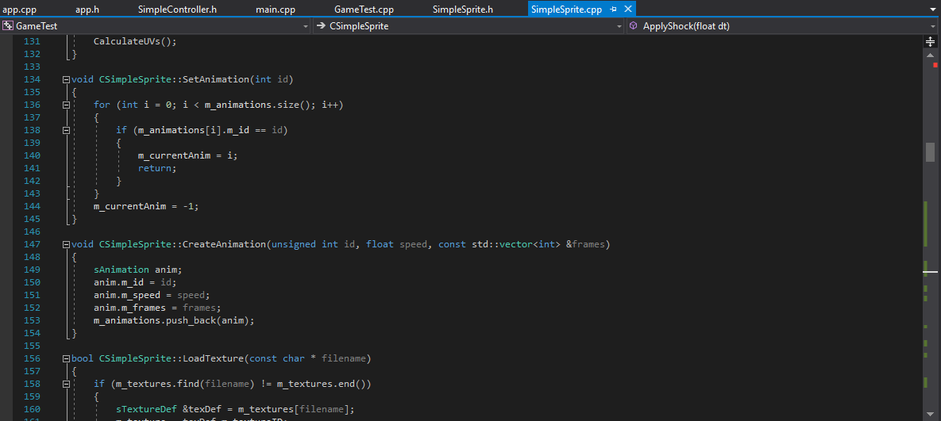
My code – CPP (Con’t)

Slide 19
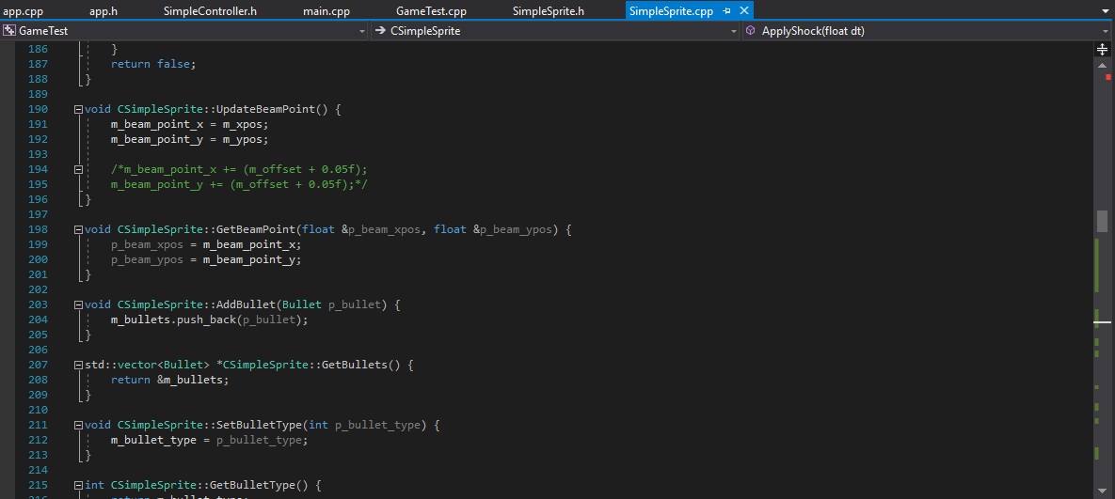
My code – CPP (Con’t)

Slide 20
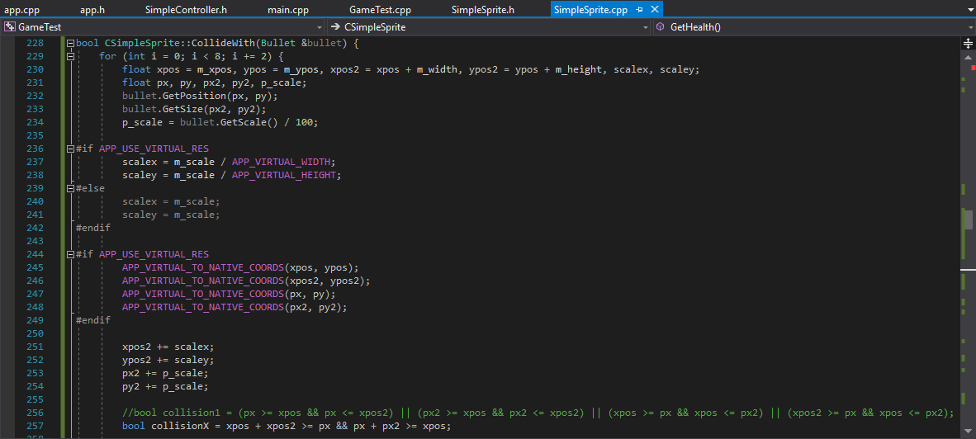
My code – CPP (Con’t)

Slide 21
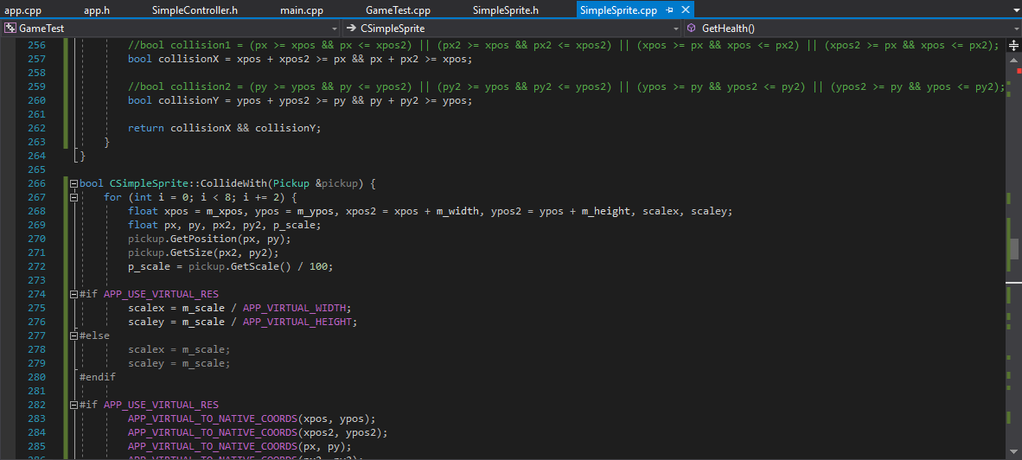
My code – CPP (Con’t)

Slide 22
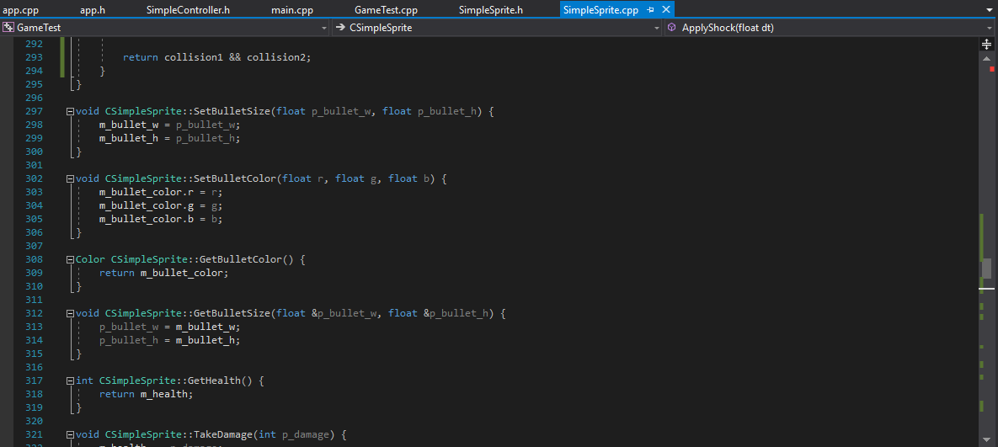
My code – CPP (Con’t)

Slide 23
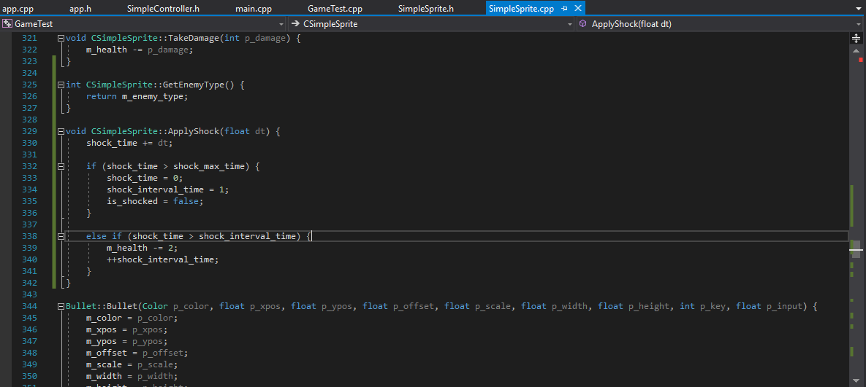
My code – CPP (Con’t)

Slide 24
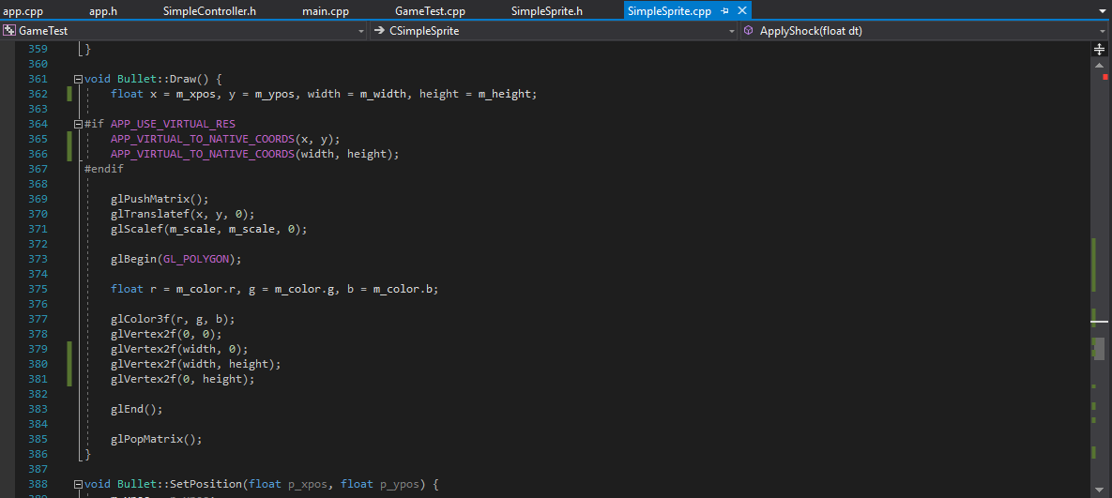
My code – CPP (Con’t)

Slide 25
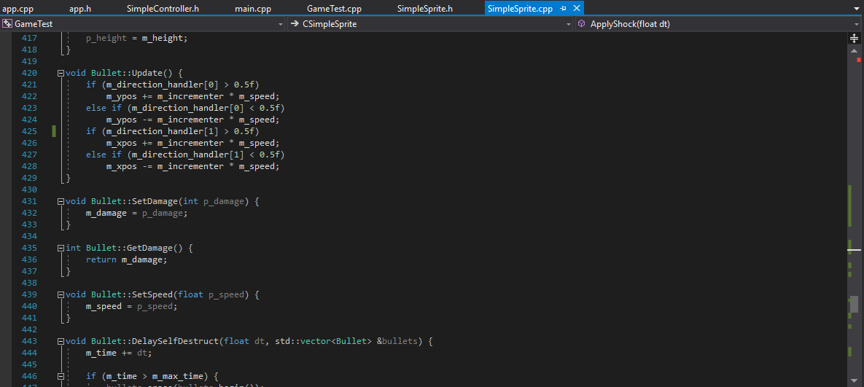
My code – CPP (Con’t)

Slide 26
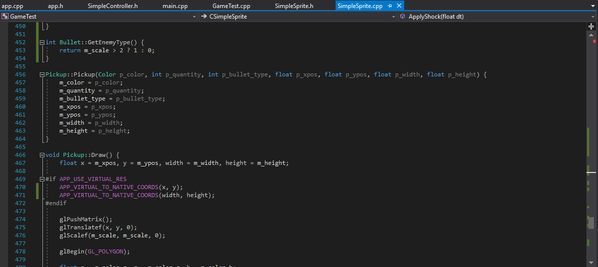
My code – CPP (Con’t)

Slide 27
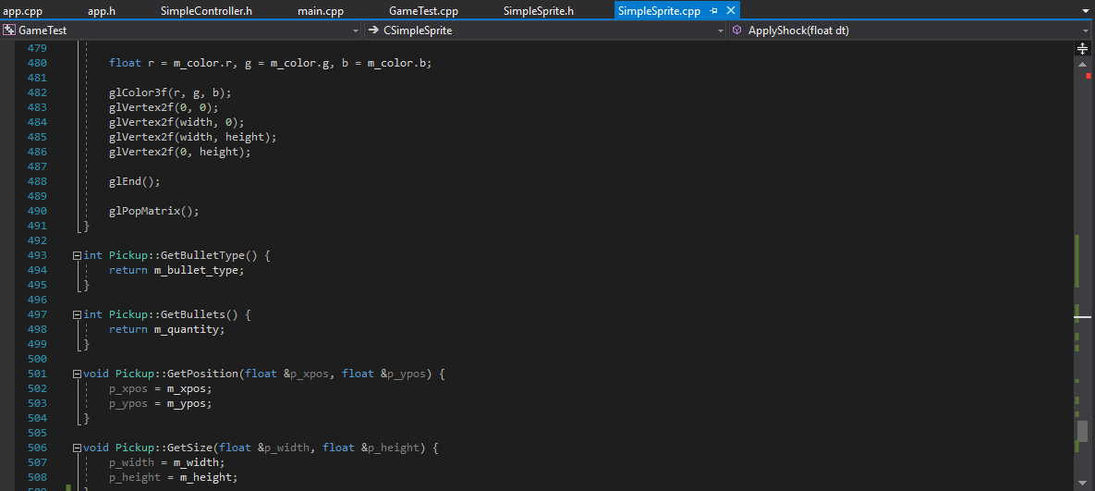
My code – CPP (Con’t)

Slide 28
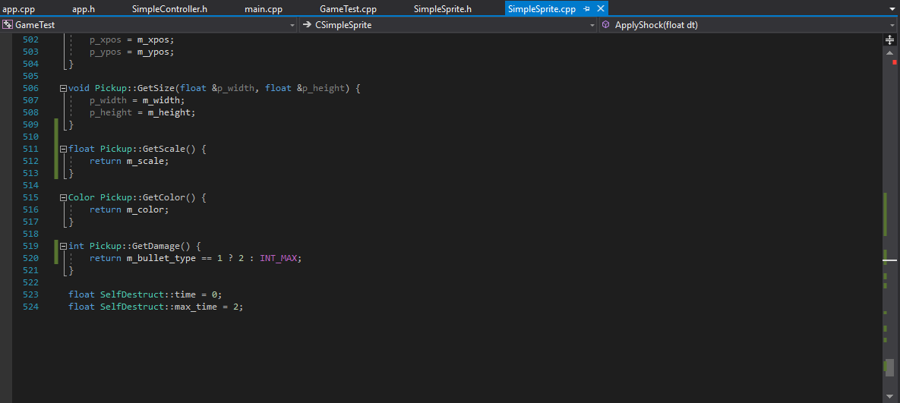
My code – CPP (Con’t)

Slide 29
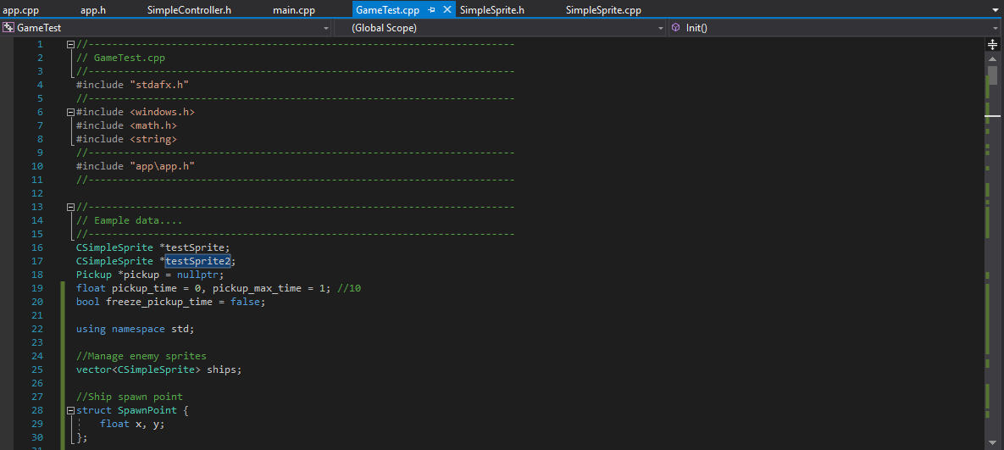
My code – Game

Slide 30
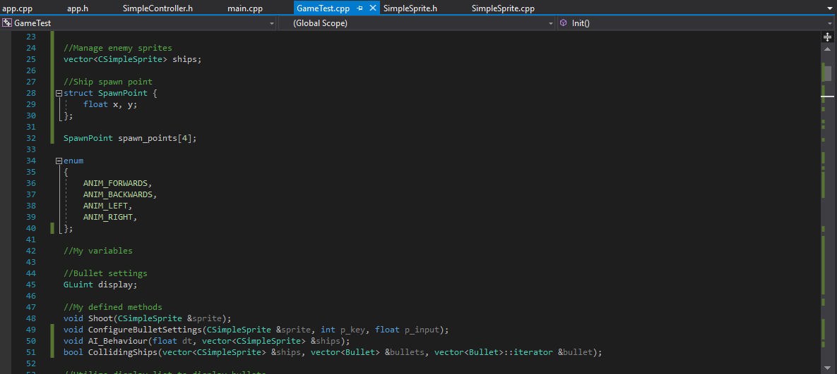
My code – Game (Con’t)

Slide 31
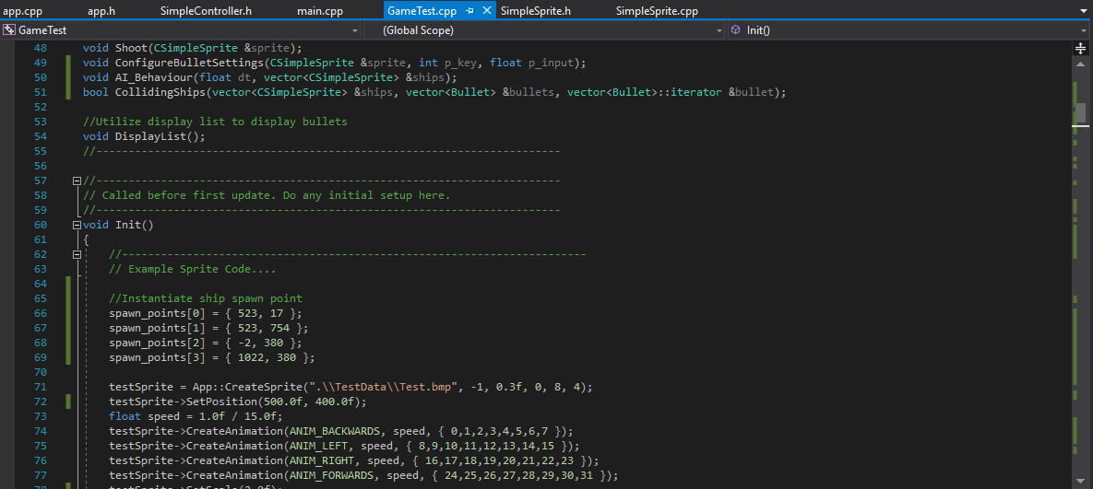
My code – Game (Con’t)

Slide 32
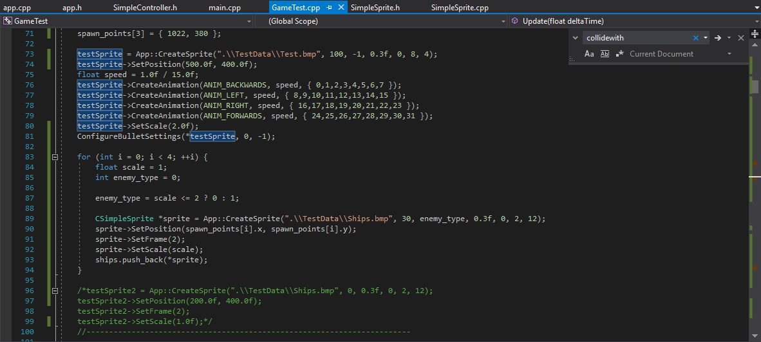
My code – Game (Con’t)

Slide 33
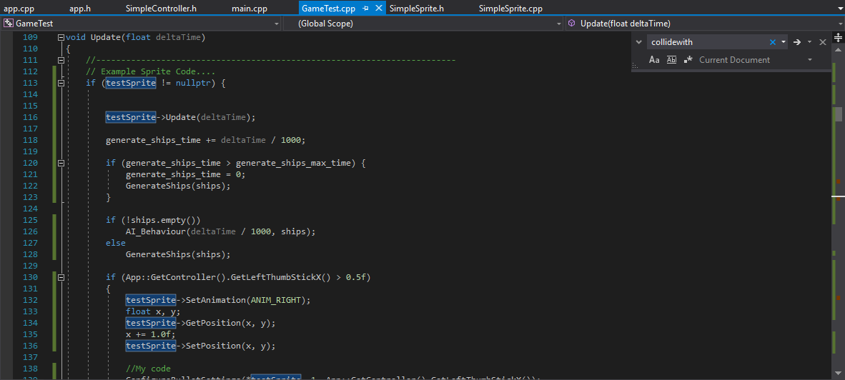
My code – Game (Con’t)

Slide 34
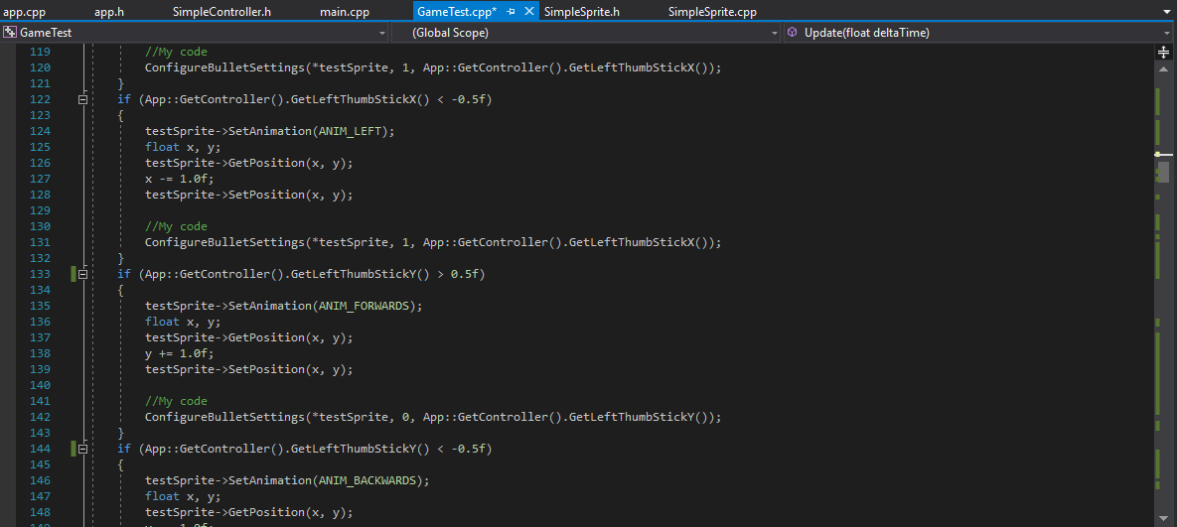
My code – Game (Con’t)

Slide 35
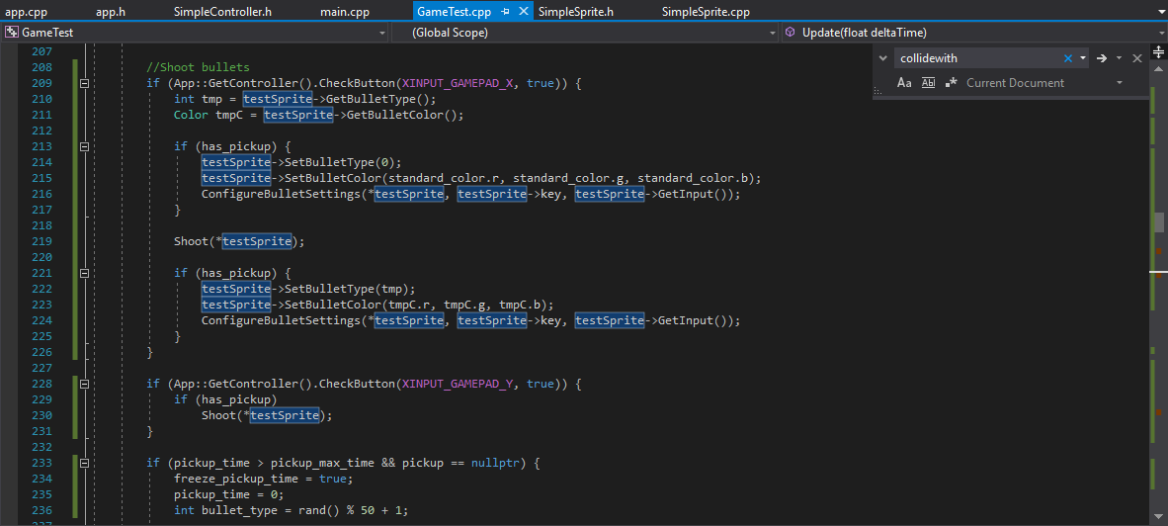
My code – Game (Con’t)

Slide 36
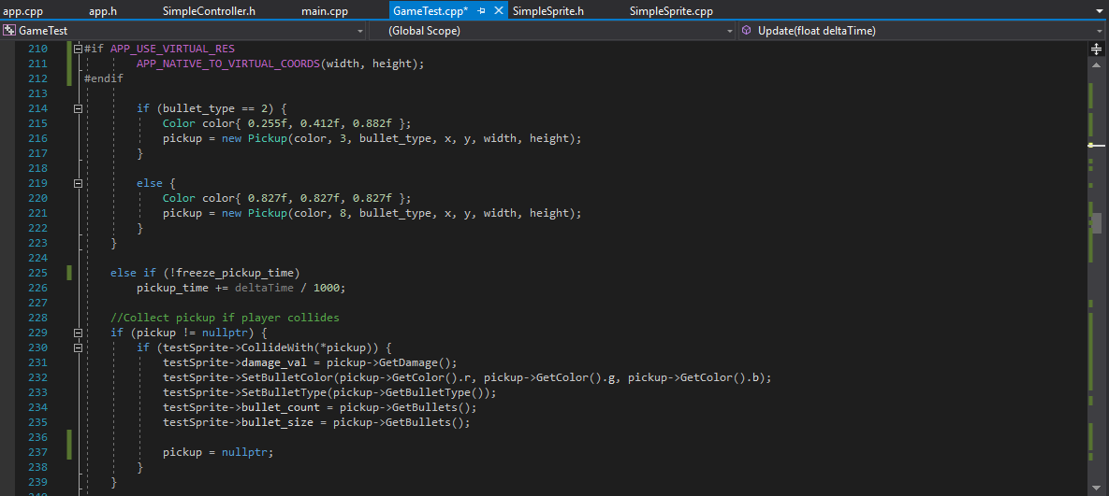
My code – Game (Con’t)

Slide 37
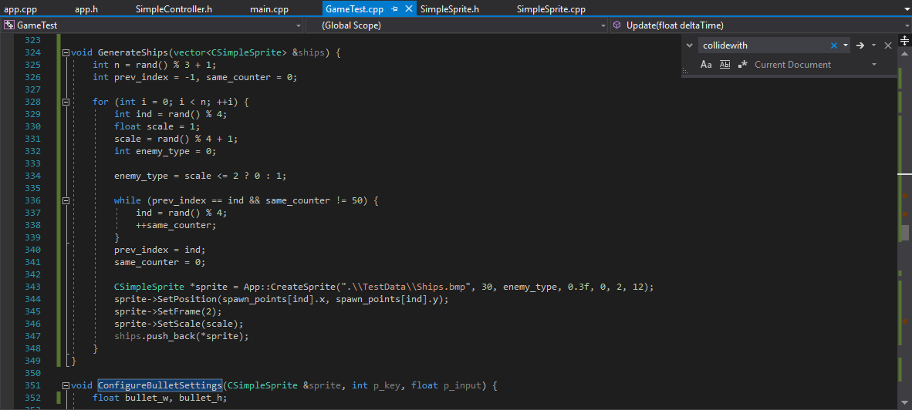
My code – Game (Con’t)

Slide 38
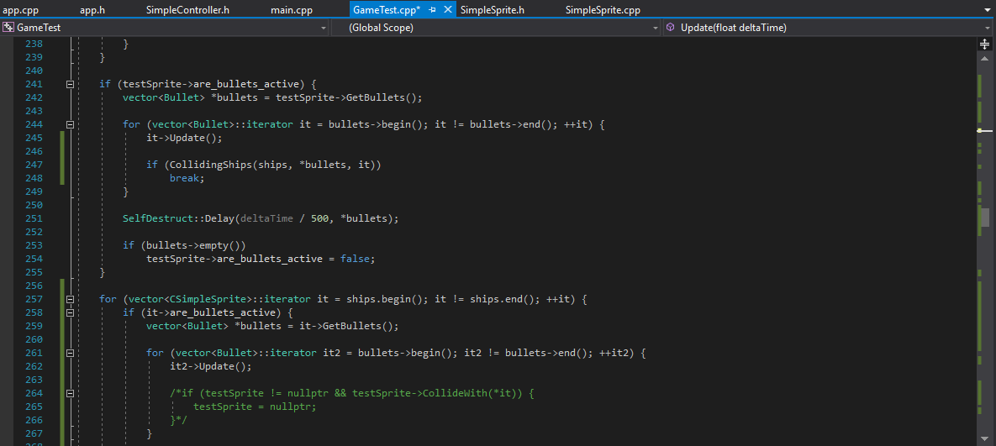
My code – Game (Con’t)

Slide 39
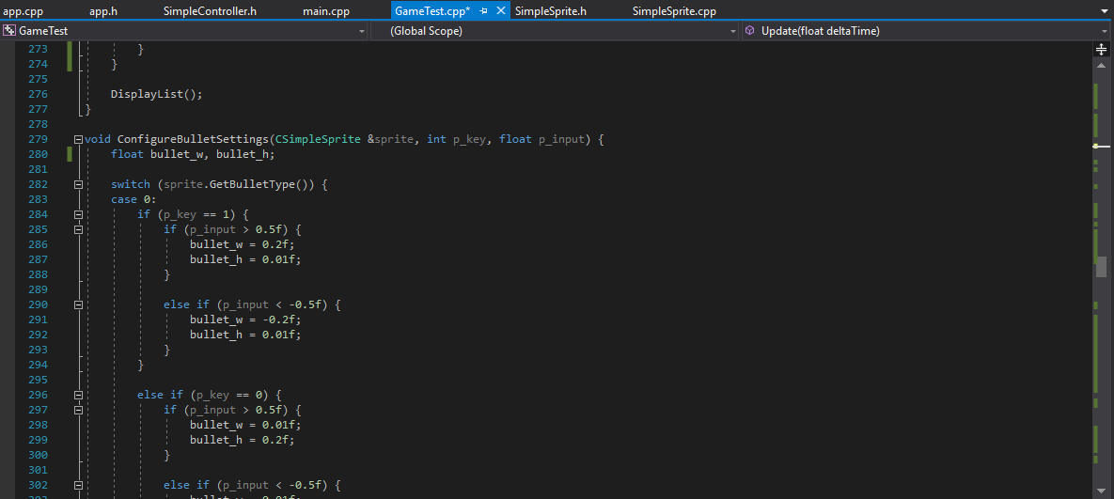
My code – Game (Con’t)

Slide 40
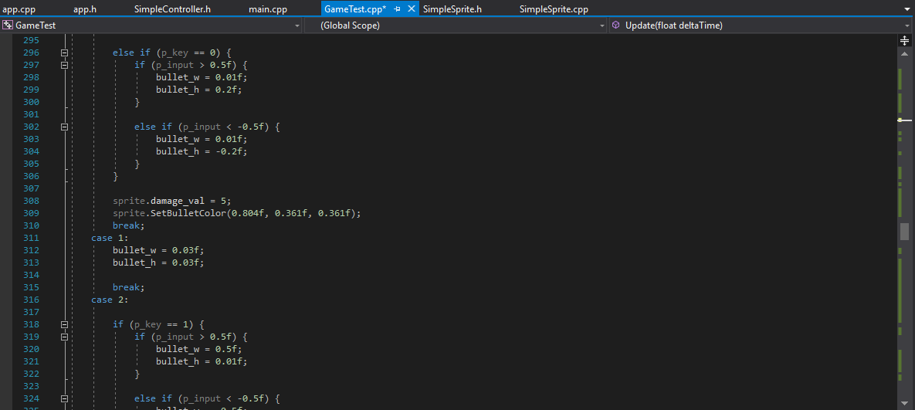
My code – Game (Con’t)

Slide 41
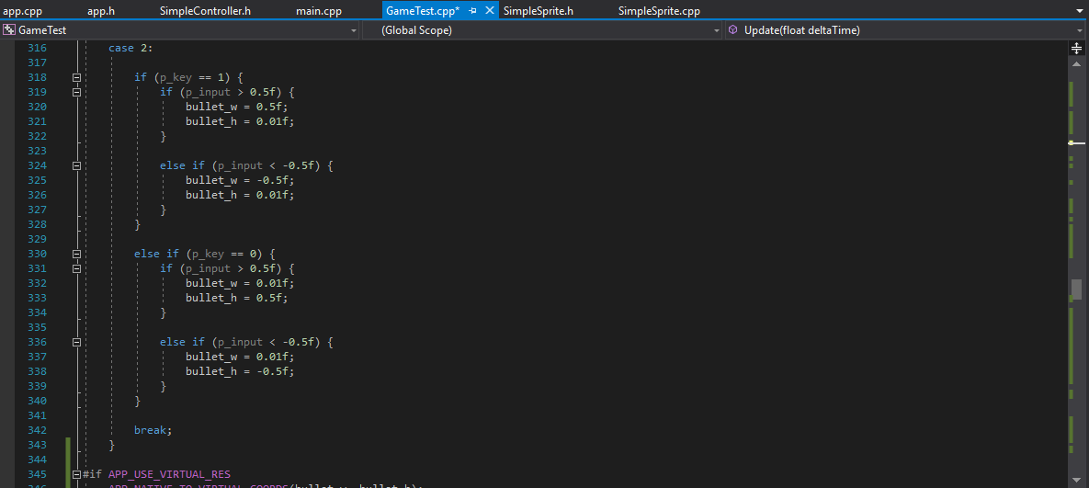
My code – Game (Con’t)

Slide 42
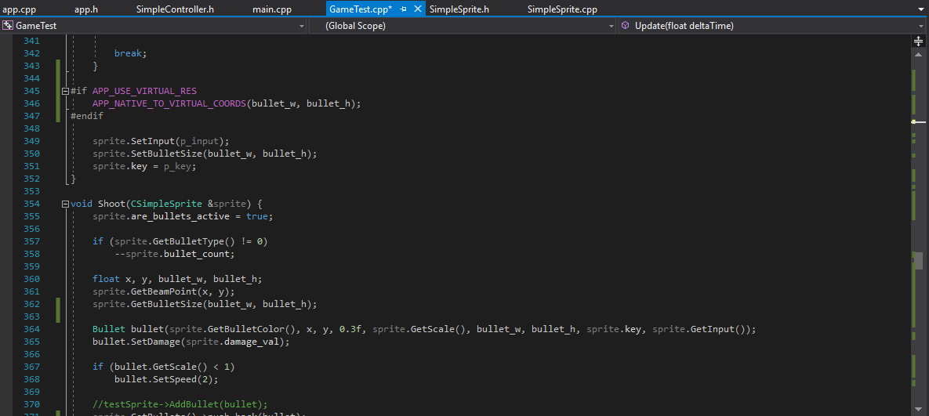
My code – Game (Con’t)

Slide 43
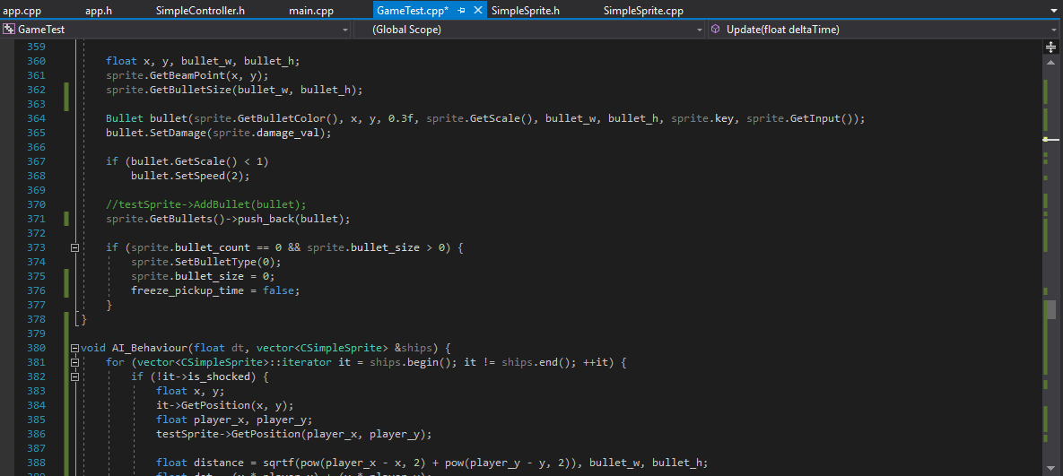
My code – Game (Con’t)

Slide 44
My code – Game (Con’t)

Slide 45
My code – Game (Con’t)

Slide 46
My code – Game (Con’t)

Slide 47
My code – Game (Con’t)

Slide 48
My code – Game (Con’t)

Slide 49
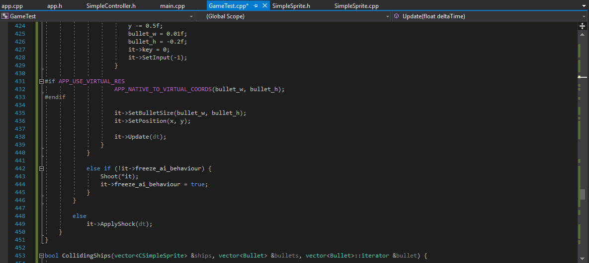
My code – Game (Con’t)

Slide 50
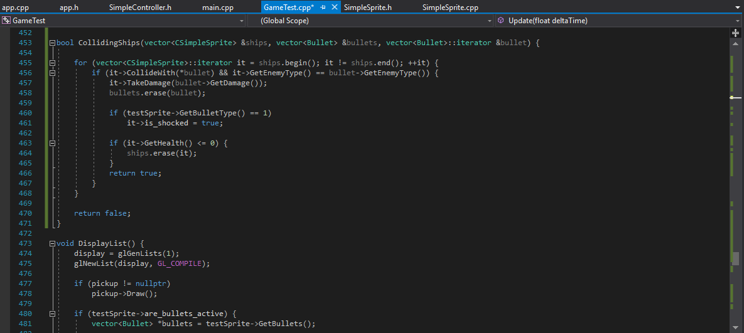
My code – Game (Con’t)

Slide 51
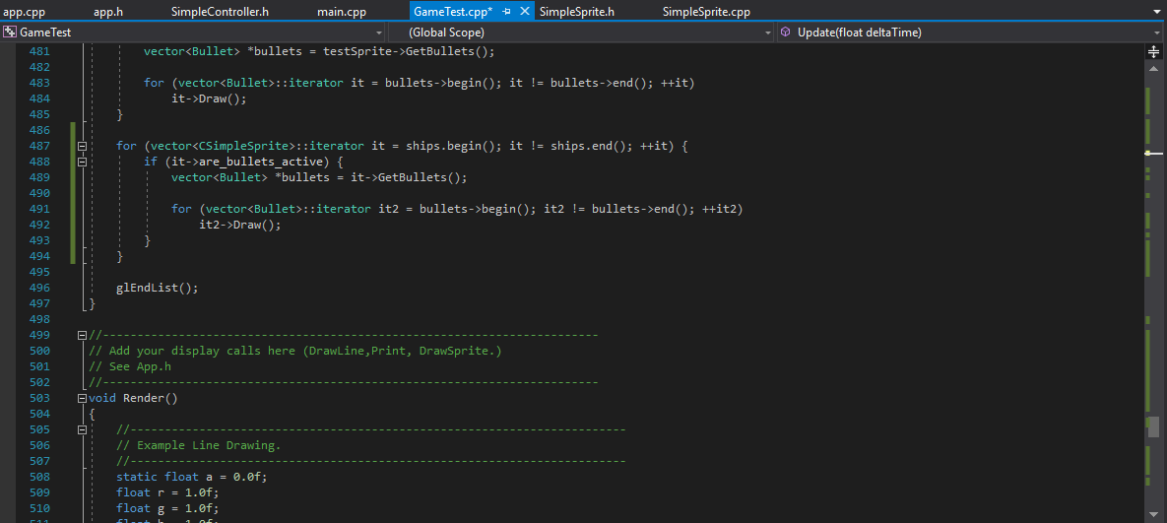
My code – Game (Con’t)

Slide 52
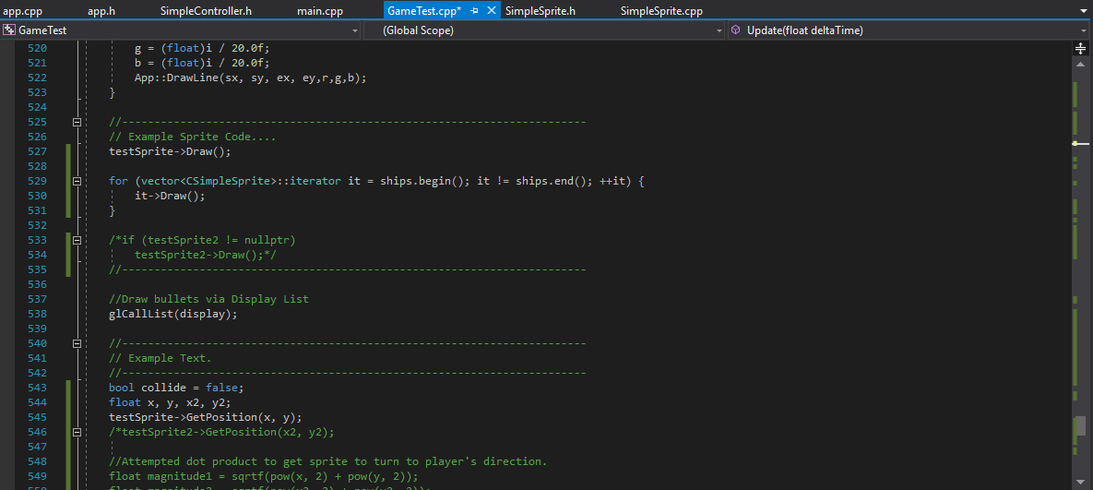
My code – Game (Con’t)

Slide 53
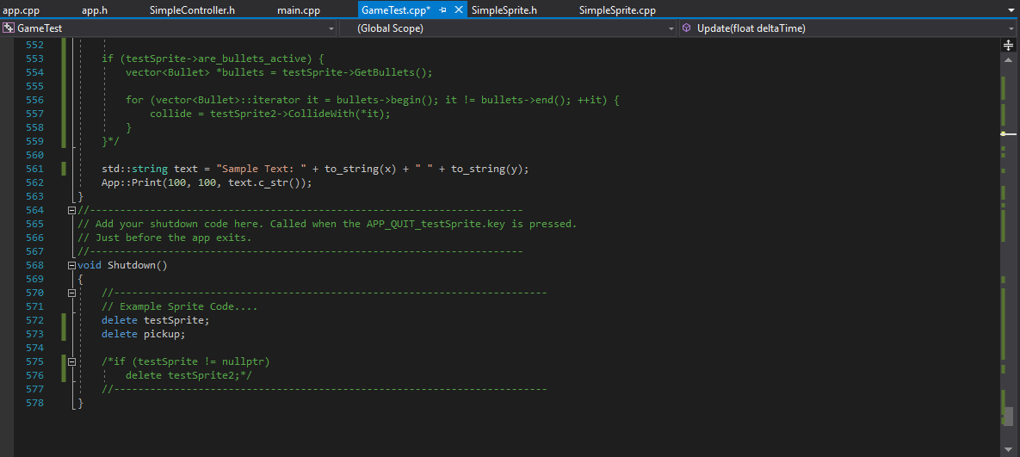
My code – Game (Con’t)

