Slide 1
I Heart Corvallis Mobile Application
Created By:
Bradley Imai
Omeed Habibelahian
Dylan Tomlinson

Slide 2
Overview
“I Heart Corvallis” is a mobile application we are creating for the Corvallis Community Relations (CCR) office
Part of the larger I Heart Corvallis initiative ran by the CCR office to encourage students to feel more connected to the greater Corvalils community
App focuses on increasing student awareness of events happening around town and creating an incentive for students to attend these events

Slide 3
Overview (cont’d…)
The app will act as a passport for students
Passport will initally be empty but will become populated with stamps as the user attends specific events around Corvallis
Some events will be worth more stamps than others
When a user accumulates enough stamps, they will get a notification that they are eligible for an award
Real rewards that will be given out at the Office of Student Life

Slide 4
Overview (cont’d…)
Only certain events around Corvallis get users a stamp
The application will contain a map, built with the Google Maps JavaScript API, that will have pins dropped at the locations of pre-approved upcoming events
Users will be able to select an event and get more details about it
In order to help students become more familiar with Corvallis, the application will have another map that will include notable locations around Corvallis, such as City Hall, parks, local restaurants, and local shops

Slide 5
Introduction to Design
In order to make the project more manageable, we split it into 9 parts, and each of us will be in charge of 3 of these parts
Omeed: Data Storage and Handling, UI Design Architecture, and Administrative Access
Dylan: User Security, Interface Scaling, and Application Testing
Bradley: Social Media Integration, Geolocation Services, and Event Display

Slide 6
User Security
In order for a user to access the full functionality of our application, they will have to create an account with a unique email address and password
We are obligated to protect these passwords, as it’s been shown that most users will repeat their passwords for different - and possibly more important - accounts
We will protect user passwords with the hash function Password-Based Key Derivation Function 2 (PBKDF2)

Slide 7
Interface Scaling
We are developing the app for Android devices, and it will be available to download from the Google Play Store
App will need to run on a variety of different Android devices, all of which have different screen sizes, resolutions, and dpi
Important for us to ensure that our application retains its visual quality regardless of which Android phone it is running on
Semantc UI provides enough of this functionality

Slide 8
Application Testing
We a list of requirements that we need to complete to constitute a finished product
In order to determine that one of these requirements has been completed, we have to be able to test that the functionality of that requirement meets our expectations and desires
This testing includes ensuring that our in-app functions perform as expected and testing that our application’s interface design is as we planned it to be
Android SDK allows us to emulate many different types of Android devices running newer and older versions of Android

Slide 9
Social Media Integration
Will allow us to add a social aspect to our application
We will be using the Instagram API to include pictures from previous events
This will help users get an idea of what to expect when attending an event
We will show pictures from that event with specific hashtags relevant to that event to the event’s detailed information page

Slide 10
Geolocation Services
Allows us to retrieve the current location from a user
By obtaining a user’s current location, we will allow the user to see various events happening around them
We will also use geolocation services to make sure users aren’t lying about completing events
Users will have to check in to the event in the app to authenticate that they are attending that event
We will be using Google Maps Geolocation API

Slide 11
Event Display
Two maps will be used to highlight useful resources around corvallis
Map #1 - Notable establishments around Corvallis
Map #2 - Events approved by the CCR for students to accumulate stamps
In order to fulfill these requirements we will be implementing Google Maps JavaScript API
The location of each event will be highlighted with a market
To get more information about an event, just press on its marker on the map and you will be taken a page providing more detailed information about the event

Slide 12
Data Storage & Handling
Our project will require a lot of communication and synchronization among several databases, as well as between the databases and the user interface
At least three separate databases
One for event information
One for prize information
At least one for user information, depending on whether or not we make separate databases for students and permanent residents
After looking at different database management systems, we decided on MySQL as a fast, secure, feature-rich option

Slide 13
UI Design Architecture
People will not use an app that is ugly and hard to use
If we want this application to succeed, we need to create our user interface in a way that is intuitive and easy on the eyes
In order to differentiate our app from other Android studio apps, we will utilize the Semantic UI library
Implemented in HTML and CSS
Provides a vast library of interface elements and designs, as well as a large collection of icons

Slide 14
Administrative Access
This is basically how the CCR will control in-app content
CCR office is not very technical and need to be able to have some sort of control of content within the application
They will need to be able to
Add, modify, and remove events from the event database
Give or take stamps from users
We will build the CCR an administrative account and interface that gives them this functionality

Slide 15
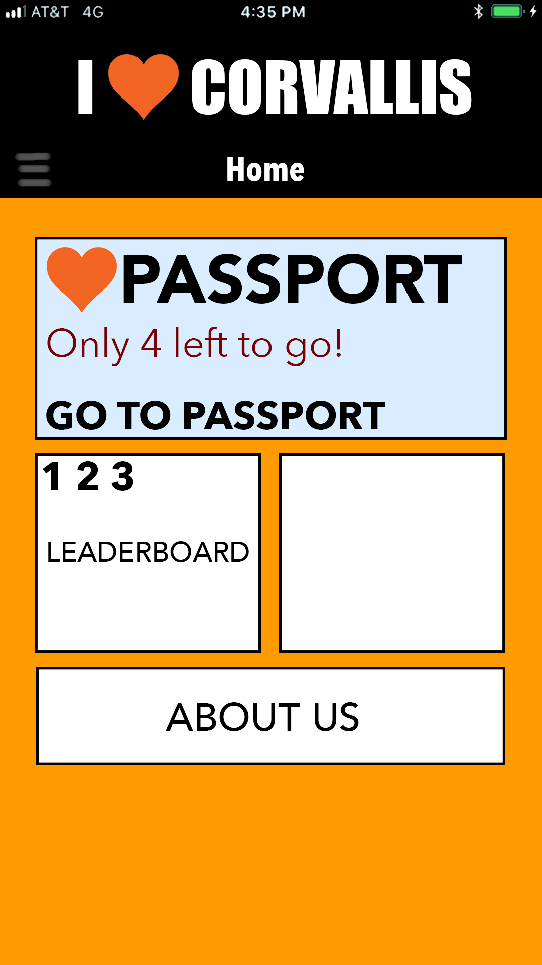
Concept: Home Page
Default page the user will see when they open the app
Quick links to the user’s passport, the event map, the stamp leaderboard, the list of prizes, the community resource page, and information about the I Heart Corvallis initiative and the CCR office
Button that opens a side menu with these links and a link to Settings

Slide 16
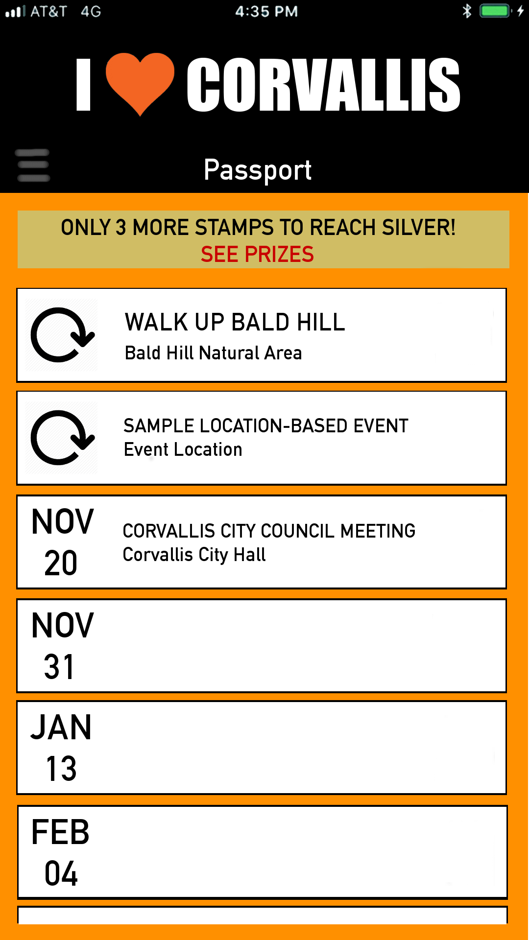
Concept: Event Page
Button above the list linking to the prize list
The color and message in this button will change depending on how many stamps you have and how far you are from the next level of prizes
Scrolling list of events
Events that users can attend anytime will be designated by a circular arrow
Events with a set date and time will be designated with their date
Pressing on an event will pull up a page with more detailed information about that event

Slide 17
Problems We’ve Encountered
The CCR office does not possess a lot of technical prowess
It has been a bit of a challenge figuring out exactly what they are picturing as a final product
We had to spent time at the beginning of the term trying to see what they want out of the app and what features they desired
We had to spend some expectations for them regarding what is and is not feasible in the timeframe we have for this project
Building two separate versions of the app (one for Android, one for iOS) could be a stretch given our timeline
The iOS version of the app is now a stretch goal

Slide 18
Current Status
We have just finished designing our application and conducting the proper research on different aspects of the app
We have defined the important pieces of our application in our Tech Review documents and our Design Document
We also decided on which APIs and systems we will use to create the best version of this application that we can
Over Winter Break we will begin the implementation and creation of the application

Slide 19
Reports from Weeks 1-3
Deltas
Set a consistent meeting time with our client for next term
Actions
Once Winter term starts, talk to our clients about the best time to meet with them to discuss app progress
Positives
Met with group for the first time
Contact client and set up a meeting date
Make sure latex is working correctly
Start on problem
Set up group git repo for app files and class docs
Met with clients for the first time
Wrote rough draft of problem statement
Researched cross-platform implementation software

Slide 20
Reports from Weeks 4-7
Deltas
Showing an actual working app interface to our client early next term instead of just concepts
Document needs to be changed to reflect changes in the project
Receive feedback from the second focus group
Actions
Beginning implementation of the app over Winter Break
We will go back through the document and update it
Have our client send us the feedback
Positives
Completed the problem statement final draft
Showed client some app interface concepts
Completed final draft of requirements document
Attended focus group to hear thoughts of the concept of the app

Slide 21
Reports from Week 8-10
Deltas
Receive feedback from the second focus group
Make any necessary changes to the Tech Review next term based on how the implementation process goes
Reflect any changes that get made to our Tech Review next term in the Design Document
Actions
Have client send us the feedback
Begin implementation of the app over Winter Break and discover complications (if any) that come up due to which technologies we chose in Tech Review and change them accordingly
Positives
Completed the final draft for the individual tech reviews and design document

