Slide 1
Finding loyalty members before they stop shopping
Churn prediction, drivers and retention scenarios for FreshBasket's loyalty programme
Tailwyndz Propel 2026 | Assessment 4: Customer Churn Prediction | FreshBasket loyalty data, Jan 2023 - Jun 2024
Notes:
Hi, I'm [NAME], and this is my Tailwyndz Propel 2026 assessment submission. For this assessment, I chose Assessment 4: customer churn prediction for FreshBasket's loyalty programme. The business problem I focused on is that FreshBasket sends the same retention offer to every member, which is expensive and mostly reaches people who were never going to leave. My objective was to find the members who are likely to stop shopping next quarter, explain why, and work out which retention actions are worth testing. I'll briefly walk through the data, methodology, modelling approach, results, and the business implications.

Slide 2
The business problem
One retention offer for everyone is expensive and mostly reaches members who would stay
2,600
18
3 months
9.6%
loyalty members (Silver, Gold, Platinum)
months of monthly activity, Jan 2023 - Jun 2024
churn window: no purchase despite earlier purchases
of active members churn per quarter
Decision supported: whom to contact each month, with which action, instead of contacting everyone
Unit of analysis: a member at a quarter-end cutoff; output: churn probability for the next 3 months
Success measure: PR-AUC, precision and recall on active members - not accuracy (90% for 'nobody churns')
Plus: why each member is at risk, and which retention actions are worth testing
Notes:
Let me start with the decision this supports. Today every member gets the same retention offer. The business wants a list instead: who is likely to stop shopping in the next three months, and why. The brief fixes the label: a member churns if they make no purchase in a three-month window despite having bought before. So the unit of analysis is a member at a point in time, and the output is a probability for the next quarter. One thing I decided early: churners are a minority, so I judge models on how well they find churners, using precision, recall and PR-AUC, not on accuracy, which looks great even for a model that predicts nobody churns.

Slide 3
The data
Three tables, one workbook, joined on CUSTOMER_ID
Table | Rows | Members | What it holds
fb Customer Profile | 2,608 | 2,600 | signup date, age, gender, city, tier, marketing opt-in, preferred store/category, store price tier
fb Monthly Activity | 28,073 | 2,594 | transactions, spend, basket, categories, promo %, app sessions, emails, coupons, tickets, complaints
fb Churn Label | 2,605 | 2,600 | CHURNED (the target) plus three columns computed over the label window
Same 2,600 members in all three tables; 0 orphan IDs; 6 members have no activity at all
Activity is one row per member-month, so a raw merge would repeat each profile 18 times
Modelling grain: one row per member per quarter-end snapshot (10,776 rows over 5 snapshots)
Features from the months up to the snapshot; label from the 3 months after it
Notes:
The data is three tables from one workbook. A customer profile with demographics and tier: 2,608 rows. Monthly activity: 28,073 rows from January 2023 to June 2024, with transactions, spend, app sessions, emails opened, coupons, support tickets and complaints. And the churn label. They all join on customer ID and contain exactly the same 2,600 members. I didn't just merge them, though. Activity is one row per member per month, so a raw join would repeat the profile every month. Instead I built one row per member per quarterly snapshot, with features from before the snapshot date and the label from after it.

Slide 4
Data quality: diagnosed, not guessed
Every finding is logged with evidence, severity and treatment
99.8%
22
13
953
of purchase months: spend = transactions x basket
negative spends: pure sign errors
mistyped totals (e.g. 3,731 vs 297), rebuilt
missing member-months: deleted records
Duplicates in every table (8 profile, 58 activity, 5 label rows); 2 conflicting pairs differed only in the sign of spend
City 40 spellings -> 10 cities, tier 12 -> 3; missing age, gender and store tier kept as 'Unknown'
Missing months treated as unknown and decided from data up to each cutoff only
Label table: LAST_PURCHASE_DATE, MONTHS_OBSERVED, INSUFFICIENT_HISTORY_FLAG are computed over the label window -> never used
Notes:
The brief warned there would be data-quality problems, and they were all there. The most useful thing I found is that total spend equals transactions times average basket on 99.8% of purchase months. That let me diagnose errors instead of guessing. The 22 negative spends were pure sign errors. Thirteen extreme spends were mistyped totals, for example 3,731 where the arithmetic says 297, so I rebuilt them from the identity. There were duplicates in all three tables, city names in 40 spellings that were really 10 cities, and 953 missing member-months that look like deleted records rather than inactivity. And one trap: three columns in the label table are calculated over the label window itself, so using them would leak the answer. I never used them.

Slide 5
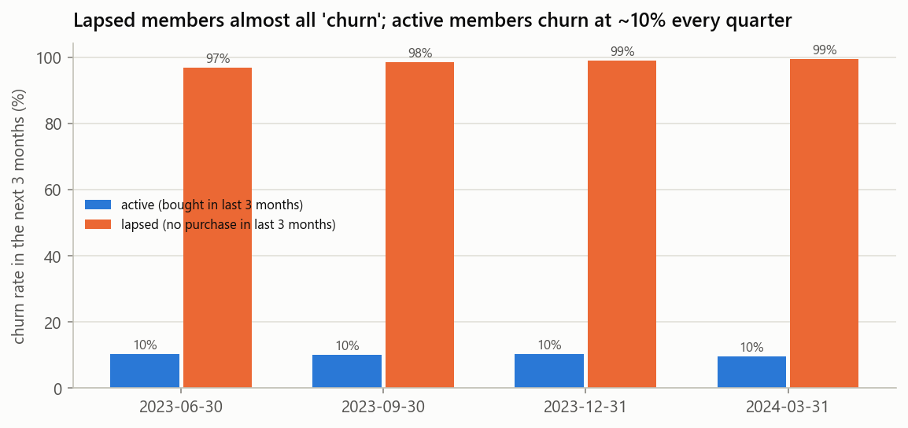
Key insight: most 'churners' had already left
80%
99%
9.6%
~10%
of Apr-Jun churners bought nothing in Jan-Mar (649 of 813)
churn among already-lapsed members
churn among members still active
active-member churn in every quarter since mid-2023
Headline churn rises (18% -> 34%) only because lapsed members accumulate. Every result is reported for both populations.
Notes:
This was the finding that shaped everything. Eighty percent of the members labelled as churned in April to June hadn't bought anything in January to March. They had already left before the label window even started. In that group churn is 99%, so there's nothing to predict, and it's too late for a retention offer. Among members who were still buying, churn is 9.6%, and it has been about 10% in every quarter since mid-2023. So the headline churn rate is rising only because lapsed members pile up. That's why I report every result for two populations, and why the active members are the real early-warning problem.

Slide 6
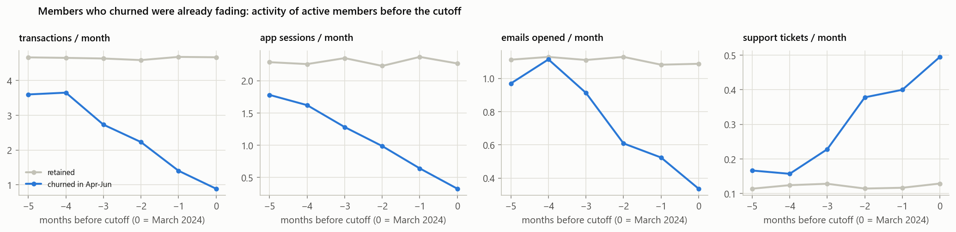
Key insight: churners fade before they leave
Active members at the March 2024 cutoff: transactions 3.6 -> 0.9 a month, app sessions 1.8 -> 0.3, tickets 0.17 -> 0.49
Retained members stay flat (about 4.7 transactions a month). There is a window to act, and trend features should help.
Notes:
The second insight is that churners fade before they leave. These are members who were still active at the end of March. The ones who churned in the next quarter had been cutting back for months. Transactions fell from 3.6 a month to 0.9, app sessions from 1.8 to 0.3, while support tickets went up from 0.17 to about 0.5. Members who stayed were flat, at about 4.7 transactions a month. That matters for two reasons: there's a window where the business can still act, and it tells me trends, not just levels, should be features.

Slide 7
36 leakage-safe features
Feature window (6 months, data <= cutoff) -> cutoff -> label window (next 3 months)
14
10
4 + 8
0
behavioural: recency, purchases, spend, trends
engagement: app, email, coupons, trends
support (tickets, trend, complaints) + demographics
feature change after deleting up to 18,975 future rows
Fixed 3- and 6-month windows, recency capped at 6 months: every quarter's features mean the same thing
Trends (last 3 months minus the 3 before) capture the fading pattern
A missing month is a deleted record or inactivity - decided from rows up to the cutoff only
Automated leakage test: every snapshot rebuilt from truncated data gives identical features
Notes:
So I engineered 36 features in four groups. Behavioural: recency, transactions and spend over three and six months, and their trends. Engagement: app sessions, emails opened and coupons, also with trends. Support: tickets, ticket trend and complaints. And demographics plus tenure. Two design choices matter. First, fixed three- and six-month windows, so every quarter's features mean the same thing. Second, everything comes only from months up to the cutoff, including the decision whether a missing month is a deleted record or real inactivity. I didn't just assume that. I rebuilt every snapshot after deleting all the data after its cutoff, up to about 19,000 rows, and not a single feature value changed.

Slide 8
Method and out-of-time validation
Learn from past quarters, predict the next one - no random splits
1 Snapshots
2 Baseline
3 Candidates
4 Out-of-time test
5 Robustness
5 quarter-end cutoffs; 3 training quarters with labels rebuilt (99.65% agree with the given label)
transparent rule: risk rises with months since the last purchase
logistic regression, random forest, LightGBM; with and without class weights
tune on Jan-Mar 2024; test once on Apr-Jun 2024 (the given CHURNED)
3-quarter rolling check, bootstrap CIs, calibration, ablation
No random splits: a member's future quarter must never help predict their past one
Imbalance (about 1 in 10 active members churn) handled by a validation-tuned threshold, not resampling
Regularisation checked on the validation quarter only: results flat across C = 0.01-10
Notes:
For validation I copied how the model would actually be used: learn from past quarters, predict the next one. The label is only given for April to June 2024, so I rebuilt the same label for three earlier quarters. It matches the given label for 99.65% of members. I tuned on the January-to-March quarter and tested once on April to June. No random splits, because those would let a member's future quarter help predict their past. I started with a simple baseline, where risk rises with months since the last purchase, and compared it with logistic regression, random forest and LightGBM, with and without class weights. On top of that I re-ran the comparison across three consecutive quarters to check the result is stable.

Slide 9
Results: a tie at the top, so the simpler model wins
Model (active members, Apr-Jun 2024) | PR-AUC (95% CI) | ROC-AUC | F1 | Brier | PR-AUC, 3 quarters
Recency rule (baseline) | 0.514 (0.437-0.589) | 0.861 | 0.576 | 0.069 | 0.502 +/- 0.038
Logistic regression | 0.828 (0.775-0.873) | 0.962 | 0.756 | 0.034 | 0.824 +/- 0.019
Logistic regression, class-weighted | 0.816 (0.756-0.865) | 0.961 | 0.740 | 0.043 | -
Random forest | 0.817 (0.764-0.863) | 0.955 | 0.711 | 0.038 | 0.765 +/- 0.045
LightGBM | 0.823 (0.769-0.872) | 0.960 | 0.749 | 0.034 | 0.804 +/- 0.025
LightGBM, class-weighted | 0.827 (0.774-0.873) | 0.960 | 0.744 | 0.037 | -
Logistic regression vs LightGBM: bootstrap PR-AUC difference +0.005 (95% CI -0.019 to +0.029) - a tie
Selected: logistic regression - best calibrated, most stable, and every score splits into exact per-member reasons
At the validation-tuned threshold: precision 0.79, recall 0.73 on active members
Notes:
Here are the results on the held-out quarter for active members. The baseline rule gets a PR-AUC of 0.51. Logistic regression gets 0.83, LightGBM 0.82 and random forest 0.82. The difference between logistic regression and LightGBM is a tie: a bootstrap puts it at plus 0.005, with an interval from minus 0.02 to plus 0.03. When models tie, I take the simpler one. The logistic regression is better calibrated and every score splits exactly into reasons per member. It's also the most stable: across three consecutive quarters it averages 0.82 and it's the best model in every one. Class weights didn't improve ranking and made calibration worse, so I handled the imbalance by tuning the threshold instead.

Slide 10
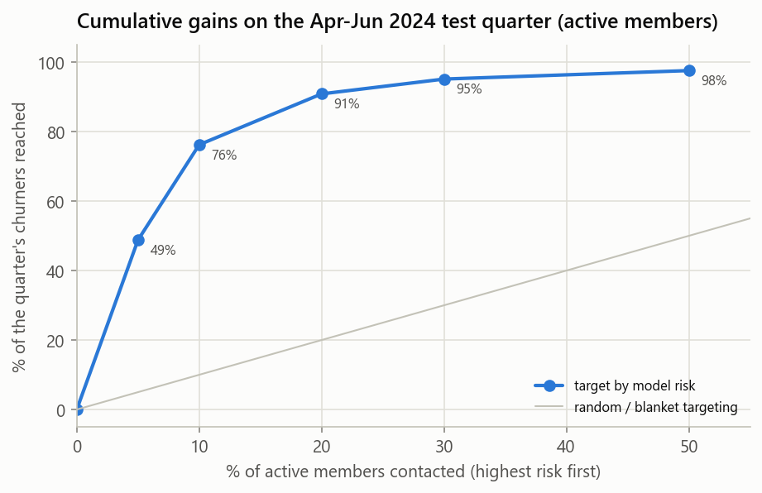
Targeting value
Active members, Apr-Jun 2024 test quarter
76%
73%
7.6x
91%
of churners reached by contacting the riskiest 10%
of those contacted really churn
better than random targeting
reached with the riskiest 20%
Calibrated: top risk decile predicted 72.4% churn, observed 72.7%.
Notes:
This is what it means for the business. If FreshBasket contacts the riskiest 10% of active members, about 170 people, it reaches 76% of the quarter's churners, and 73% of the people it contacts really are about to churn. That's 7.6 times better than picking at random. The riskiest 20% reaches 91%. And the probabilities can be trusted: in the top risk decile the model predicted 72.4% churn and the actual rate was 72.7%.

Slide 11
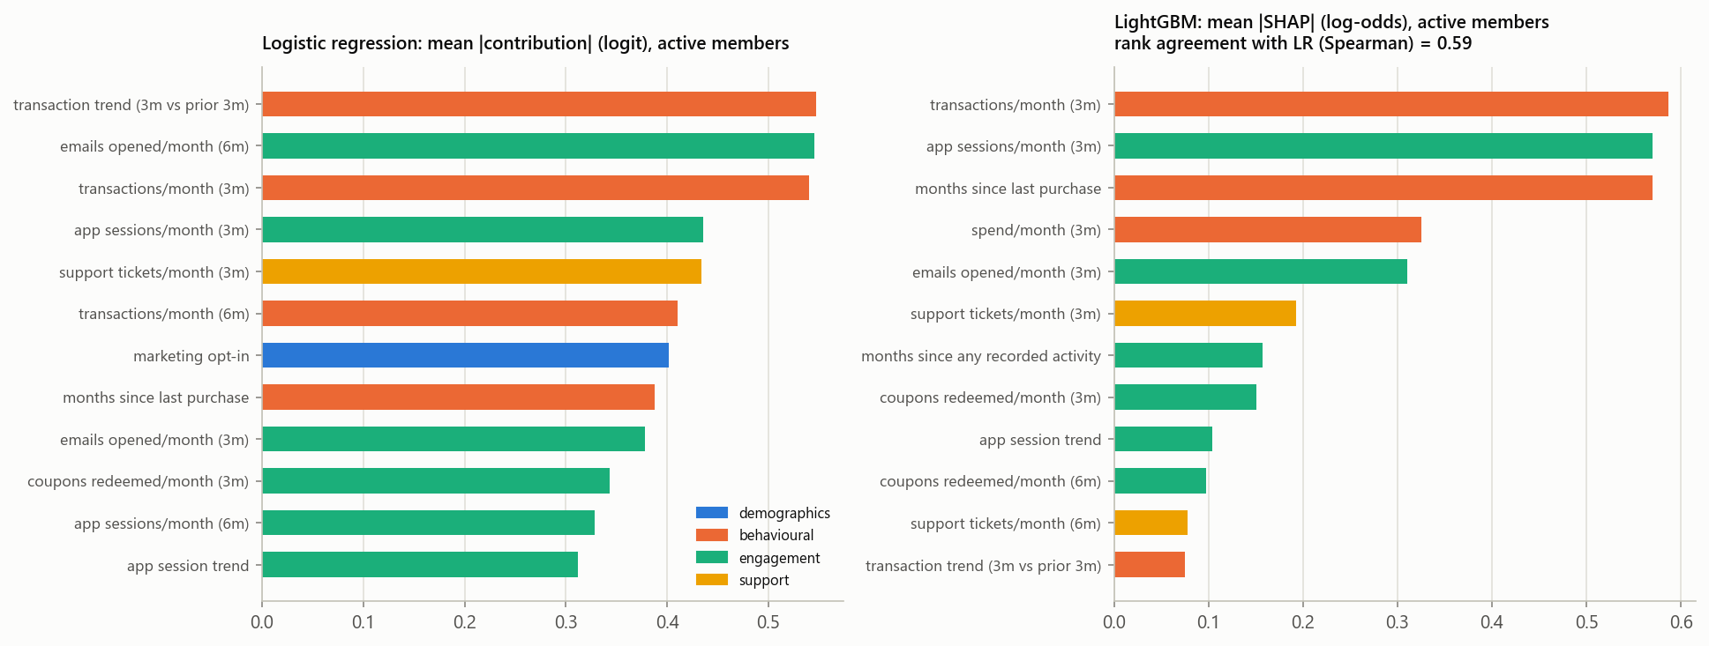
What drives churn
Behaviour and engagement - not demographics or tier
Attribution for active members: behavioural 40%, engagement 37%, demographics 15%, support 7% - LightGBM SHAP points to the same drivers
Risk rises with falling transactions, fewer emails and app sessions, and more support tickets
Tier makes no difference: Silver 9.5%, Gold 9.8%, Platinum 9.4%
Ablation (ROC-AUC, active): demographics 0.51 -> + behaviour 0.93 -> + engagement 0.96; every member gets their own top reasons
Notes:
What drives the predictions? Mostly behaviour and engagement: about 40% of the model's attribution is behavioural and 37% engagement. Falling transactions, fewer emails opened, fewer app sessions, rising support tickets. LightGBM's SHAP values point to the same drivers. Demographics barely matter. On their own they score a ROC-AUC of 0.51 for active members, which is chance, and tier makes no difference: Silver, Gold and Platinum all churn at about 9.5%. In the ablation, adding behaviour lifts it to 0.93 and engagement to 0.96. And because it's a logistic regression, every member on the list comes with their own reasons, like 'support tickets up, transactions falling'. These are associations, not causes.

Slide 12
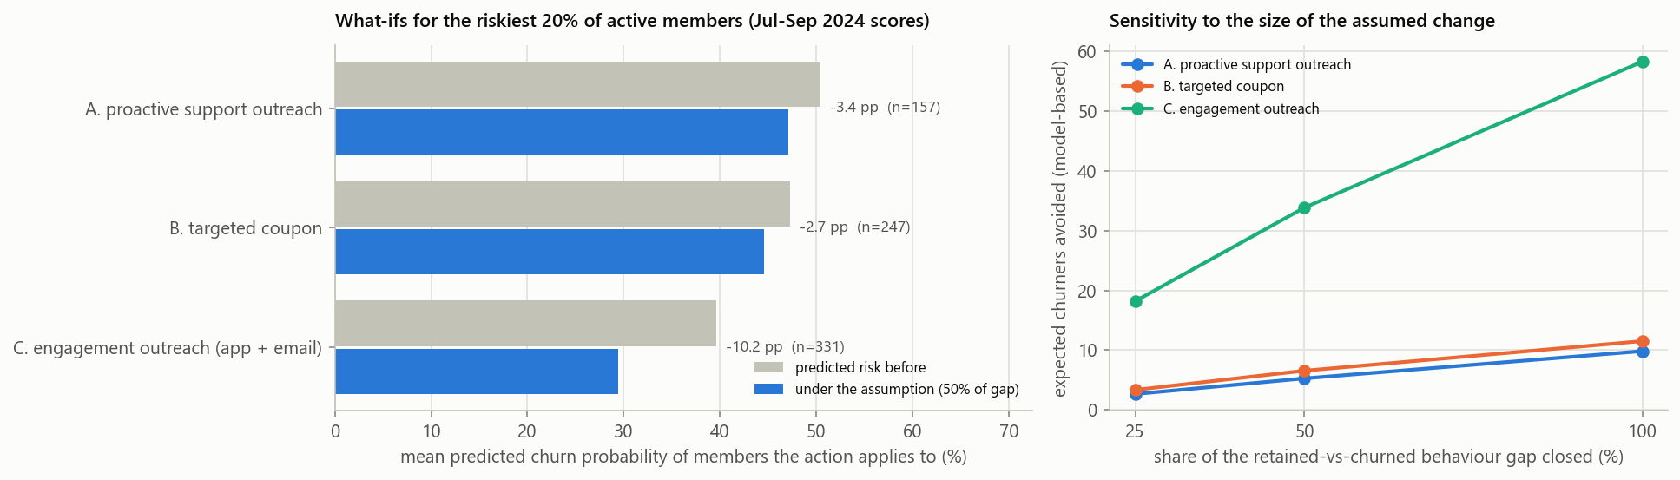
Retention what-ifs for the riskiest 20% (model-based)
331 members holding 131 of 140 expected churners; each action closes half the retained-vs-churned behaviour gap
-10 pp
-3.4 pp
-2.7 pp
25-100%
engagement outreach (n=331): ~34 fewer expected churners
proactive support for members with tickets (n=157)
targeted coupon (n=247)
of the gap closed: sensitivity shown on the right
Changes in predicted risk under stated assumptions: they rank what to test, not what the actions will achieve.
Notes:
Finally, the retention scenario. I took the riskiest 20% of members active in June 2024, 331 people holding 131 of the 140 expected churners, and asked the model what happens to their risk if their behaviour moved part of the way towards a typical retained member. I didn't invent the size of the change. Each action closes half the observed gap between retained and churning members, with 25% and 100% as sensitivity. Engagement outreach lowers predicted risk by about 10 points, roughly 34 fewer expected churners. Coupons and support outreach move it by about 3 points each. But this is the model's association, not a causal effect, so these numbers tell us what to test first, not what will happen.

Slide 13
Business decision and limitations
What FreshBasket should do
What not to assume
Monthly risk list of active members; contact the top 10% (~170) with their reasons
Test engagement outreach and proactive support with a 20-30% random hold-out
Report active-member churn as the KPI; run win-back separately for lapsed members
Capture offer cost and member value to size campaigns on expected value
The scores and what-ifs are associations, not causal effects of any action
Signals are unusually clean (likely synthetic data): re-validate on live data
One given label quarter; earlier labels rebuilt (~0.4% noise)
Threshold tuned for F1, not costs (no cost data supplied)
Notes:
So what should FreshBasket do? First, replace the blanket offer with a monthly risk list of active members, starting with the top 10%, each with their reasons attached. Second, test engagement outreach and proactive support with a 20 to 30% random hold-out, so we measure what actually works. Third, report churn among active members as the KPI and run a separate win-back programme for lapsed members. And capture offer costs and member value, so campaigns can be sized in money rather than F1. What the business should not assume: that these scores are causal, that accuracy will be this high on live data, because the signals here are unusually clean, or that one test quarter is enough. The model should be re-validated every quarter. Before I wrap up, let me show you the project itself. [DEMO, about 2 minutes: switch to the GitHub repository / README, then run notebooks/06_live_demo.ipynb; come back for the last slide.]

Slide 14
Takeaways
1
Most measured churn is members who had already left; active-member churn is a steady ~10% per quarter
2
A transparent model finds 76% of next quarter's churners in the riskiest 10% of active members
3
Target by behaviour, not tier - and prove the retention actions with a hold-out test
Notes:
To sum up. Most of the churn FreshBasket sees is members who had already left, while active-member churn is a steady 10% a quarter. A transparent, well-calibrated model finds about three quarters of next quarter's churners in the riskiest 10% of active members, validated on quarters it never saw. And the drivers are behaviour, not tier. My recommendation is a monthly targeted list plus a controlled test of the retention actions. Thanks for watching.

