Slide 1
RAILS ORM
de-mystifying ActiveRecord

Slide 2
NoteToSelf: Know your audience
Who has used an ORM?
Daily:
  Who uses Relational Databases?
  Who uses Java?
  Who uses PHP?
  Who uses Javascript?
Who has used [Perl, Smalltalk, Lisp, Ruby]

Slide 3
NTS: Address a Need
What I want =>
How can I do my job smoother, faster, and to a higher standard?
Where can I can get a ‘run-time’ model of rails?
What I need first =>

Slide 4
NTS: Fulfill need
What does it do for me?
What do I need to do for it?
Rails is Ruby,
Ruby is Awesome,
Transitive Relation ,
Rails is Awesome.

Slide 5
What you are about to see
Picture that looks like a 5 year drew
(2) one-to-many relationships
External Resource Scheme

Slide 6
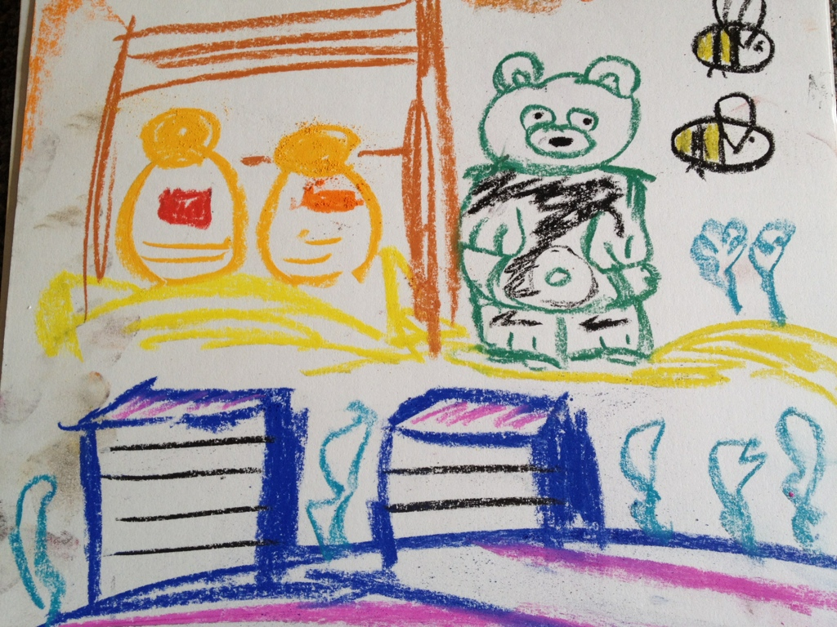
Papa Bear Honey Share

Slide 7
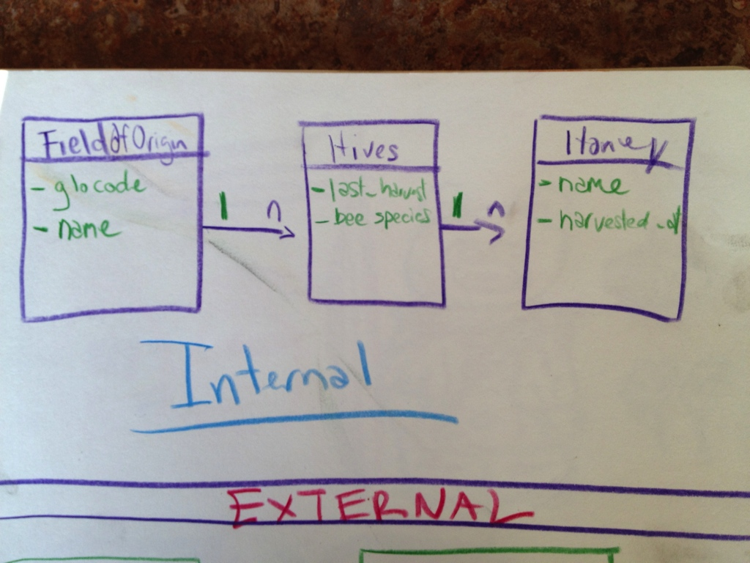
Internal Data Model

Slide 8
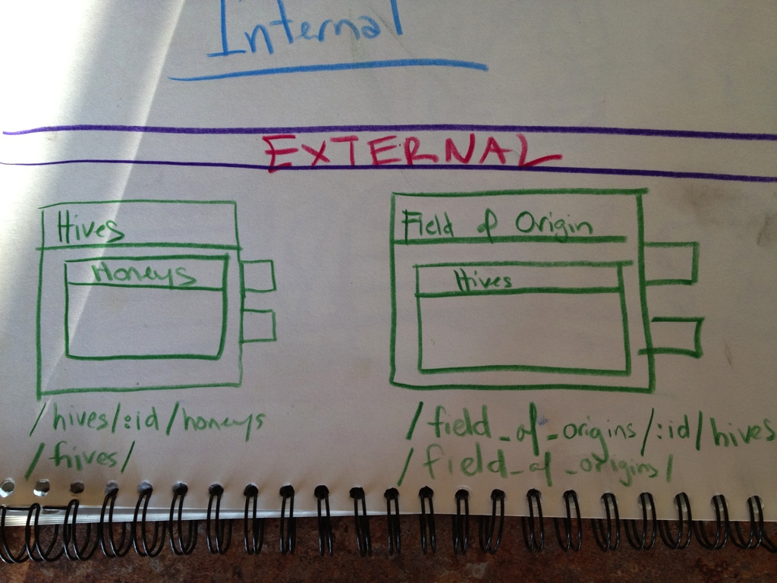
External REST Resource API

Slide 9
demo

