Slide 1
Neural Data Analysis Tutorial
2020 CCBR Winter Workshop
Chinmay Purandare
PhD Student (Mayank Mehta lab), UCLA
W. M. Keck Center for Neurophysics

Slide 2
Agenda 7th Jan
Definition of spikes and LFP
Motivation for modelling spikes as Poisson processes
Basics of MATLAB
Simulation of neural spike train
Autocorrelation, cross correlations and ISI-histograms
Simulate a periodic signal
HW-
a. Check if Poisson by Exponential fit and autocorrelation
b. Simulate periodic but asynchronous spike trains c. Cross correlation between 2 spike trains

Slide 3

Methods and scales in study of neuroscience

Slide 4
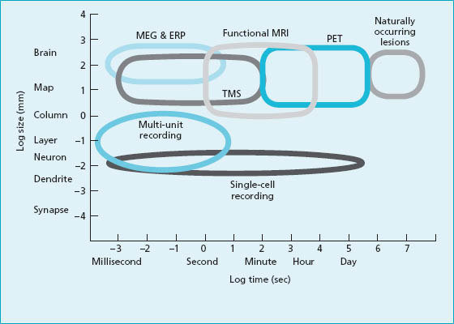
Adapted from Churchland and Sejnowski, 1988
Using Electrode arrays

Slide 5
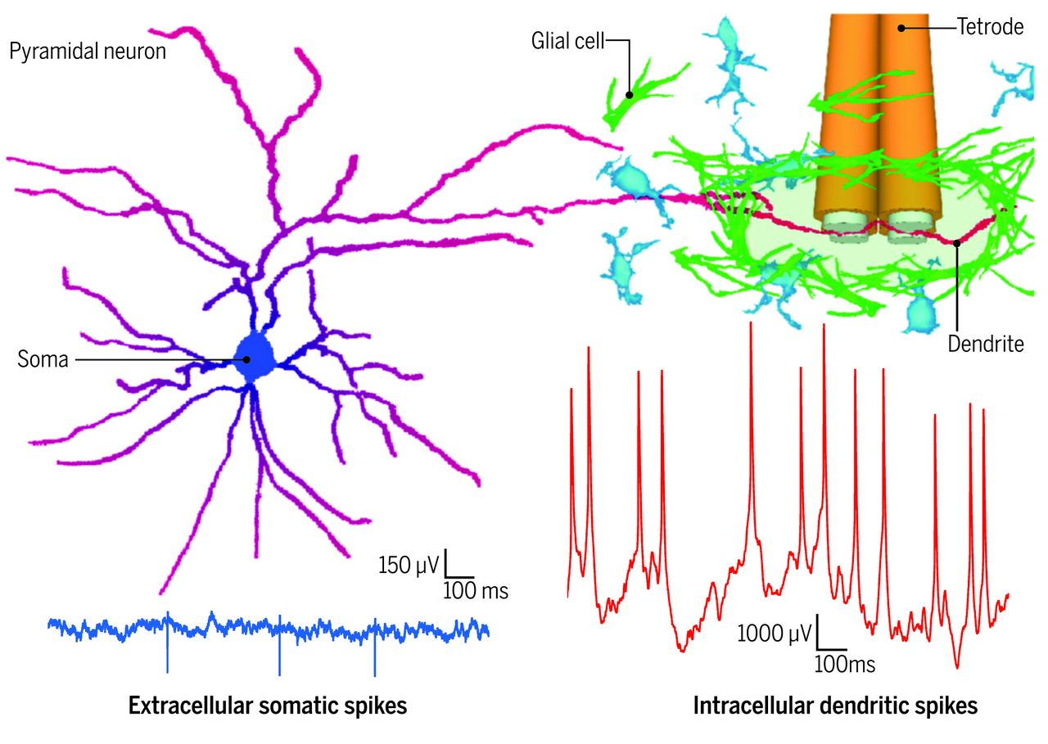
Local field potentials
LFP are electrical signals generated in nervous and other tissues by the summed electrical activity of the individual cells (e.g. neurons) in that tissue. LFP are "extracellular" signals, meaning that they are generated by transient imbalances in ion concentrations in the spaces outside the cells, that result from cellular electrical activity.
Moore et al, Science 2017
Notes:
Source Wikipedia

Slide 6
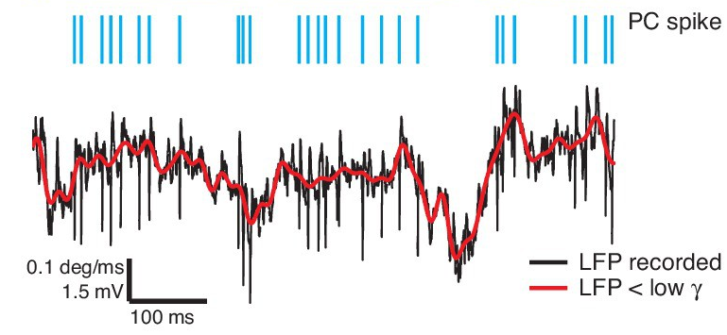
Spike train
Spike trains are the time-series electrical signals recorded from individual neurons in the brain. They are essentially the action potentials (nerve impulses) generated by neurons. Spike trains are the signals generated by neurons used to communicate with one another.
Hong etal, eLife 2016
Notes:
Source- Wikipedia

Slide 7
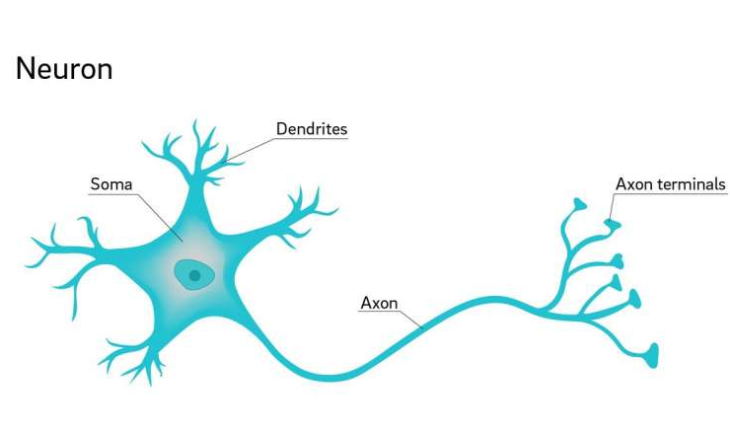
Spike Trains as Poisson processes
Firing of a neuron is highly variable.
This variability is believed to occur due to stochasticity of synaptic inputs to this neuron. If we assume that these inputs have a constant drive and are independent, then the occurrence of spikes by a particular neuron can be assumed to be a Poisson point process.
The probability that a spike will occur in an interval is the same for all intervals of equal size and is proportional to the size of the interval.
Notes:
10 minutes upto this point

Slide 8
Using MATLAB to simulate spike
Part 0 – Basics of MATLAB
Interface
As a calculator
Syntactic concerns- newline, ; ,[],(),{}
Using a script and making subsections
Commonly used functions- rand, hist, plot, clear
Notes:
30 minutes

Slide 9
Simulate a spike train, compute its firing rate
Notes:
50 minutes

Slide 10
Autocorrelation and ISI histogram
Notes:
90 minutes

Slide 11
Agenda 8th Jan
PSTH and tuning curves
Quantify strength of tuning- sparsity, depth of modulation
Bootstrapping methods(run through demonstration only)
LFP oscillations and band passing
Power spectrum

Slide 12
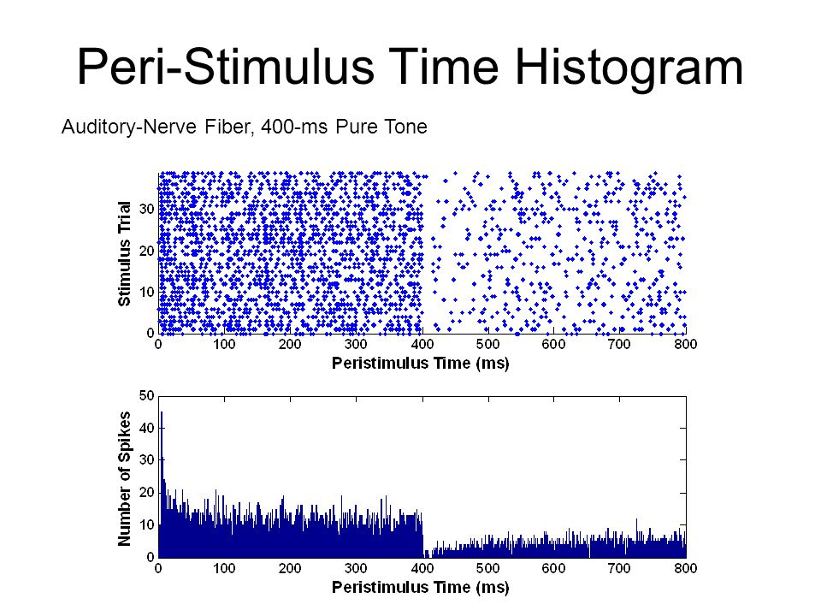
Repetition of experiment with multiple trials, stacked together (top) Binned histogram of number of spikes (below)
Auditory laboratory:
Bertrand Delgutte

Slide 13
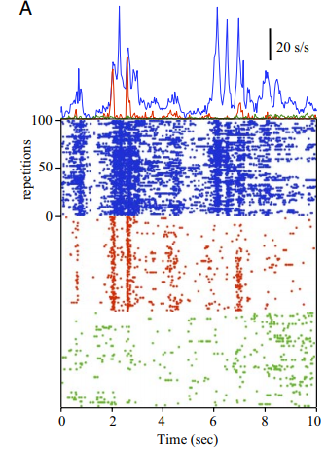
Yen, Shih-Cheng & Baker, Jonathan & Gray, Charles. (2007). Journal of neurophysiology. 97. 1326-41. 10.1152/jn.00747.2006.

Slide 14
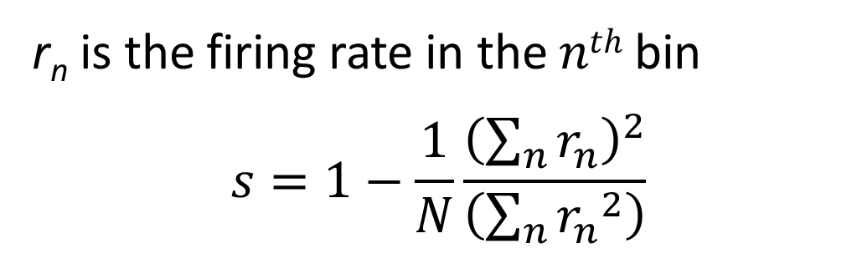
Definition of sparsity
r_{n} is the firing rate in the 𝑛^{𝑡ℎ} bin $$s=1−\frac{1}{N}\frac{{\left(\sum_{n}{r_{n}}\right)}^{2}}{\left(\sum_{n}{{r_{n}}^{2}}\right)}$$

Slide 15
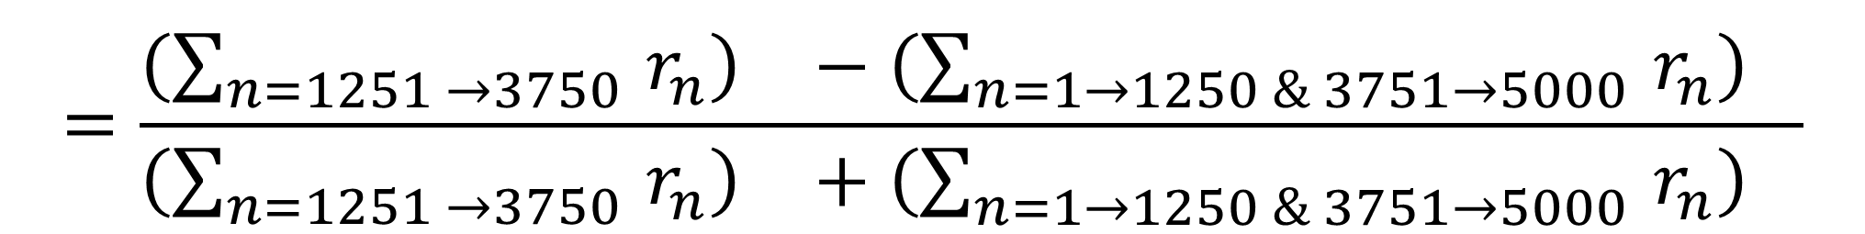
Another quantification of strength of tuning
Depth of Modulation
For total of (say) 5000 datapoints where tuning curve is computed, and we want to compute the strength of tuning around the center
$$=\frac{{\left(\sum_{n=1251 →3750 }{r_{n}}\right)}^{}−{\left(\sum_{n=1→1250 \& 3751→5000 }{r_{n}}\right)}^{}}{{\left(\sum_{n=1251 →3750 }{r_{n}}\right)}^{}+{\left(\sum_{n=1→1250 \& 3751→5000 }{r_{n}}\right)}^{}}$$

Slide 16
Band passing Raw LFP signal in theta range
Theta rhythm is a natural rhythm observed in hippocampus during active exploration and REM sleep.
The frequency range of theta is variable across species, but for rodent data, 4 to 12Hz is a well accepted range for theta.
Load the raw LFP signal provided with the timepoints at which it was obtained(in microseconds) and bandpass it in the theta range using “butterworth” filter design in MATLAB and a symmetric(acausal) bandpass function filtering (functions butter and filtfilt.)

Slide 17
Extra work: compare the relationship between running speed and theta band power.

Slide 18
Files provided
This presentation
SampleLFP_speed dataset of local field potential signal and running speed
makeSparsity.m function to compute sparsity
ShuffleTrials.m file for shuffling individual trials with a random amount of quantify Bootstrapping methods-based strength of tuning
Poisson_Heeger.pdf file to read up about modelling spike trains as Poisson processes
TunedNeuron_CCBR.mat response of an actual neuron showing tuning across multiple trials

Slide 19
Files To be provided after tutorial
CCBR_jan8_script.m containing all code and homework assignment questions covered in class.

