Slide 1
VISIT Tutorial
Created by Zack Blazejewski

Slide 2
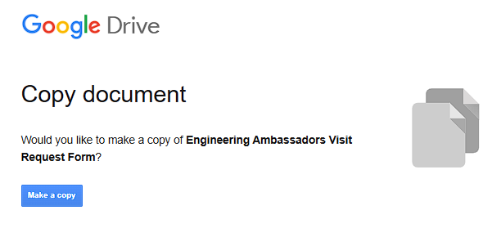
1. Make copies of the google forms
Use the links here to make personal copies of the Student and Teacher google forms

Slide 3

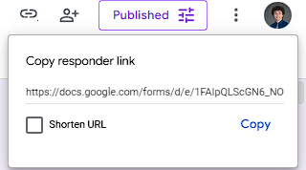
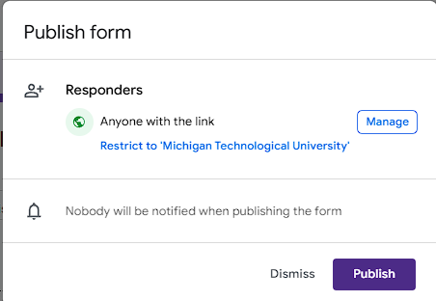
2. Send Google Forms Out
Publish each google form and send it out to students and teachers
Ensure this says “Anyone with the link”
Share this link

Slide 4
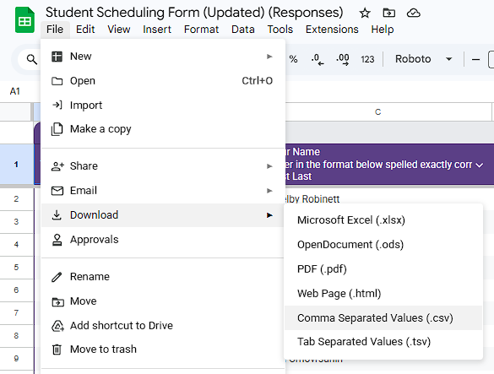
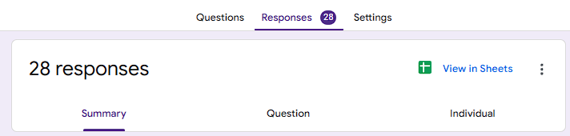
3. Download Data
Once the forms have been filled out, download the responses as .csv’s
This tab
Click “Link to Sheets”

Slide 5
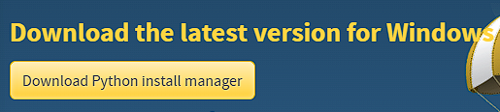
4. Install Python
Follow the link and steps here to install python on your machine
Click this and then follow the rest of the prompts

Slide 6
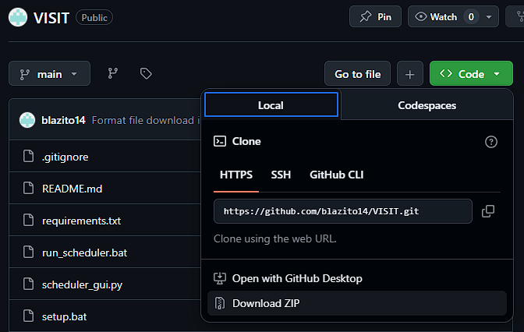
5. Download the VISIT Tool
Visit the link here to download the VISIT tool from my GitHub

Slide 7
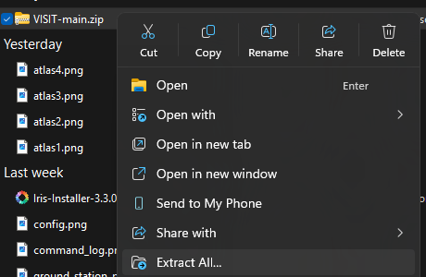
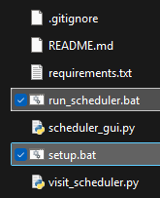
6. Run the VISIT Tool
Unzip the File
Double click the setup.bat script
This installs all of the dependencies
Run it if questioned
Double click the run_scheduler.bat
This opens a GUI
Run it if questioned

Slide 8
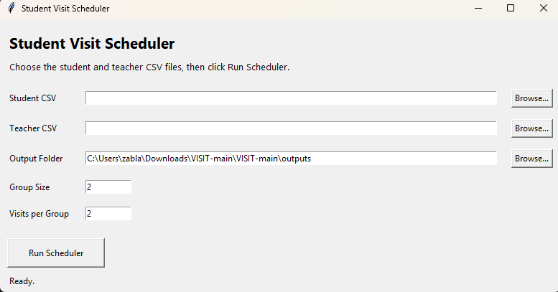
7. Operate the VISIT GUI
Select each csv
Select an output folder
Run!
(You can optionally set a desired group size and visits per group

Slide 9
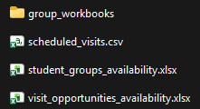
8. Schedule VISITS
The automatically scheduled visits sheet should give you all of the automatically scheduled visits
Use the scheduled_visits.csv to see all of the automatically scheduled visits

Slide 10
9. Use the manual tools if necessary
Explore and use the student_group availability, remaining visit opportunities, and group workbooks to manually schedule any other groups.
Workbooks with each group’s overlap with each visit opportunity
The overall availability of each student group
The overall availability of each visit opportunity

