Slide 1
VELMA-MOEA: Background
Barnhart, McKane, Djang, Halama, Pettus, Brookes

Slide 2
Overview of Genetic Algorithms
Goal is to find solution or set of solutions to optimization problems.
VELMA: Tune calibration parameters in order to maximize fit with observed data, minimize error

Slide 3
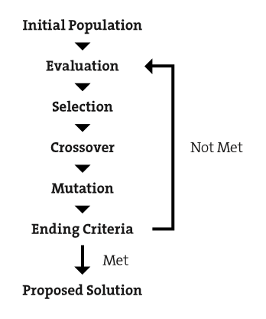
Overview of Genetic Algorithms
Individual: A set of calibration parameters
Population: A set of Individuals
Evaluation: min Eval = f(Individual)
Selection: Choosing on which individuals to perform an operation.
Crossover: Blending two individuals to create a new individual
Mutation: Altering a single individual to create a new individual.
http://gamelearninglab.nctu.edu.tw/ctsun/visualization%20of%20evolutionary%20computation%20processes.pdf

Slide 4
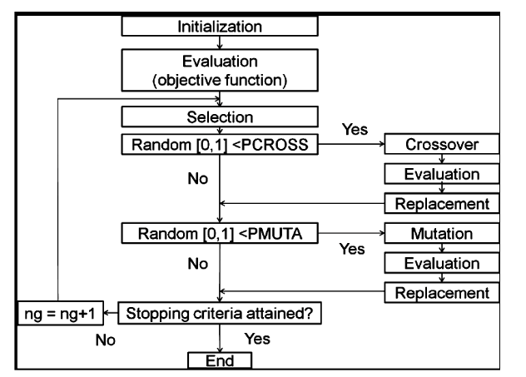
GA Example
Boisvert et al. 2016. http://file.scirp.org/pdf/OJMH_2016072616182516.pdf

Slide 5
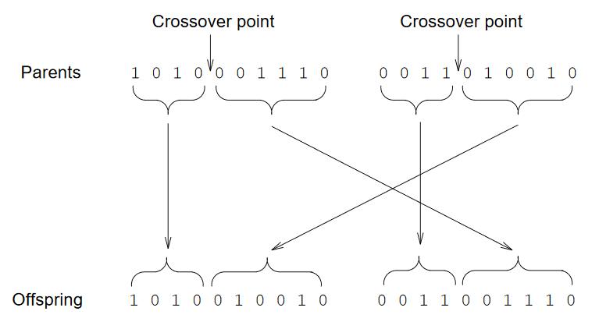
Crossover (sex)
Beasley, 1993. http://mat.uab.cat/~alseda/MasterOpt/Beasley93GA1.pdf

Slide 6
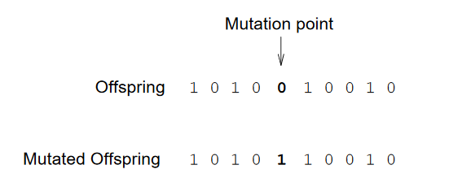
Mutation
Beasley, 1993. http://mat.uab.cat/~alseda/MasterOpt/Beasley93GA1.pdf

Slide 7
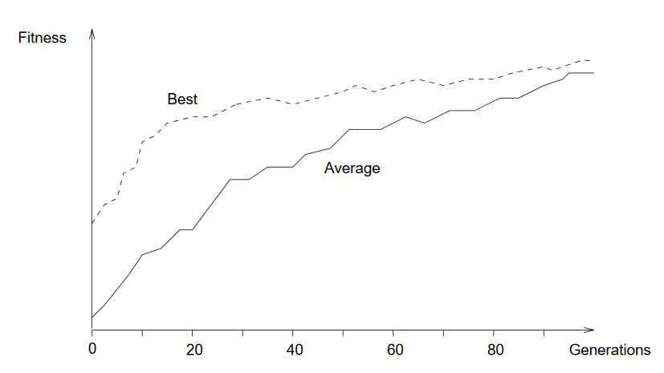
Convergence
Beasley, 1993. http://mat.uab.cat/~alseda/MasterOpt/Beasley93GA1.pdf

Slide 8
Multiple objectives gives a set of nondominated (indifferentiably good) solutions called the Pareto Front
f₂
Feasible Region
Pareto Front
f₁
Kalyanmoy Deb. www.polymtl.ca/namp/docweb/Modules.../M15_Part1_Tier1_MultiObjective.ppt

Slide 9
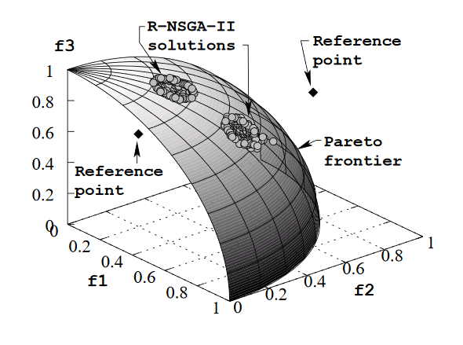
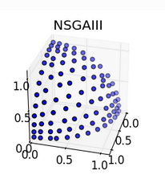
Many-objective problems produce nondominated surfaces and hypervolumes
Platypus via Python.
http://platypus.readthedocs.io/en/latest/experimenter.html#comparing-algorithms-visually
http://www.egr.msu.edu/~kdeb/papers/k2005012.pdf

Slide 10
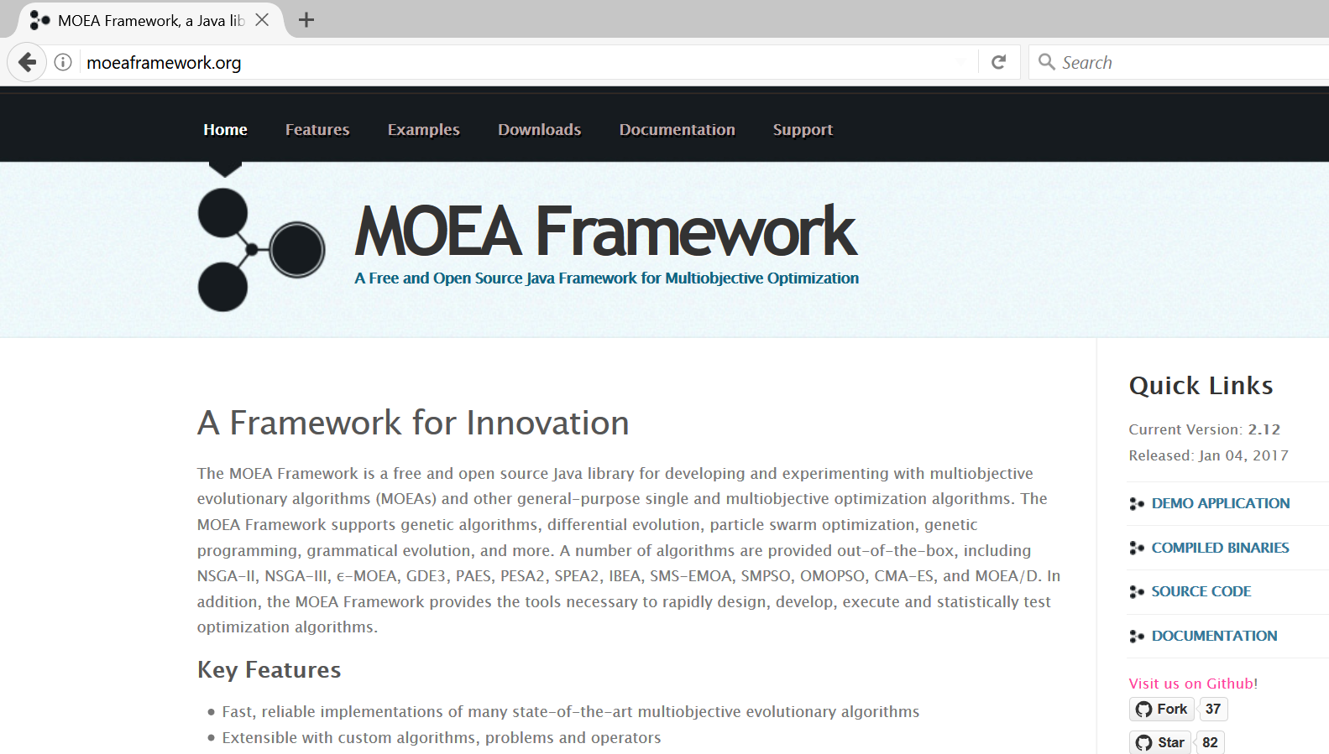
VELMA is linked with the MOEA Framework

Slide 11
Why MOEA Framework?
Developed within Java
Open Source
Many algorithms to choose from
Actively developed and supported by Hadka, Reed Group (Penn State, Cornell)

Slide 12
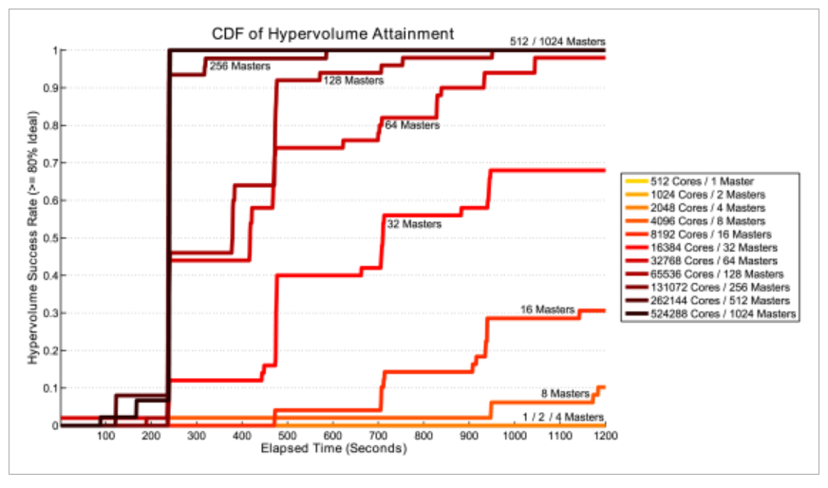
Works with massively parallel systems (borg example)
Reed and Hadka, 2014. Evolving many-objective water management to exploit exascale computing. Water Resources Research

