Slide 1
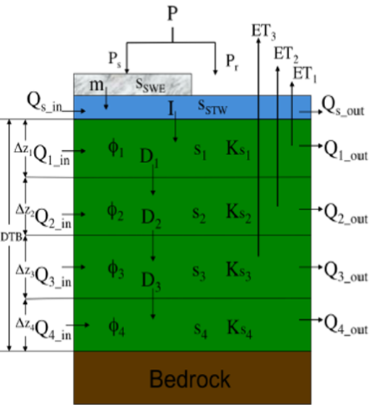
Optional Impermeable Layer
Layer 1
Green Roof
Impermeable Layer
Layer 2
Layer 2
Layer 3
Layer 3
Layer 4
Layer 4
Boundary
Boundary
Fig X. Depiction of flows of water and nutrients amongst the layers of a single VELMA cell. The left panel shows the original VELMA setup, and the right panel represents model changes associated with implementing green roofs in VELMA.
1

