Slide 1
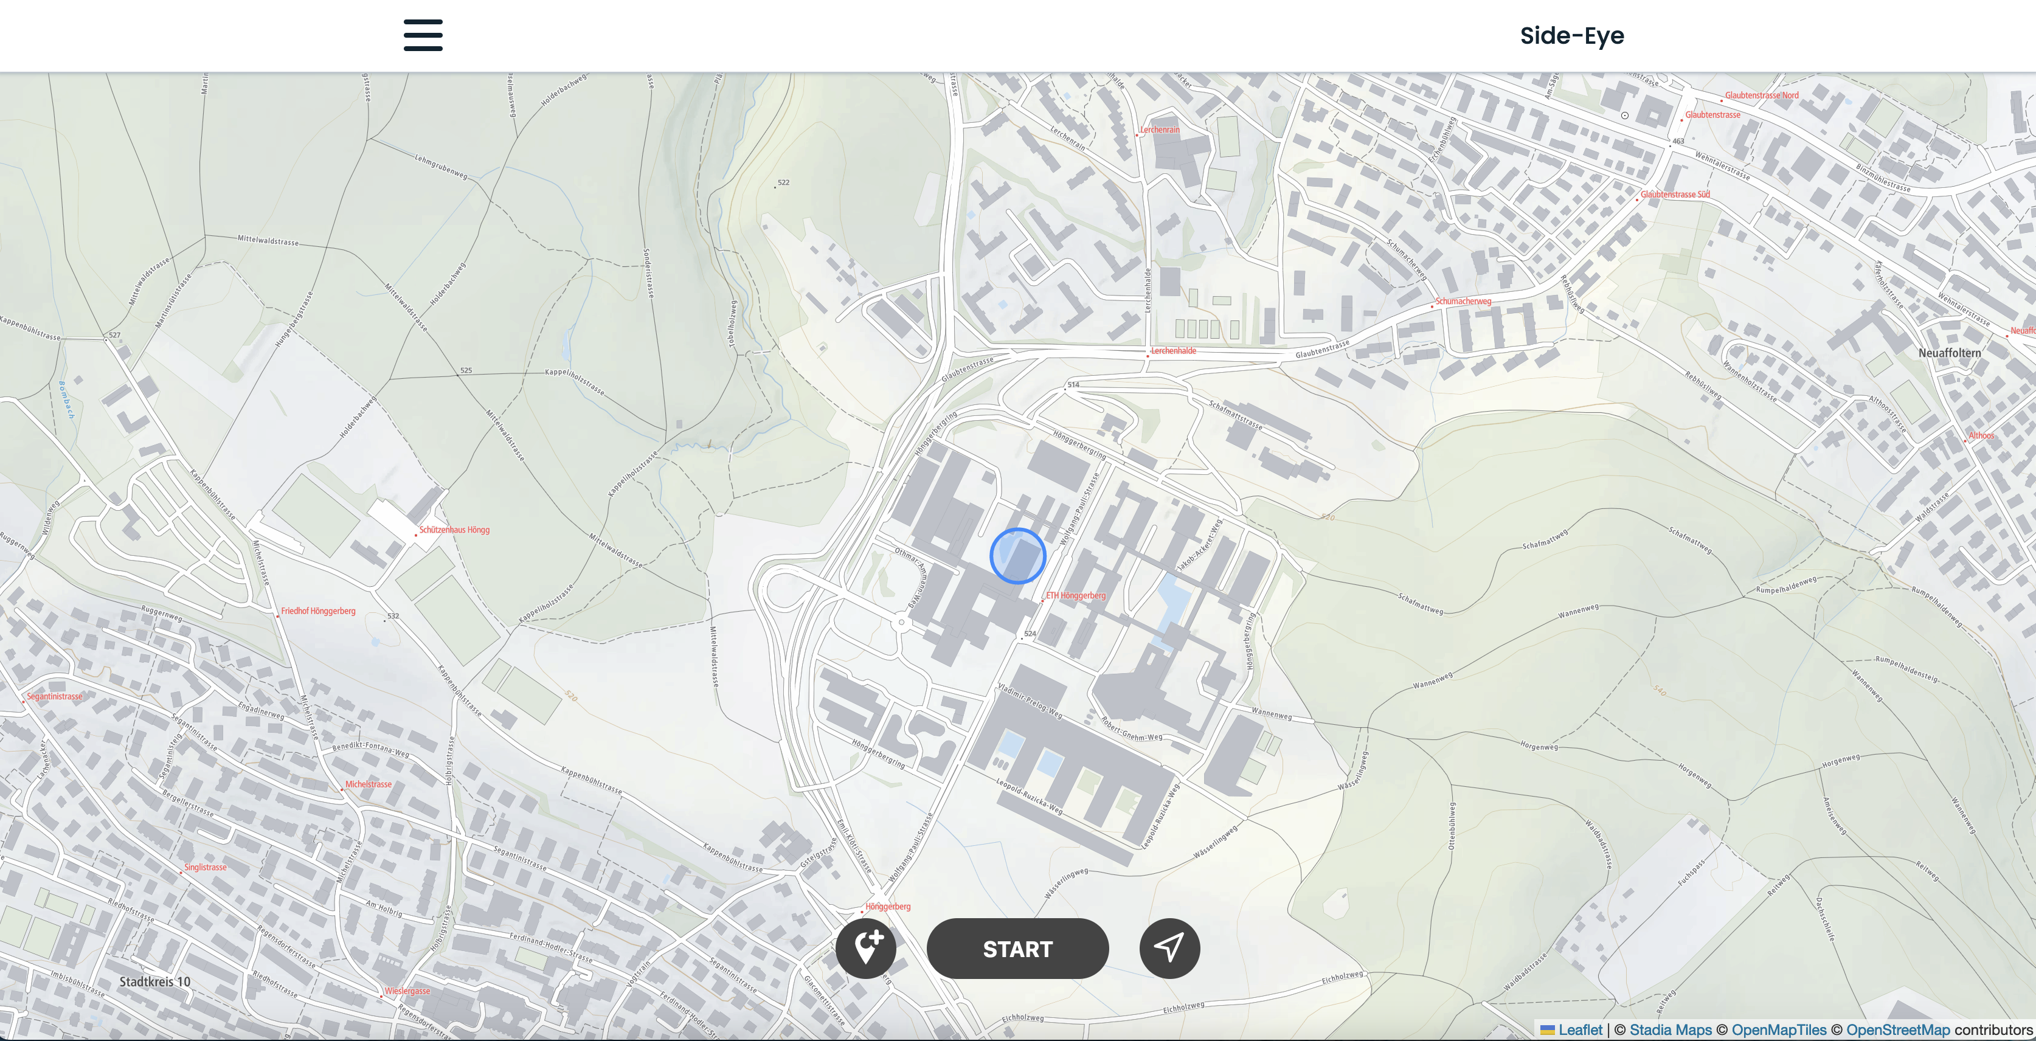
Side-Eye
GTA Group 8
Geoinformationstechnologien und –analysen 19. December 2023

Slide 2
Story
[Bild von commuter am Handy]

Slide 3
Research Question
”How can self-recorded trajectories be combined with open-source data in a
geospatial analysis while optimizing the user interface and experience?”
Two spotlights:
- Backend
- User Guidance and Design

Slide 4
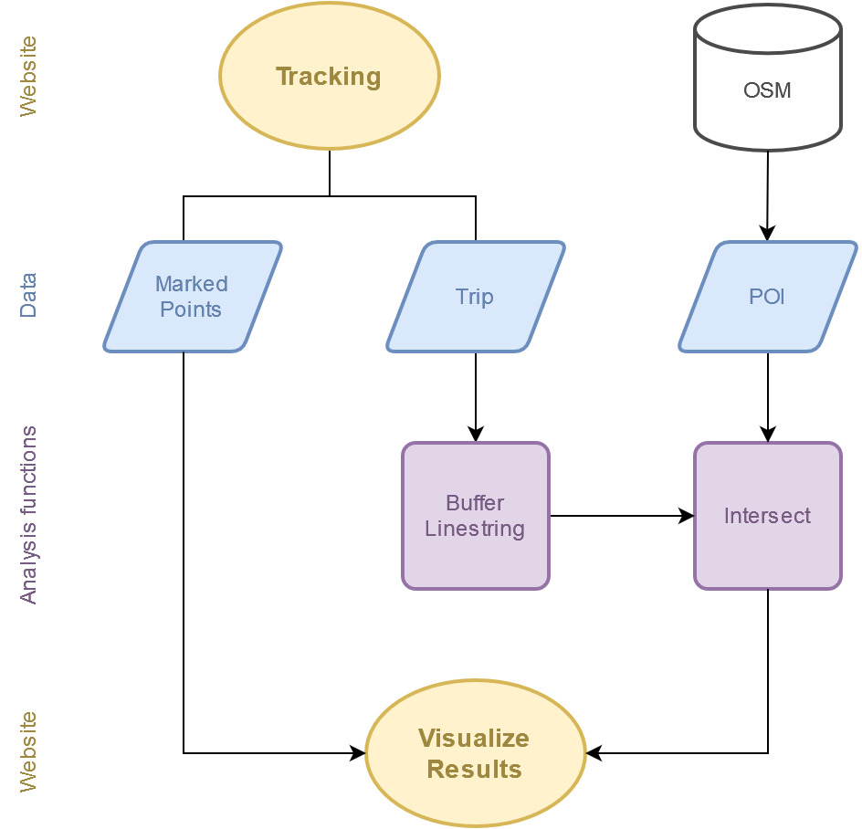
Backend: Vercel and GitHub
Processing
Linestring…
Vercel and Github
Connection of the GitHub repository to the Vercel project
Automatic deployment of every push in GitHub

Slide 5
User Guidance and Design
pop-ups
loading screen
consistent coloring

Slide 6

Have fun exploring!

