Slide 1
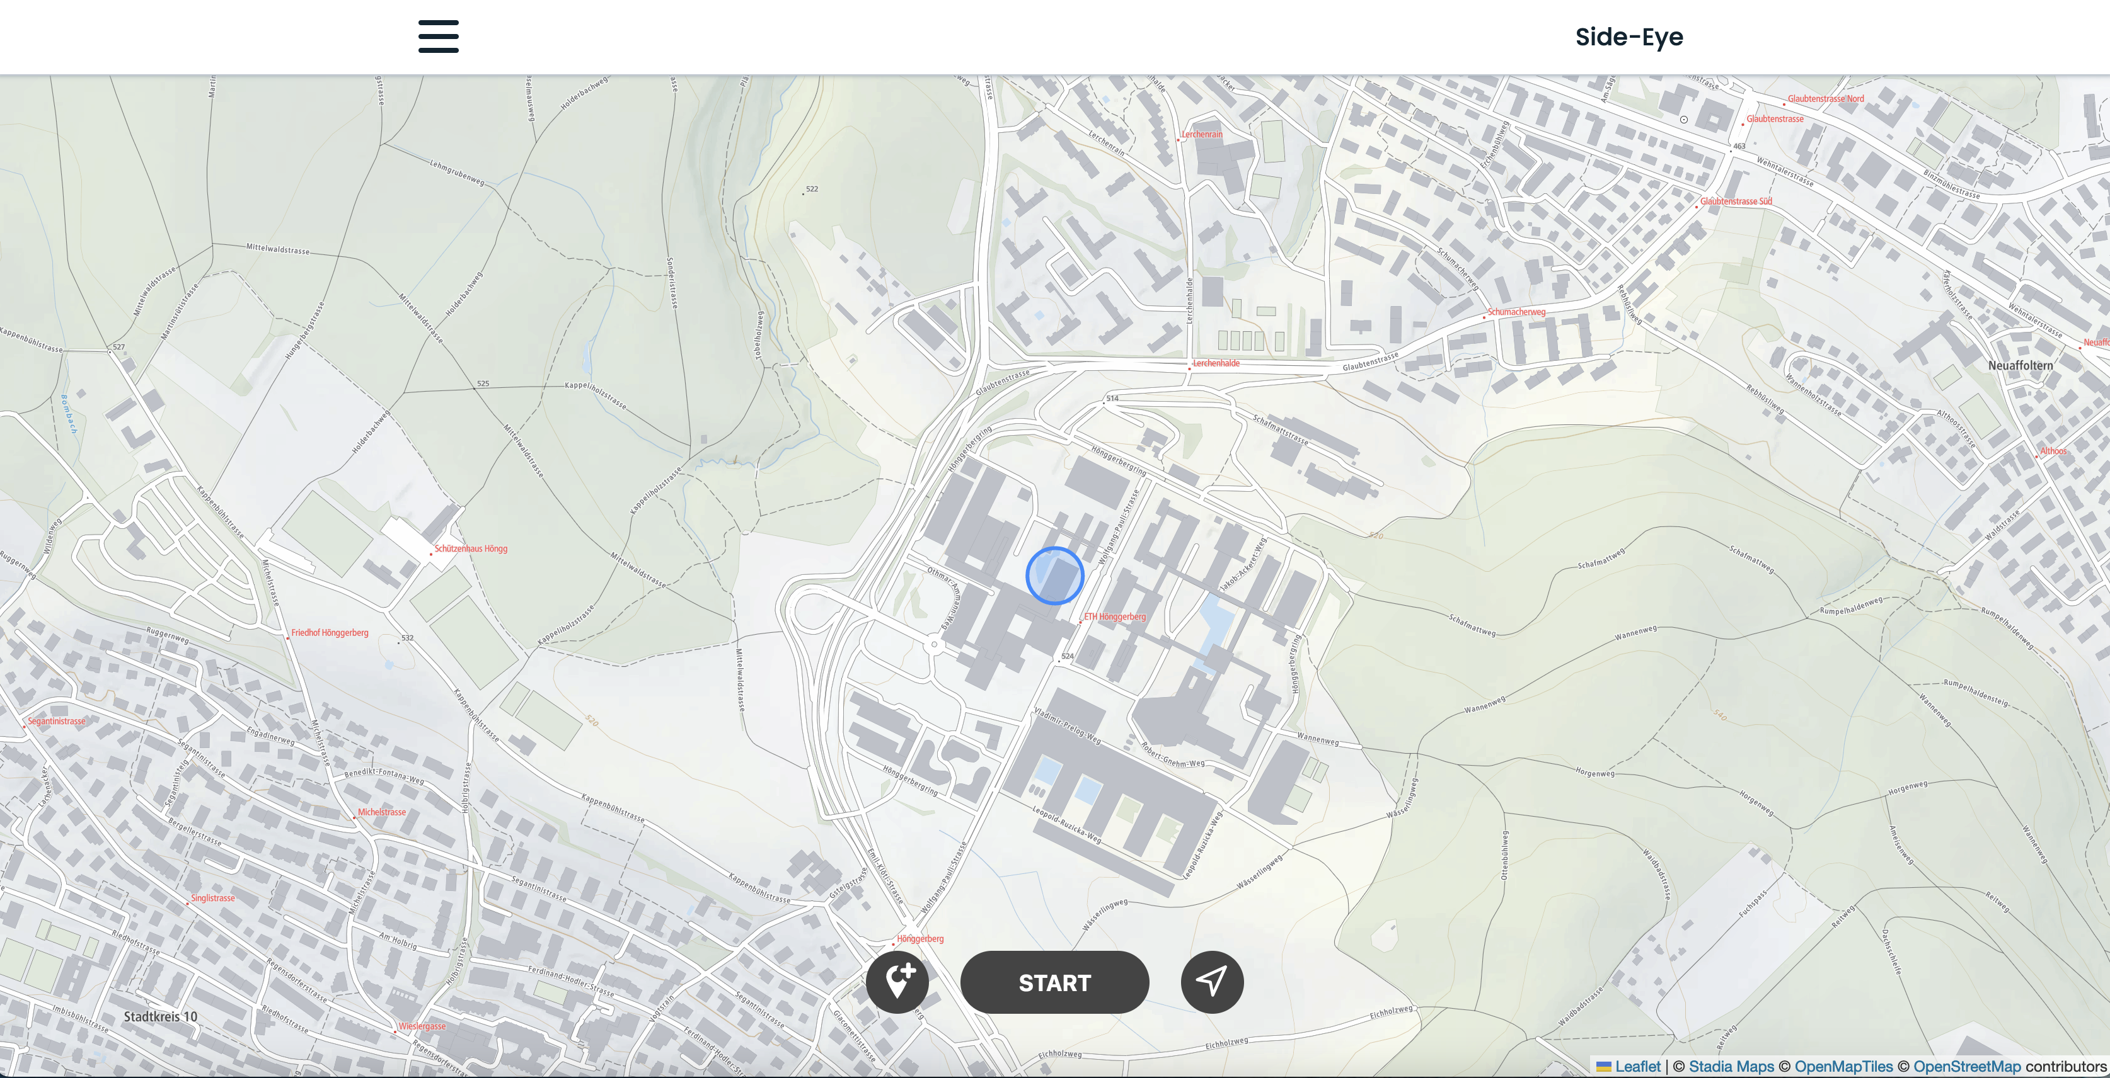
Side-Eye
GTA8
GTA, HS 2023
19. December 2023

Slide 2
Story
Introduction and motivation
Research question that you would like to answer
RQ 1
…
Some motivating pictures…

Slide 3
Research question
Data
Which data will you collect?
What are the attributes of point data?
Which kind of trajectory data will you collect?
How are you going to combine them?
Which kind of public data is available?
What are the added value of these data?

