Slide 1
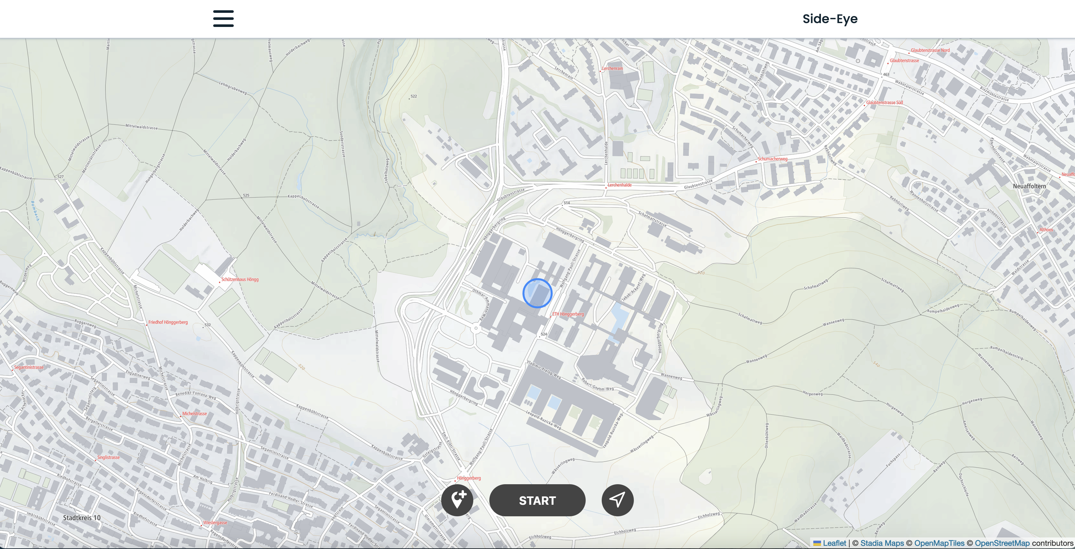
Side-Eye
GTA8
GTA, HS 2023
19. December 2023

Slide 2
Introduction
Introduction and motivation
Research question that you would like to answer
RQ 1
…
Some motivating pictures…

Slide 3
Data
Data
Which data will you collect?
What are the attributes of point data?
Which kind of trajectory data will you collect?
How are you going to combine them?
Which kind of public data is available?
What are the added value of these data?

Slide 4
Methods
Software and framework (e.g., HTML 5, Python, Geoserver) for achieving the functionalities
Assumptions, if any are made
Step-by-step analysis approach
Want kind of spatial analysis will be needed?
Possibly visualized as a flow chart

Slide 5
Results
Anticipated result of the analysis
(e.g., tables, maps or the working app itself?)
How does this answer the research question(s)?

