Slide 1
AI CAPABILITY OBSERVATORY
Measuring, Forecasting, and Governing
AI Model Capability
An enterprise platform that replaces leaderboard opinion with an
auditable, reproducible measurement system.
Executive Briefing
Confidential

Slide 2
Agenda
1. Executive summary
2. The business problem
3. What AICO does — the capability pipeline
4. Platform architecture at a glance
5. Capability tour: measurement → governance
6. The web application
7. Engineering rigor & trust
8. Roadmap
Appendix: backup slides addressing anticipated leadership questions follow the main deck.
AI Capability Observatory — Confidential
2

Slide 3
Executive Summary
AICO turns “which AI model is best” from opinion into an auditable,
reproducible measurement system.
MEASURE
UNDERSTAND
DECIDE
GOVERN
Hierarchical Bayesian capability scores with uncertainty — not a single leaderboard number.
Why scores moved, whether the scale itself is stable, where capability is headed.
Procurement, ROI, and budget recommendations that are risk-adjusted and explainable.
Every action audited, every fit reproducible and signed, access controlled by policy.
Status today
16
24
16
1,300+
99.8%
analytical engines
REST endpoints
web app pages
automated tests
line coverage
AI Capability Observatory — Confidential
3

Slide 4
The Business Problem
Why measuring AI capability the ad-hoc way breaks down at enterprise scale
— Benchmark scores are point estimates — no uncertainty, so a 2-point gap looks the same whether it's real or noise.
— Public leaderboards drift as benchmarks saturate or leak, silently invalidating year-over-year comparisons.
— Every team scores models differently, so procurement and engineering can't compare notes on the same scale.
— Model-selection decisions are made without quantified ROI, risk, or budget trade-offs.
— When a decision is questioned, there is no audit trail back to the data, the model, or the person who published it.
Consequence: procurement overpays or underbuys, rankings flip-flop with the next data refresh, and
leadership has no defensible answer when a model choice is challenged.
AI Capability Observatory — Confidential
4

Slide 5
What AICO Does
One pipeline, eight capability stages, each subsuming the last
1
2
3
4
5
6
7
8
Measure
Stabilize
Forecast
Attribute
Optimize
Decide
Govern
Observe
Bayesian
capability score
Scale stays
comparable over time
Where capability
is headed
Why a score
moved
Which benchmarks
are worth running
Procurement, ROI,
risk, budget
Audit, reproduce,
secure
One platform,
plugins, SDK
Each stage is a full analytical engine, not a feature flag: stability and attribution both ship
changepoint/causal machinery beyond what today's web app surfaces, and portfolio optimization
(stage 5) is the newest capability, live in production this release.
The web application and REST API expose stages 1 through 7 today; stage 8 (the platform layer —
plugins, SDK, workflow engine) is what lets every other stage be extended without touching the
engines it coordinates.
AI Capability Observatory — Confidential
5

Slide 6
Platform Architecture at a Glance
Business logic depends on protocols, never on infrastructure
PRESENTATION
REST API · Web application · Interactive dashboards · Executive reports
DOMAIN & APPLICATION
16 analytical engines · Fit pipeline · Workflow orchestration · SDK facade
INFRASTRUCTURE
Versioned storage (memory / SQLite / PostgreSQL) · Auth · Observability · Plugins
Two structural rules, enforced by construction:
— Business logic never imports infrastructure — the heavy statistical pipeline, storage, and even the workflow engine's clock are all injected, swappable protocols.
— The dependency graph is acyclic across all 16 engine packages — no circular coupling to untangle later.
AI Capability Observatory — Confidential
6

Slide 7
Capability Measurement
Hierarchical Bayesian latent-ability estimation
STAGE 1
— Every model gets a full posterior distribution — mean, median, and a 95% credible interval — never a bare number.
— Scores roll up through five layers: benchmark → domain → public/internal → global, so a regression is traceable to the exact benchmark that caused it.
— Item Response Theory item parameters (discrimination, difficulty) separate "how hard is this benchmark" from "how capable is this model" — the same discipline standardized testing uses.
— NUTS (full Bayesian) or Variational Inference (fast, approximate) — the same report shape either way.
AI Capability Observatory — Confidential
7

Slide 8
Scale Stability & Drift
A score should move only when the model changes — not when the ruler does
STAGE 2
— Tracks difficulty and discrimination drift between fits with statistical significance tests (not just "the number changed").
— Flags benchmark saturation — when scores cluster against a ceiling and stop discriminating between models.
— Detects leakage risk: models whose scores deviate suspiciously from what their ability predicts.
— Equating machinery keeps old and new benchmark versions on one comparable scale, the same technique standardized exams use across test forms and years.
AI Capability Observatory — Confidential
8

Slide 9
Forecasting
Where capability is headed, with calibrated uncertainty
STAGE 3
— State-space, BSTS, GP, and saturation-curve forecast models — extrapolating the fitted history, not just drawing a trend line.
— Every forecast horizon carries a growing uncertainty band — the platform is honest about how much less it knows further out.
— Threshold probabilities answer the leadership question directly: "what's the chance model X clears bar Y by Q3?"
— Feeds the decision engine's forward-looking risk assessment and the portfolio engine's one-step-ahead validation.
AI Capability Observatory — Confidential
9

Slide 10
Attribution
Why did a model's score move? — a Shapley decomposition, not a guess
STAGE 4
— Decomposes any score change between two fits into exact, game-theoretic credit shares across domains or benchmarks — the shares always sum to the observed movement.
— Exact enumeration for small component sets; a seeded Monte Carlo estimator scales to large ones without losing determinism — the same request always returns the same answer.
— The engine writes the narrative itself: "reasoning drove +0.08 of the +0.11 gain; coding contributed the rest" — no manual interpretation step.
— The deeper causal path (distribution-change attribution over raw observations) is a validated library capability, staged for a future job-based release.
AI Capability Observatory — Confidential
10

Slide 11
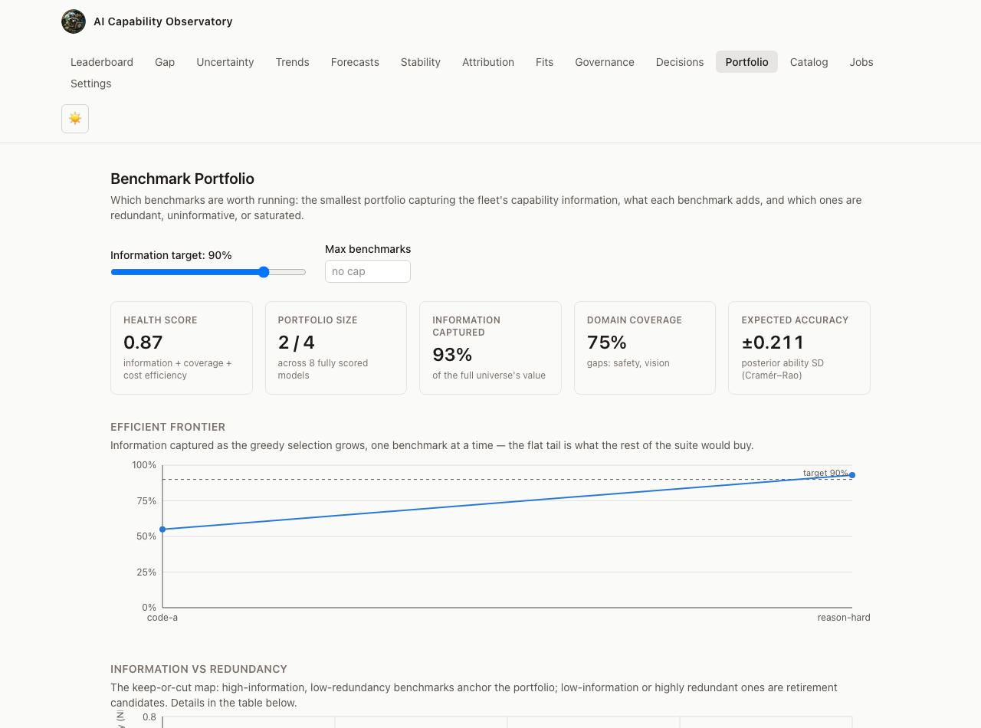
Portfolio Optimization
Which benchmarks are worth running — the smallest suite, the most information
STAGE 5 · NEW THIS RELEASE
— Selects the smallest benchmark portfolio that captures a target share of the fleet's measurement information, via a provably near-optimal greedy algorithm.
— Flags redundant, low-information, and saturated benchmarks with cited evidence — each a ranked retirement candidate, not a black-box score.
— Every recommendation is evidence-linked: "retire X — 99.8% correlated with Y" or "add coverage to vision — 0% of its minimum requirement met."
— Directly reduces evaluation spend: fewer benchmarks run per cycle without losing measurement fidelity.
Live product screenshot — /portfolio
AI Capability Observatory — Confidential
11

Slide 12
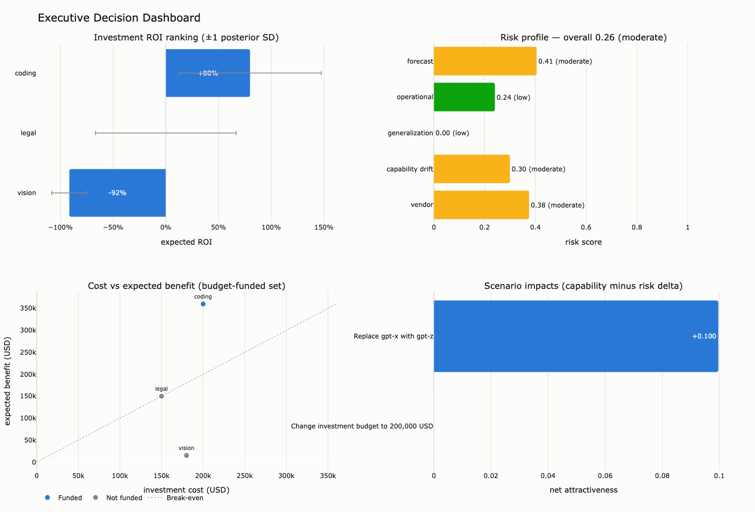
Decision Intelligence
From measurement to a funded, risk-adjusted recommendation
STAGE 6
— Ranks investment candidates by expected ROI with uncertainty bands — never a single-point estimate leadership can't sanity-check.
— Multi-criteria risk scoring (forecast, drift, vendor, generalization, operational) rolls up to one overall risk rating per candidate.
— Budget-constrained knapsack allocation funds the best portfolio under a real dollar cap, with instant what-if scenarios ("what if the budget were $200K instead?").
Live output — the executive decision dashboard
AI Capability Observatory — Confidential
12

Slide 13
Governance & Trust
Every action audited, every fit reproducible, every report signed
STAGE 7
— An append-only, durable audit trail records every registration, ingestion, fit, decision, and attribution — who did what, when, with full detail.
— Every published fit seals a reproducibility manifest — git commit, package versions, sampler seed, environment — hash-reverified on every read, so tampering is visible, not silent.
— Deny-by-default RBAC/ABAC access control, HMAC-signed executive reports, and a generated CycloneDX SBOM for supply-chain review.
— This is the difference between "a dashboard said so" and "here is the exact data, model, and person behind this number."
AI Capability Observatory — Confidential
13

Slide 14
The Web Application
Every analytical surface, one same-origin proxy, one Zod-validated contract
Leaderboard
Gap
Uncertainty
Trends
Ranked models, interval bars, CSV export
Public vs internal generalization gap
Value- and rank-HDI widths at any layer
Domain trajectories, small multiples
Forecasts
Stability
Attribution
Fits
History + forecast bands, threshold odds
Drift status, worst movers, tolerance bands
Shapley waterfall, driver table
Immutable fit history, convergence, pagination
Decisions
Portfolio
Catalog
Jobs
Procurement cards, risk bars, budget what-ifs
Frontier chart, retirement candidates
Domains, benchmarks, CSV ingestion
Background recomputes, live SSE progress
Governance
Settings
Audit trail, manifests, signature checker
API connection, session, disconnect
Next.js + TypeScript (strict) + Tailwind, dark mode, keyboard navigation, WCAG A/AA accessibility.
AI Capability Observatory — Confidential
14

Slide 15
Engineering Rigor — By the Numbers
The quality bar every change is held to before it ships
1,300+
99.8%
99.0%
100%
automated tests
line coverage
branch coverage
type-checked (mypy --strict)
24
16
0
8
REST API endpoints
web app pages, WCAG A/AA
known security findings (bandit + pip-audit)
maturity stages, each fully tested
Every change clears the same gate:
— ruff (lint) + mypy --strict (no untyped code) + bandit + pip-audit (dependency vulnerabilities), run on every commit.
— A coverage gate blocks merge below 95% line / 90% branch — the platform runs at 99.8% / 99.0%.
— A wheel build and the full test suite must pass before any release is considered shippable.
AI Capability Observatory — Confidential
15

Slide 16
Security & Deployment
Production-grade from day one, not bolted on later
Security
Deployment
— Deny-by-default RBAC/ABAC — every access decision is explainable and auditable.
— API-key authentication at the edge; rate limiting per credential.
— Secrets never in code or images — environment variables / AWS Secrets Manager only.
— HMAC-signed executive reports; CycloneDX SBOM generated per release.
— Structured request-ID logging; OpenTelemetry traces; Prometheus + Grafana dashboards.
— AWS: ALB → ECS Fargate (API, autoscaling) → RDS PostgreSQL 16 → S3 artifacts, via Terraform.
— Docker Compose for local production-like stacks; a hardened Kubernetes manifest ships too.
— CI quality gate: ruff, mypy --strict, bandit, pip-audit, full test suite + coverage gate, wheel build.
— Storage is a swappable protocol — memory, SQLite, or PostgreSQL — no application code changes.
AI Capability Observatory — Confidential
16

Slide 17
Roadmap
Shipped this program, and what's next
SHIPPED
✓ Capability measurement, stability, forecasting, attribution — the full analytical core
✓ Portfolio optimization — the smallest benchmark suite, live this release
✓ Decision intelligence — procurement, ROI, risk, budget what-ifs
✓ Governance — durable audit trail, sealed reproducibility manifests, signed reports
✓ Production deployment path — Docker, Kubernetes, Terraform/AWS, CI quality gate
NEXT
Phase | What | Size
Graph Explorer | Interactive capability dependency graph — up next | Medium
Simulation Lab | Synthetic recovery/calibration studies, live progress | Medium–Large
Auth v2 + Polish | Role-scoped API keys, role-aware UI, i18n extraction | Medium
AI Capability Observatory — Confidential
17

Slide 18
Closing
What we're asking leadership for
AICO is production-ready today: measurement through governance, live API, live web app.
— Confirm which business units pilot first — procurement/vendor selection is the fastest path to a visible ROI story.
— Approve production cloud budget (AWS ECS/RDS/S3) to move from local/dev to a hosted deployment.
— Prioritize the roadmap: Graph Explorer, Simulation Lab, or Auth v2 — see backup for the trade-offs.
— Identify the benchmarks and models leadership most wants measured first, so onboarding starts with what matters most to this quarter's decisions.
Appendix follows: detailed answers to the questions this room is most likely to ask next.
AI Capability Observatory — Confidential
18

Slide 19
APPENDIX
Backup Slides
Detailed answers to the questions this room is most likely to ask —
ROI framing, build-vs-buy, methodology, security detail, scalability,
extensibility, risks, phase history, data sources, and a glossary.
AI Capability Observatory — Confidential
19

Slide 20
Backup: What's the ROI Case?
“Why should we fund this over just reading benchmark leaderboards?”
AICO is decision support — its ROI shows up in the decisions it improves, not in a license fee avoided.
Cost driver today (without AICO) | How AICO changes it
Procurement picks a model on a public leaderboard number | Picks on a posterior score with uncertainty, adjusted for your own internal benchmarks
A ranking flip after a benchmark update triggers a re-litigation | Drift and saturation are flagged before they silently invalidate a comparison
Evaluation budget is spent re-running every benchmark, every cycle | Portfolio optimization identifies which benchmarks are redundant or low-information
A contested model choice has no paper trail | Every score, decision, and access is in an immutable, queryable audit trail
The honest framing for leadership: this is a risk-reduction and evaluation-efficiency investment,
not a revenue line. The clearest, fastest-to-quantify win is the portfolio optimization engine —
it directly reduces the number of benchmark runs per cycle, which is a real, measurable line item.
Model-selection ROI (avoiding an over- or under-priced vendor contract) is larger in principle but
harder to attribute cleanly; recommend tracking it via a pilot on one upcoming procurement decision.
AI Capability Observatory — Confidential
20

Slide 21
Backup: Why Build Instead of Buy?
“Couldn't we just use a vendor leaderboard or a spreadsheet?”
Approach | Uncertainty? | Your own benchmarks? | Audit trail? | Decision support?
Public leaderboard | No | No | No | No
Internal spreadsheet | No | Yes | No | Manual
Vendor eval platform | Varies | Limited / paid tiers | Varies | Basic
AICO | Yes — full posteriors | Yes — first-class | Yes — durable, signed | Yes — ROI/risk/budget
— Public leaderboards measure public benchmarks only — they cannot see your internal, proprietary evaluation suites at all.
— A vendor platform means your evaluation methodology, and your model comparisons, live in someone else's system of record — with a recurring license cost either way.
— The platform is one Python distribution with a documented plugin system, so bringing in a vendor's specific benchmark or storage backend later is an integration, not a rebuild.
AI Capability Observatory — Confidential
21

Slide 22
Backup: How Do We Know the Numbers Are Trustworthy?
“What stops this from just being another confident-sounding dashboard?”
— Hierarchical Bayesian estimation, not point statistics — every score is a posterior distribution sampled with NUTS (or approximated with Variational Inference), with convergence diagnostics (R-hat, effective sample size, divergences) checked on every fit.
— Item Response Theory separates benchmark difficulty from model ability — a hard benchmark and an easy one are never compared on the same raw scale.
— A dedicated validation package runs parameter-recovery studies, forecast calibration checks, coverage-probability tests, and posterior-predictive checks — inside the same automated test gate as every other engine, not a one-off notebook.
— A fit that fails its convergence checks is marked as such in the API response — the platform surfaces its own uncertainty about its uncertainty rather than hiding a bad fit.
The credible interval is the point: two models 0.1 apart on the scale with overlapping 95%
intervals are reported as statistically indistinguishable — not silently ranked 1st and 2nd.
AI Capability Observatory — Confidential
22

Slide 23
Backup: Security & Compliance Detail
“What are the actual guarantees, not just the marketing language?”
Control | Mechanism | Where
Authentication | API-key bearer tokens, checked on every request | server/auth.py
Authorization | Deny-by-default RBAC + ABAC; every decision has a human-readable reason | observatory/security.py
Audit | Append-only, durable trail of every registration, ingestion, fit, decision, access | governance/, observatory/audit.py
Secrets | Never in code or images; env vars locally, AWS Secrets Manager in production | deployment/terraform/
Report integrity | HMAC-SHA256 signed executive reports; detached signature verification | observatory/security.py
Provenance | Every fit sealed under a SHA-256 content hash; re-verified on every read | observatory/manifest.py
Supply chain | CycloneDX SBOM generated per release; pip-audit + bandit in the CI gate | CI quality gate
Rate limiting | Per-credential request limits with Retry-After on 429 | server/rate_limit.py
AI Capability Observatory — Confidential
23

Slide 24
Backup: Cloud Architecture & Scalability
“How does this scale, and what does it cost to run?”
Users
ALB
ECS Fargate
RDS PostgreSQL
S3
Web app
(browser)
Application
Load Balancer
API service
(CPU autoscaled)
Versioned
storage
Artifacts &
reports
Provisioned entirely by Terraform (deployment/terraform/) — ECR, Secrets Manager, and CloudWatch complete the stack.
— The API scales horizontally behind the load balancer — CPU-based autoscaling on ECS Fargate; a Kubernetes manifest with the same shape ships for teams standardized on k8s.
— The heaviest cost driver is the Bayesian fit itself (NUTS sampling), not request serving — it runs as a background job with live progress, so API latency stays flat regardless of fit duration.
— Storage is a swappable protocol, not a hard dependency: start on SQLite for a pilot, move to the same RDS PostgreSQL instance as everything else once volume justifies it — no application code changes.
— DuckDB, S3, Azure Blob, and GCS all attach through the same storage-plugin interface if a different cloud or a data-lake pattern is preferred later.
AI Capability Observatory — Confidential
24

Slide 25
Backup: Extensibility & Maintenance Burden
“What does it take to keep this running and to extend it?”
— One Python distribution, one version, one CI gate — not sixteen separately-released packages to coordinate. Bounded contexts are enforced by import discipline and per-package tests, not repo splits.
— Eleven plugin kinds (benchmark, metric, normalizer, likelihood model, IRT model, forecast model, visualization, report, authentication, storage, notification) let a team add a new benchmark type, storage backend, or forecast model without touching platform code — declared via a versioned manifest and discovered automatically.
— The workflow engine (retries, backoff, abort-vs-skip recovery) is domain logic today, in-process — the same step and retry definitions host on Temporal or Prefect unchanged if the team later needs a distributed job scheduler.
— The frontend is a genuinely separate project (its own toolchain, its own gate) so frontend and platform engineers can each own their half without stepping on each other's release cadence.
Practical read: one engineering owner can maintain the platform day-to-day; extending it with a
new benchmark type or storage backend is a plugin, not a fork.
AI Capability Observatory — Confidential
25

Slide 26
Backup: Risks & Mitigations
“What could go wrong, and what's already in place for it?”
Risk | Mitigation | Residual
Benchmark leakage / saturation goes unnoticed | Automated saturation & leakage-risk scoring flag it before it silently invalidates scores | Watch
A bad fit is trusted as if it converged | Convergence diagnostics (R-hat, ESS, divergences) gate every fit; failures are surfaced, not hidden | Watch
Over-reliance on automation for high-stakes calls | Every number ships with uncertainty and a narrative explanation — designed for human judgment, not to replace it | Managed
Provenance data is tampered with after the fact | Manifests are hash-sealed and re-verified on every read; tampering shows up as a visible flag | Low
A single point of failure in storage | Storage is a swappable protocol on managed RDS PostgreSQL with automated backups — not a bespoke datastore | Low
Unauthorized access to sensitive capability data | Deny-by-default RBAC/ABAC plus a full audit trail of every access decision | Low
AI Capability Observatory — Confidential
26

Slide 27
Backup: Delivery History
What shipped, phase by phase, this program
Phase | Delivered
Core | Hierarchical Bayesian capability estimation, IRT, scoring, benchmark catalog
Core | Scale stability, drift detection, equating
Core | Forecasting engine — state-space, BSTS, GP, saturation
Core | Attribution engine — Shapley decomposition, causal graphs
Core | Governance, security, observability, plugin architecture, SDK
Frontend 0–1 | Web app foundations; every existing endpoint exposed as a page
Frontend 2.1–3 | Forecasts, decisions, stability pages; Vitest/Playwright/axe; Docker/Terraform/CI
Frontend 2b | Attribution — Shapley waterfall page + backend endpoint
Frontend 2e | Governance — durable audit trail, sealed manifests, signature checker
Frontend 2c | Portfolio optimization — scorecard, frontier, retirement candidates (this release)
AI Capability Observatory — Confidential
27

Slide 28
Backup: Data Sources & Ingestion
“What data does this actually run on, and who controls it?”
— Three typed objects define every input: a Benchmark (what's being measured, which domain, public or internal), a Metric (the likelihood family — accuracy, pass-rate, ordinal rubric score, and more), and an Observation (one model's value on one metric).
— Benchmarks are explicitly tagged public or internal — public leaderboard benchmarks and your own proprietary evaluation suites are first-class citizens on the same scale, never conflated.
— Observations are appended, never mutated in place — the full history of what was measured, and when, is preserved for every fit that was ever published.
— Onboarding a new benchmark runs through a calibration pipeline with pass / needs-review / reject recommendations — a new evaluation suite doesn't silently degrade the shared scale.
Nothing about the platform requires your data to leave your infrastructure: bring your own
PostgreSQL, your own S3 bucket, your own network boundary — the storage layer is a protocol.
AI Capability Observatory — Confidential
28

Slide 29
Backup: Glossary
Plain-language definitions for terms used in this deck
ICI
Shapley value
Internal Capability Index — the platform's composite Bayesian capability score.
A game-theoretic way to split credit for an outcome fairly among its contributing factors.
Posterior / credible interval
Drift / saturation
The Bayesian result: a range of plausible values with a probability attached, not one number.
Drift: the measurement scale shifting under you. Saturation: a benchmark's scores clustering at the ceiling, so it stops discriminating between models.
HDI
RBAC / ABAC
Highest Density Interval — the narrowest range containing a given probability mass (e.g. 95%).
Role-Based / Attribute-Based Access Control — who is allowed to do what, and under what conditions.
IRT
SBOM
Item Response Theory — separates "how hard is the test" from "how able is the model".
Software Bill of Materials — an inventory of every software component in a release, for supply-chain review.
NUTS / VI
Reproducibility manifest
No-U-Turn Sampler (full Bayesian, slower, exact) and Variational Inference (fast, approximate) — the platform's two fitting methods.
A sealed record of exactly what produced a result — code version, data, configuration, environment — so it can be checked or rerun later.
AI Capability Observatory — Confidential
29

