Slide 1
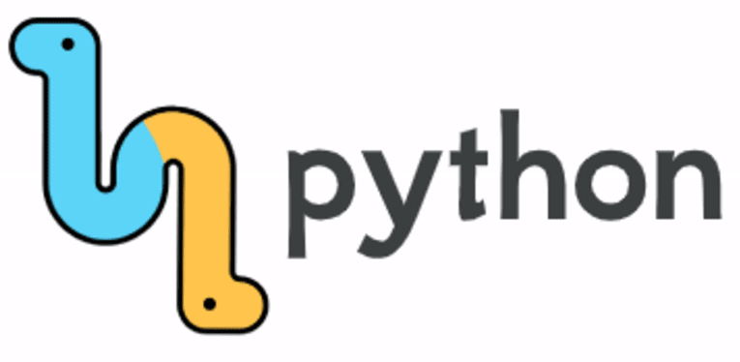
Introduction to programming using Python

Slide 2
History of Python
Python laid its foundation in the late 1980s.
The implementation of Python was started in December 1989 by Guido Van Rossum at CWI in Netherland.
In February 1991, Guido Van Rossum published the code (labeled version 0.9.0) to alt.sources.
In 1994, Python 1.0 was released with new features like lambda, map, filter, and reduce.
Python 2.0 added new features such as list comprehensions, garbage collection systems.
On December 3, 2008, Python 3.0 (also called "Py3K") was released. It was designed to rectify the fundamental flaw of the language.
ABC programming language is said to be the predecessor of Python language, which was capable of Exception Handling and interfacing with the Amoeba Operating System.
The following programming languages influence Python:
ABC language.
Modula-3
Fact: Python is named after the comedy television show Monty Python's Flying Circus.

Slide 3
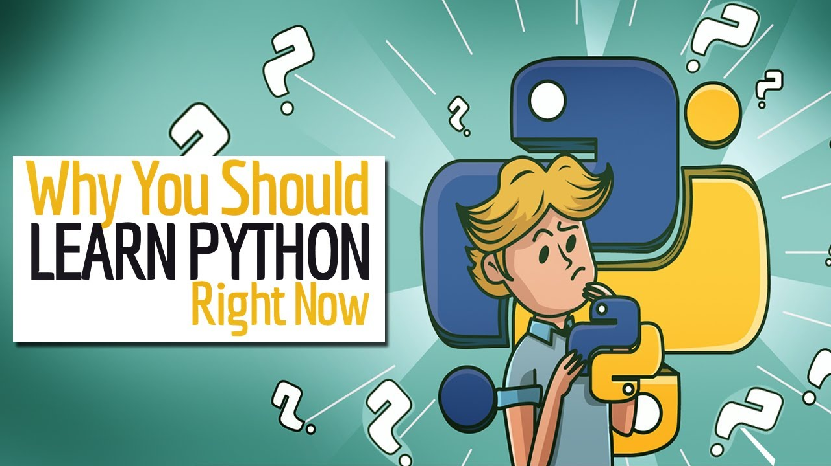

Slide 4
Python provides lots of features
Easy to Learn and Use
Python is easy to learn and use compared with other programming languages. It is developer-friendly and high level programming language.
Interpreted Language
Python is an interpreted language because no need of compilation. This makes debugging easy and thus suitable for beginners.
Cross-platform Language
Python can run equally on different platforms such as Windows, Linux, Unix and Macintosh etc. So, we can say that Python is a portable language.
Free and Open Source
The Python interpreter is developed under an open-source license, making it free to install, use, and distribute.
Object-Oriented Language
Python supports object oriented language and concepts of classes and objects come into existence.
GUI Programming Support
Graphical user interfaces can be developed using Python.
Integrated
It can be easily integrated with languages like C, C++, and JAVA etc.

Slide 5
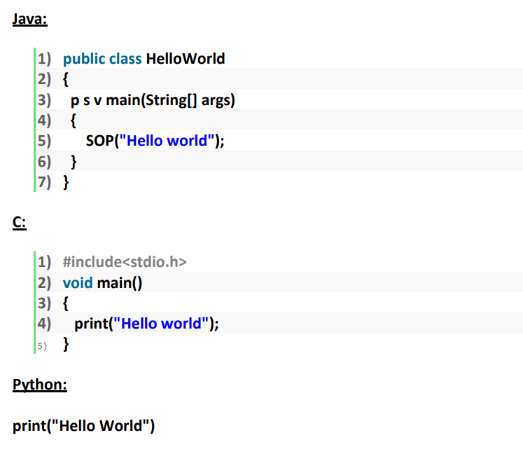
Example: To print “Hello World”

Slide 6
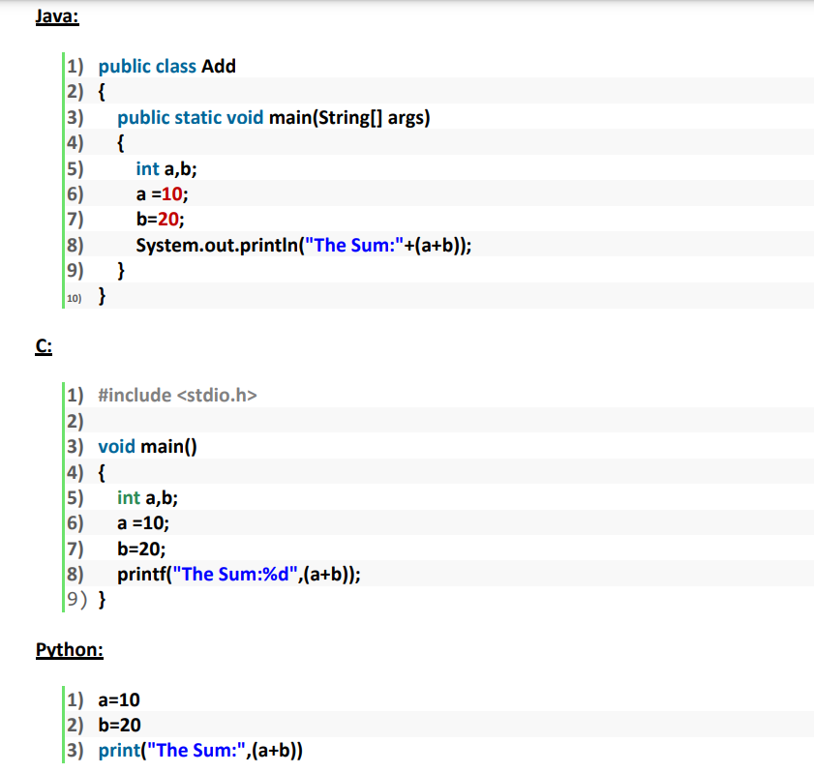
Example: To print the sum of 2 numbers

Slide 7
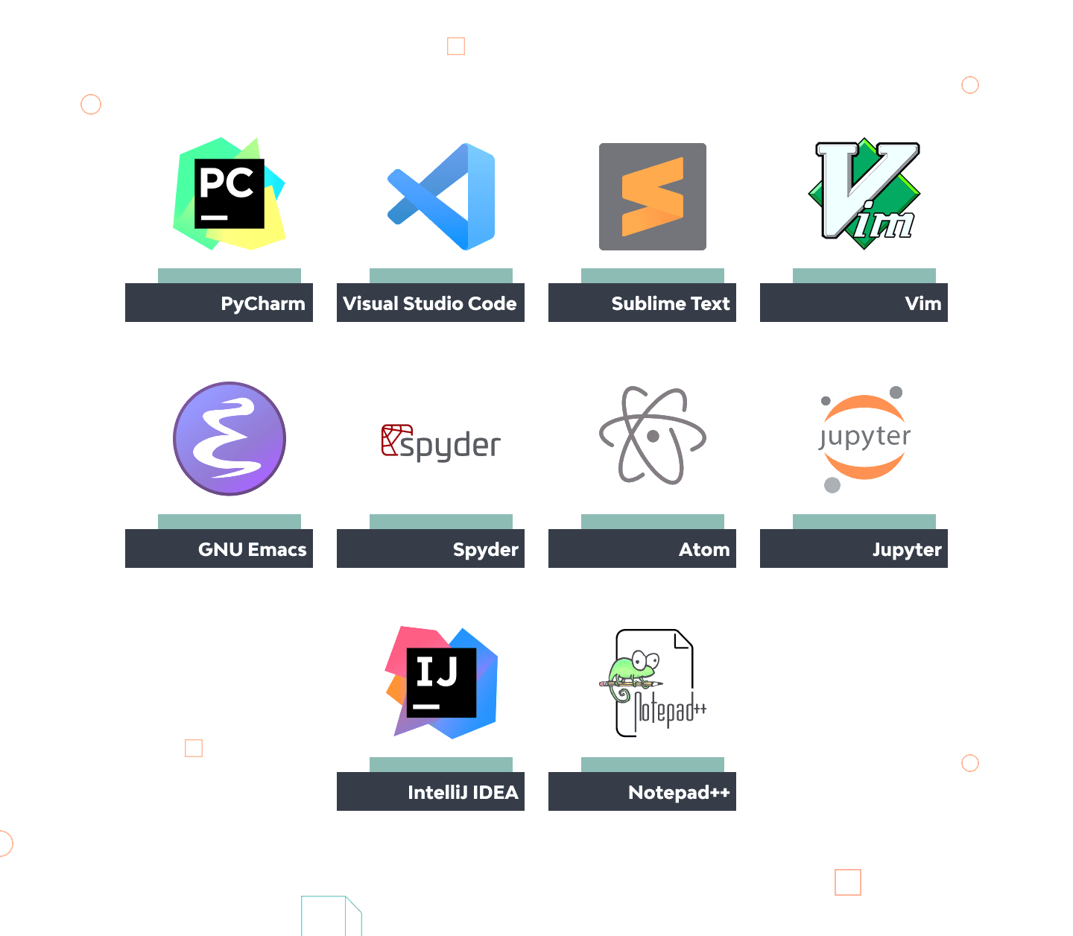

Slide 8
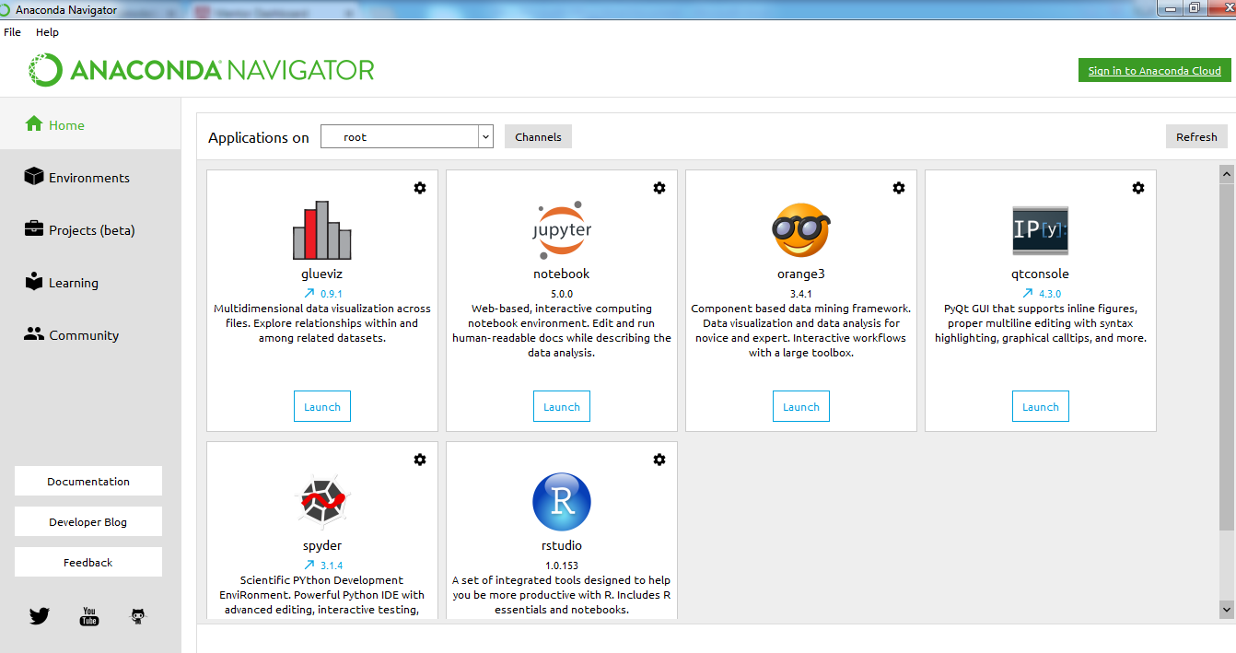
Anaconda Navigator

Slide 9
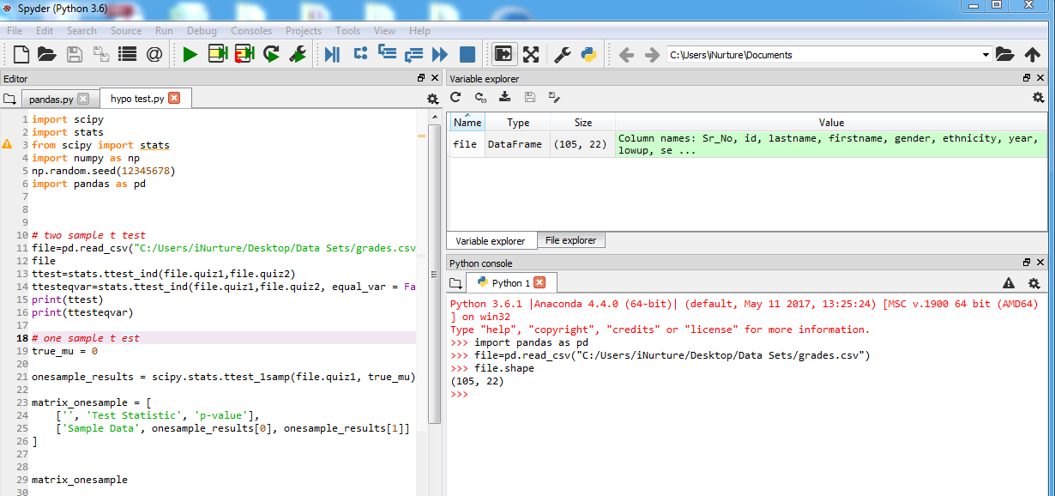
Spyder

Slide 10
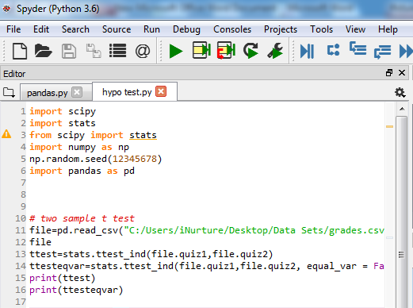
Script

Slide 11
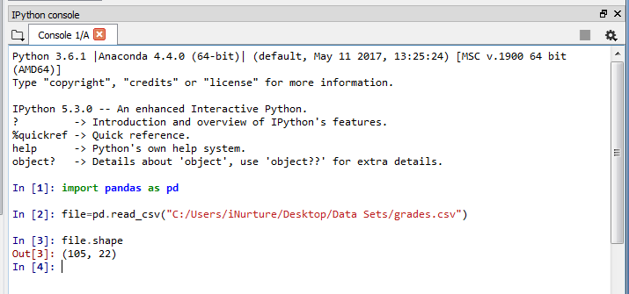
IPython console

Slide 12
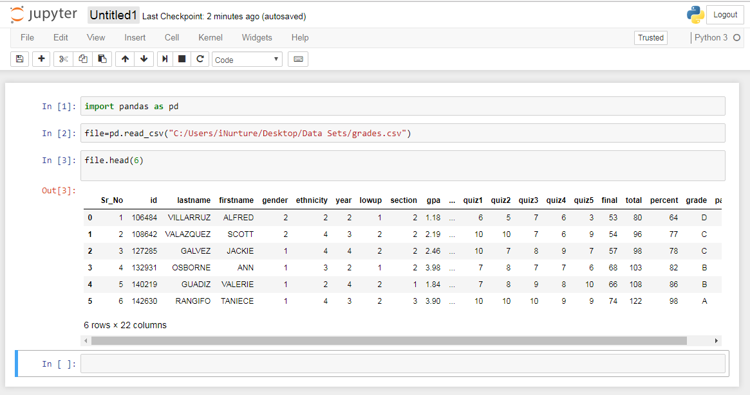
Jupyter

Slide 13
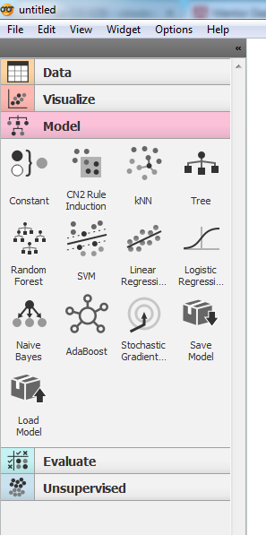
Orange: Data Mining Tool

Slide 14
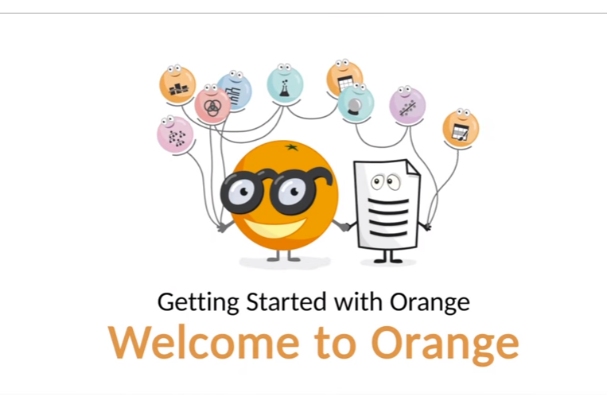
Go to help → Example

Slide 15
Identifiers or Variables
A name in a Python program is called an identifier.
It can be a class name or function name or module name or variable name.
a = 10
Rules to define identifiers in Python:
1. The only allowed characters in Python are
alphabet symbols(either lower case or upper case)
digits(0 to 9)
underscore symbol(_)
By mistake, if we are using any other symbol like $ then we will get a syntax error.
cash = 10 √
Ca$h =20 X

Slide 16
Identifiers
2. Identifier should not start with a digit
123total X
Total123 √
3. Identifiers are case-sensitive. Of course, Python language is a case-sensitive language.
total=10
TOTAL=999
print(total) #10
print(TOTAL) #999

Slide 17
Keywords
Python also has some reserved words. These words hold some special meaning. Sometimes it may be a command, or a parameter etc. We cannot use keywords as variable names.
The Python Keywords are
True | False | class | def | return
if | elif | else | try | except
raise | finally | for | in | is
not | from | import | global | lambda
nonlocal | pass | while | break | continue
and | with | as | yield | del

Slide 18
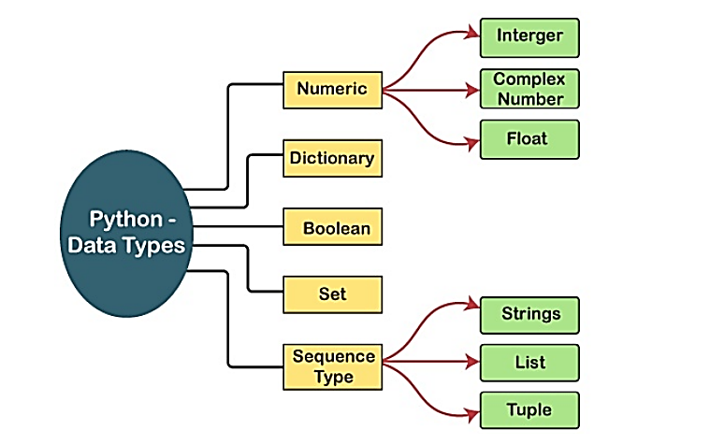
Data Types

Slide 19
Data Types
There are eight kinds of types supported by Python:
bool: Boolean (true/false) types. Supported precisions: 8 (default) bits.
int: Signed integer types. Supported precisions: 8, 16, 32 (default), and 64 bits.
uint: Unsigned integer types. Supported precisions: 8, 16, 32 (default), and 64 bits.
float: Floating point types. Supported precisions: 16, 32, 64 (default) bits and extended precision floating point.
complex: Complex number types. Supported precisions: 64 (32+32), 128 (64+64, default) bits, and extended precision complex.
string: Raw string types. Supported precisions: 8-bit positive multiples.
time: Data/time types. Supported precisions: 32 and 64 (default) bits.

Slide 20
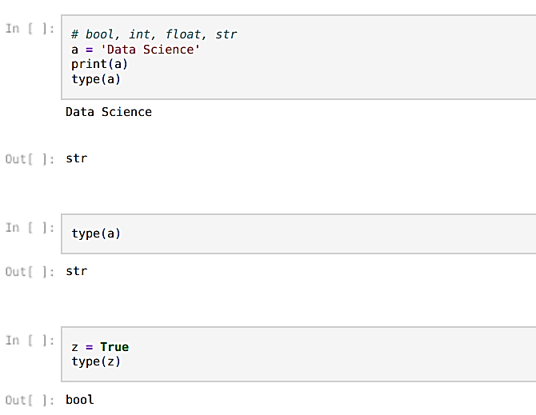
Codes Snippet
bool -> True, False / 1,0
int -> 3,5,-1,-9
float -> 3.45
str -> 'data scientist'

Slide 21
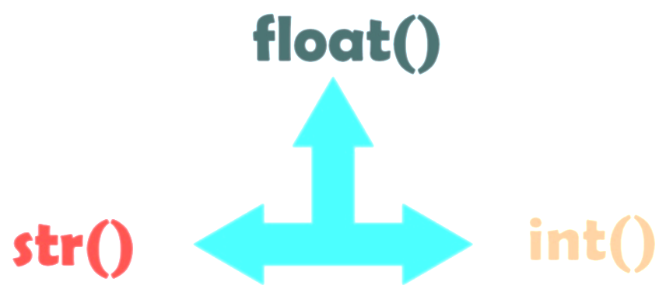
Type Casting
The conversion of one data type into the other data type is known as type casting in Python or type conversion in Python.

Slide 22
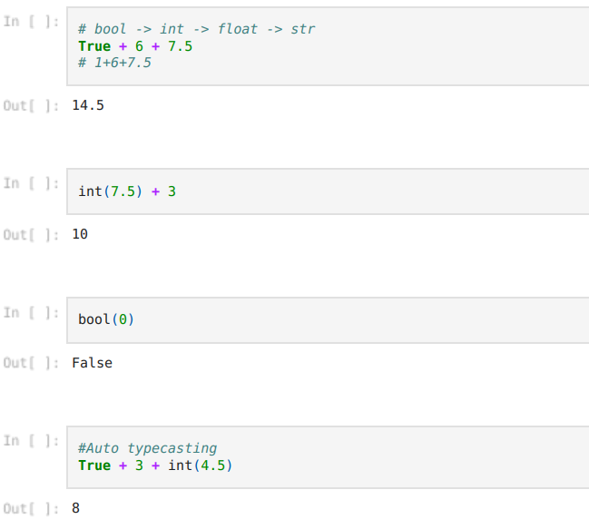
Codes Snippet

Slide 23
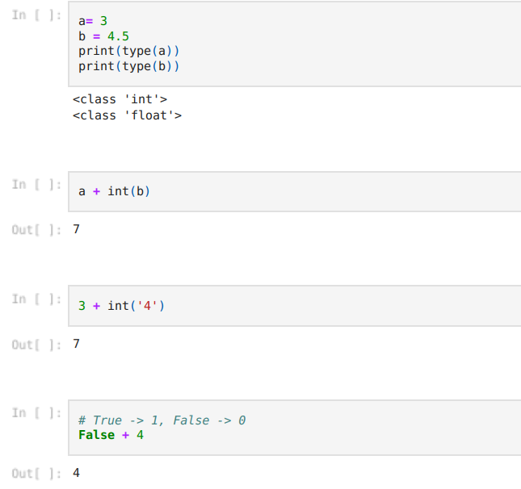
Codes Snippet

Slide 24
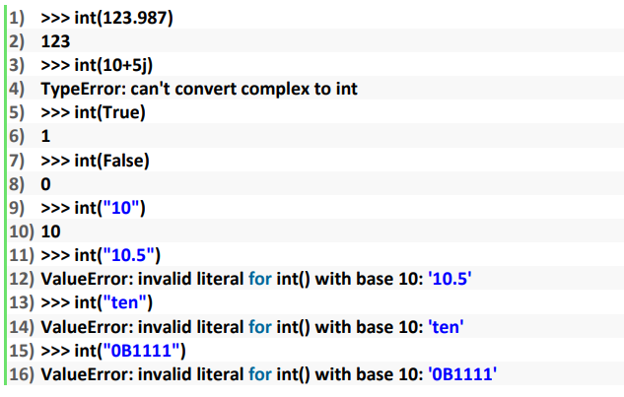
Codes Snippet: Practice
1.int():
Note:
We can convert from any type to int except complex type.
If we want to convert the str type to int type, compulsory str should contain only integral value and should be specified in base-10

Slide 25
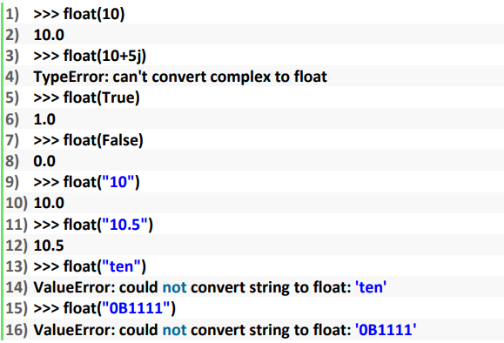
Codes Snippet: Practice
2. float():
Note:
We can convert any type value to float type except complex type.
Whenever we are trying to convert str type to float type compulsory str should be either integral or floating point literal and should be specified only in base-10.

Slide 26
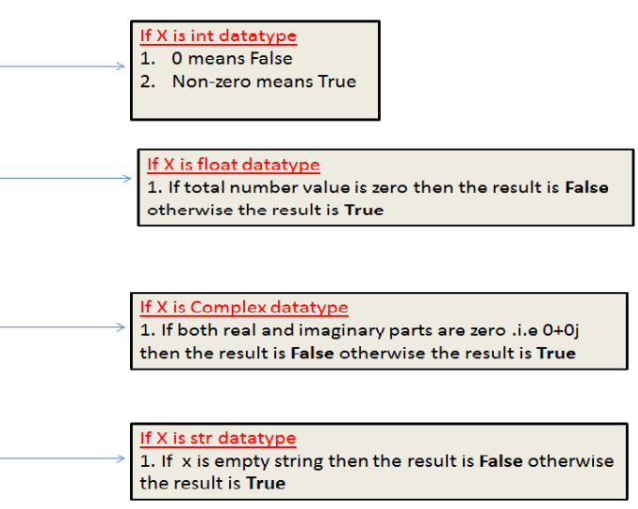
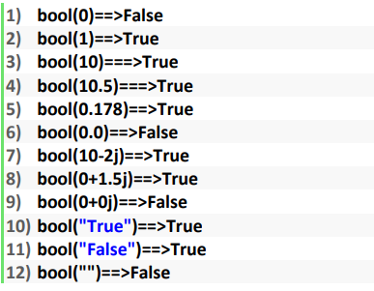
Codes Snippet: Practice
2. bool():

Slide 27
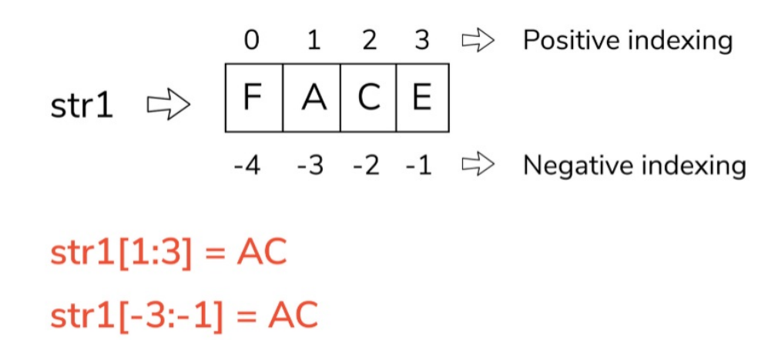
Slicing
Python slice() Function
A slice object is used to specify how to slice a sequence. You can specify where to start the slicing, and where to end. You can also specify the step, which allows you to e.g. slice only every other item.

Slide 28
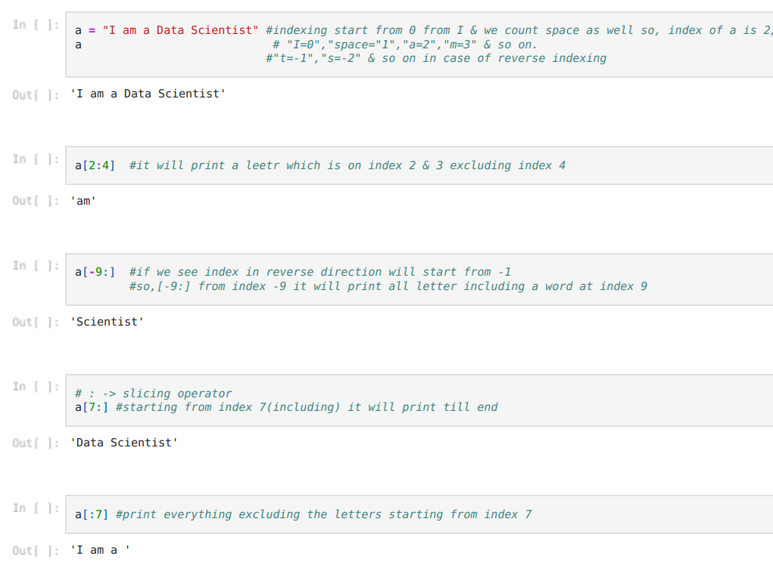
Codes Snippet

Slide 29
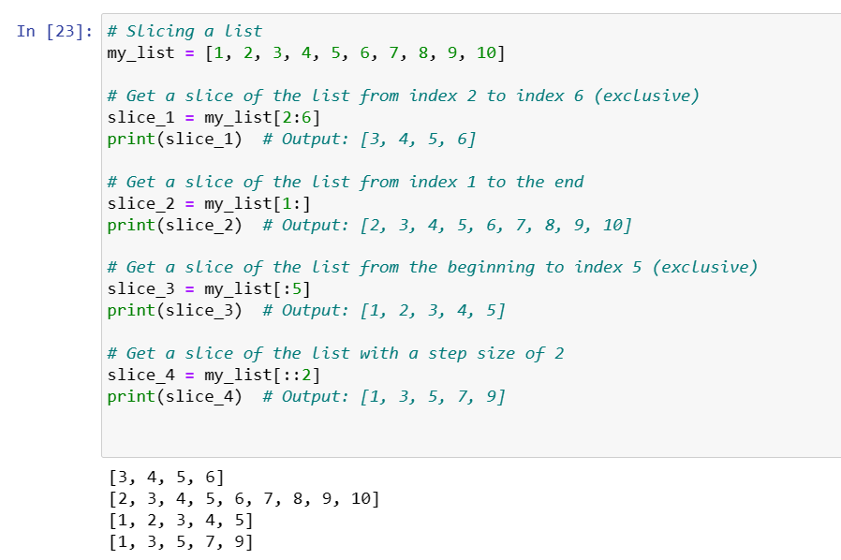
Codes Snippet: Practice
OUTPUT

Slide 30
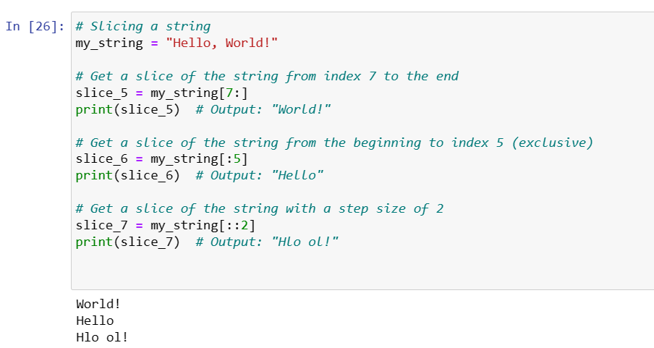
Codes Snippet: Practice
OUTPUT

Slide 31
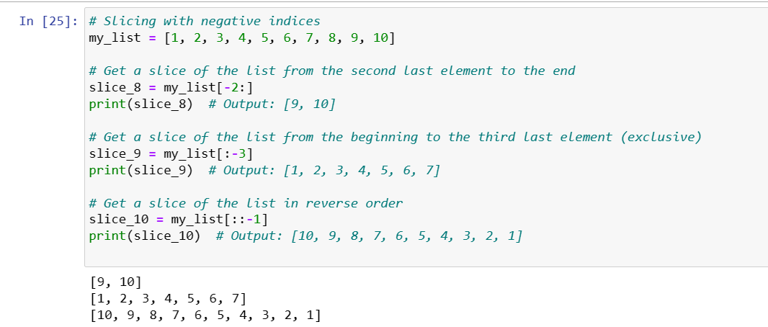
Codes Snippet: Practice
OUTPUT

Slide 32
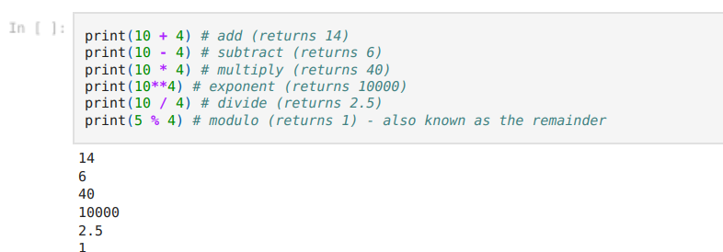
Maths Operators: Arithmetic Operators
Arithmetic operators are used with numeric values to perform common mathematical operations

Slide 33
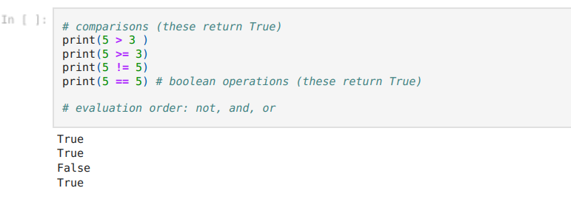
Maths Operators: Logical / Comparison
Logical operators are used to combine conditional statements while Comparison operators are used to compare two values.

Slide 34
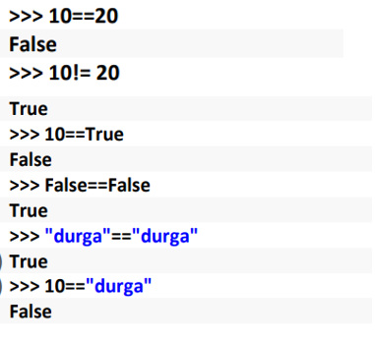
Equality Operators
== , !=
We can apply these operators for any type even for incompatible types also

Slide 35
Logical Operators
and, or , not
For boolean types behavior:
and ==>If both arguments are True then the only result is True
Or ==>If at least one argument is True then the result is True
not ==>complement
True and False ==>False
True or False ===>True
not False ==>True
For non-boolean types behavior:
0 means False
non-zero means True
empty string is always treated as a False

Slide 36
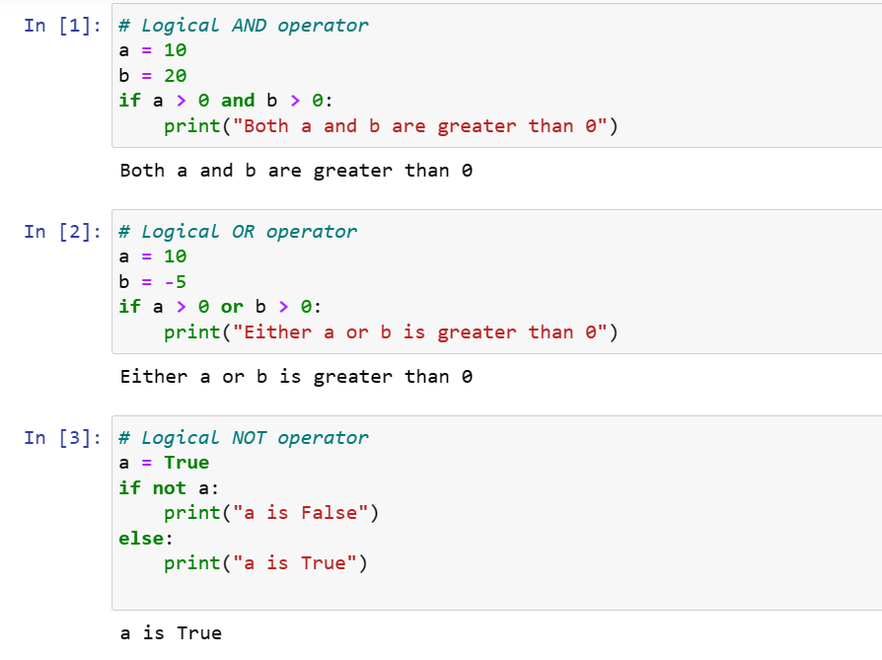
Code Snippet

Slide 37
Bitwise Operators
Bitwise AND (&):
Sets each bit to 1 if both corresponding bits are 1, otherwise sets it to 0.
Bitwise OR (|):
Sets each bit to 1 if at least one of the corresponding bits is 1, otherwise sets it to 0.
Bitwise XOR (^):
Sets each bit to 1 if only one of the corresponding bits is 1, otherwise sets it to 0.
Bitwise NOT (~):
Flips the bits, changing 1 to 0 and 0 to 1.
Left Shift (<<):
Shifts the bits of the number to the left by the specified number of positions.
The leftmost bits are filled with zeros.
Right Shift (>>):
Shifts the bits of the number to the right by the specified number of positions.
The rightmost bits are filled with zeros for non-negative numbers and with ones for negative numbers (arithmetic right shift).

Slide 38
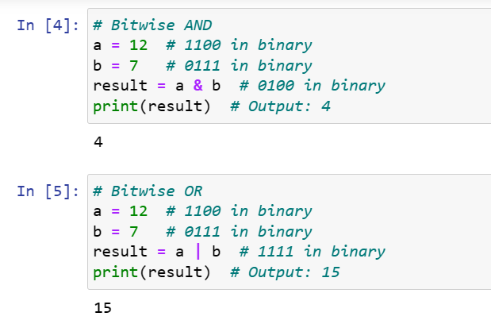
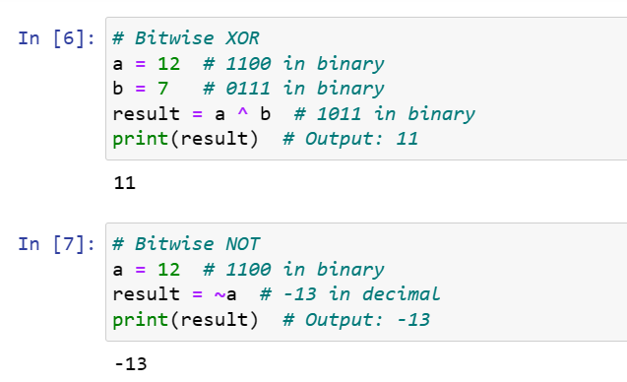
Code Snippets

Slide 39
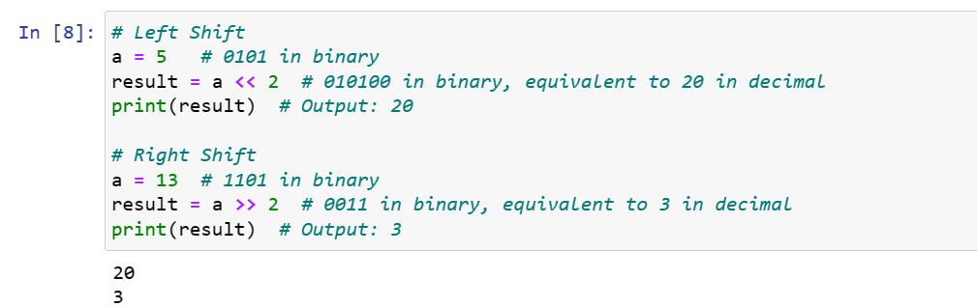
Code Snippets

Slide 40
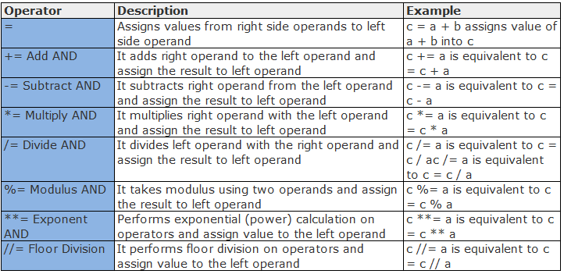
Assignment Operators

Slide 41
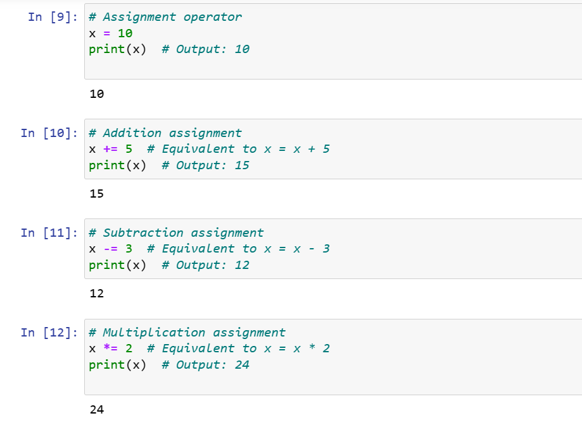
Code Snippets

Slide 42
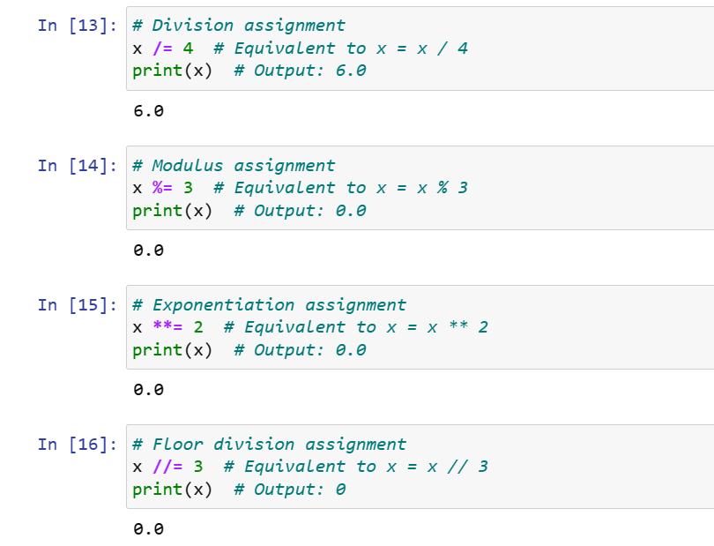
Code Snippets

Slide 43
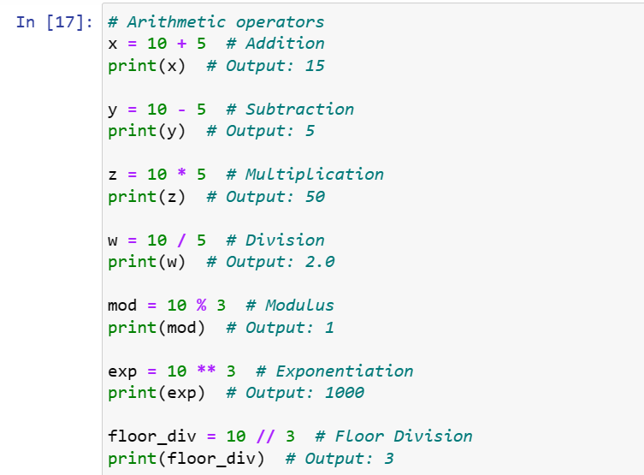
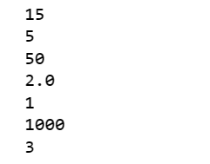
Codes Snippet: Practice
OUTPUT

Slide 44
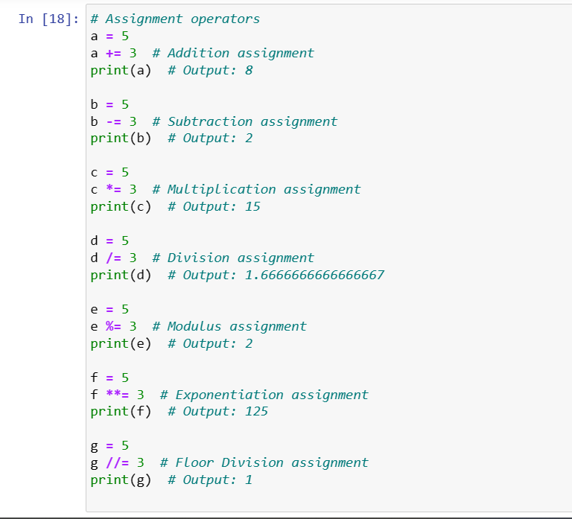
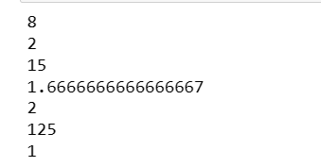
Codes Snippet: Practice
OUTPUT

Slide 45
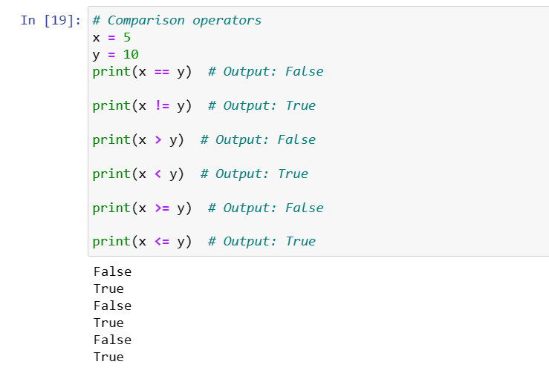
Codes Snippet: Practice
OUTPUT

Slide 46
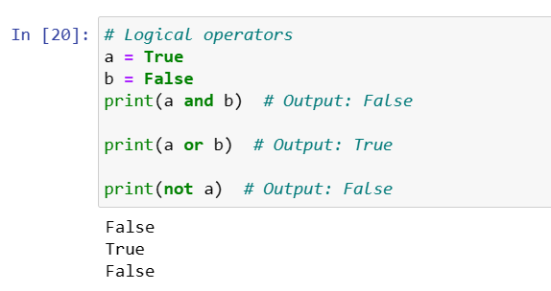
Codes Snippet: Practice
OUTPUT

Slide 47
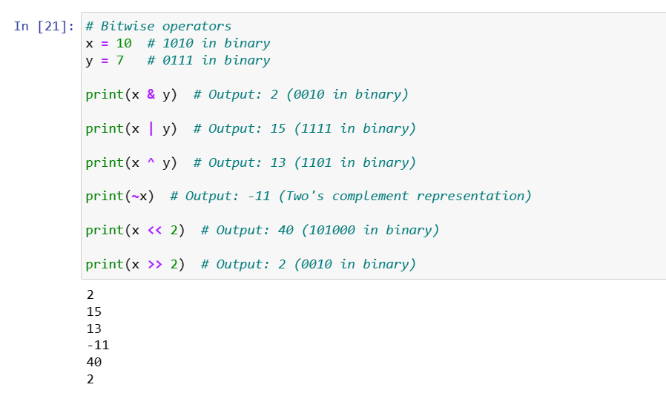
Codes Snippet: Practice
OUTPUT

Slide 48

Q & A

