Slide 1
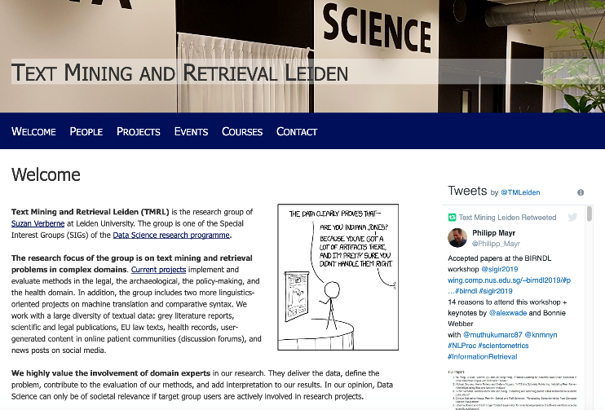
Text Mining and Retrieval Leiden
http://tmr.liacs.nl

Slide 2

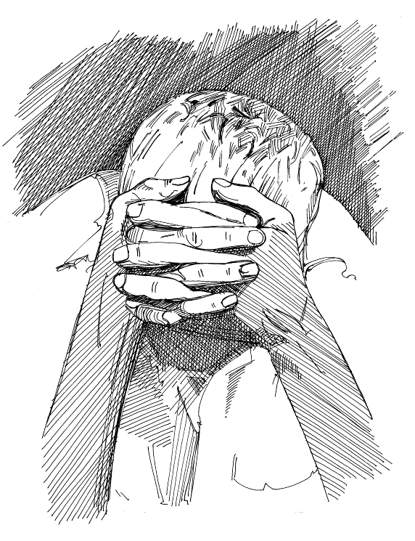
Text mining psychosocial coping on social media
“ I am feeling depressed”
“ I am hopeful about my treatment”
How can we measure psychosocial well-being on patient forums?
How can we measure coping strategies?
Supervision: Anne Dirkson

Slide 3

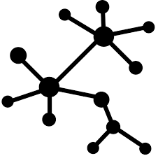


Text mining Knowledge graphs from biomedical literature
Too much literature to possibly read.
How can we compile a knowledge graph from literature to be able to compare to other data sources?
Supervision: Anne Dirkson
Room 1.26
a.r.dirkson@liacs.leidenuniv.nl

Slide 4
Text mining Metadata classification for archaeological reports
Preprocessing for Information Retrieval
To what extent can we classify excavation reports into time, subject & location? Can we extract headings and document structure from PDF?
Time | Iron age
Type | Excavation
Location | Leiden
Results? | Yes
Supervision: Alex Brandsen
a.brandsen@arch.leidenuniv.nl

Slide 5

https://www.antesgroep.nl/
Projects at Antes
Antes provides mental healthcare and addiction care for patients in the Rotterdam Area. The data science department consists of three people working to support our healthcare professionals providing the best possible treatment for our patients. Psychiatry is a very language-driven profession, so we find there is a lot of value in the clinical notes of our professionals. Possible research topics:
“Text summarisation of Electronic Health Records”
“Improvement of NLP prediction pipeline”
“finding ‘hidden’ features in clinical notes”
“Explainability of NLP models”
When to use 1) structured (tabular) data, 2) unstructured data (clinical notes), 3) combination of both in predictive modelling
Student:
Not afraid of 'messy' data
Pro-active, inquisitive, not afraid to ask questions
Works in Python
At least 50% on-site in Rotterdam. Antes' data science team will be available for support, sparring and guidance
Supervision: Suzan Verberne s.verberne@liacs.leidenuniv.nl

Slide 6
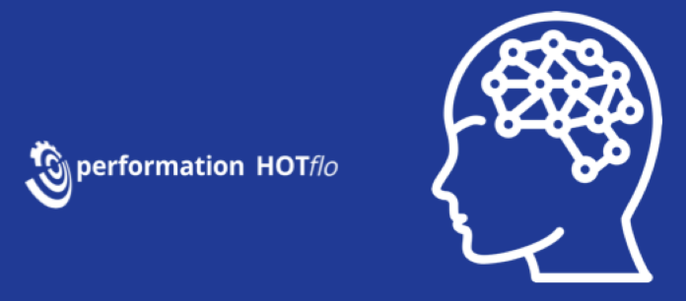
Possible research projects
Artificial Intelligence in de zorg
Development of deep learning models / neural networks on discharge letters and hospital notes for prediction hospital outcomes
Apply machine learning / deep learning models on multiple datasets on different locations without sharing the data (distibuted learning / federated learning)
Development of models voor patiënt pathways thru the hospital
Development of riskmodels on structured data for mortality, long length of stay and readmissions
Supervision: Suzan Verberne
s.verberne@liacs.leidenuniv.nl

