Slide 1
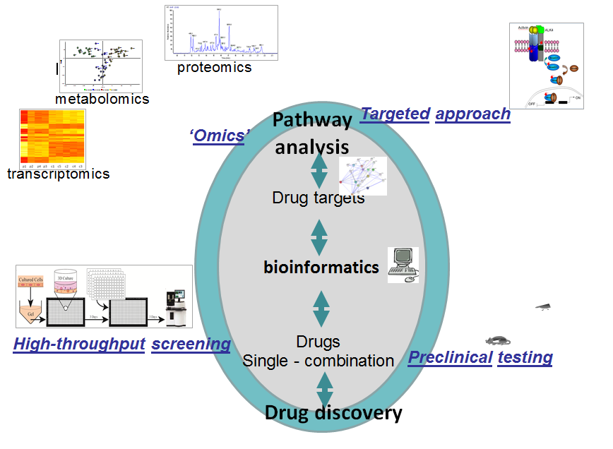
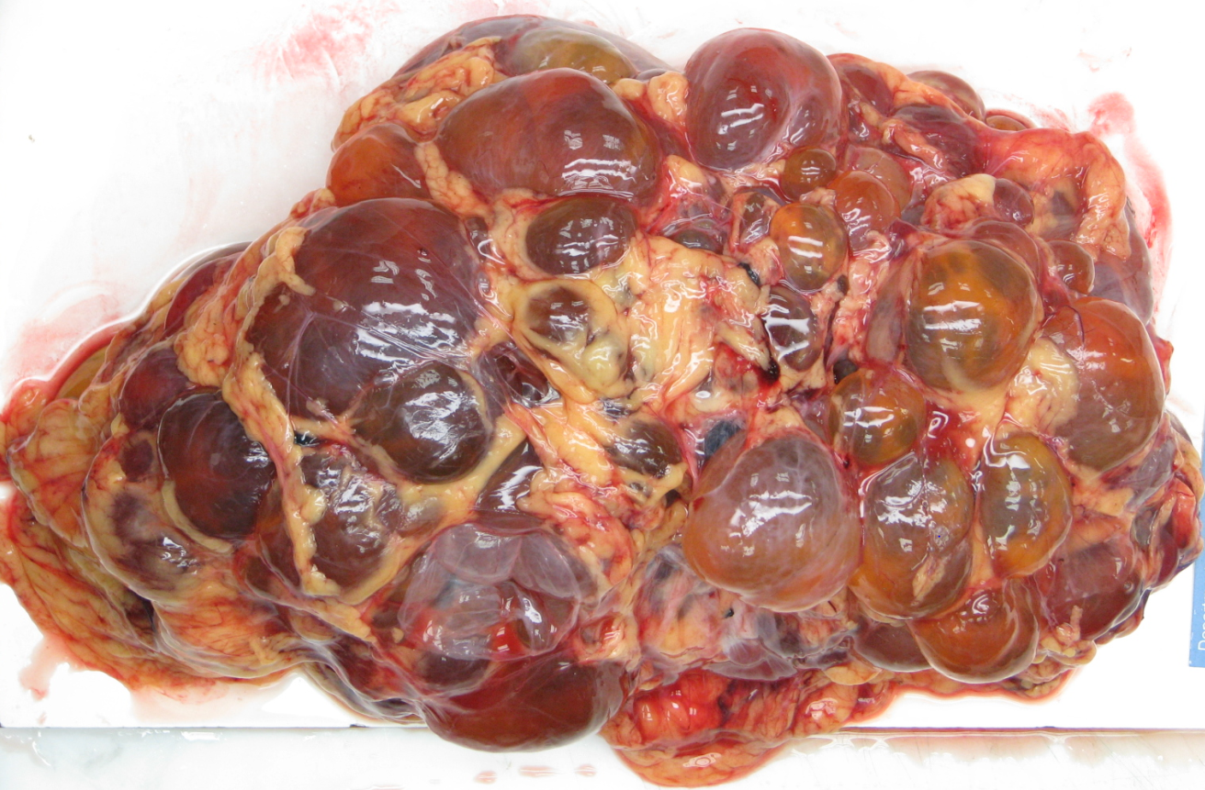
Polycystic Kidney Disease: Bioinformatics Analysis and Data Integration
Katy Wolstencroft, LIACS and Dorien J.M. Peters, LUMC
3 projects:
Identification of signalling pathways directly affected by drug treatment – single cell RNA and tissue expression
multi-omics data integration – transcriptomics, proteomics and metabolomics
Drug screening and comparative transcriptomics – human, mouse and rat
Fluid-filled cysts in kidneys
Renal failure 55-65 years
Prevalence 4:10,000

Slide 2
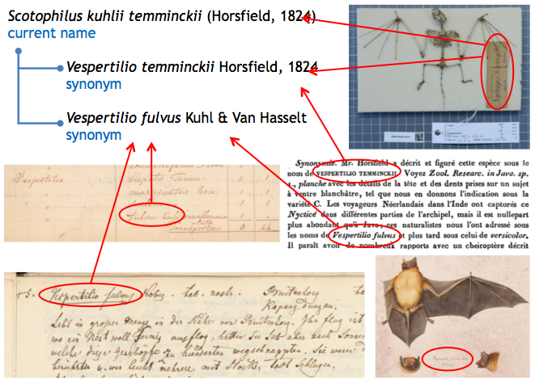
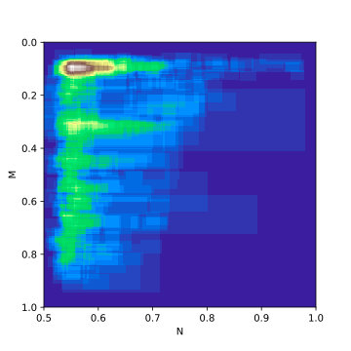
Making Sense of Historical Handwritten Documents – Katy Wolstencroft and Lise Stork
Automating the extraction and understanding of the content of historical biodiversity research
Project 1: Semantic Modelling and Linking
Can we use our semantic model to annotate transcribed collections, e.g. Smithsonian Field Book Project, in order to semantically compare and link historical archives
How does the historical data from our collection relate to present day biodiversity in the same geographical region?
Project 2: Deep Learning
Neural network model for automatic identification and extraction of species names from historical biodiversity records
Visual structural features – Underlined, capital letters etc
Position – where in the page these terms are typically found
Context - Adjacency matrices showing relationship between the positions of different words
Improving and refining the model – comparing approaches and architectures

