Slide 1

Compare different Classifiers for Human Activity Recognition and Energy Expenditure
Research/Master Thesis Project
Topic: Classify human activities and esteimate energy expenditure using multiple sensors.
Sensor data: The sensor network considered have sensors placed in different parts of the body (wrist, ankle, chest, waist). The data are already collected and pre-processed (GOTOv project from LUMC).
Scientific Challenge: Building and compare Activity Recognition and Energy Expenditure models.
Company/Organization LUMC
Student Profile CS/DS
Time frame can start immediately
Advisors Supervisor: Arno Knobbe
Everyday-supervisor: Stylianos Paraschiakos
Information: s.paraschiakos@liacs.leidenuniv.nl
Office Nr. :113 (Thursdays/Fridays)

Slide 2
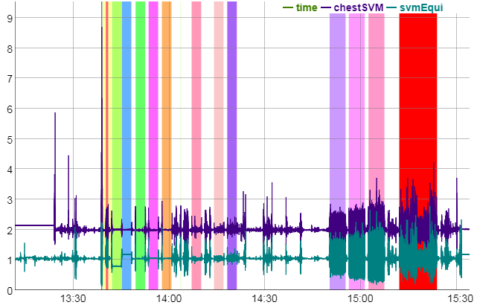


Activity analysis on GOTO activity data
Research or Master Thesis Project
Topic: Activity analysis and its relation with ageing factors
Data: 2 weeks of accelerometer data with their predicted activity
Predict activity from accelerometers (given an Activity Recognition model)
Perform post-processing to the outputs
Aggregate predictions (per day, week, etc.)
Build the above in a Dashboard as deliverable
Scientific Challenges (Research Project): Suggest activity measures (intensity, loss of weight, etc.)
Scientific Challenges (Master Thesis Project): Use a tool like the above and identify groups of people with similar activity patterns. Research on the use of clustering and sub-group discovery methods.
Company/Organization LUMC
Student Profile CS/DS/Bio-Informatics
Time frame can start immediately
Advisors Supervisor: Arno Knobbe
Everyday-supervisors: Stylianos Paraschiakos/Marian Beekman
Information: s.paraschiakos@liacs.leidenuniv.nl
Office Nr. :113 (Thursdays/Fridays)

Slide 3








Building a proxy for different devices
Research Project (3-months)
Topic: Building proxy model from one accelerometer device to another with different saturation levels, device orientation, etc.
Sensor Data: GOTOv dataset given, use of other free online activity recognition datasets
Scientific Challenges: Suggest the steps of signal transformation in order to approximate the signal of a similar device with focus on accelerometers for Activity Recognition.
Company/Organization LUMC
Student Profile CS/DS/Bio-Informatics
Time frame can start immediately
Advisors Supervisor: Arno Knobbe
Everyday-supervisor: Stylianos Paraschiakos
Information: s.paraschiakos@liacs.leidenuniv.nl
Office Nr. :113 (Thursdays/Fridays)

