Slide 1

LIACS Master/Research Projects 2019
Activity profiling to study Ageing and Longevity
Research on:
Modeling sensor data (time series) for activity recognition and
energy expenditure estimation.
Contact details:
Stylianos (Stelios) Paraschiakos – LUMC/LIACS (Arno’s group) s.paraschiakos@liacs.leidenuniv.nl, office: 113 (Thursdays/Fridays)

Slide 2
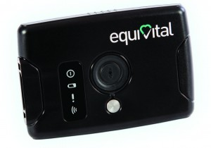
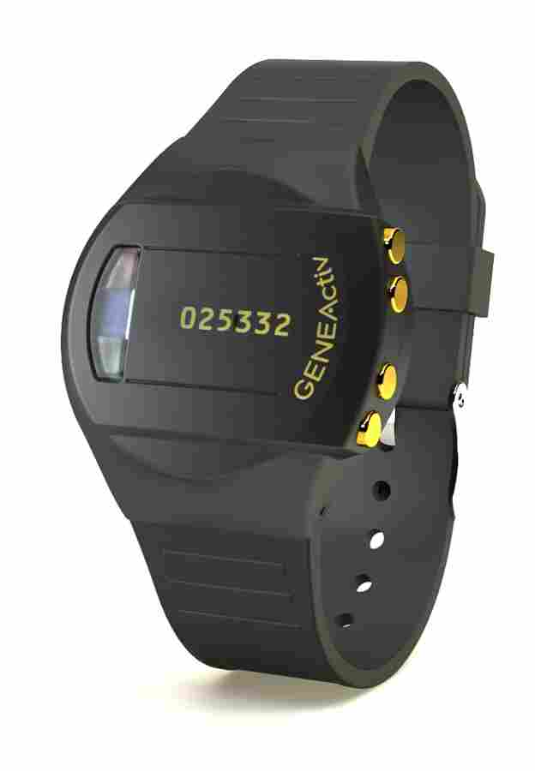

Compare different Classifiers for Human Activity Recognition and Energy Expenditure
Research/Master Thesis Project
Topic: Classify human activities and estimate energy expenditure using multiple sensors.
Sensor data: The sensor network considered have sensors placed in different parts of the body (wrist, ankle, chest, waist). The data are already collected (SwitchBox study LUMC):
135 middle-aged participants.
Accelerometers, ECG, BR, temperature
Scientific Challenge: Compare existing Activity Recognition and Energy Expenditure models. Improve models by incorporating intensity of activity using ECG and respiration data
Company/Organization LUMC
Student Profile CS/DS/Bio-informatics
Time frame can start immediately
Advisors Supervisor: Arno Knobbe
Everyday-supervisor: Stylianos Paraschiakos/E. van den Spoel (LUMC)
Information: s.paraschiakos@liacs.leidenuniv.nl
Office Nr. :113 (Thursdays/Fridays)

Slide 3
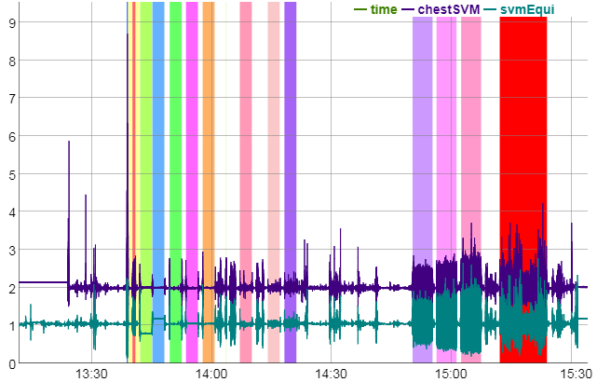


Activity analysis on GOTO activity data
Research or Master Thesis Project
Topic: Activity analysis and its relation with ageing factors
Data: 2 weeks of accelerometer data;
Predict activity from accelerometers (given an Activity Recognition model)
Perform post-processing to the outputs
Aggregate predictions (per day, week, etc.)
Build the above in a Dashboard as deliverable
Scientific Challenges (Research Project): Suggest activity measures (intensity, loss of weight, etc.)
Scientific Challenges (Master Thesis Project): Use a tool like the above and identify groups of people with similar activity patterns. Research on the use of clustering and sub-group discovery methods.
Organization LUMC
Student Profile CS/DS/Bio-Informatics
Time frame can start immediately
Advisors Supervisor: Arno Knobbe
Everyday-supervisors: Stylianos Paraschiakos/Marian Beekman
Information: s.paraschiakos@liacs.leidenuniv.nl
Office Nr. :113 (Thursdays/Fridays)

Slide 4








Building a proxy for different devices
Research Project (3-months)
Topic: Building proxy model from one accelerometer device to another with different saturation levels, device orientation, etc.
Sensor Data: GOTOv dataset given, use of other free online activity recognition datasets
Scientific Challenges: Suggest the steps of signal transformation in order to approximate the signal of a similar device with focus on accelerometers for Activity Recognition.
Organization LUMC/LIACS
Student Profile CS/DS/Bio-Informatics
Time frame can start immediately
Advisors Supervisor: Arno Knobbe
Everyday-supervisor: Stylianos Paraschiakos
Information: s.paraschiakos@liacs.leidenuniv.nl
Office Nr. :113 (Thursdays/Fridays)

Slide 5
Do you have any questions on these projects or any other research ideas based on such datasets?
Feel free to contact us in order to discuss it!

