Slide 1
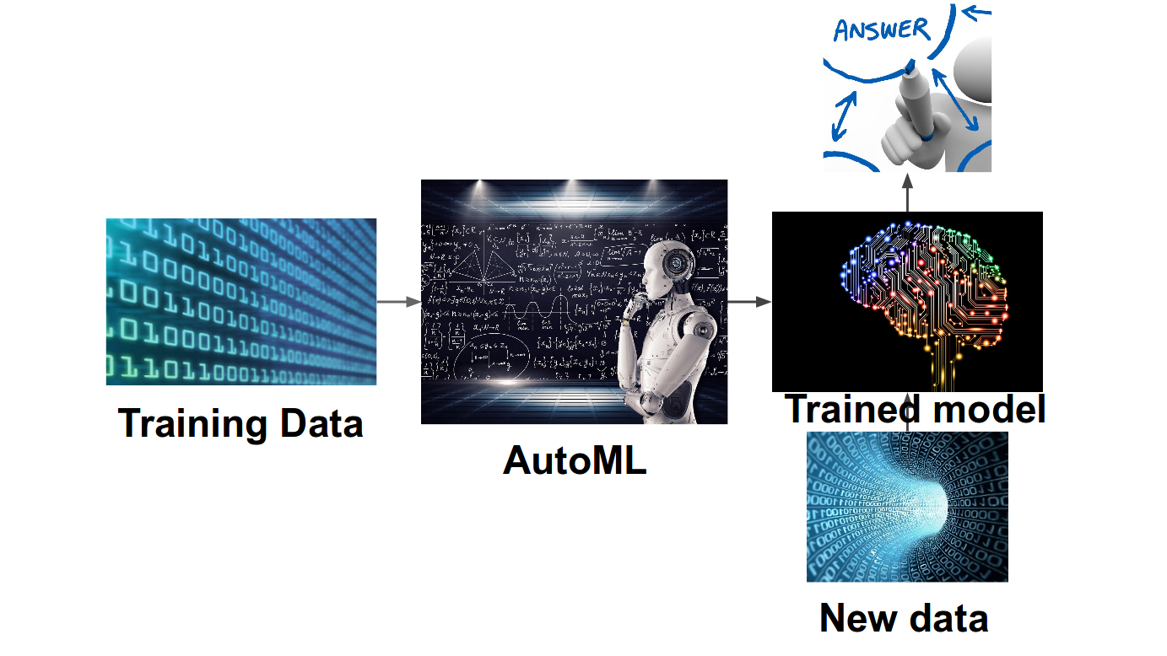
Master project
27.06.2019
Automated machine learning in Smart Grid
From detecting skin cancer, to translating languages, to forecasting electricity consumption, machine learning has granted computer systems entirely new abilities. But how does it really work under the hood? The successes of machine learning crucially rely on human machine learning experts, who select appropriate machine learning models and their hyperparameters. Since end users in application domains are normally not machine learning experts, there is an urgent need for suitable support in terms of tools that are easy to use. Automated machine learning provides methods and processes to make machine learning available for non-machine learning experts, to improve efficiency of machine learning and to accelerate research on machine learning. In this project, you will work with Honda Motor Company and develop (a) AutoML method(s) to predict the energy consumption. In general, you will work on real time time series data.
Abstract:
You are under supervision of Prof. Dr. Thomas Bäck who is a professor of Natural Computing, Prof. Dr. Holger Hoos who is a professor of Machine learning, Dr. Mitra Baratchi who is a doctor of Urban computing and M.Sc Can Wang who is PhD candidate on AutoML. Email: c.wang@liacs.leidenuniv.nl

