Slide 1

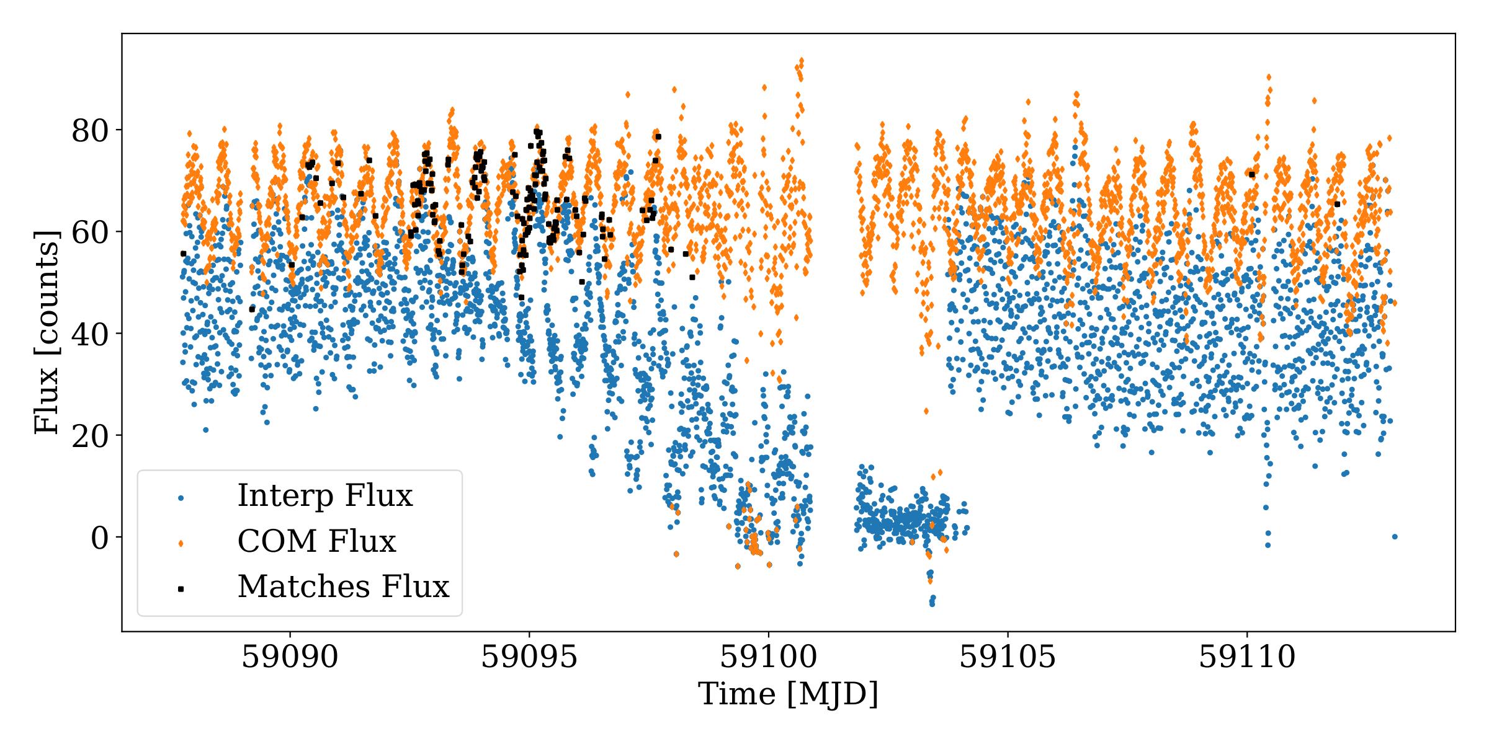
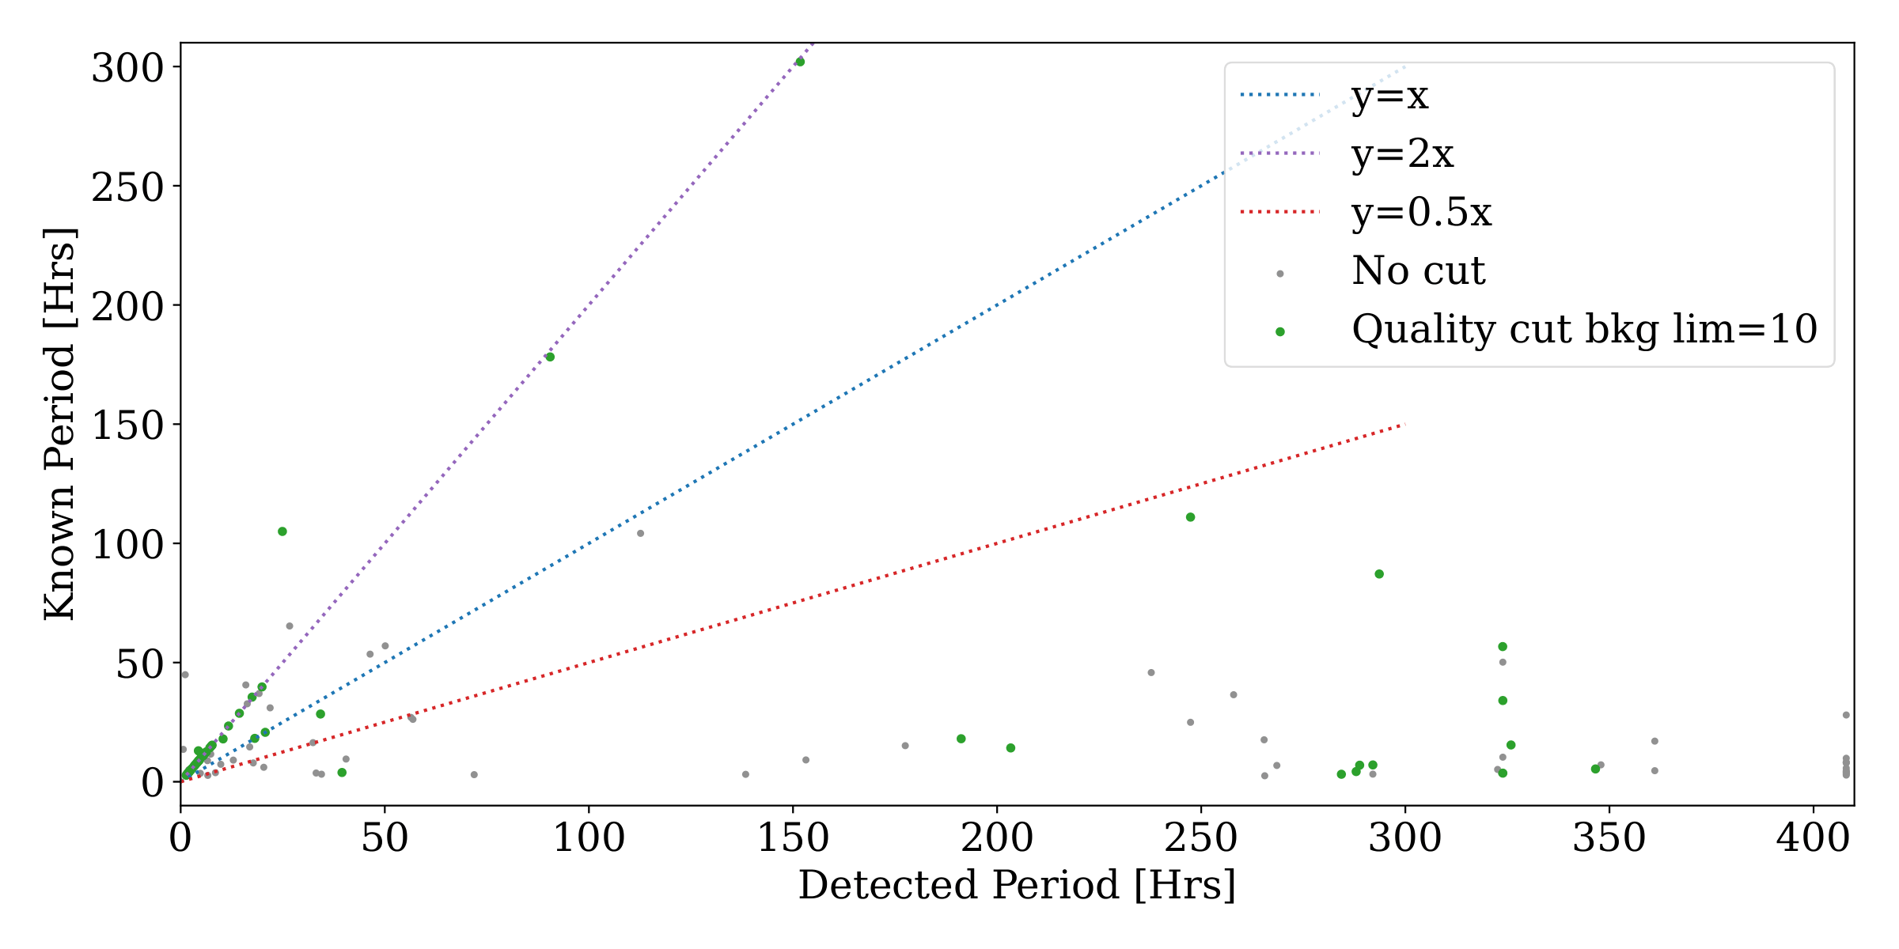
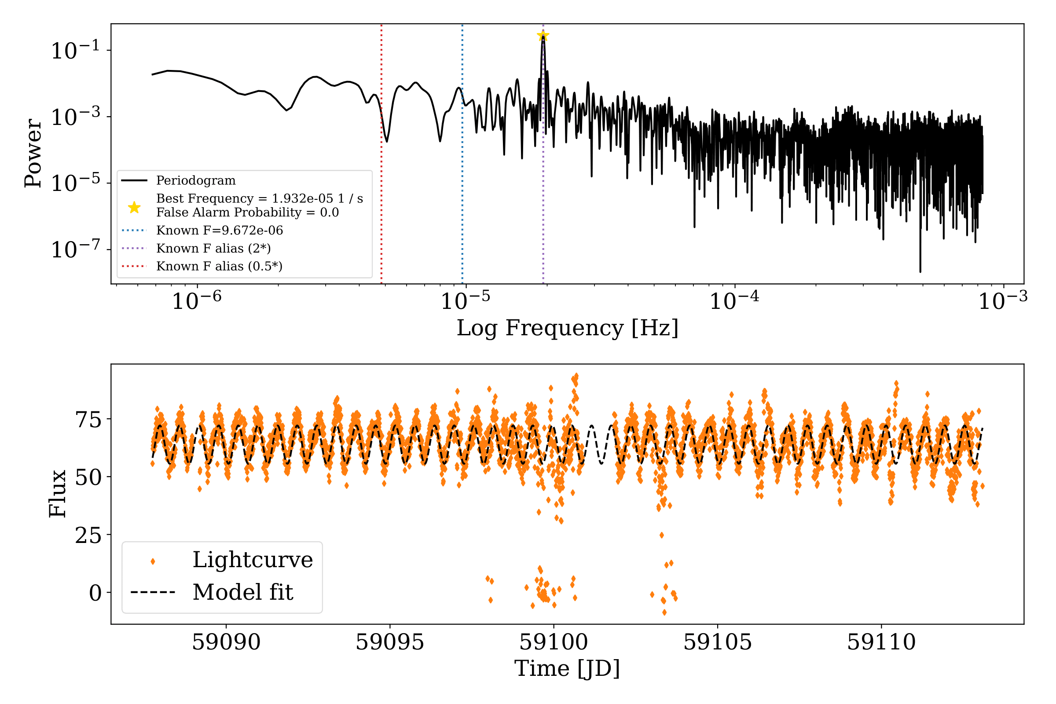
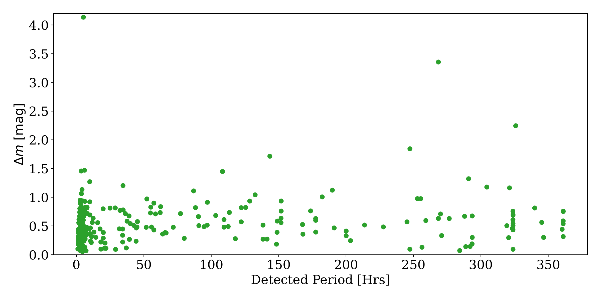
Asteroids in TESS
Brayden Leicester
Supervisors: Ryan Ridden and Michele Bannister
Introduction:
TESS is the Transient Exoplanet Sky Survey Telescope [1], and has been observing 96˚x 24˚ swathes of sky since 2018 at an angular resolution of 21” per px. The Full Frame Images (FFIs) were originally 30 minute integrations, this work uses 10min FFIs, and TESS currently observes at a 200s cadence. Leveraging the power of TESSreduce [2], the new TESSELLATE pipeline detects any transient events in the FFIs on a per pixel basis. Bright asteroids are present in the images and detected as they pass though a pixel, but a lightcurve of the asteroids was not being produced. I have used the data reduction of the pipeline to make these lightcurves, and then analysed them to determine the rotation properties of the asteroids that pass through the TESS field of view.
Results:
The main results of my work are the amplitudes and periods of the asteroids. A cut on the quality of the periodograms needed to be made. These were based on the mean flux of the lightcurve being greater than 10 counts to get above the noise floor, the number of observations of an asteroid >200, the max power of the periodogram > 0.1, and the detected period less than 90% of the maximum window of 408 hours, to avoid the periodogram defaulting to the longest period when no signal was present, and the period being greater than 1 hour, so avoid known problems with asteroids in TESS [5].
The exact values of the quality bounds were informed by both [5] and comparison between asteroids in both the sector and the lightcurve database (LCDB) [6], this comparison is seen in Figure 3. The majority of those that pass the checks fall on the y=2x line, which indicates that the period detected is half the known period, which is expected from asteroid rotation curves [5], see alias found in Figure 2.
309 asteroids passed these quality checks, from the 5664 found in the field of view of the sector to a limiting magnitude of V=20. The detected periods in hours are plotted again in Figure 4 against the amplitude of the lightcurve variation in magnitudes. This allows for comparison to objects with a large variation, such as the first interstellar object 1I/‘Oumuamua [7].
Figure 1: Lightcurves of the interpolated positions (blue), COM positions (Orange) and TESSELLATE matches (black).
Figure 3: Comparison of detected period and known period for all the asteroids in the field and the LCDB (grey), and those that passed the quality checks (green).
Figure 2: Upper Panel: An example periodogram.
Lower Panel: The model fit to the lightcurve.
Methods:
The asteroids bright enough to be in TESS have known positions. Doing a cone search using SkyBot [3], I was able to find the position of the asteroid in the sector every 12hr. This is too coarse of a time step, so interpolating between these position was required down to the frame times of the FFIs. Properties of the asteroids (a,e,i,H) were found with Asteroquery [4] and JPL Horizons This was also used to check the interpolated position by brute force of a few asteroids.
The TESSELLATE pipeline has already reduced the FFIs, so I used a 1.5px aperture and photutils to do forced aperture photometry at the interpolated positions, and at the centre of mass of an area around this position to correct for sawtoothing in the lightcurve. The COM flux is much more regular (see Figure 1) and is what is fit in the lower panel of Figure 2. Sigma clipping (3σ) of this lightcurve was preformed to remove outliers.
Lomb-Scargle periodograms were computed for each lightcurve (Top panel of Figure 2), these are analogous to both a Fourier transform of the data, and a least squares fit to sine and cosine functions, but adapted to work on unevenly spaced data. TESS has a very regular cadance, but the mid-sector gap and the sigma clipping introduce gaps in time that the periodogram handles well.
Figure 4: Detected periods against the amplitude variation of all the asteroids that pass the quality checks.
Conclusion:
The quality checks I have imposed are evidently not great, such as the asteroid with a 4 magnitude variation in Figure 4. Checking the lightcurve manually shows it is all over the place, but it somehow passes all the checks. As it is I have cut out some valid period solutions, but where the line is drawn is quite unstable.
The amplitude variation does not seem to depend on the rotation period, as seen in Figure 4. The magnitude variation seems to stay rather constant across all rotation periods derived. There are outliers, but no clear ‘larger period means larger amplitude’ relationship.
While a lot of what TESSELLATE detects while looking near the ecliptic are asteroids, it seems to only detect them some of the time. Even bright asteroids are not constantly detected.
References:
[1] G.R. Ricker et al. (2014), JATIS,1, 1 . [2] R. Ridden-Harper et al. (2021) arXiv 2111:15006. [3] J. Berthier et al. (2006) ASPC, 351, 367. [4] A. Ginsberg et al. (2019), The Astronomical Journal, 157, 98.
[5] A. McNeill et al. (2023),The Astronomical Journal,166,152. [6] B.D. Warner et al. (2009), Icarus, 202, 134. [7] K.J. Meech et al. (2017), Nature, 552, 378.

Slide 2
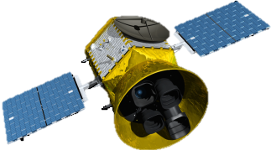
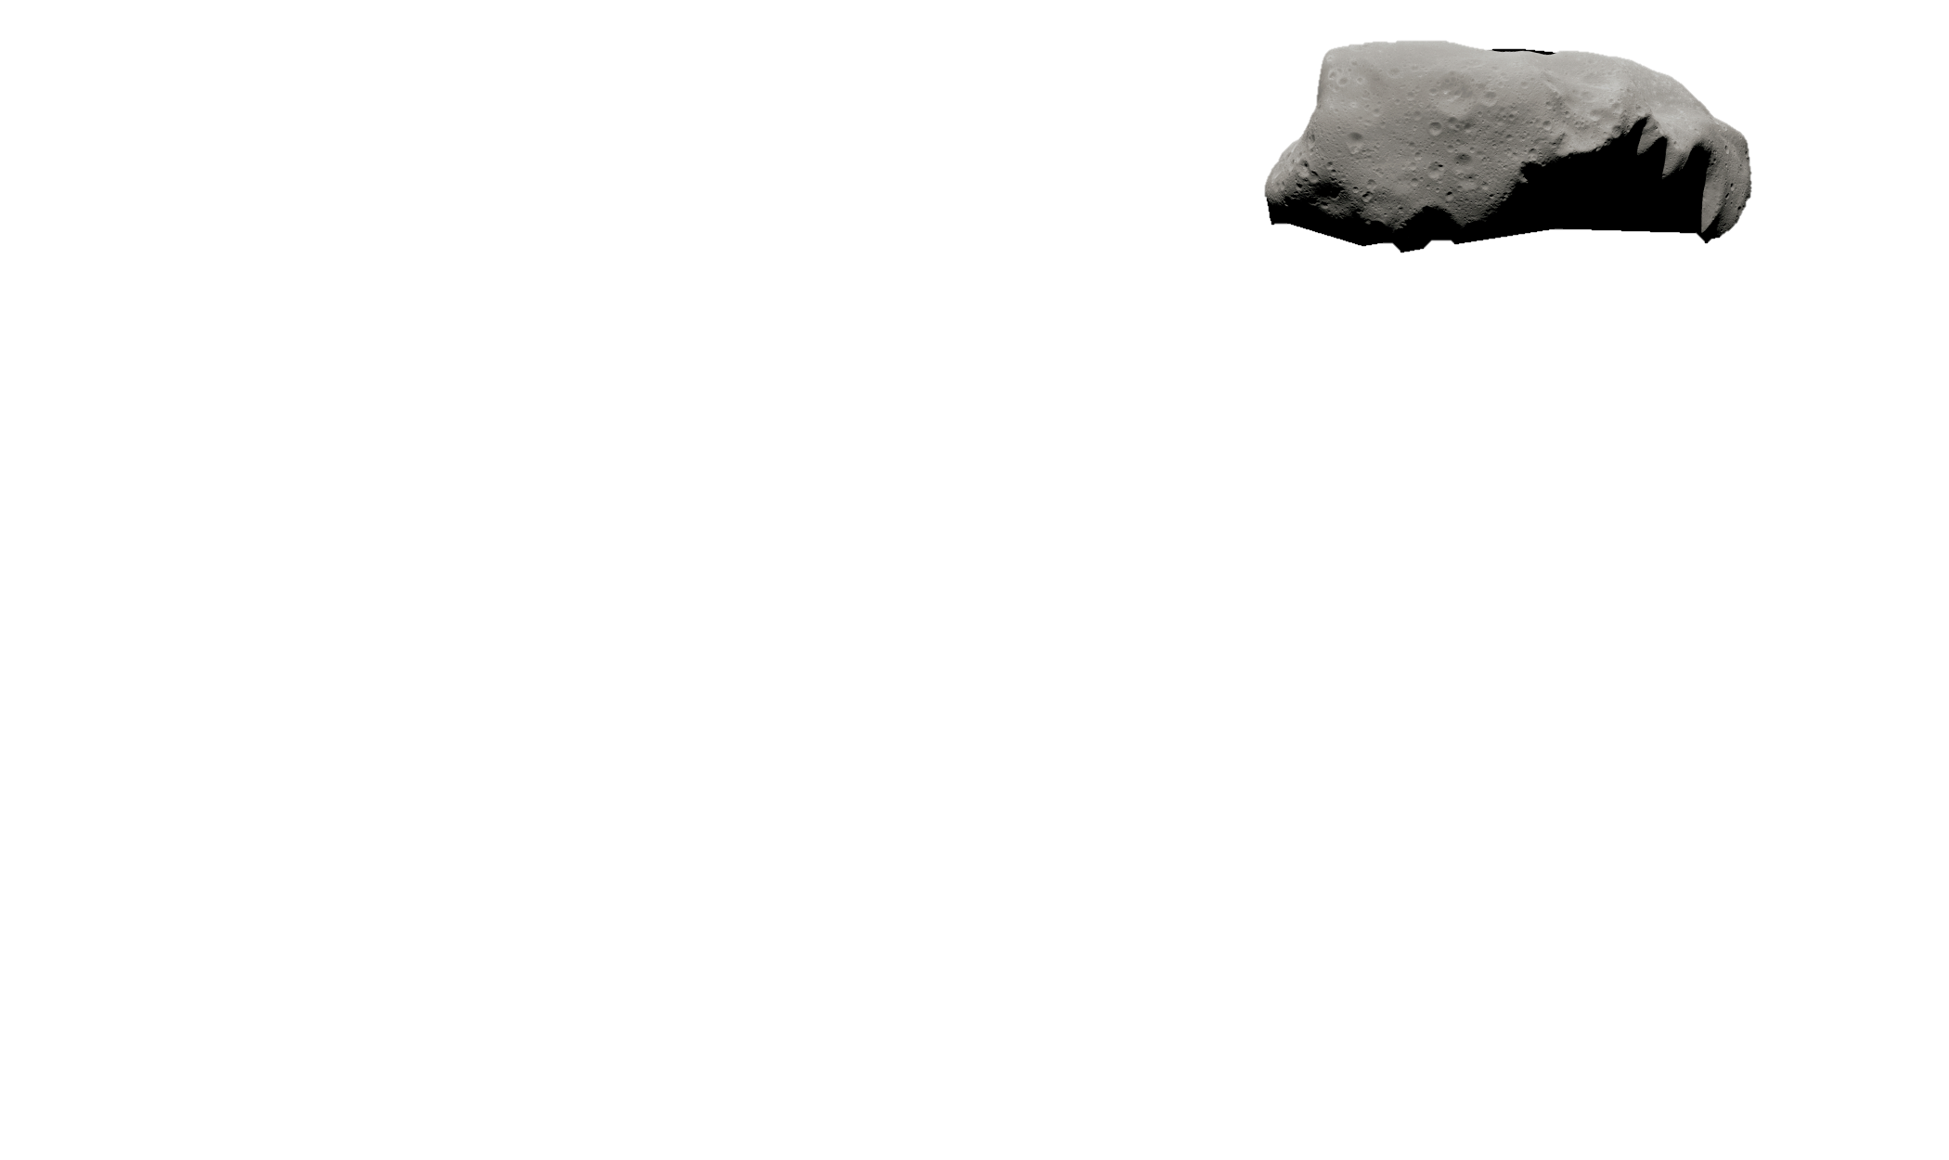
Detecting asteroid lightcuves and periodograms with TESSELLATE
Figure 1: Lightcurves of the interpolated positions (blue), COM positions (Orange) and TESSELLATE matches (black).
TESS can give accurate asteroid rotation periods.
Figure 2: Upper Panel: An example periodogram.
Lower Panel: The model fit to the lightcurve.
Figure 3: Comparison of detected period and known period for all the asteroids in the field and the LCDB [6] (grey), and those that passed the quality checks (green).
Figure 4: Detected periods against the amplitude variation of all the asteroids that pass the quality checks.
The amplutide of variation of is constant with rotation period.
Brayden Leicester
Supervisors: Ryan Ridden-Harper and Michele Bannister
References:
[1] G.R. Ricker et al. (2014), JATIS,1, 1 B.D. Warner et al. (2009), Icarus, 202, 134

