Slide 1
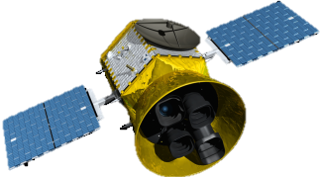
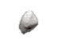

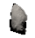
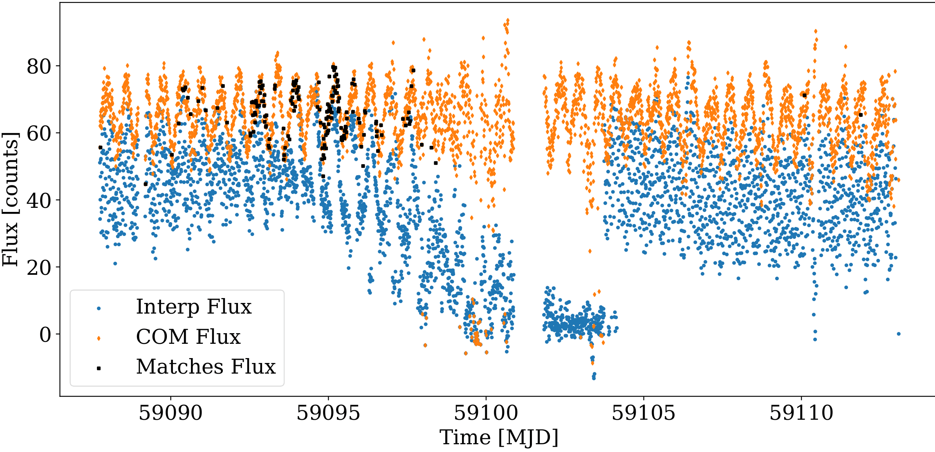
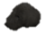
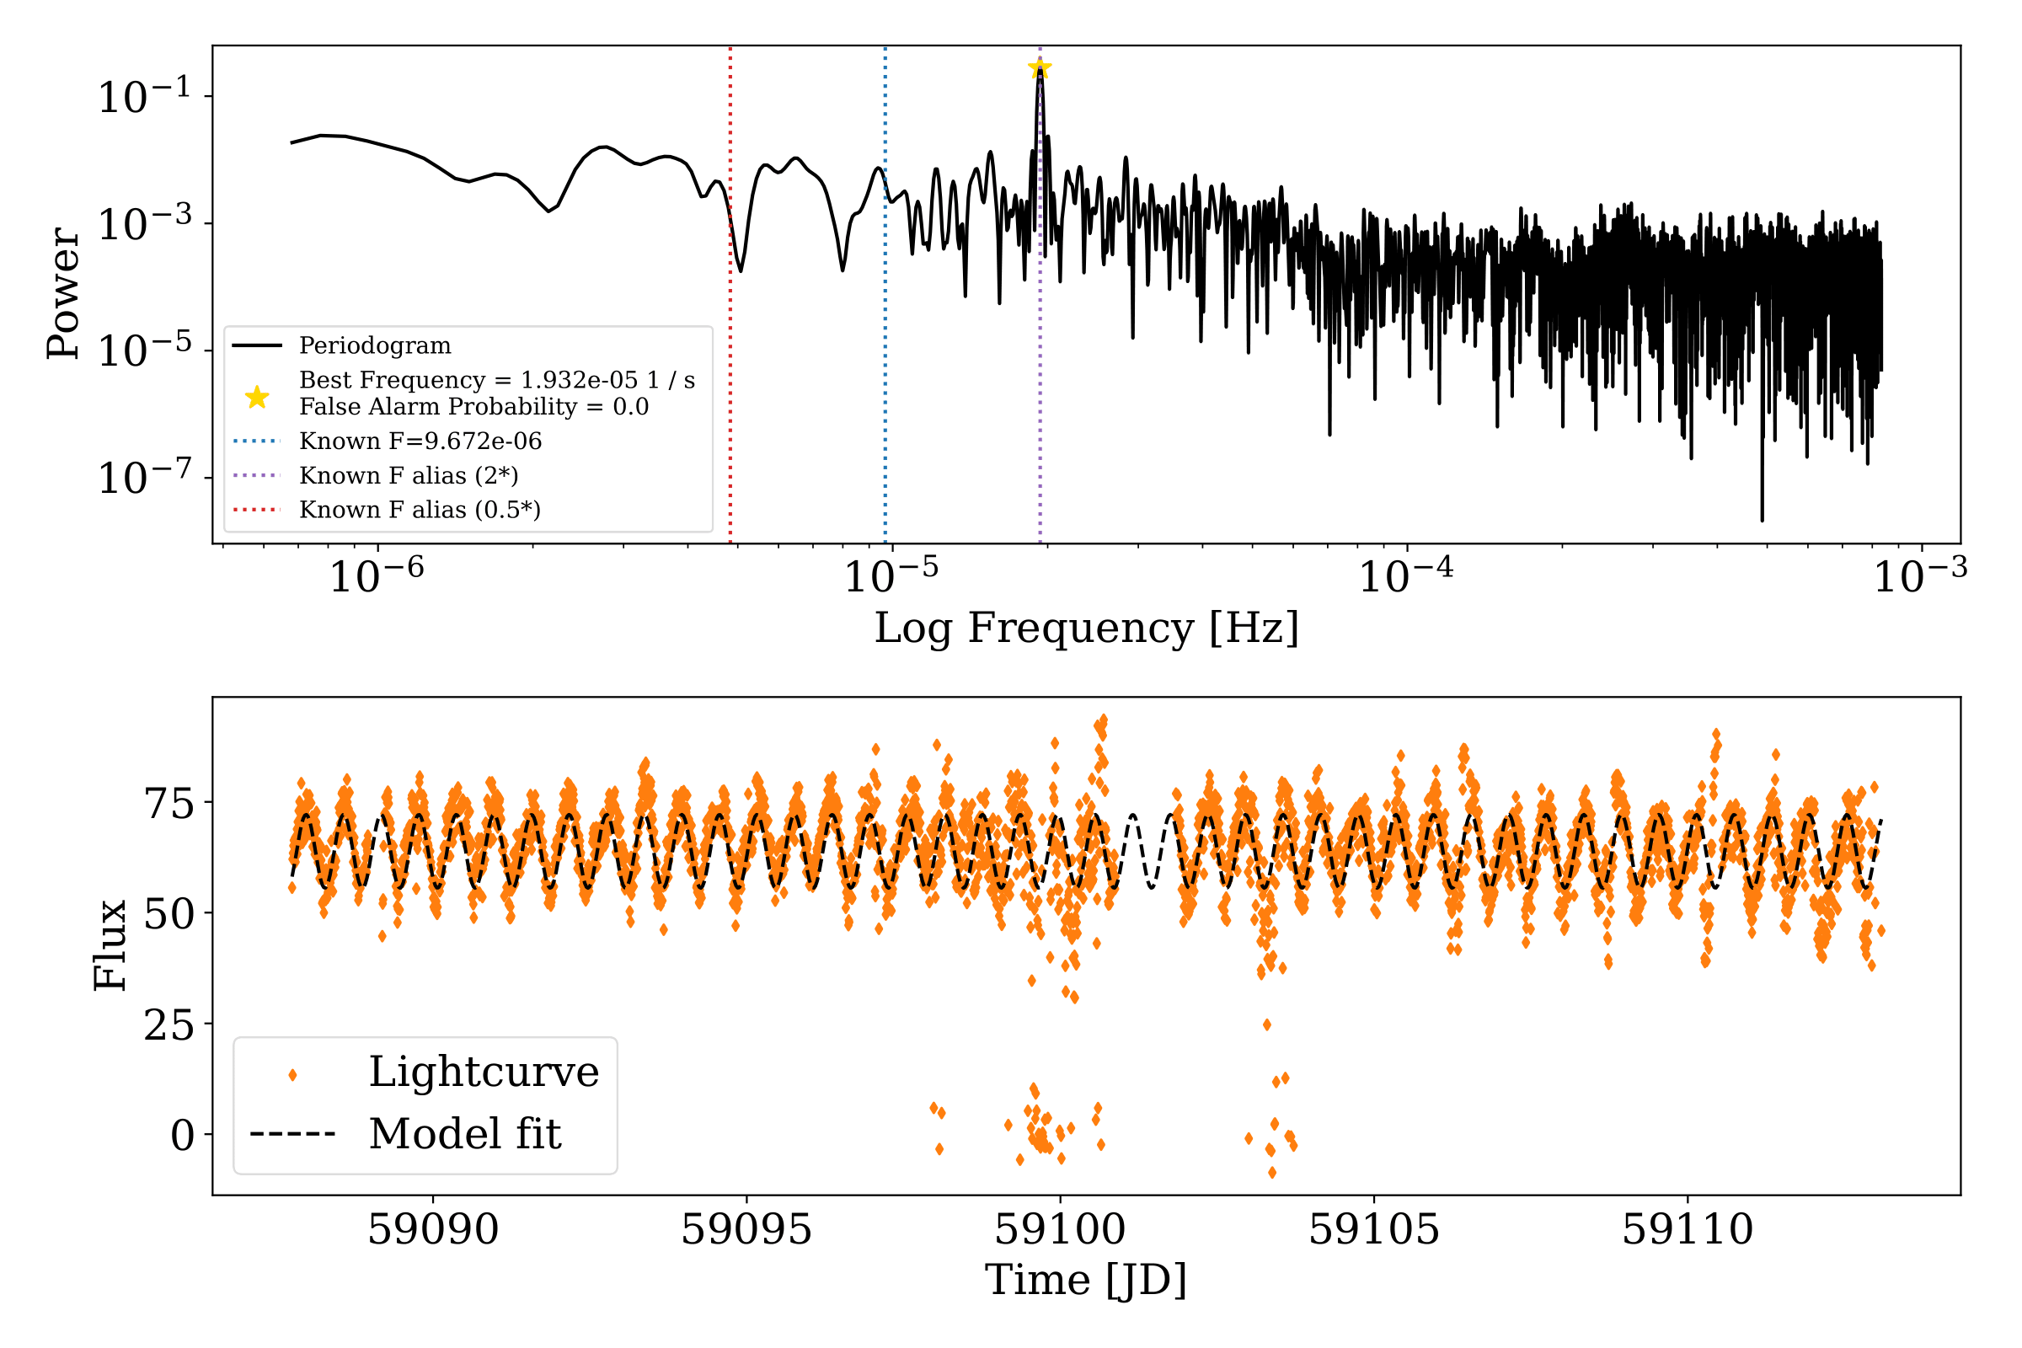
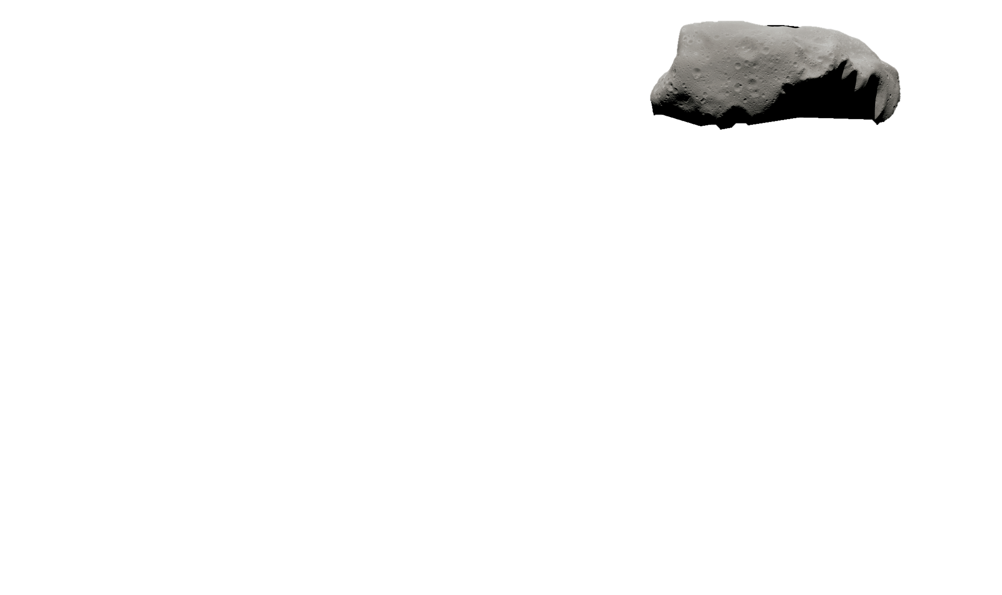
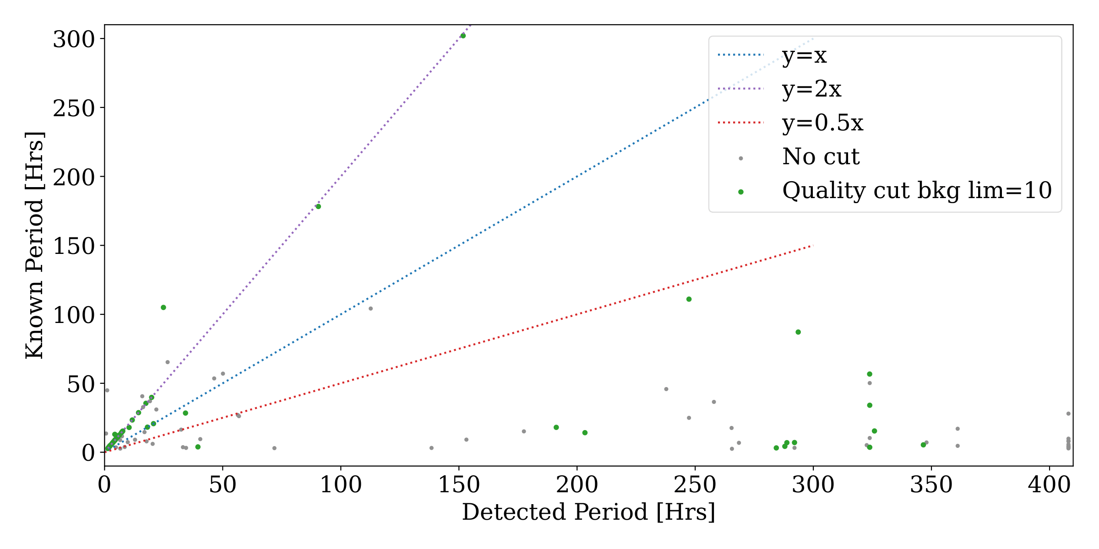
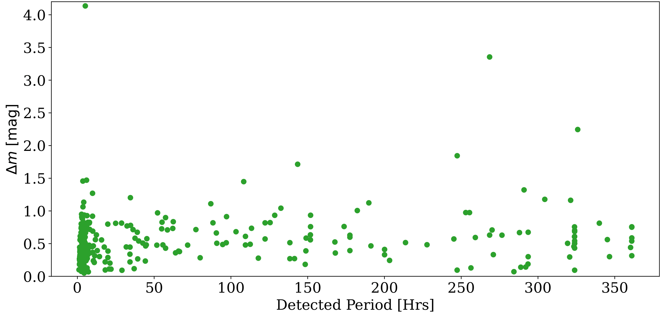
Detecting asteroid lightcurves and periodograms with TESSELLATE
Figure 1: Lightcurves of the interpolated positions (blue), COM positions (Orange) and TESSELLATE matches (black).
TESS can give accurate asteroid rotation periods.
Figure 2: Upper Panel: An example periodogram.
Lower Panel: The model fit to the lightcurve.
Figure 3: Comparison of detected period and known period for all the asteroids in the field and the LCDB [6] (grey), and those that passed the quality checks (green).
Figure 4: Detected periods against the amplitude variation of all the asteroids that pass the quality checks.
The amplitude of variation is constant with rotation period.
Brayden Leicester Supervisors: Ryan Ridden-Harper and Michele Bannister
References:
[1] G.R. Ricker et al. (2014), JATIS,1, 1
[2] B.D. Warner et al. (2009), Icarus, 202, 134

