Slide 1
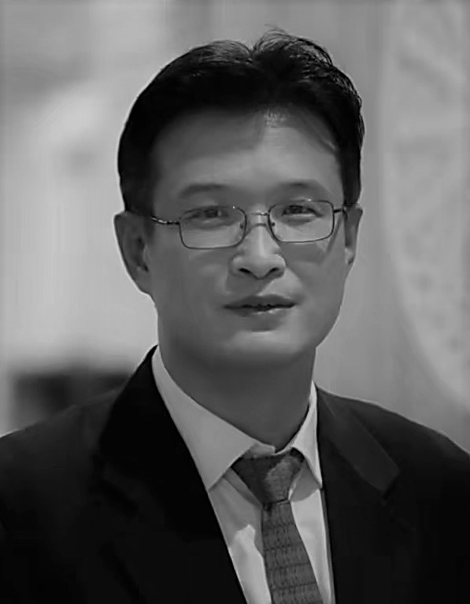
Our Core Team
Alan C. Ph.D. Senior Quantitative Developer
Quantitative Developer and Full Stack Software Engineer with over 20 years of experience in asset management, investment banking, financial services,
and tech start-ups
M.S. Computer Science from University of Illinois, Urbana-Champaign, USA
Ph.D. Biochemistry and Bioinformatics from University of Illinois, Urbana-Champaign, USA
EXAMPLES OF WORK:
Tier 1 Investment Bank – Fixed Income/Securitized Products. Developed a web-based platform to manage and report the workflow of private funding investments.
Tier 1 Investment Bank – Fixed Income Trading front office. Developed an automated trade surveillance reporting system for fixed income security trading. Analyzed alert-triggering events to reduce false positives. Prototyped a next-generation trade surveillance platform integrating tracking, market data, historical surveillance records with machine learning techniques.
Tier 1 Investment Bank – Foreign exchange trading front office. Responsible for the development of option pricing and trading system, settlement, transaction tracking software, FX option trading support.
Global top tier asset management firm – Built a global investment planning platform. Major components include capital market simulations, investment vehicle and asset class modelling, portfolio construction optimizations. Lead the architecture and implementation of the high-performance computation engine, database components, distributed system from on-premise to cloud, web front end, mobile application.
Global top tier financial data provider - Designed and implemented a corporate data delivery gateway executing over 20 million daily transactions.
Silicon valley start-up – Devised industry’s leading embedded internet browsing software known for robust performance and low resource consumption.
SPECIFIC TECHNICAL SKILLS:
Full stack: C, C++, Python, C#, SQL, React, Typescript, Linux, Windows, mobile OS, MSSQL, MongoDB, PostgreSQL, Azure
Financial model implementation, foreign exchange derivatives, fixed income, wealth management, private lending
Large data analysis, market data mining, machine learning, artificial intelligence
High-throughput, low latency application design and optimization.
Distributed computing.
Project and team management experience in organizations of all sizes

