Slide 1


Brian Leathem, JBoss by Red Hat
Realize the full potential of JSF with Seam Faces and CDI

Slide 2

What's this all about?
Seam Faces
Seam 3
JSF 2 / CDI integration is not as thorough is it could have been.
How does Seam Faces solve these problems?
How are these solutions implemented in Seam Faces?
Notes:
Today I’d like to talk you all about...
JSF 2 and CDI – part of Java EE 6,
improved upon by Seam Faces
extension points → portable
contribute

Slide 3
Who am I?
Brian Leathem
Senior Software Engineer, JBoss by Red Hat
RichFaces Core Developer
Seam Faces Module Lead
JSR 344: JavaServer Faces 2.2

Slide 4
The Seam Faces Emblem

Slide 5
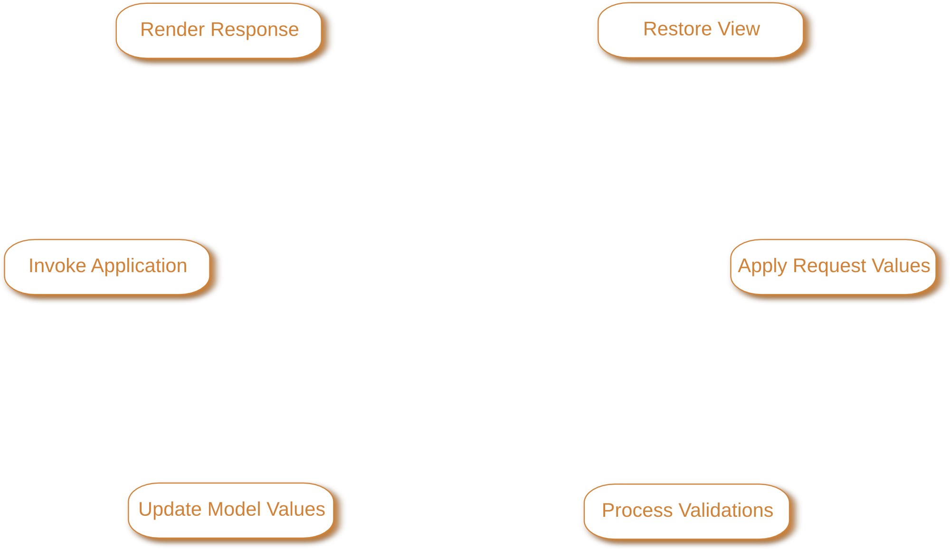
The Seam Faces Emblem

Slide 6
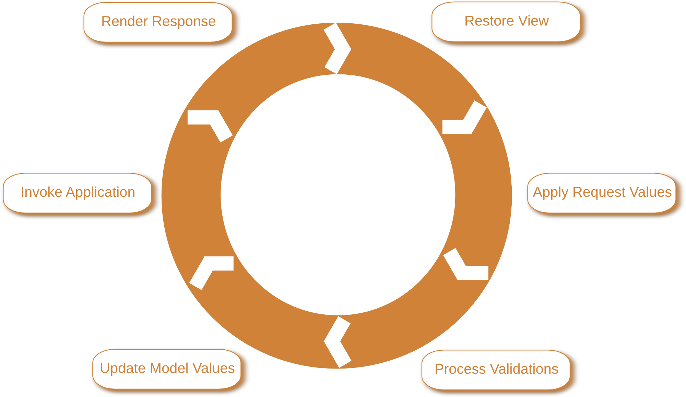
The Seam Faces Emblem

Slide 7
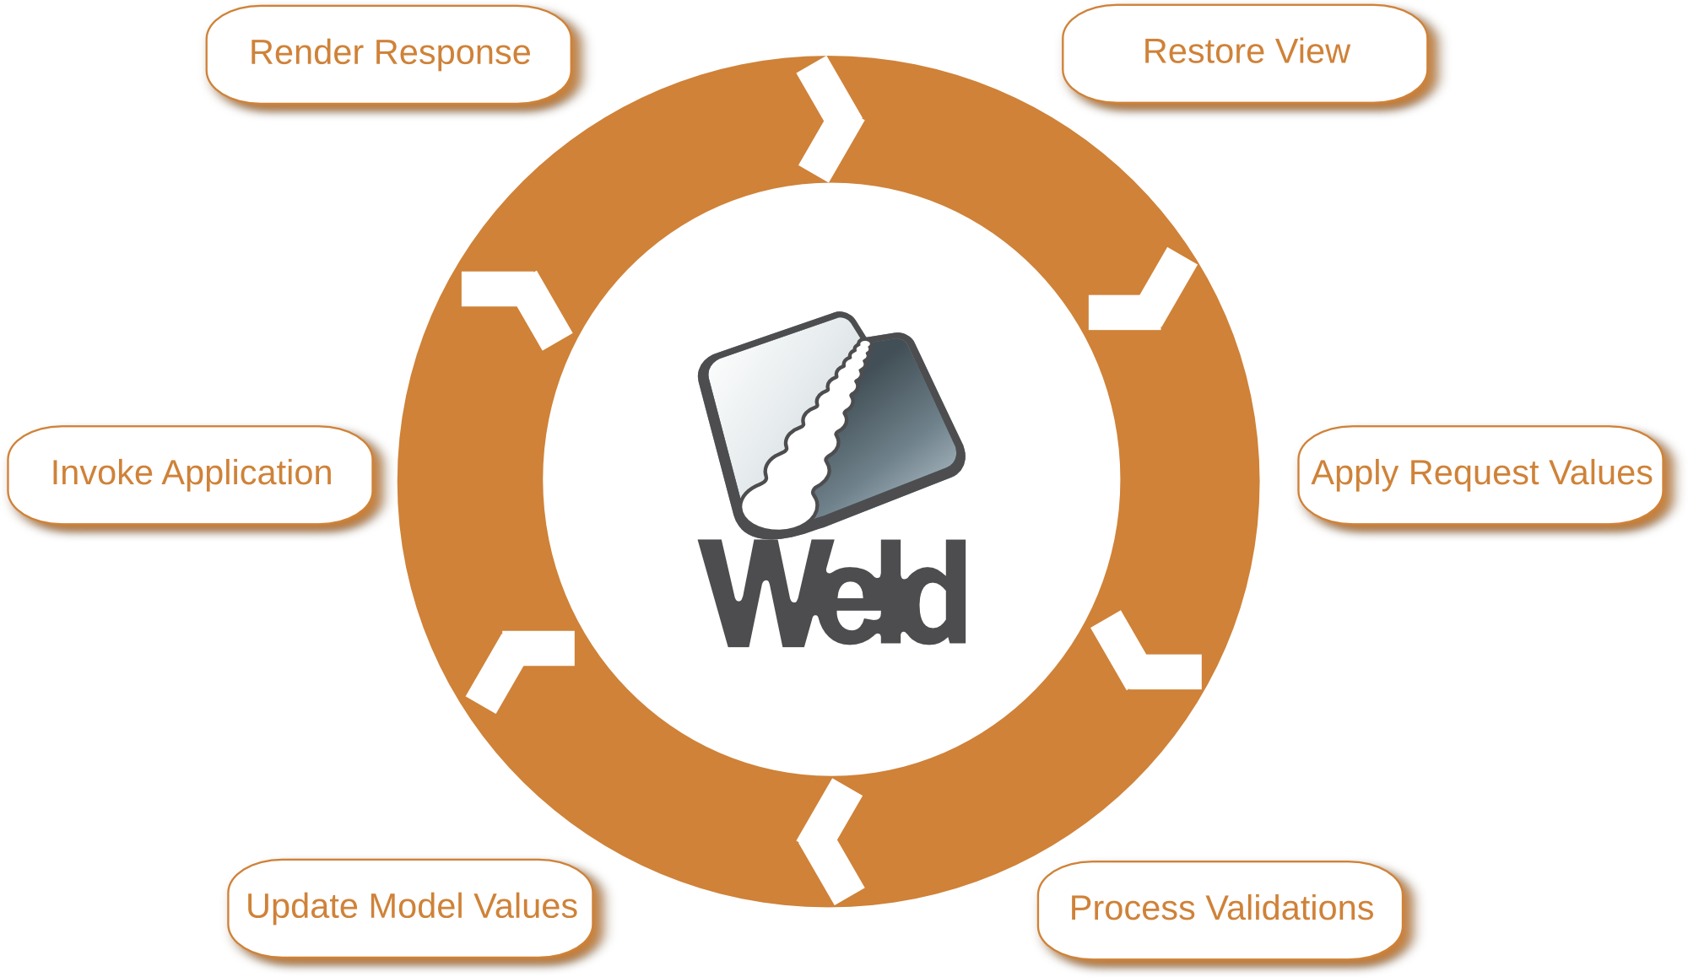
The Seam Faces Emblem

Slide 8
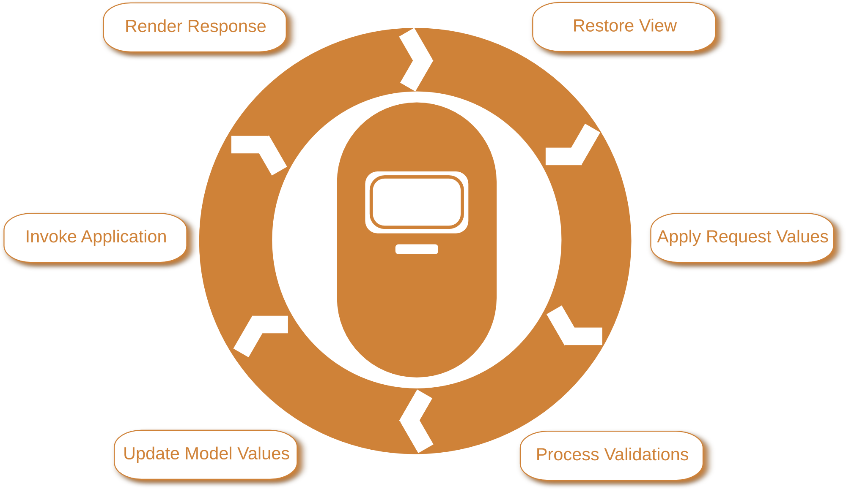
The Seam Faces Emblem

Slide 9
JSF? CDI? What?
Show of hands for those in the audience who:
        are familiar with JSF?
        actively develop with JSF?
        JSF 2?
        are familiar with CDI?
        are familiar with Seam 2?
Notes:
But before I proceed any farther, I’d like to take a survey for a quick level check
Can I see a show of hands from those of you familiar with JSF?
and who actively develops with JSF?
how about with JSF 2?
Who is familiar with CDI?
Who is familiar Seam 2?

Slide 10
JSF and CDI – Full Potential
  Overview: JSF, CDI, Seam 3
  Productivity shortcuts
  Dependency Injection for Everyone!
  JSF/CDI Event Bridging
  View Configuration
  Exception Handling
  Seam Faces – non visual components
  JSF & CDI Scopes
  Testing with Arquillian and JSFUnit
Notes:
Here is the list of topics I plan to cover. We'll see this slide a few more times throughout the presentation, as we make our way through the topics.
<discuss the slide>

Slide 11
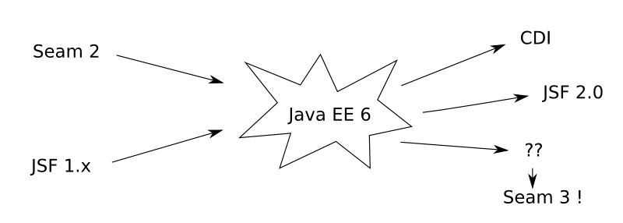
Seam: Innovation, Standardization
Seam 2 married JSF 1.x with EJB 3
Much of Seam 2 was standardized in JSF 2.0 and CDI
Notes:
The Seam project has a history of solving developer pain points in the Java EE platform, and turning those innovations around, back into the platform as improvements to the standard.
<discuss the slide>
In fact, with all the JSF integration contained in the Seam Faces module, JSF is not even required to use any of the other Seam 3 modules.

Slide 12
But why bother?
Why did the Seam project bother improving JSF, and not just write yet another Java Web framework?
Why is the Seam 2 project being re-written as a set of CDI components?

Slide 13

JSF is Great! – A lot going for it
Part of the Java EE standard
Many groups working to make things easier for developers.
These improvements are turned back into the platform as appropriate
  As we saw earlier with Seam 2
  As we saw with AJAX and JSF 1.2
Notes:
Why did the Seam project bother improving JSF, and not just write yet another Java Web framework?
JSF is good! and has a lot going for it. While not perfect (not that any framework for web development is perfect), JSF is a Standard, and is part of the Java EE platform.
The JSF ecosystem is rich, lots of people
improvements are turned back into the platform via the standardization process.
Seam 2,
AJAX in JSF 1

Slide 14
The JSF Ecosystem
Two JSF implementations:
JSF component suites:
1. Oracle's Mojarra | http://java.net/projects/mojarra/
2. Apache MyFaces | http://myfaces.apache.org/
1. JBoss RichFaces | http://www.jboss.org/richfaces
2. IceFaces | http://www.icefaces.org/
3. PrimeFaces | http://www.primefaces.org/
4. Apache MyFaces Tomahawk / Trinidad / Tobago | http://myfaces.apache.org/tomahawk/
5. OpenFaces | http://openfaces.org/
Notes:
There are two implementations of the JSF standard, and both are open-source:
* Mojarra (Oracle)
* MyFaces (Apache
JSF ecosystem is enriched
many competing JSF Component providers.
out-of-the box, ready-to-use components
paginated tables,
collapsible trees,
tabbed panels,
calendar widgets, etc.
Makes application development easier

Slide 15

CDI is Awesome!
CDI: Contexts and Dependency Injection for Java EE 6
Contexts:
Request, Session, Conversation, etc.
Dependency Injection:
@Inject, @Produces, etc.
Events:
public void myObserver (@Observes MyEvent myEvent) { ... }
Finally! A consistent programming model for working with all parts of Java EE, almost...
Notes:
The other piece to this puzzle is CDI. CDI brings a consistent programming model to the Java EE platform. CDI provides:
* the concept of Contexts available outside of the web tier.
* Dependency Injection
* And a powerful eventing mechanism, where any POJO can be an event object, and publishing and listening to events is simple and intuitive.

Slide 16
JSF + CDI ⇒ Only OK.
Working with CDI and JSF 2 together is not as Seamless as it should be
    The scopes cannot easily interact
    Not all JSF classes are "Injectable"
    Disconnected event mechanisms
“The developer bears the burden of integrating these potentially highly-complimentary technologies.”
Notes:
JSF and CDI independently are quite powerful,
when used together even more so.
the integration is as yet incomplete
incompatible Contexts,
incomplete support for Injection in JSF objects,
and altogether different event mechanisms,
the developer bears the burden of integrating these potentially highly-complimentary technologies.

Slide 17
Enter Seam Faces
The Seam Faces goal:
“Build further on the integration of JSF and CDI, providing developers with a truly worthy web framework.”
Seam Faces aims to:
    Reduce boilerplate
    Make CDI the managed bean facility in JSF
    Ease integration with other technologies
    Fill in gaps in the specification
Notes:
This is where Seam Faces comes in
Seam Faces aims to <see slide>

Slide 18
JSF and CDI – Full Potential
  Overview: JSF, CDI, Seam 3
  Productivity shortcuts
  Dependency Injection for Everyone!
  JSF/CDI Event Bridging
  View Configuration
  Exception Handling
  Seam Faces – non visual components
  JSF & CDI Scopes
  Testing with Arquillian and JSFUnit
Notes:
We will begin our look at the platform improvements provided by Seam Faces with a look at some of the “smaller” convenience improvements – the “Productivity shortcuts”
These aren't game changers, but do make the platform easier to work with

Slide 19
Colour code
JSF style “developer” code
Seam Faces style “developer” code
Seam Faces framework code
Notes:
Throughout this presentation I've provided many code snippets. I've adopted this color scheme to make it more clear what code is the “old” JSF way of doing things (the red), what is the replacement Seam Faces style code you would write instead (the green).
The blue code is Seam Framework code that you would never write, and I present for illustrative purposes.

Slide 20

EL short-cut refs, and Injection
@Inject
#{javax.enterprise.conversation}
#{facesContext}
#{facesContext.externalContext}
#{flash}
#{facesContext.application.
navigationHandler}
#{facesContext.application.
projectStage}
#{conversation}
-
#{externalContext}
-
#{navigationHandler}
#{projectStage}
Notes:
Seam faces provides a number of short-hand EL expressions for accessing JSF constructs from EL, and makes existing JSF EL shortcuts available via injection
In the red is the EL one would use with vanilla JSF, the green is the Seam Faces alternative.
All of the references are made available for injection by Seam Faces.

Slide 21
@Named @Produces
These EL references are made using the named CDI Producers:
public class ProjectStageProducer {
@Named
@Produces
public ProjectStage getProjectStage(final FacesContext context) {
return context.getApplication().getProjectStage();
}
}
Notes:
These EL shortcuts are implemented by making use of the CDI @Produces and @Named annotations.
The @Produces annotation makes the return value of the method available for injection into other classes,
and the @Named annotation makes it available via Expression language
There is nothing special going on here, this is standard CDI. But we've written this code, and provided it with Seam Faces so you don't have to do it yourself.

Slide 22
Conversation Boundaries
@ConversationScoped
provided with CDI
transient: Scope bounded by the JSF Lifecycle
long-running: Spans multiple requests
Conversations are made “long-running” programatically
@Inject Conversation conversation;
public void method() {
conversation.begin();
....
}
Notes:
The Conversation context, provided with CDI allows us to have Conversation scoped objects for performing multi-step business operations, or “wizard” style user interactions. This Conversation context has two running modes:
1) Transient
2) Long-running
In the transient, or short running mode, the conversation persists until the end of the current JSF lifecycle.
At any point, a conversation can be promoted to long running, where the conversation persists until it is ended (or it time's out).
CDI provides a programmatic API for beginning and ending long running conversations. This is done by injecting the conversation into the class, and invoking the begin method of the conversation object. This promotes the conversation context associated with that instance to be long running.
Seam Faces provides a pair of annotations, to facilitate this process. Annotating a method with @Begin or @End is sufficient to begin/end the conversation.

Slide 23
@Begin/@End Conversation
Seam Faces provides annotations for conversation demarcating conversation boundaries
@Begin – begins the conversation when the method is invoked
@End – ends the conversation when the method is invoked
@Begin
public void method() {
....
}

Slide 24
JSF Converters: Boilerplate
JSF Converters work with Object, one ends up casting in every converter created.
These casts result in boilerplate code!
public class MyConverter implements Converter {
@Override
public Object getAsObject(FacesContext context, UIComponent component, String string) {
Object object;
// convert string into an object
return object;
}
@Override
public String getAsString(FacesContext context, UIComponent component, Object object) {
MyClass instance = (MyClass) object;
String string;
// convert object into a string
return string;
}
}
Notes:
A JSF developer writes a fair number of Converters while developing an application.
Converters are good!
Too many casts, repeated amongst many converters

Slide 25
<Generic> Converters
Seam Faces provides <Generic> Converters:
public abstract class Converter<T> implements javax.faces.convert.Converter {
@Override
public Object getAsObject(final FacesContext context, final UIComponent comp, final String value) {
this.context = context;
return toObject(comp, value);
}
@Override
public String getAsString(final FacesContext context, final UIComponent comp, final Object value) {
this.context = context;
return toString(comp, (T) value);
}
public abstract T toObject(UIComponent comp, String value);
public abstract String toString(UIComponent comp, T value);
}
Notes:
Seam faces provides an Abstract <Generic> converter that does the cast for you, reducing the amount of redundancy in your code base.

Slide 26
Converter – The Seam Faces way
The Seam Faces Converter has no casts:
Further improvements coming in a new Seam 3 module, and later in a JSR
public class MyConverter extends Converter<MyClass> {
@Override
public MyClass toObject(UIComponent comp, String value) {
MyClass myClass;
// convert string into an object
return myClass;
}
@Override
public String toString(UIComponent comp, MyClass value) {
String string;
// convert object into a string
return string;
}
}

Slide 27
JSF and CDI – Full Potential
  Overview: JSF, CDI, Seam 3
  Productivity shortcuts
  Dependency Injection for Everyone!
  JSF/CDI Event Bridging
  View Configuration
  Exception Handling
  Seam Faces – non visual components
  JSF & CDI Scopes
  Testing with Arquillian and JSFUnit
Notes:
Next I'd like to talk about Dependency Injection, and how Seam Faces is able to extend DI to all JSF classes.

Slide 28
Can't use DI in some JSF classes
JSF 2 has the @ManagedProperty annotation for DI
Whereas with CDI, we use the @Inject annotation
Unfortunately neither is supported out of the box throughout all JSF classes
JSF/CDI does not support injection in Converters & Validators
@ManagedProperty(value="#{userManager}")
private UserManager userManager;
@Inject
private ItemServiceFacade itemService;
Notes:
Dependency Injection is a great way to wire up your application. Personally I have found that a lower barrier of object lookup facilitates the proper separation of concerns.
JSF 2 supports dependency injection in managed beans with the @ManagagedProperty annotation. However when we use JSF with CDI, we opt instead for the typesafe @Inject annotation.
Unfortunately, neither of these injection mechanisms are available in all JSF classes.

Slide 29
DI for Everyone!
Yet, we still need to reference business objects.
This results in nasty EL lookups to retrieve managed beans:
Or even worse, JNDI lookups:
public MyClass getMyClass() {
ELContext context = FacesContext.getCurrentInstance().getELContext();
MyClass myClass = (MyClass) context.getELResolver().getValue(context, null, "myClass");
return myClass;
}
private MyClass getMyClass() {
try {
InitialContext ctx = new InitialContext();
return (TodoDaoInt) ctx.lookup("jsfejb3/MyClass/local");
} catch (Exception e) {
...
}
}
Notes:
As a result, one ends up with a lot of boiler plate code to lookup other objects in order to use them in your converters.
Still need your business objects
If you're a JSF developer, you no doubt seen the following code snippets before
... <point to slide> ...
This is horrible boiler plate, and exactly the kind of thing Seam Faces aims to help with.

Slide 30
Seam Faces DI solution
Seam Faces enables @Inject in JSF Converters & Validators
public class MyConverter implements Converter {
@Inject
private MyClass myClass;
@Override
public Object getAsObject(FacesContext context, UIComponent component, String string) {
...
}
...
}
Notes:
Seam Faces lets us use @Inject in our JSF converters and validators.
... <point to slide> ...

Slide 31
But how?
Seam Faces implements a JSF ApplicationWrapper that intercepts all calls for Converters and Validators.
Seam Faces then provides Bean Managed instances of Converters and Validators.
public class SeamApplicationWrapper extends ApplicationWrapper {
...
@Override
public Converter createConverter(final String converterId) {
log.debugf("Creating converter for converterId %s", converterId);
Converter result = parent.createConverter(converterId);
result = attemptExtension(result);
return result;
}
...
}
Notes:
How Seam Faces achieves this is in fact rather straightforward.
JSF provides many extension points where components and frameworks can hook into the implementation. Once such extension point is the ApplicationWrapper.
By implementing the ApplicationWrapper interface, Seam Faces can intercept each call to provide either a converter or validator.
The Seam Faces wrapper then delegates to the CDI Bean Manager interface to provide an instance of the desired class, which in turn resolves all the injection points.

Slide 32
JSF and CDI – Full Potential
  Overview: JSF, CDI, Seam 3
  Productivity shortcuts
  Dependency Injection for Everyone!
  JSF/CDI Event Bridging
  View Configuration
  Exception Handling
  Seam Faces – non visual components
  JSF & CDI Scopes
  Testing with Arquillian and JSFUnit
Notes:
Next I'd like to talk about the differing event mechanisms in JSF and CDI, and how Seam Faces bridges these events to provide a consistent experience for handling events.

Slide 33
JSF Events
Figure: Copyright 2010 Ed Burns
Notes:
You can’t get far with JSF without a good understanding of the JSF life-cycle.
The JSF lifecycle consists of 6 phases, from “Restore view”, through to “Render response”.
<look at slide, Phase/System Events, preRenderView>
Listening to either of these types of events involves implementing listener interfaces, and defining callback methods.

Slide 34
JSF Phase Listeners
Implement a JSF Phase Listener - cumbersome
public class MyPhaseListener implements PhaseListener {
@Override
public void afterPhase(final PhaseEvent e) {
// do stuff
}
@Override
public void beforePhase(final PhaseEvent e) {
// do stuff
}
@Override
public PhaseId getPhaseId() {
return PhaseId.RESTORE_VIEW;
}
}
Notes:
Here is a typical JSF Phase listener. You can see it implements the PhaseListener interface, and defines the methods...

Slide 35
JSF System Event Listener
Implement a JSF SystemEventListener
Non-uniform approach to listening to events
Lots of LoC
public class MySystemEventListener implements SystemEventListener {
@Override
public boolean isListenerForSource(final Object source) {
return true;
}
@Override
public void processEvent(final SystemEvent e) throws AbortProcessingException {
// do stuff
}
}
Notes:
Likewise here is a JSF System Event listener. It also implements an interface, in this case it is the SystemEventListener, and defines the methods...
So, even within JSF itself, we are lacking a uniform way if handling events, and each requires it's fair share of lines of code, and inherent complexity.

Slide 36
CDI Events: An Elegant Solution
On the other hand the CDI event mechanism, is much simpler, and easier to use
Publish an event:
Listen for an event:
@Inject Event<MyClass> myClassEvents;
public void someMethod() {
MyClass myClass = new MyClass();
myClassEvents.fire(myClass);
}
public void myObserver (@Observes MyEvent myEvent) {
// do stuff
}
Notes:
On the other hand, the event mechanism introduced to the Java EE platform with CDI is incredibly elegant and powerful.
To have a single event mechanism used throughout all layers of your application, down to the business logic and page controllers implemented by application developers is a very attractive idea.
Parameter injection

Slide 37
Publish JSF Event as CDI Event
Seam Faces writes these JSF listeners for you, and publishes the Phase Events on the CDI event bus.
public class SystemEventBridge implements SystemEventListener {
@Inject
BeanManager beanManager;
@Override
public boolean isListenerForSource(final Object source) {
return true;
}
@Override
public void processEvent(final SystemEvent e) throws AbortProcessingException {
Object payload = e.getClass().cast(e);
Annotation[] qualifiers = getQualifiers(e);
beanManager.fireEvent(payload, qualifiers);
}
…
}
Notes:
Seam Faces provides implementations of the above listeners whose sole purpose is to broadcast the Phase and System events using the CDI event mechanism, In this way, Seam Faces delivers on this goal of developing with a single event mechanism.

Slide 38
Now Listening to Events is Easy!
With Seam Faces, listening to JSF events is much easier
public class MyClass {
public void aMethod(@Observes @After @RestoreView PhaseEvent event) {
// do stuff
}
...
public void bMethod(@Observes PostConstructApplicationEvent event) {
// do stuff
}
}
Notes:
With JSF events published as CDI events, listening to JSF events has become much easier.
In this first example, you can see that...

Slide 39
Additional events
Seam Faces adds to the already rich list of JSF events available:
@Observes PreNavigate event
  useful for intercepting and altering JSF navigation
@Observes PreLogin event
@Observes PostLogin event
  Provide a session map where values can be stored/retrieved during the login process
Notes:
In addition to exposing the JSF events as CDI events, Seam Faces defines a few new events, to provide yet a a finer degree of control to application developers.
These events are...

Slide 40
JSF and CDI – Full Potential
  Overview: JSF, CDI, Seam 3
  Productivity shortcuts
  Dependency Injection for Everyone!
  JSF/CDI Event Bridging
  View Configuration
  Exception Handling
  Seam Faces – non visual components
  JSF & CDI Scopes
  Testing with Arquillian and JSFUnit
Notes:
Next I would like to talk about the mechanism Seam Faces provides as a means of centrally defining the behavior of your JSF views.

Slide 41
View Configuration
A type-safe mechanism to configure the behaviour of your JSF views.
So far these configurable behaviors include:
  Restricting view access by integrating with Seam Security
  Configuring URL rewriting by integrating with PrettyFaces (or any other pluggable URL rewriting framework
  Configuring Transactions via Seam Persistence
  JSF internals: set “?faces-redirect=true” when navigating to a view
Notes:
Adhering to the CDI core tenet of type safety, Seam Faces offers a type-safe mechanism to configure your JSF views.
So far these configurable behaviors include some JSF specific behavior, but also provide a mechanism to integrate JSF and Seam Faces with other Seam 3 modules and 3rd party libraries.
So far the list of integrations includes:
<see slide>

Slide 42
@ViewConfig: configuration enum
@ViewConfig
public interface MyAppViewConfig {
static enum Pages {
@ViewPattern("/admin.xhtml")
@Admin
ADMIN,
@ViewPattern("/item.xhtml")
@UrlMapping(pattern="/item/#{id}/")
@Owner
ITEM,
@ViewPattern("/*")
@FacesRedirect
@AccessDeniedView("/denied.xhtml")
@LoginView("/login.xhtml")
ALL;
}
}
https://issues.jboss.org/browse/CDI-127
Notes:
Here is an example of a typical @ViewConfig enum.
At first glance, appear odd.
<talk about:>
Each enum property has an @ViewPattern annotation
@ViewPattern's support wildcards, conflicts resolved
In the following few slides, we'll go into the details of each of these annotations.

Slide 43
@ViewConfig annotations
@ViewPattern("/*")
@FacesRedirect
@LoginView("/login.xhtml")
@AccessDeniedView("/denied.xhtml")
ALL;
@FacesRedirect
sets faces-redirect=true for all associated JSF navigations
@LoginView
the view to navigate to when login is required
@AccessDeniedView
the view to navigate to when access is denied
Notes:
The @FacesRedirect
Override with the annotation @FacesRedirect(false).
no more “?faces-redirect=true”
LoginView specifies the JSF view to navigate to when authentication is required
AccessDeniedView specifies the JSF view to navigate to when the access is denied

Slide 44
@ViewConfig - Securing Views
Use Annotations to link view patterns to Securing methods
@ViewPattern("/item.xhtml")
@Owner
ITEM,
...
@SecurityBindingType
@Retention(RetentionPolicy.RUNTIME)
public @interface Owner {
}
...
public @Secures @Owner boolean ownerChecker(Identity identity, @Current Item item) {
if (item == null || identity.getUser() == null) {
return false;
} else {
return item.getOwner().equals(identity.getUser().getId());
}
}
Notes:
@User is user-provided
<talk to slide>
Restriction is applied at both “Invoke Application” and “Render Response” phases
Configurable with @RestrictAtView
It is the Seam security module that is responsible for invoking this authorisation check, and it must be present on the calsspath of your web application.

Slide 45
@ViewConfig - URL Rewriting
Use Annotations to rewrite URLS
@ViewPattern("/item.xhtml")
@UrlMapping(pattern="/item/#{id}/")
ITEM,
“#{id}” tells the rewriting-engine to treat the last portion of the URL as a the value of the query-parameter named “id”
urls like:
/item/1/
get mapped into:
/item.jsf?item=1
Courtesy of PrettyFaces (http://ocpsoft.com/prettyfaces/)
Notes:
The view config also let’s us configure URL rewriting for a view using the @UrlMapping annotation.
<talk to slide>
By integrating the configuration of rewriting URLs alongside the rest of the view configuration, Seam Faces attempts to make this powerful technology more accessible, and a core part of JSF application development.

Slide 46
ViewConfig - Into the guts
The ViewConfigStore:
An API to programatically add and remove view configuration from the data store.
This API is used by Seam Faces to read the annotation data from the @ViewConfig enum
This API is source agnostic: the plan is to provide additional ways to feed data into the ViewConfig data store

Slide 47
ViewConfig Extension
The CDI extension API makes annotation scanning easy:
public class ViewConfigExtension implements Extension {
private final Map<String, Set<Annotation>> data = new HashMap<String, Set<Annotation>>();
public <T> void processAnnotatedType(@Observes ProcessAnnotatedType<T> event) {
AnnotatedType<T> type = event.getAnnotatedType();
if (type.isAnnotationPresent(ViewConfig.class)) {
// add the annotations to the View Config Data Store
}
}
...
}

Slide 48
ViewConfig Data Store
The ViewConfigStore consumes the ViewConfigExtension
This ViewConfigStore is configuration source agnostic
<f:metadata> configuration
XML configuration
Database configuration
@ApplicationScoped
public class ViewConfigStoreImpl implements ViewConfigStore {
@Inject
public void setup(ViewConfigExtension extension) {
for (Entry<String, Set<Annotation>> e : extension.getData().entrySet()) {
for (Annotation i : e.getValue()) {
addAnnotationData(e.getKey(), i);
}
}
}
...
}

Slide 49
JSF and CDI – Full Potential
  Overview: JSF, CDI, Seam 3
  Productivity shortcuts
  Dependency Injection for Everyone!
  JSF/CDI Event Bridging
  View Configuration
  Exception Handling
  Seam Faces – non visual components
  JSF & CDI Scopes
  Testing with Arquillian and JSFUnit
Notes:
Next, exception handling in JSF applications

Slide 50
Exception Handling
Java Applications throw exceptions. Fact of life.
Applications need to properly handle exceptions, provide appropriate logging, and direct the user accordingly.
Handling Exceptions in JSF is ugly.
  Implement a ExceptionHandler
  Provide a ExceptionHandlerFactory
  Register this factory via the faces-config.xml
Incredible power and flexibility, but too verbose
Notes:
Exceptions are unavoidable in Java applications. Either through end-user abuse, or an out-of-the-ordinary situation, exceptional behaviour is inevitable. Unfortunately handling exceptions with JSF is a little bit messy.
A JSF developer must implement the ExceptionHandler interfaces, provide a factory for that handler, and register it via the faces-config.xml

Slide 51
JSF ExceptionHandler
One has to write the ExceptionHandler:
public class MyHandler extends ExceptionHandlerWrapper {
@Override
public ExceptionHandler getWrapped() {
return this.wrapped;
}
@Override
public void handle() throws FacesException {
...
}
}

Slide 52
JSF ExceptionHandlerFactory
Then One must extend the ExceptionHandlerFactory:
And register it in the faces-config.xml
public class MyHandlerFactory extends ExceptionHandlerFactory {
public MyHandlerFactory(ExceptionHandlerFactory parent) {
super();
this.parent = parent;
}
@Override
public ExceptionHandler getExceptionHandler() {
...
}
}
  <factory>
  <exception-handler-factory>
  my.package.MyHandlerFactory
  </exception-handler-factory>
  </factory>

Slide 53
Integration with Seam Catch
Seam Faces publishes all JSF Exceptions using the CDI event mechanism
One writes Exception Handlers to handle the exceptions:
This is a much “cleaner” way of handling exceptions
@HandlesExceptions
public class MyHandlers {
void printExceptions(@Handles CaughtException<Throwable> evt) {
System.out.println("Something bad happened: " + evt.getException().getMessage());
evt.markHandled();
}
}
Notes:
Handling exceptions is much easier when you bundle Seam Catch with your application. Seam Faces has it's own Exceptionhandler that publishes all JSF exceptions using the CDI event mechanism.
All that is left for the JSF developer to do is to provide @Handles methods for handling the exceptions themselves.
Note: the exception handling methods inherit the same parameter injection available to CDI event Obeservers.

Slide 54
JSF and CDI – Full Potential
  Overview: JSF, CDI, Seam 3
  Productivity shortcuts
  Dependency Injection for Everyone!
  JSF/CDI Event Bridging
  View Configuration
  Exception Handling
  Seam Faces – non visual components
  JSF & CDI Scopes
  Testing with Arquillian and JSFUnit
Notes:
While Seam Faces does not provide any visual components, some non-visual components are provided.

Slide 55

Non-visual Components
See RichFaces for UI Components:
However some non-visual components are available in Seam Faces:
<s:viewAction>
<s:validateForm>
<sc:inputContainer>
Notes:
Seam Faces is not in the business of providing UI components.
These non-visual components are the “viewAction”, “validateform”, and “inputContainer” components. We'll go into each of these in detail.

Slide 56
<s:viewAction>
Like observing the preRenderView event on steroids
Doesn't perform navigation
Can't conditionally choose the execution phase
Can't disable for a POST
<f:metadata>
<f:viewParam name="id" value="#{itemManager.itemId}"/>
<f:event name="preRenderView" listener="#{itemManager.loadEntry}" />
</f:metadata>
@Named
@RequestScoped
public class ItemManager {
private Item itemId;
public Item getItemId() {
return itemId;
}
public void setItemId(Integer id) {
ItemId = id;
}
private void loadItem() {
// do stuff
}
}
Notes:
In standard JSF 2, one can listen for the PreRenderView event, and execute some login at render time. While a fantastic feature to have in the platform, listening to this event falls short. One cannot:
perform navigation
conditionally choose the execution phase
disable for POSTs

Slide 57
<s:viewAction>
A view action is a UICommand for an initial (non-faces) request.
<f:metadata>
<f:viewParam name="id" value="#{itemManager.itemId}"/>
<s:viewAction action="#{itemManager.loadItem}"/>
</f:metadata>
Can perform navigation - a full fledged UICommand
Can conditionally choose the execution phase
Can disable for a POST
Notes:
Seam faces provides the viewAction to provide these features.
A view action is a UICommand for an initial (non-faces) request.
Since it is a UICommand, it has implicit support for JSF navigation, in the same way as a commandLink or commandButton
It is executed by default during the Invoke Application phase.
It can optionally be invoked on postback as well.
In essence, it provides a light-weight front-controller solution for executing code upon the loading of a JSF view

Slide 58
<s:validateForm>
Perform cross-field form validation is simple
Place the <s:validateForm> component in the form you wish to validate, then attach your custom Validator.
<h:form id="locationForm">
<h:inputText id="cityId" value="#{bean.city}" />
<h:inputText id="stateId" value="#{bean.state}" />
<h:inputText id="zip" value="#{bean.zip}" />
<h:commandButton id="submit" value="Submit" action="#{bean.submitPost}" />
<s:validateForm fields="city=cityId state=stateId" validatorId="locationValidator" />
</h:form>
@FacesValidator("locationValidator")
public class MyValidator implements Validator {
@Inject
private InputElement<String> city;
@Inject
private InputElement<String> state;
...
}
Notes:
By Using the validateFrom component, Seam Faces provides developers with a means to perform validation across multiple fields. This is incredibly useful when checking that an email address entered a second time matches, or checking the consistency of address information.
In this JSF facelet snippet, you can see the JSF validator is bound to the validateForm component, and passed the ids of the relevant inputs as attributes.
In the validator itself, we can see that components are injected into the Inputelement properties, where the component itself, as well as it's clientId are stored. Validation can then be performed in the JSF validation phase, and messages returned accordingly.

Slide 59
<sc:inputContainer>
Wraps any input component (EditableValueHolder)
  xmlns:sc="http://java.sun.com/jsf/composite/components/seamfaces"
  <sc:inputContainer label="name" id="name">
  <h:inputText id="input" value="#{person.name}"/>
  </sc:inputContainer>
Reduces Facelet boiler plate, by creating:
  The JSF label, with required flag
  The message associated with the input
  matches up the "id" and the "for" attributes as required
Notes:
The inputContainer component reduces a significant amount of boiler plate when building up a form. The inputContainer wraps any input component, and provides the label, and message tags, taking care of matching up the “id” and “for” attributes of the resulting components.
This can be a big deal when building a form of complex size.

Slide 60
<sc:inputContainer>
Define your own InputContainer to control the layout
<cc:interface componentType="org.jboss.seam.faces.InputContainer">
<cc:attribute name="label" required="true"/>
<cc:attribute name="required" required="false"/>
<cc:attribute name="ajax" required="false" default="false"/>
<cc:attribute name="inputs" required="false" default="1"/>
</cc:interface>
<cc:implementation>
<div class="entry" id="#{cc.clientId}">
<h:outputLabel id="label" for="" value="#{cc.attrs.label}:"
styleClass="#{cc.attrs.invalid ? 'label errors' : 'label'}">
<h:panelGroup styleClass="required" rendered="#{cc.attrs.required}">*</h:panelGroup>
</h:outputLabel>
<span class="#{cc.attrs.invalid ? 'input errors' : 'input'}">
<cc:insertChildren/>
</span>
<h:panelGroup rendered="#{cc.attrs.invalid}">
<c:forEach var="i" begin="1" end="#{cc.attrs.inputs}">
<h:message id="message#{i}" for="" styleClass="error errors"/>
</c:forEach>
</h:panelGroup>
</div>
</cc:implementation>
Notes:
If you don't like the layout of the provided input container, you can create your own using the JSF 2 composite component functionality. If we look at this example we can see...

Slide 61
JSF and CDI – Full Potential
  Overview: JSF, CDI, Seam 3
  Productivity shortcuts
  Dependency Injection for Everyone!
  JSF/CDI Event Bridging
  View Configuration
  Exception Handling
  Seam Faces – non visual components
  JSF & CDI Scopes
  Testing with Arquillian and JSFUnit
Notes:
Next, lets look at the JSF & CDI Managed Bean Scopes

Slide 62
JSF & CDI Scopes
There is a disconnect between the JSF and CDI scopes:
Seam Faces overrides the JSF scopes with the corresponding CDI scopes.
Same Faces provides a CDI enabled @ViewScoped
JSF Provided Scopes | CDI Provided Scopes
javax.faces.bean.RequestScoped | javax.enterprise.context.RequestScoped
// No JSF equivalent | javax.enterprise.context.ConversationScoped
javax.faces.bean.SessionScoped | javax.enterprise.context.SessionScoped
javax.faces.bean.ViewScoped | // No CDI equivalent
javax.faces.bean.ApplicationScoped | javax.enterprise.context.ApplicationScoped
Notes:
The disconnect between JSF and CDI is apparent when you look at the scopes provided in the JavaEE 5 platform.
Seam Faces remedies this, by dynamically replacing any JSF scopes it comes across, with the corresponding CDI scope.

Slide 63
Dynamic Annotation Replacement
Seam Faces scans for JSF Scope annotations, and replaces them with CDI Scope annotations
Again, taking advantage of the CDI Extenstion mechanism
public class FacesAnnotationsAdapterExtension implements Extension {
...
public void aliasJsfScope(@Observes final ProcessAnnotatedType<Object> annotatedType) {
for (Class<? extends Annotation> scope : scopeAliasMapping.keySet()) {
if (annotatedType.getAnnotatedType().isAnnotationPresent(scope)) {
annotatedType.setAnnotatedType(
decorateType(annotatedType.getAnnotatedType(), scope));
break;
}
}
}
}

Slide 64
@RenderScoped
Seam Faces provides a new scope, the Render Scope
Beans placed in the @RenderScoped context are scoped to, and live through but not after, the next "Render Response" phase
What other scopes would be useful?
Come, engage the Seam community and help to define the “killer scope”

Slide 65
JSF and CDI – Full Potential
  Overview: JSF, CDI, Seam 3
  Productivity shortcuts
  Dependency Injection for Everyone!
  JSF/CDI Event Bridging
  View Configuration
  Exception Handling
  Seam Faces – non visual components
  JSF & CDI Scopes
  Testing with Arquillian and JSFUnit
Notes:
Finally, lets look at JSF & CDI Scopes, and the contexts to which they are bound.

Slide 66
In container testing required
How can we test the result of dependency injection in our unit tests?
With object mocking?
Full system tests?
How about independent and isolated in-container tests?
Aka, “Real tests”!

Slide 67
Arquillian & JSFUnit
Arquillian drives the in container tests. The container in turn:
Resolves DI
Manages transactions, the persistence context, and all other container services
JSFUnit drives the UI, tests:
Action Commands
Page navigation
Message Creation
etc.

Slide 68

Shrinkwrap
We use the Shrinkwrap API to build the deployment artifact:
public static WebArchive createDeployment() {
WebArchive war = ShrinkWrap.create(WebArchive.class).addAsWebInfResource(
new File("src/test/webapp/WEB-INF/faces-config.xml"), "faces-config.xml");
war.addAsWebResource(new File("src/test/webapp", "index.xhtml")).addAsWebResource(
new File("src/test/webapp", "inputcontainerform.xhtml"));
war.addAsWebInfResource(EmptyAsset.INSTANCE, "beans.xml");
return war;
}

Slide 69

Arquillian
Arquillian manages the container lifecycle, and deploys the Shrinkwrap built bundle
@Deployment
public static WebArchive createDeployment() {
WebArchive war = Deployments.createCDIDeployment();
return war;
}

Slide 70

JSFUnit driving the test
JSFUnit drives the test by:
loading the page
filling in the values,
clicking a button
verifying the rendered response
@Test
@InitialPage("/inputcontainerform.xhtml")
public void checkComponentRenderAfterSuccess(
JSFServerSession server, JSFClientSession client) throws IOException {
Assert.assertEquals("/inputcontainerform.xhtml", server.getCurrentViewID());
client.setValue(AGE_INPUT_CLIENT_ID, "100");
client.setValue(NAME_INPUT_CLIENT_ID, "jose_freitas");
client.click("submitInputContainer");
Assert.assertTrue(client.getPageAsText().contains(
"The test succeeded with jose_freitas of 100 years old"));
}

Slide 71


Developing new mobile, web or Java EE apps?
Deploy easily to the cloud w/ auto-scaling built-in
Supports Java EE, PHP, Ruby and Python
Check out a demo at the JBoss booth #313
Pick up some limited edition swag
try-it: openshift.com twitter: @openshift

Slide 72
Upcoming features
Killer Scope
Type safe navigation rules
@ViewConfig controls in <f:metadata>
Global Protection against XSRF attacks
<s:debug>
Notes:
After working a while building JSF/CDI applications, it is apparent that the provided scopes are insufficient. Over the course of the next few months, I am hoping to engage the community in a discussion of what would be a “killer” scope, and provide that scope via Seam Faces in the next major release.
Other upcoming features include:...

Slide 73
JSF 2.2
The next iteration of the JSF spec is being hashed out.
CDI Integration is on the table:
http://java.net/jira/browse/JAVASERVERFACES_SPEC_PUBLIC-976
s:viewAction no longer requires f:viewParam tags
http://java.net/jira/browse/JAVASERVERFACES_SPEC_PUBLIC-872
s:viewAction is also being considered:
http://java.net/jira/browse/JAVASERVERFACES_SPEC_PUBLIC-758
Notes:
It's worth pointing out that the next iteration of the JSF specification is being addressed, and the topic of CDI integration is on the table. If this is something you feel should be remedied at the platform level, please make yourselves heard, and help ensure that it is included in the next iteration of the specification.

Slide 74
JBoss, Seam & CDI @JAXConf
Java EE 6 secrets: Wield CDI like a Ninja Master
(Dan Allen & Lincoln Baxter III)
Forge new Ground in Rapid Enterprise Java Development
(Dan Allen & Lincoln Baxter III)
Seam 3 brings Java EE improvements of tomorrow, today (Dan Allen)
The future of Java enterprise testing (Dan Allen)
7 reasons to love JBoss AS 7 (Dan Allen @ JBoss Day)
RichFaces 4.0 Component Deep Dive (Jay Balunus)
The Mobile Web Revealed For The Java Developer
(Jay Balunus @ JBoss Day)
Java EE on Google App Engine: CDI to the Rescue! (Ales Justin)

Slide 75
Conclusion
Seam Faces improves upon the JSF 2 / CDI integration, providing JSF developers with a full featured framework for developing Web Applications
Productivity shortcuts
Dependency Injection for Everyone!
JSF/CDI Event Bridging
View Configuration
Exception Handling
Seam Faces – non visual components
JSF & CDI Scopes
Testing

Slide 76
Get Involved
Get involved with Seam Faces, and help make the JSF platform into what you need it to be.
http://seamframework.org/Seam3/FacesModule
http://seamframework.org/Community
Twitter: #SEAM, #SEAMFACES
http://twitter.com/brianleathem
Github:
https://github.com/seam/faces

