Slide 1
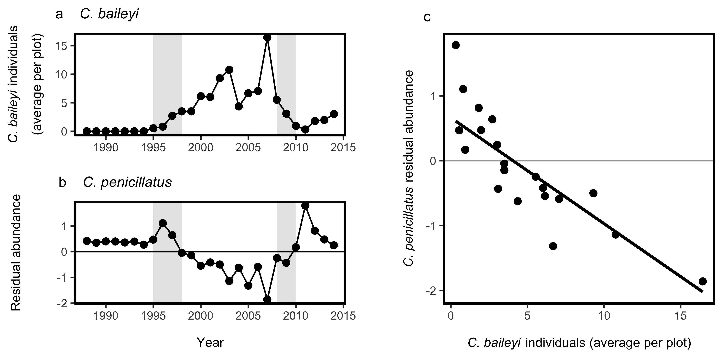
KR exclosure
Control

