Slide 1
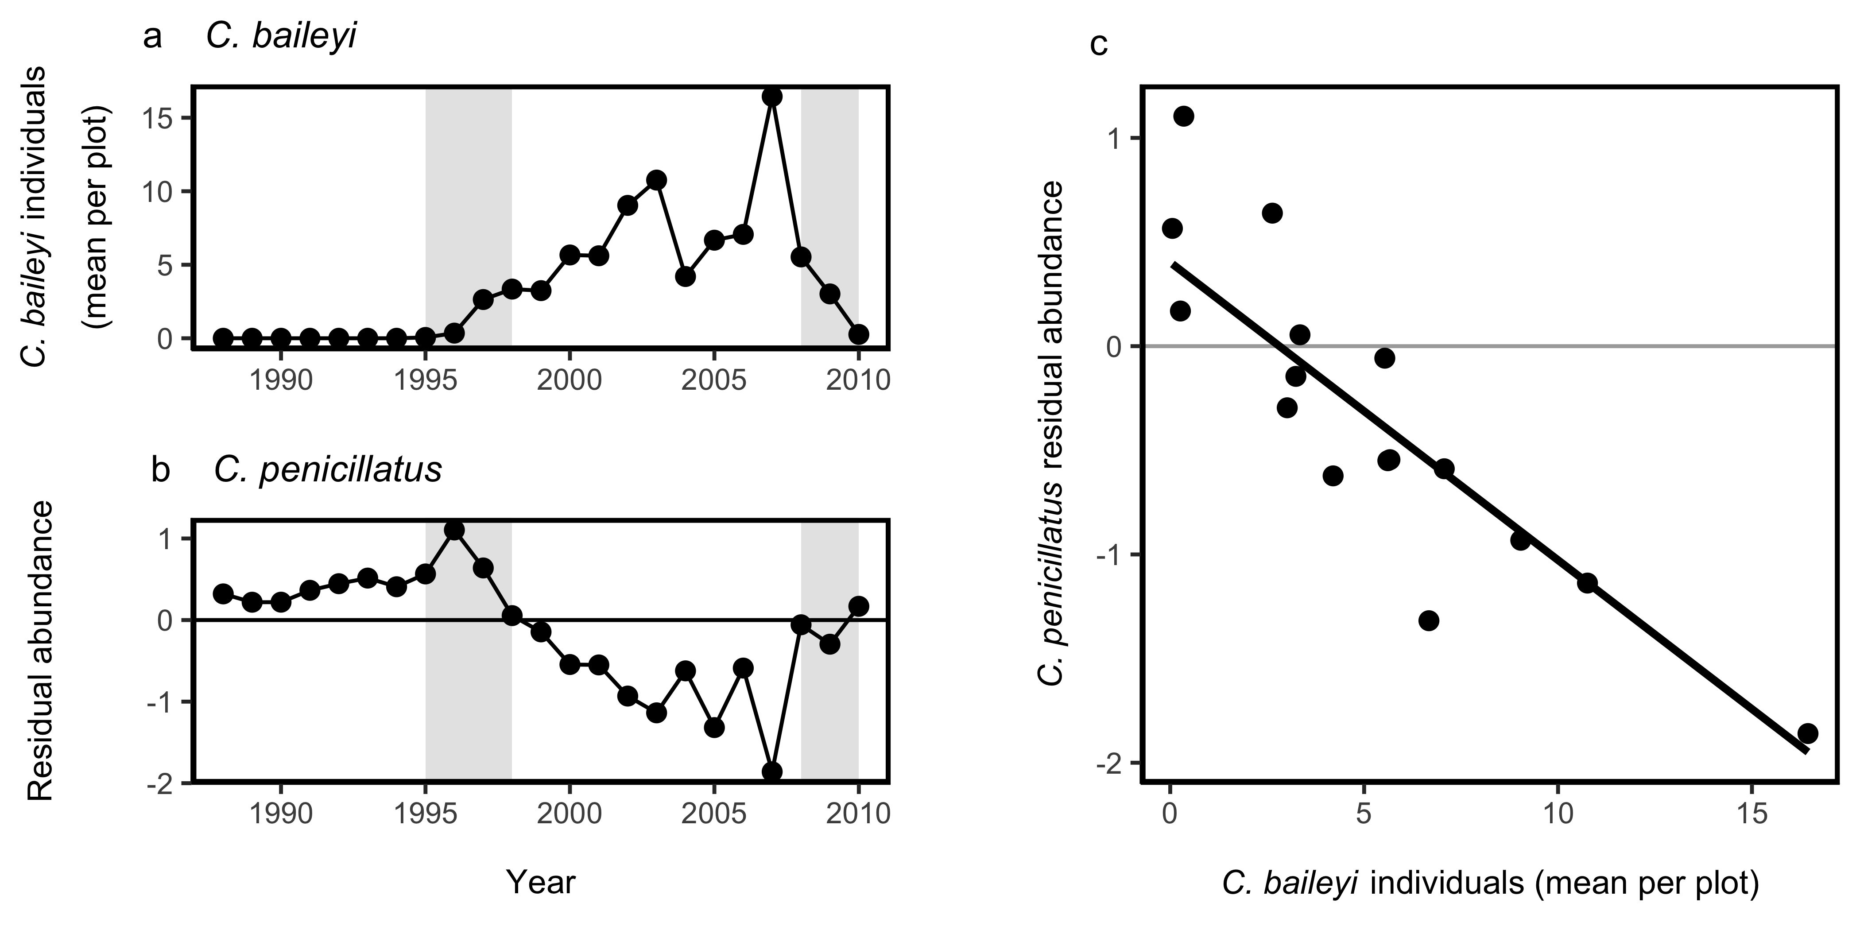
KR Exclosure
Control

