Slide 1
Common Problems in Spreadsheets
(and what to do instead)

Slide 2
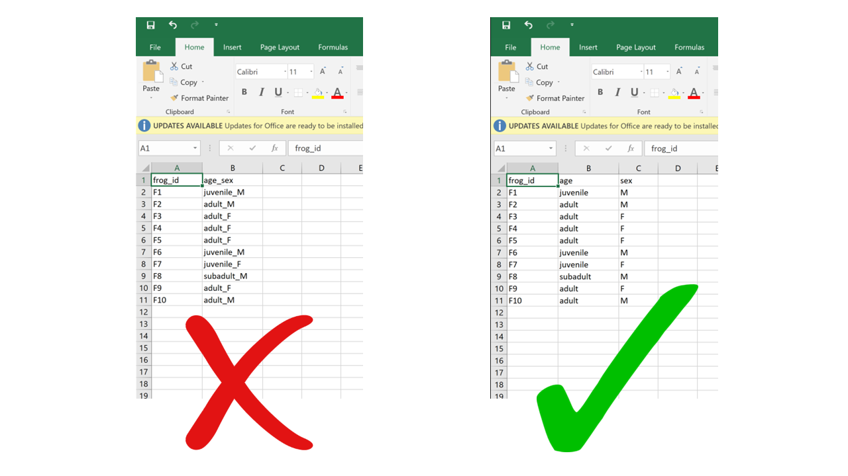
1. Multiple variables in a single column
❌
Each column should have a single variable.
Similarly, each cell should contain a single data unit/value.

Slide 3
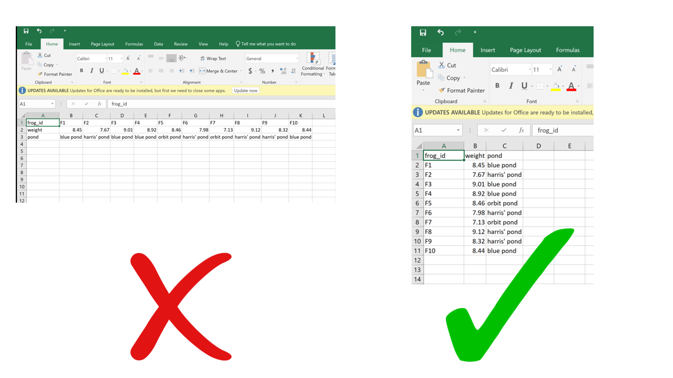
2. Rows for variables, columns for obvs.
❌
Most functions in R assume that the columns are the variables

Slide 4
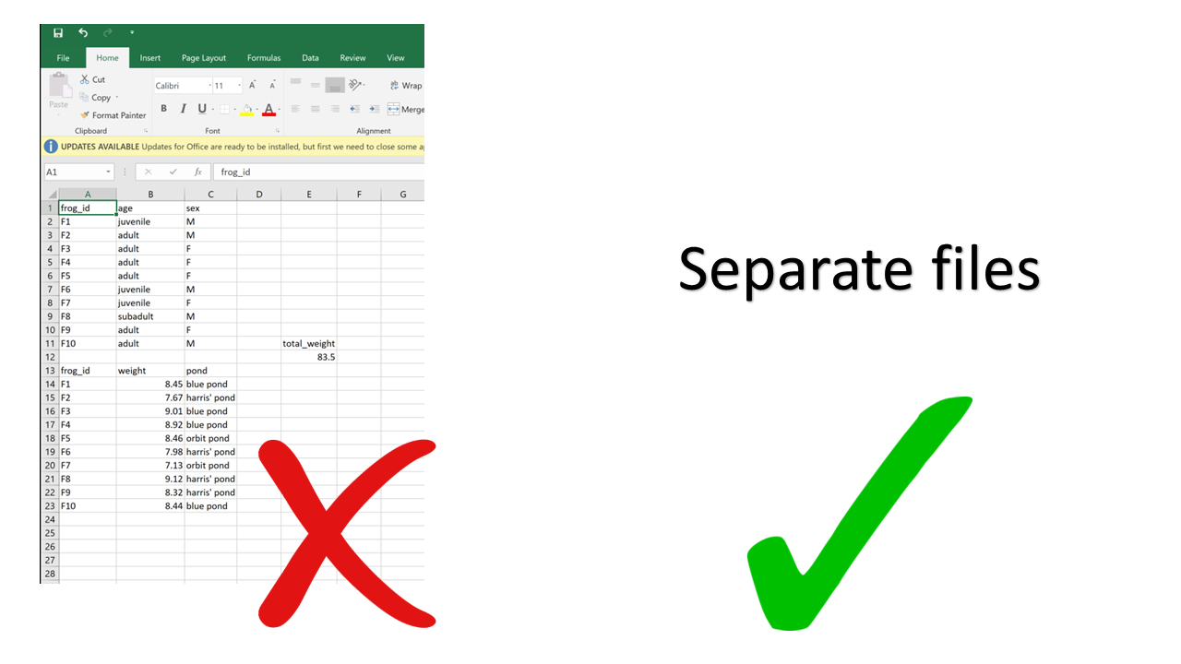
3. Multiple tables in a single spreadsheet
❌
Human-readable but not computer-readable

Slide 5
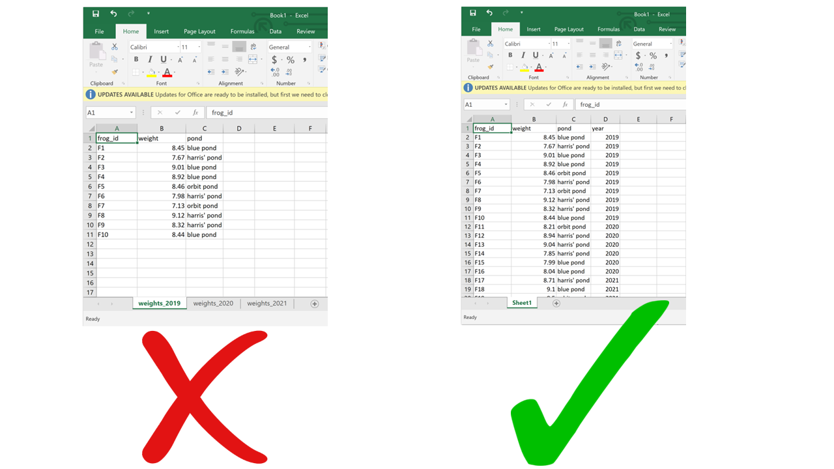
4. Multiple sheets
❌
We often want to save our files as CSV files (non-proprietary file format). CSVs are only one table, so you might lose your data.
While there are now ways to read multiple sheets/tabs into R, it should still be avoided.
If the same type of data (observational unit) is in each sheet, you can collapse it all down into one sheet! Otherwise, save them as separate files instead.

Slide 6
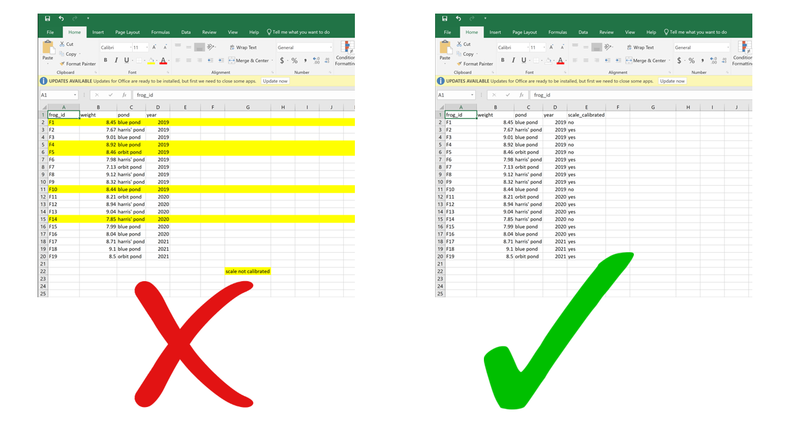
5. Using formatting to convey info
❌
Human-readable but not computer-readable. You will lose information!

Slide 7
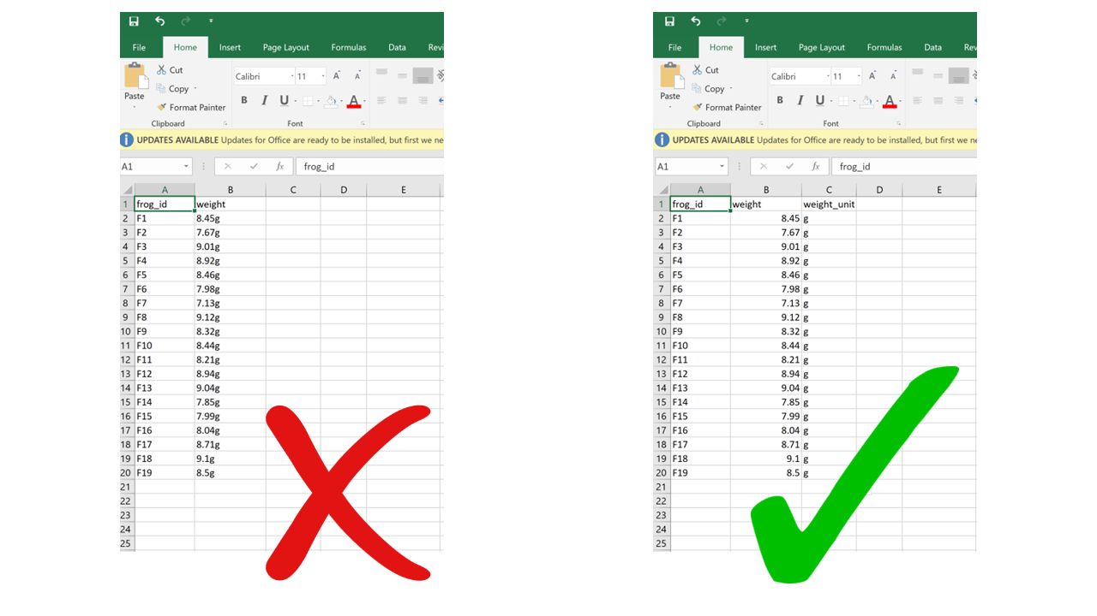
6. Putting units in cells
❌
The method of adding a specific column for the unit is fine but not ideal. It should only be used if the units differ in the column (also not great)
The best option (shown next) is to have the units included in the column name.

Slide 8
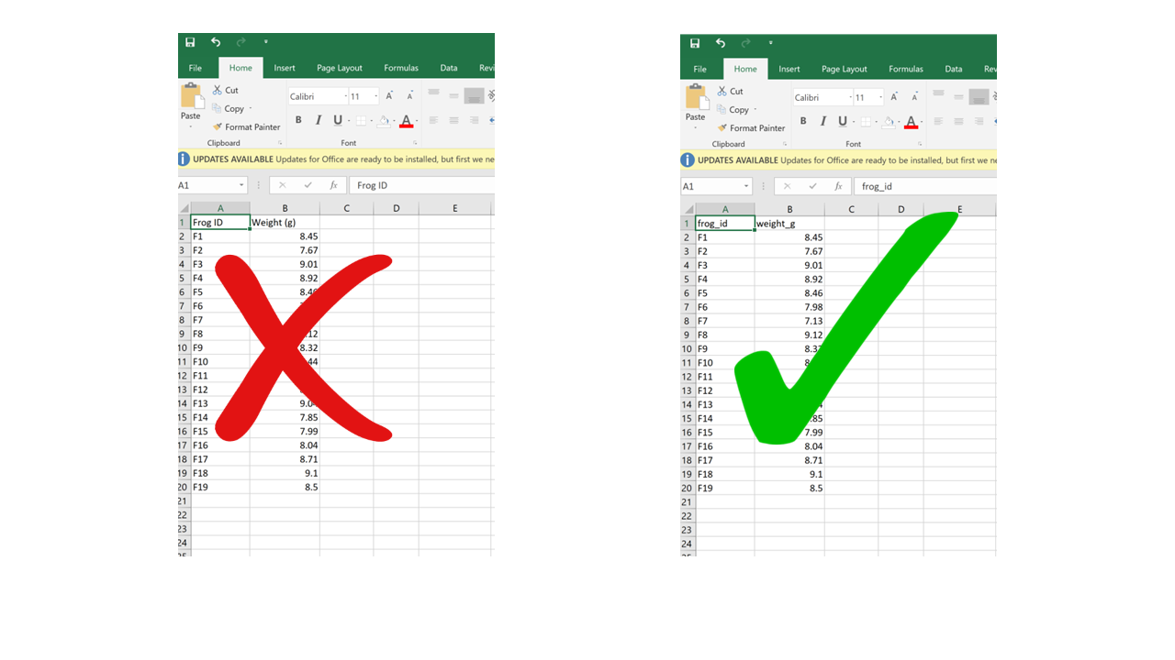
7. Improper (unhelpful?) column names
❌
Spaces and special characters (like paratheses) are not computer-friendly.

Slide 9
Other things to watch out for:
8. Conflating zeros and missing/null values (0 vs. NA)
There is a big difference between something you didn’t measure (NA) and something you did and found nothing there (0)
9. Using problematic null values
Sometimes you will see “999,” “-999,” or “-999.99” used to represent null values. This can lead to issues if not filtered out!
“Unknown” or “n/a” are often read as text, which is going to cause problems if the actual values in the column are numbers!
NA is usually your best bet (blank is ok but not great)

Slide 10
More things…
10. Inconsistent value formatting
Mismatches is text/character data is particularly tricky
Often occurs when multiple people are entering data
Watch out for capital vs. lowercase letters
11. Dates. Dates are kind of a nightmare.
Spreadsheets often try to be too helpful with dates.
One way to avoid issues is have dates in multiple columns (Day, Month, Year)
Another option is to store dates in ISO standard (YYYYMMDD)

