Slide 1
Module 2: Data, Meet Computer
Feb 7, 2022

Slide 2
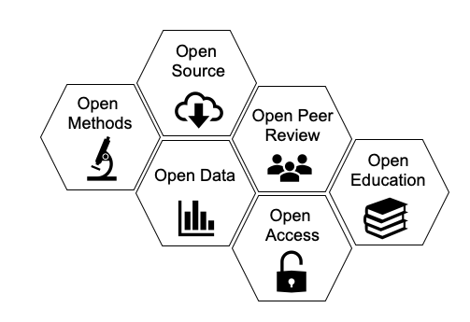
What will this module cover?
Data management
Reproducibility
Open science
How?
Best practices
Spreadsheets
Coding in the programming language R

Slide 3
Our aim is reproducible science
Reproducible: we can repeat the original study using the same data, materials, and methods
Confirms reliability of original study conclusions
Replicable: we can repeat original study using the same materials, and methods but different data
A study is deemed replicated if the replication study reached the same statistical conclusions
Computational reproducibility: Data processing, analysis, visualization, and presentation are entirely and independently reproducible, yielding the exact same outputs

Slide 4
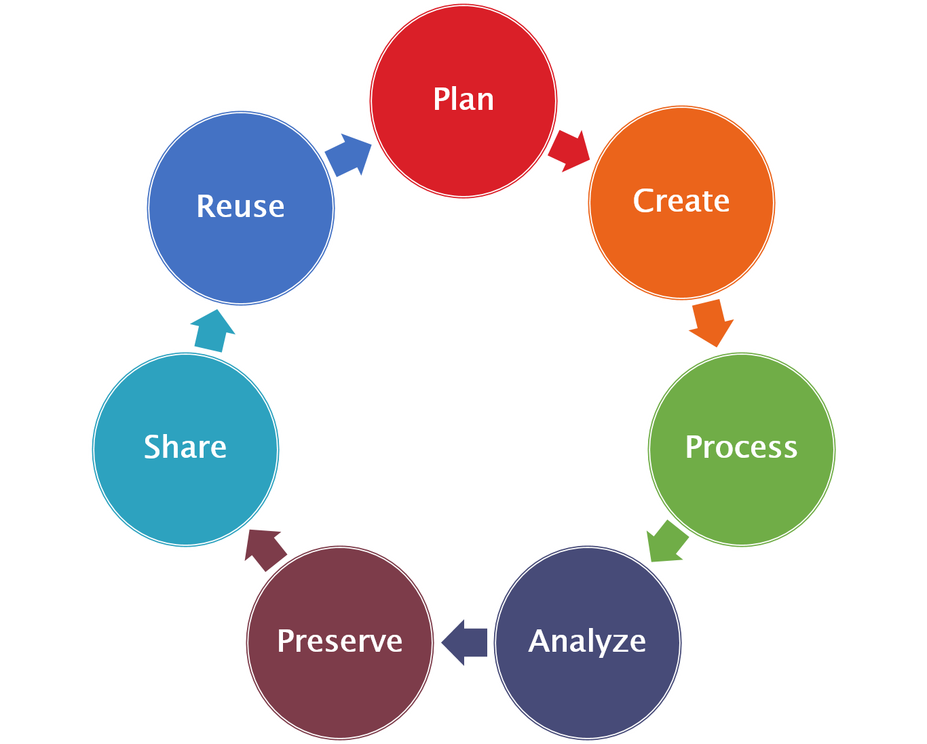
The Data Life Cycle
Data management needs to happen at all stages of the data life cycle.
Each aspect* of data management has its own best practices, or standards.
* I’m using the stages to help us walk through some key ideas, but most best practices apply throughout the data life cycle

Slide 5
1. Plan
Folder organization:
Choose a schema for file and folder names and stick to it
Names should be unique and descriptive
Names should have only letters, numbers, and – or _ (no spaces!)
Options include CamelCase, kebab-case, and snake_case
Try not to nest folders more than 3 levels
Example: My SaguaroModel2020 folder has Data, Analyses, Output folders

Slide 6
2. Create
File names:
Same practices as folder naming
Good file names use something unique and descriptive to a variety of users (not just the creator)
e.g., site, sample, collection date, type of analysis, etc.
Metadata:
Data about data, often in the form of a ReadMe file
Methods, file naming conventions, folder organization, description of any abbreviations, description of software used, licenses, etc.

Slide 7
3. Process
Data Entry and Validation:
We can use qualities of spreadsheets to our advantage when entering data to minimize mistakes.
Human- vs. Computer-readable:
We also want to make sure our spreadsheets are both human-readable and computer-readable.

Slide 8

4. Analyze
Why programming? Why not just use spreadsheets?:
“point-and-click” ≠ reproducible
This is why we always need to save a copy of the original data!
Version Control:
Keeping track of the most current iteration of your data/analysis is important!
Many ways to do this, but some are better than others
“Save as” and add the date or v1, v2, v3, etc. to the end of file names
Note changes in a ReadMe file
Software such as git/GitHub, SVN

Slide 9
5. Preserve
Back-Ups:
Ensure your data and work are backed up during your project
Follow the 3-2-1 rule
3 copies of 2 different storage types with 1 copy offsite
Archives:
When your project is done, upload your work to an archive
Some open, some not; some discipline specific, some not
Examples include Zenodo, DataVerse, GenBank

Slide 10
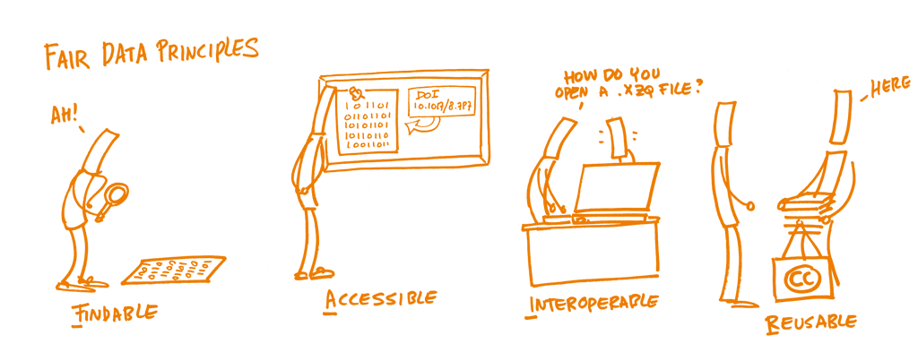
6. Share
Share data, code, analyses, manuscripts, etc.
Many archives will provide a DOI (Digital Object Identifier)
DOIs are permanent identifiers for material
Openly shared
Good metadata helps!

Slide 11

7. Re-use
Proprietary vs. Non-proprietary:
Proprietary formats/software are owned by a company
Usually not free and not interoperable (e.g., Excel, JMP, SPSS)
Non-proprietary formats/software are often called open-source and are owned by the community
Free and do not require special software (e.g., R, csv files)--interoperable
Copyrights/Licenses:
Creative Commons licenses are common
CC0 and CC-BY are standard practice for open science

Slide 12
Open Science
Scientific research conducted and communicated in an honest, accessible, and transparent way*, such that – at a minimum – a study can be reproduced and/or replicated.
* Open Science prioritizes inclusiveness, respecting cultural sensitivities and diversity in ways of knowing, and ensuring equitable engagement of all stakeholders in the research process, how it is disseminated, and how it is accessed

Slide 13
Open Science
Benefits
Concerns
Re-use methods / code that work, avoid using ones already found to be ineffective
Avoids duplication while enabling replication
Facilitates meta-analyses
Promotes more rapid and accurate discovery
Democratizes science and promotes equitable access and relevance to all stakeholders
Fear of getting scooped
Esp. relevant for early career researchers
Sense of possession over data collected given amount of time/money/energy
Sensitive data (often can be anonymized)
Locations of threatened/endangered species
Indigenous data sovereignty

Slide 14
Remember to have R and RStudio installed!
*we aren’t using them in lab today but I want to be ready to go for Wednesday in class
Notes:
https://ecorepsci.github.io/reproducible-science/spreadsheets.html

