Slide 1
Lecture 7: Intro to R/RStudio
Feb 9, 2022

Slide 2

Why use R?
Reproducibility
Command-line interface rather than “point-and-click”
Non-proprietary, meaning it is free!
Interdisciplinary
Packages expand R’s capabilities
Scales with sizeable datasets
High-quality, publication-worthy graphics
Large community to help

Slide 3

R vs. RStudio? What’s the difference?
R refers to both the programming language and the software that interprets scripts written in the language.
RStudio is an integrated development environment (IDE) that helps us interact with R more easily.

Slide 4
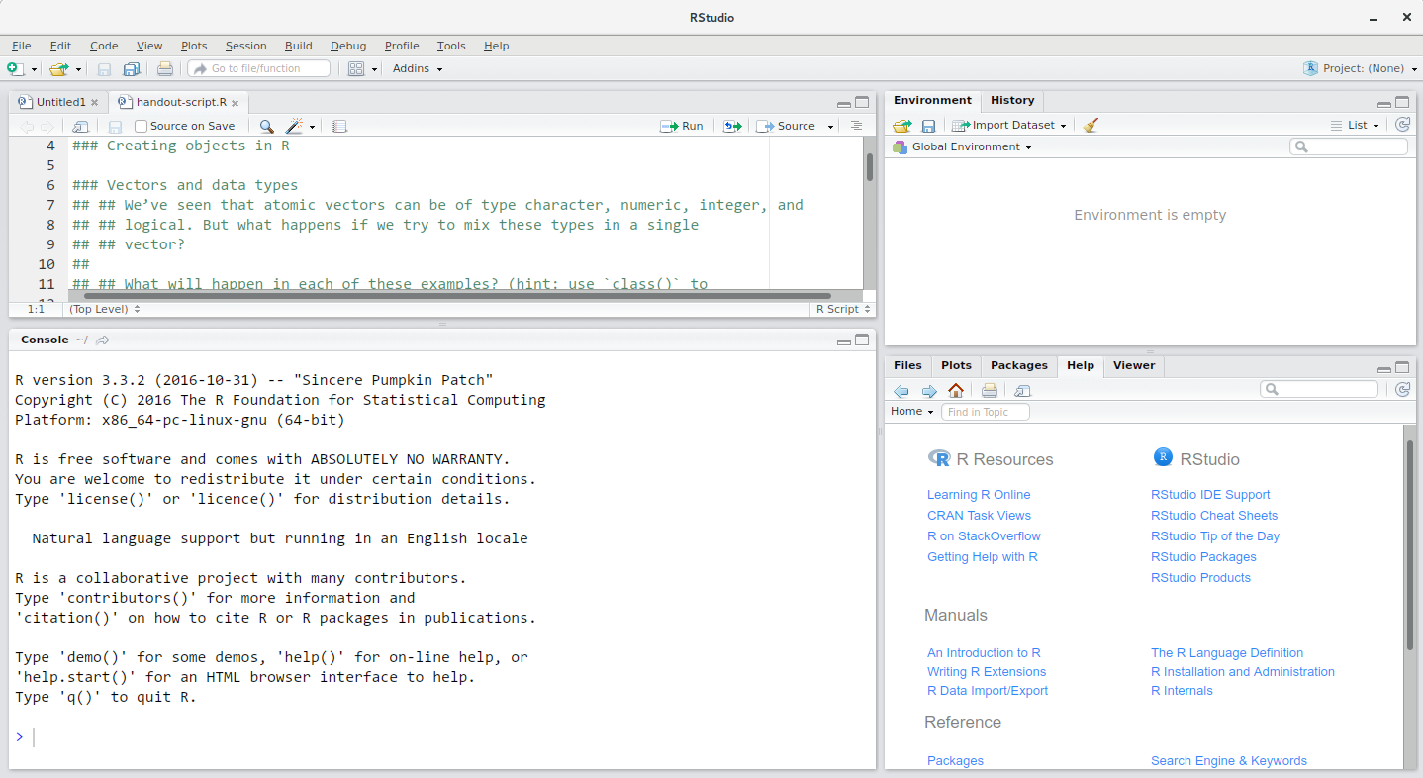
Source
This is where you create scripts and documents.
Environment
See objects in your working space
Console
Type code (not saved) and see outputs
Files/Plots/Help
See plots, find help with functions, etc.

