Slide 1
What is data (science), anyway?
Jan 17, 2023

Slide 2
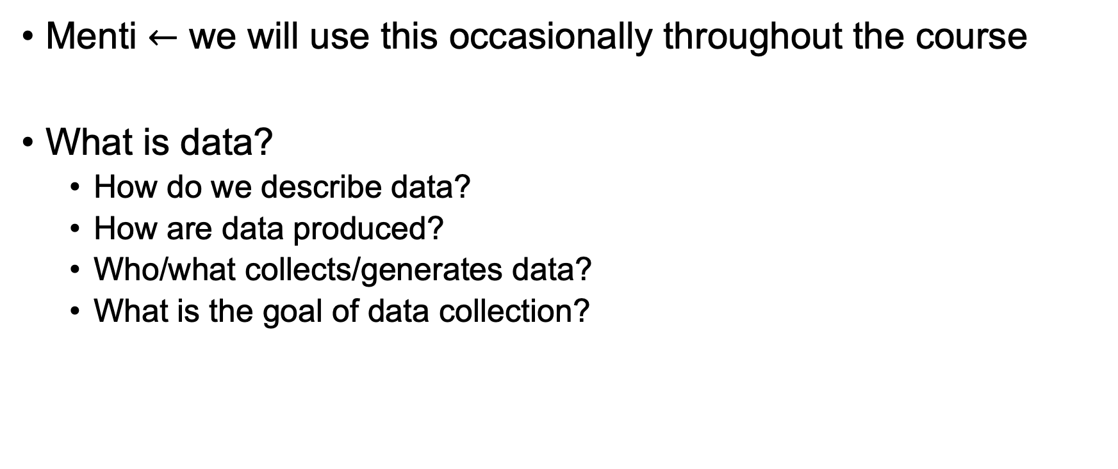
Let’s start with some questions:
Menti $←$ we will use this occasionally throughout the course
What is data?
How do we describe data?
How are data produced?
Who/what collects/generates data?
What is the goal of data collection?
Notes:
https://www.mentimeter.com/app/presentation/al7uhjxjnfd1phqmbmwb7bqw7uwzs66w
Used broadly and in a range of different ways
individual “facts”, measurements, numbers, symbols, texts
Collection of values (quantitative or qualitative) that convey information
How might we describe data? Qualitative vs. quantitative; Categorical vs. continuous
How are data produced?
Collected from the field, from measurements in experiments, from observations, from individual entities
Who collects (or generates) data?
Humans! (or human created bots)
What’s the goal of data collection?
Use as raw data for information generation -> make data-driven decisions
stored for later retrieval

Slide 3
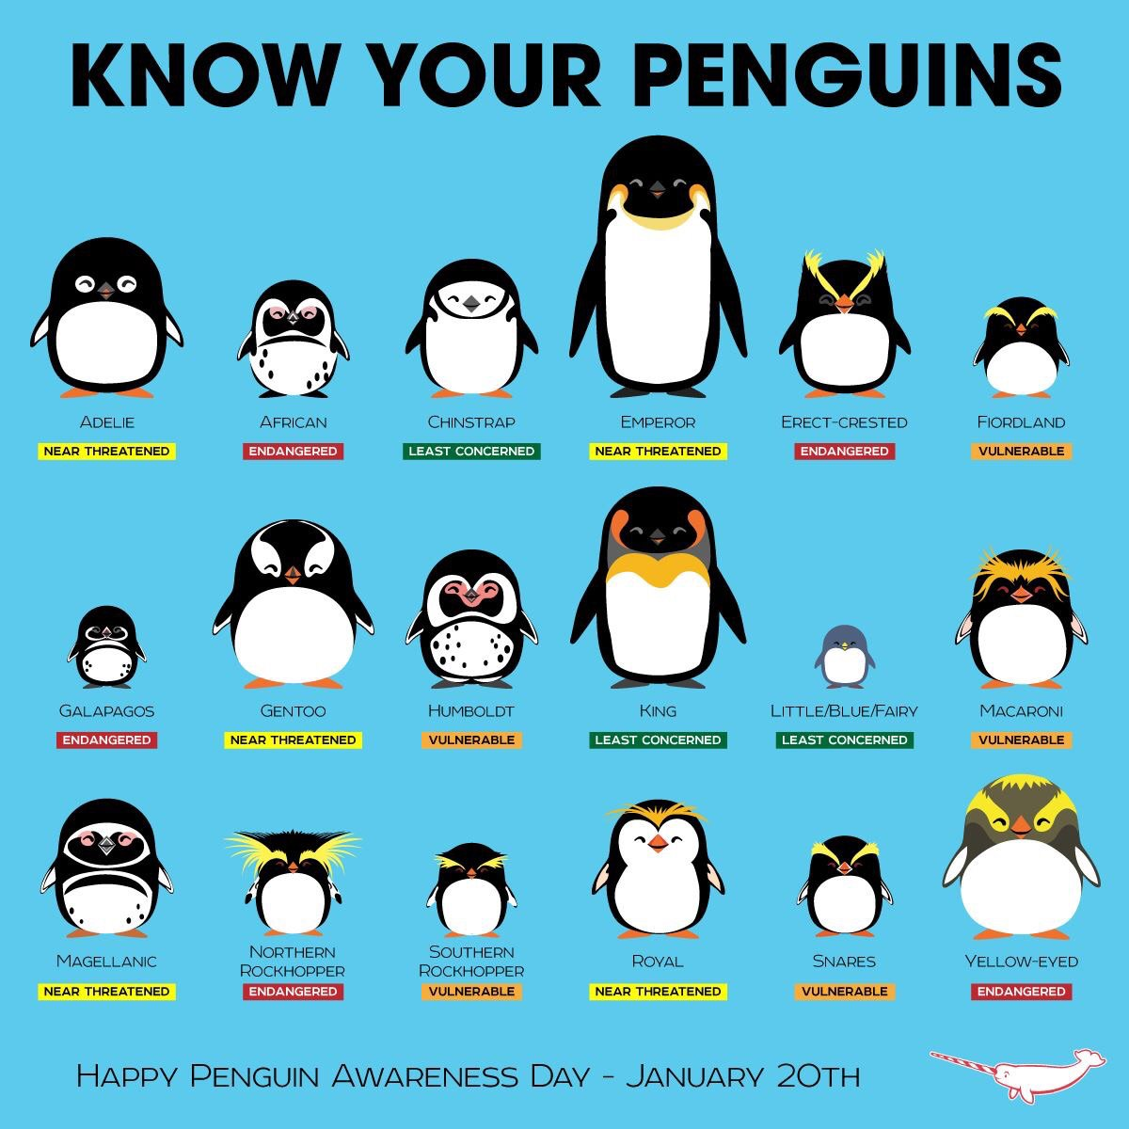
How do we describe data?
Qualitative/Categorical
Quantitative/Continuous
Penguin Densities (individuals / m²)
4.2
4.0
3.2
1.7
2.0
3.9
5.1
0.8
3.6

Slide 4
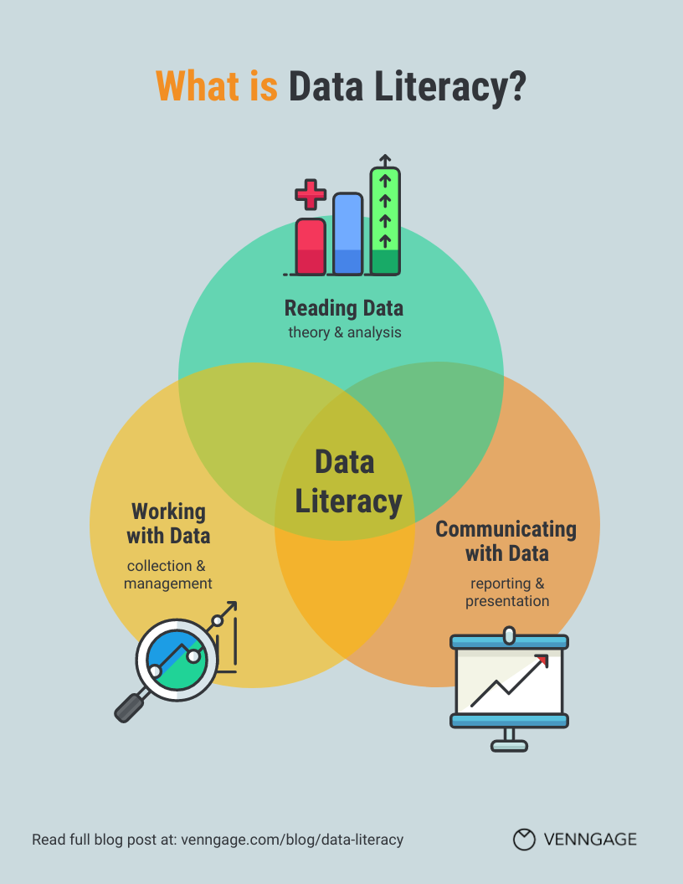
“The generally accepted definition of data literacy is ‘the ability to derive meaningful information from data’.”

Slide 5
Let’s talk about data literacy:
5-10 minutes to read article below (link in D2L announcement):
https://medium.com/@macbryla/data-literacy-skill-for-the-21st-century-702cb573fd4f
Get in groups (introduce yourselves!) and develop:
3 reasons why data literacy is important
3 questions you have about data science and data literacy after reading the article
Be prepared to report out!

Slide 6
What is data science, anyway?
Back in your groups, use the web (feel free to Google liberally) and discuss and answer the questions below.
Be prepared to report out with a summary of your answers and discussion.
What is data science?
How do you envision using a DS (data science) toolkit during your time at UA?

Slide 7
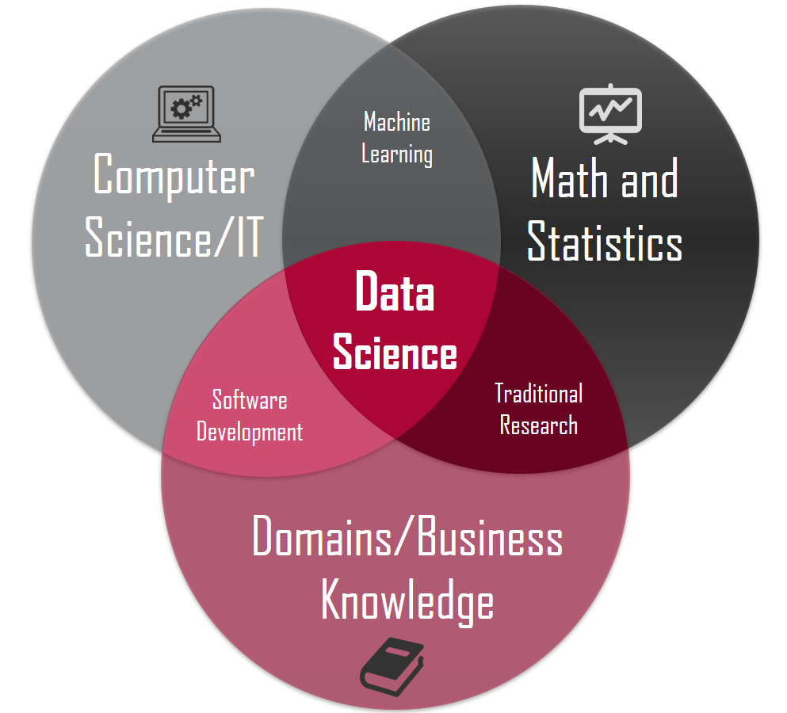

Slide 8
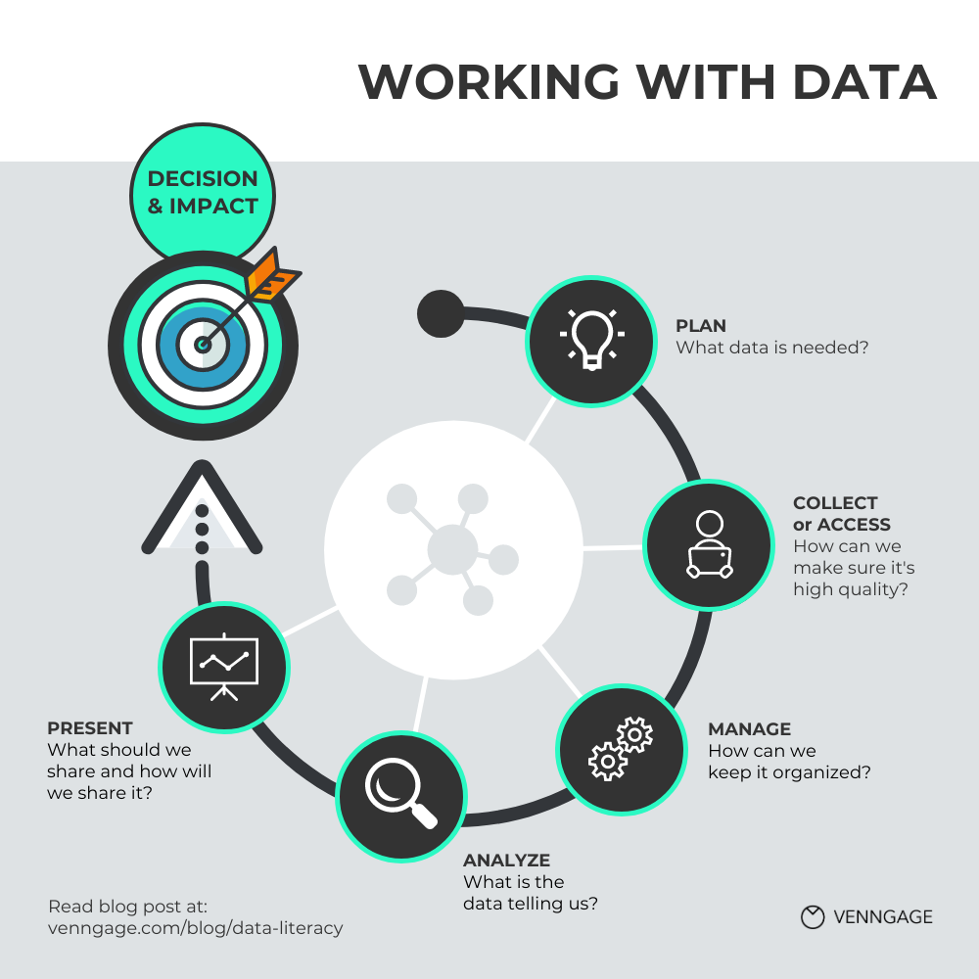
The Data Life-Cycle
In this course, we will be focusing on managing, analyzing, presenting, and making decisions
The life cycle continues; the impact of our decisions will inform our next plans!

Slide 9
Intro to R/RStudio

Slide 10

Why use R?
Reproducibility
Command-line interface rather than “point-and-click”
Non-proprietary, meaning it is free!
Interdisciplinary
Packages expand R’s capabilities
Scales with sizeable datasets
High-quality, publication-worthy graphics
Large community to help

Slide 11

R vs. RStudio? What’s the difference?
R refers to both the programming language and the software that interprets scripts written in the language.
RStudio is an integrated development environment (IDE) that helps us interact with R more easily.

Slide 12
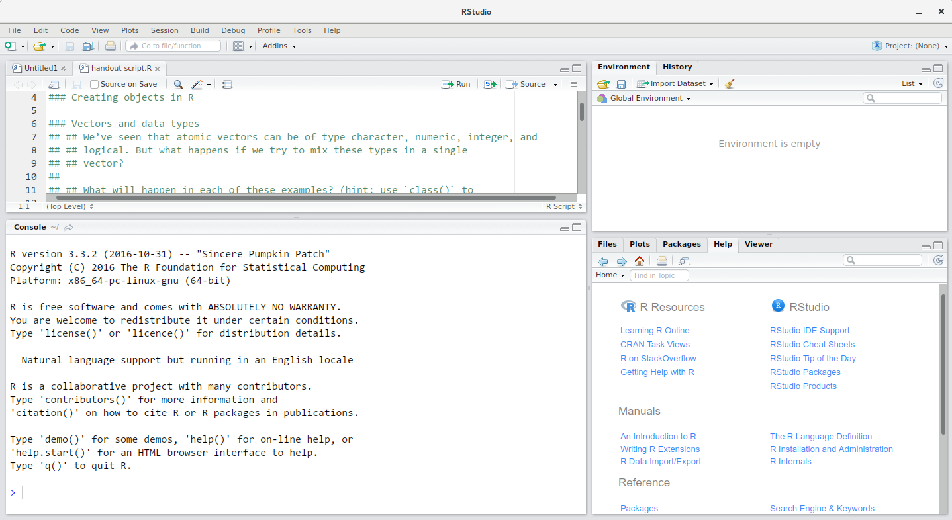
Source
This is where you create and use scripts and documents.
Environment
See objects in your working space
Console
Type code (not saved) and see outputs
Files/Plots/Help
See plots, find help with functions, etc.

