Slide 1
Intro to R/RStudio
Jan 19, 2023

Slide 2
Our Aim is Reproducibility
Reproducible: we can repeat the original study using the same data, materials, and methods
Confirms reliability of original study conclusions
Replicable: we can repeat original study using the same materials, and methods but different data
A study is deemed replicated if the replication study reached the same statistical conclusions
Computational reproducibility: Data processing, analysis, visualization, and presentation are entirely and independently reproducible, yielding the exact same outputs

Slide 3

Why use R?
Reproducibility
Command-line interface rather than “point-and-click”
Non-proprietary, meaning it is free!
Interdisciplinary
Packages expand R’s capabilities
Scales with sizeable datasets
High-quality, publication-worthy graphics
Large community to help

Slide 4

R vs. RStudio? What’s the difference?
R refers to both the programming language and the software that interprets scripts written in the language.
RStudio is an integrated development environment (IDE) that helps us interact with R more easily.

Slide 5
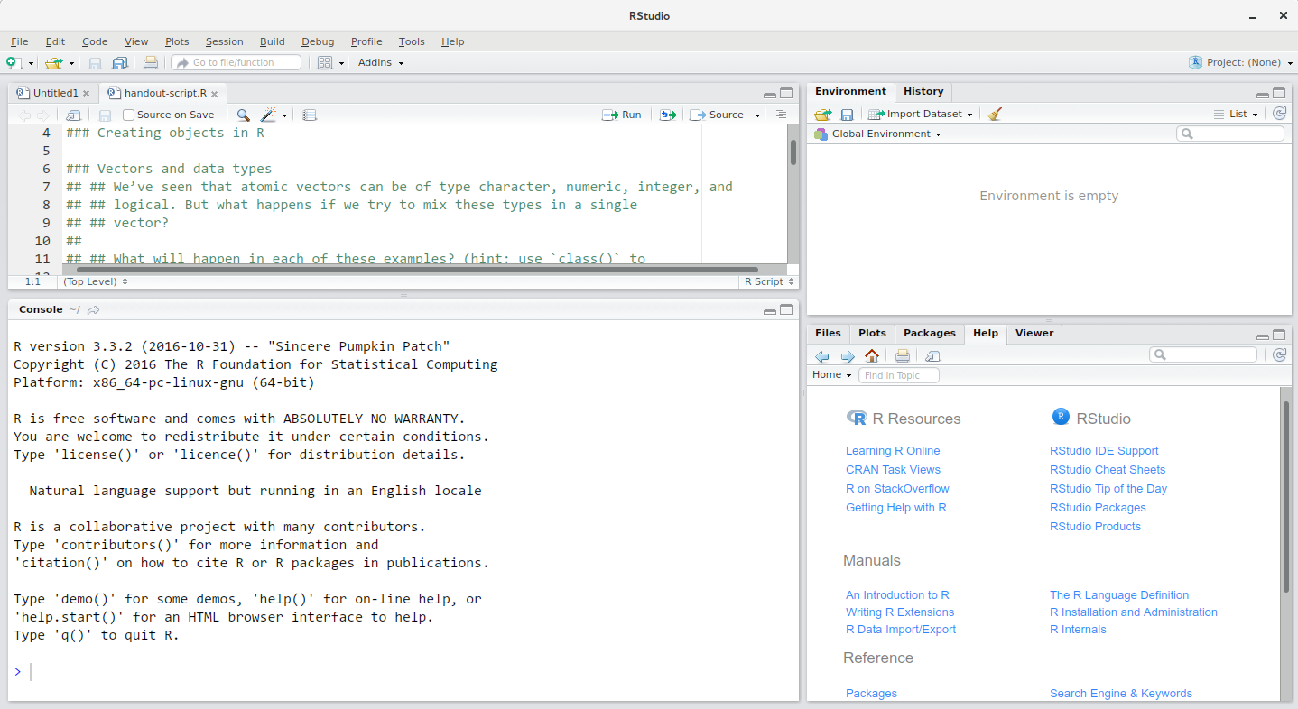
Source
This is where you create scripts and documents.
Environment
See objects in your working space
Console
Type code (not saved) and see outputs
Files/Plots/Help
See plots, find help with functions, etc.

Slide 6

The company known as RStudio has renamed itself posit.
What does this mean for us?
We will be using the RStudio interface on the internet
This space is called posit Cloud
First, a demo!
https://tinyurl.com/RStudioCloud
Now, let’s get started with our accounts.
https://tinyurl.com/positcloud-WFSC223-Spring2023

