Slide 1
Descriptive Statistics
February 14, 2023

Slide 2
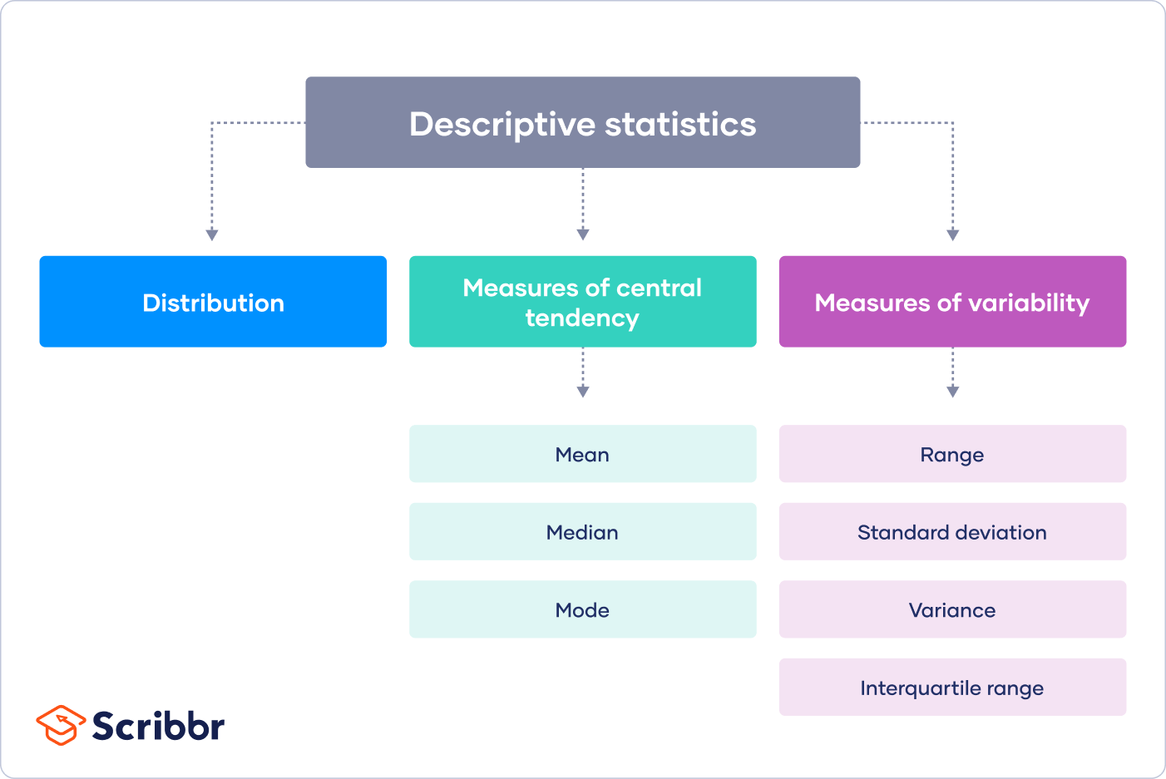
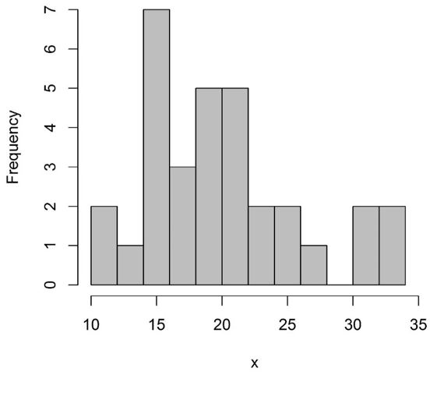
Notes:
https://www.scribbr.com/statistics/descriptive-statistics/

Slide 3
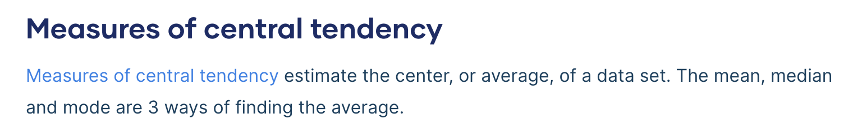

Slide 4
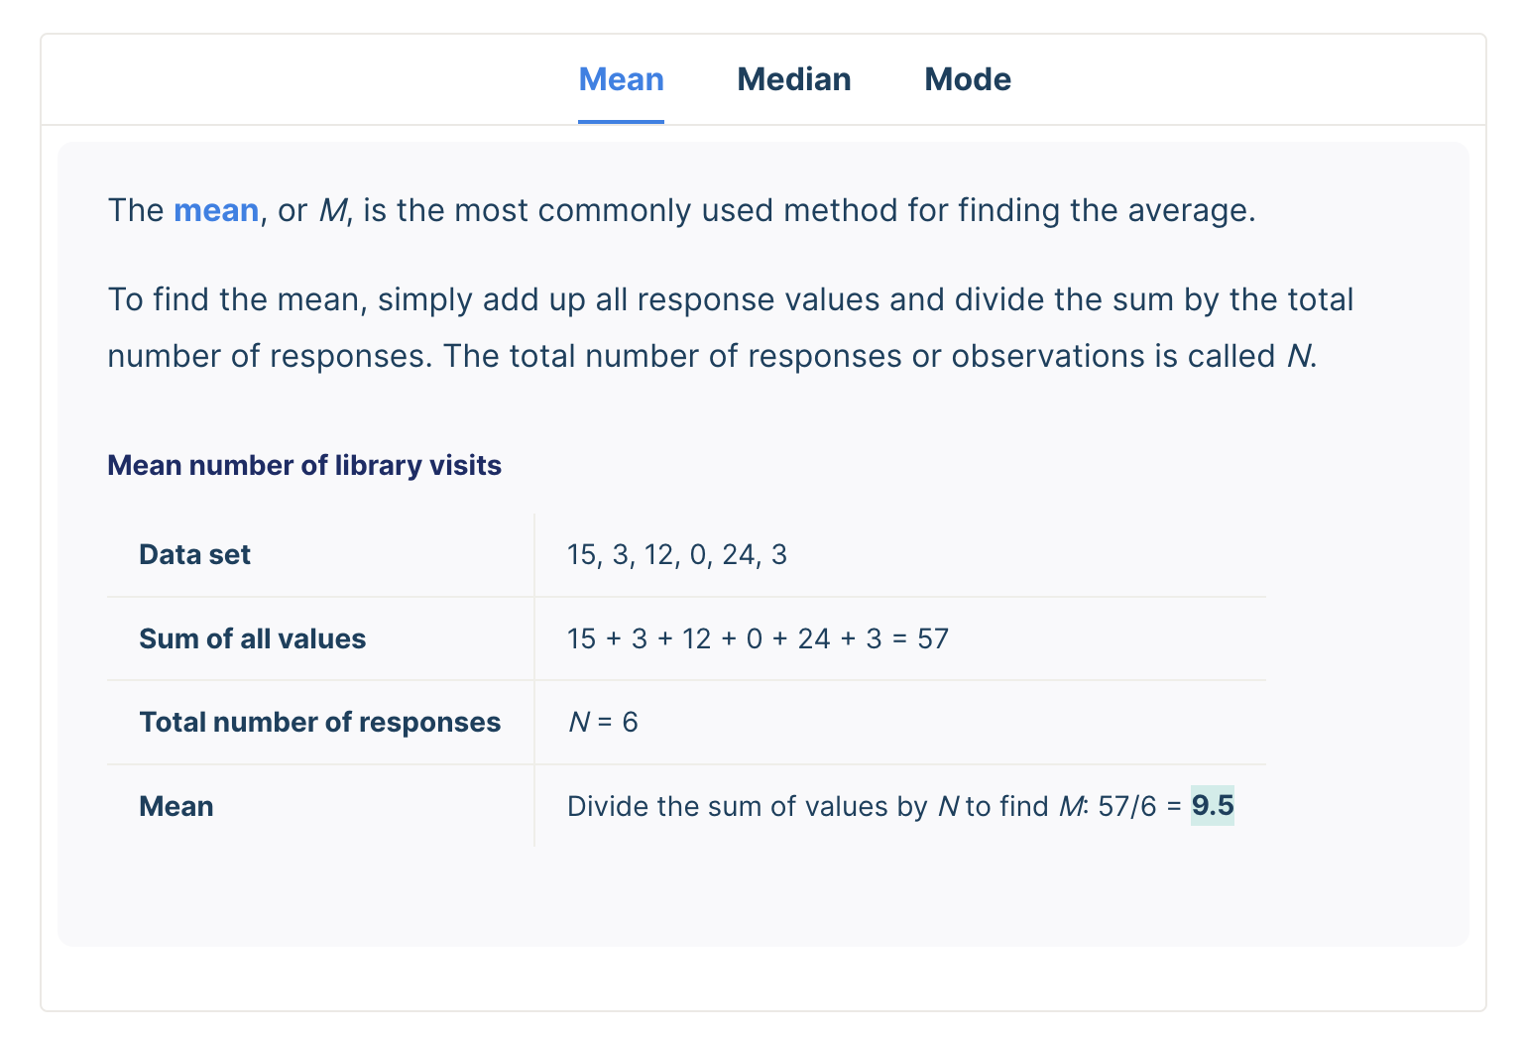

Slide 5
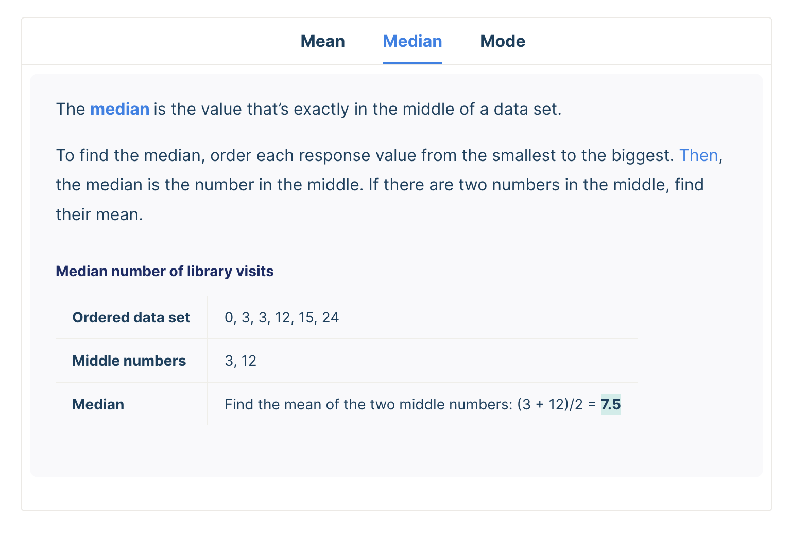

Slide 6
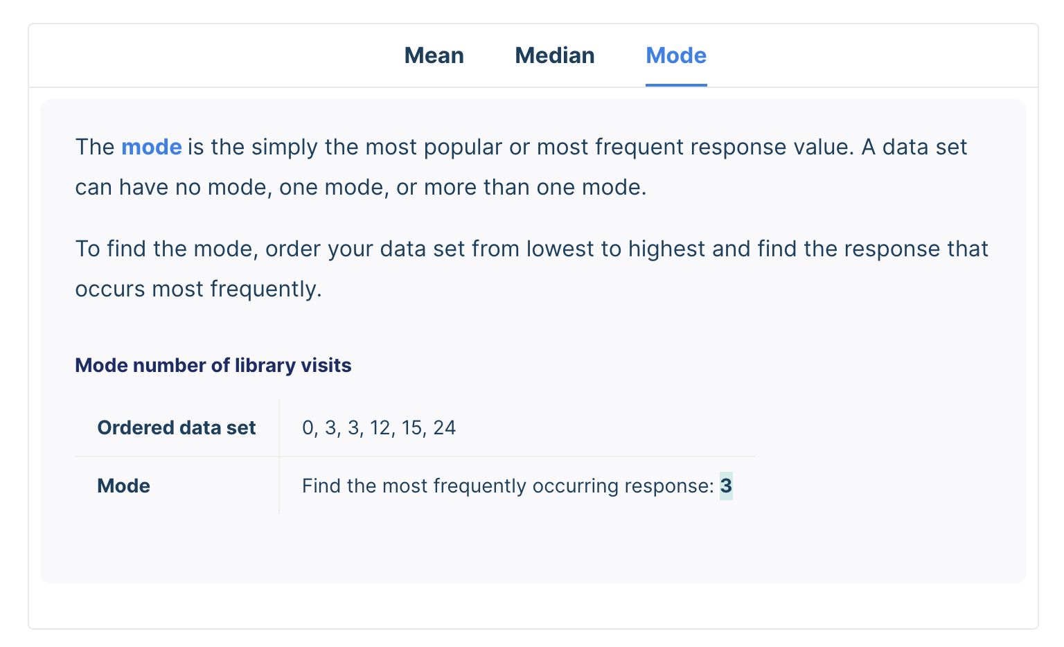

Slide 7
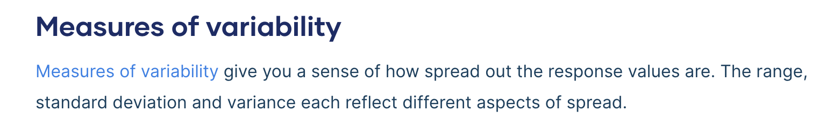

Slide 8
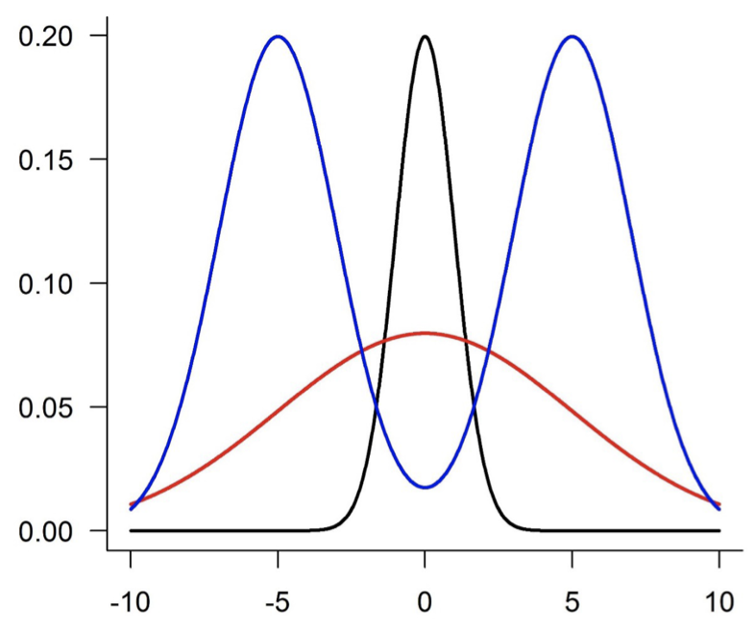
Why do we need measures of variability?

Slide 9
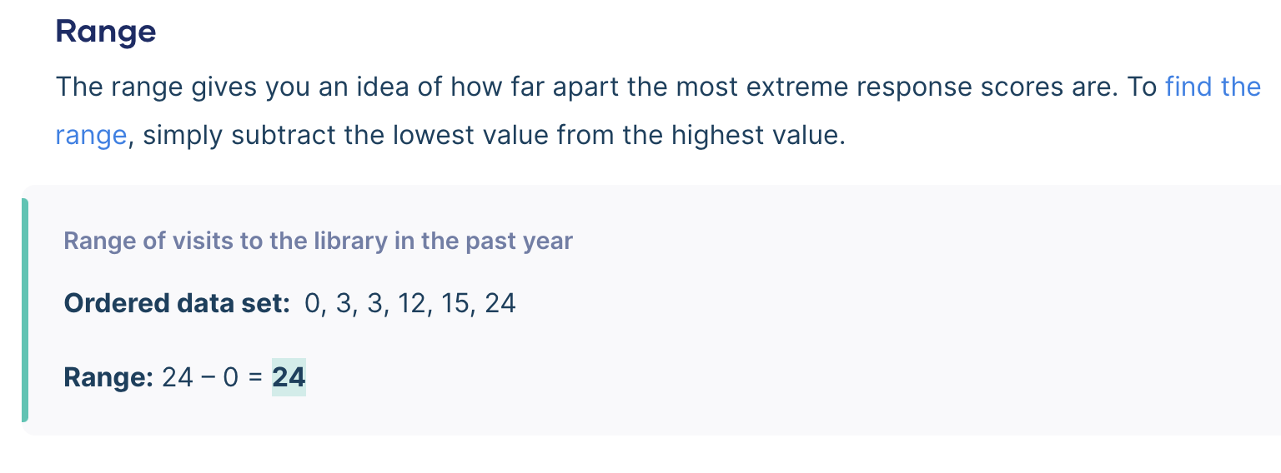

Slide 10
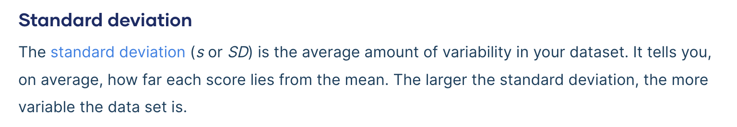

Slide 11
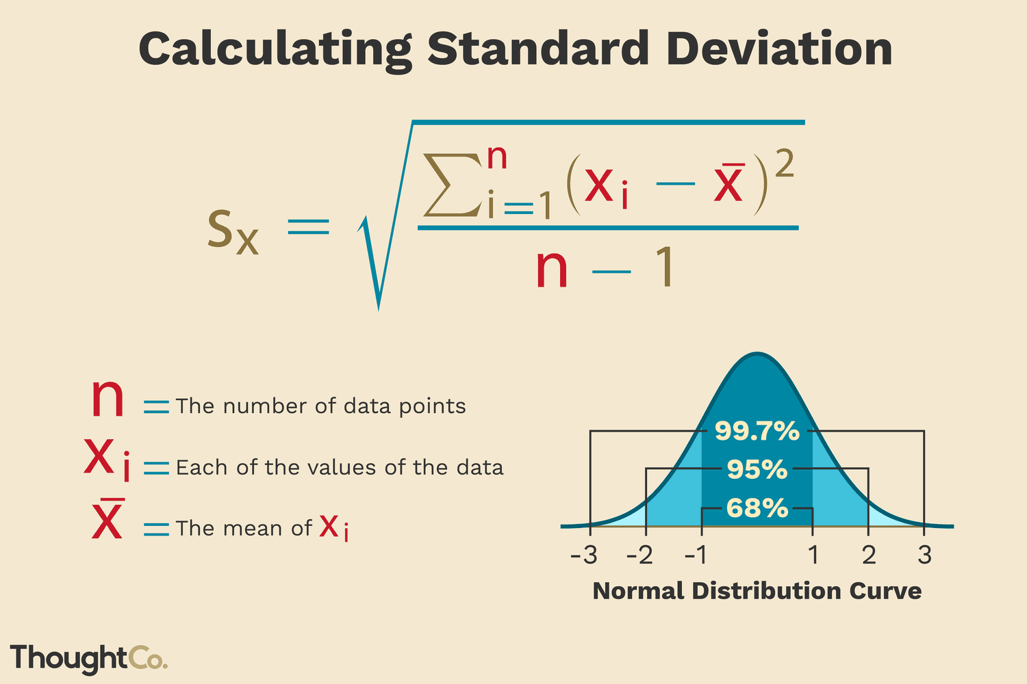
You don’t need to know how to calculate the standard deviation by “hand,” but you should know the general components of the equation

Slide 12
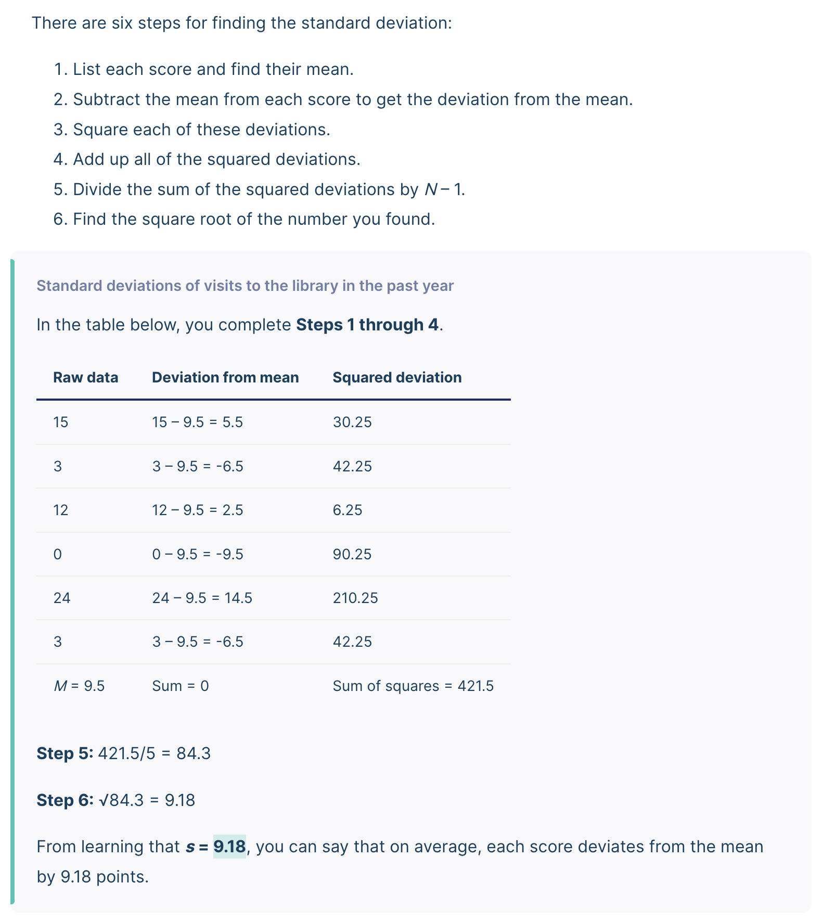
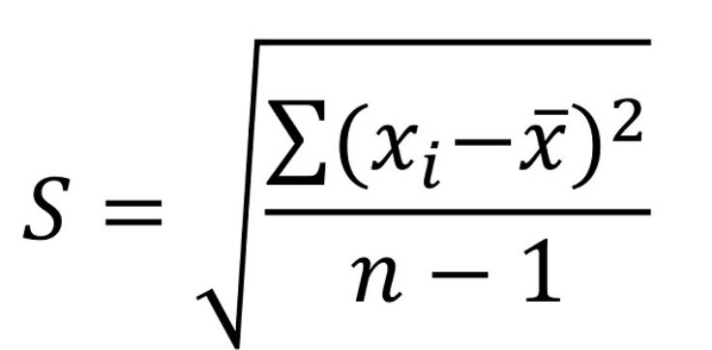
Measure of how different values are from the average
Measure of how many values there are in total

Slide 13
Notes:
https://www.scribbr.com/statistics/descriptive-statistics/

