Slide 1
Correlation Coefficient (r)
A number between -1 and 1
Looks at relationship between 2 numeric variables
-1: perfect negative (as x gets larger, y gets smaller)
0 - no relationship (flat line)
1: perfect positive relationship: as x gets larger, y gets larger
1 or -1 if all points fall exactly on the line

Slide 2
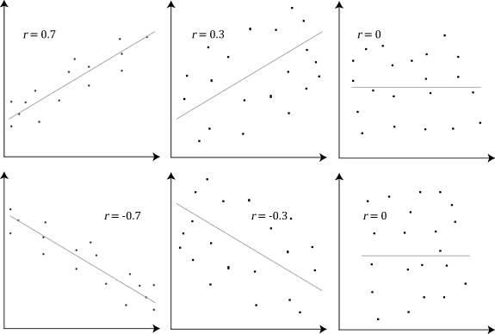

Slide 7
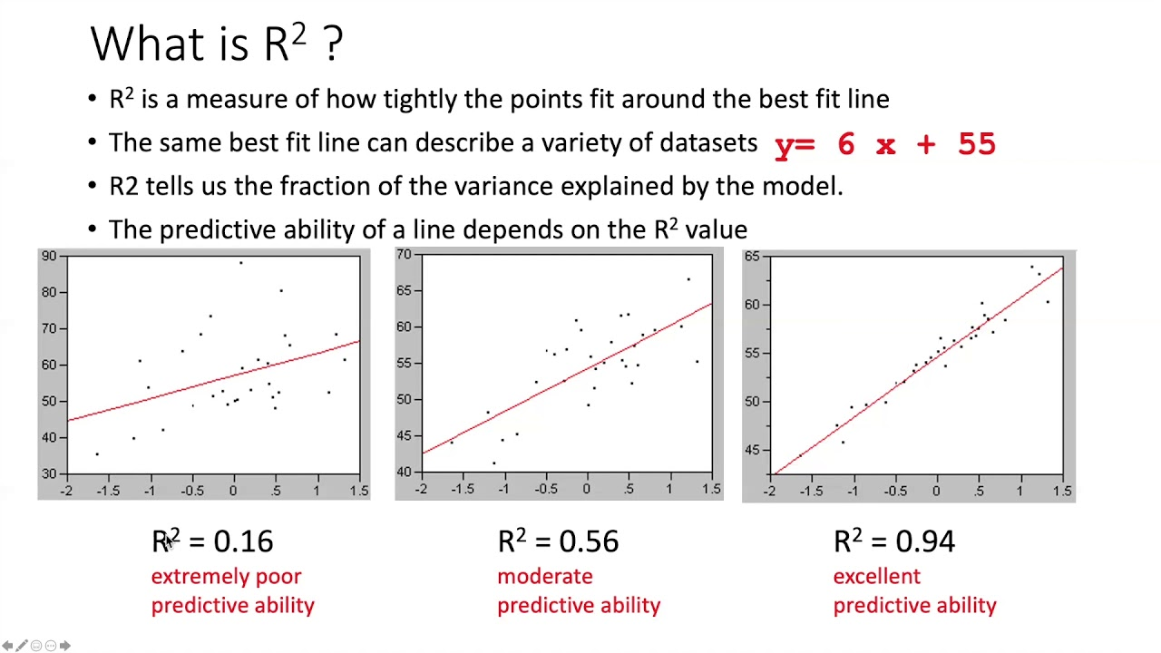
R²
Calculated by squaring the correlation coefficient
R² is a measure of how tightly the data points fit around the “line of best fit”
Tells us how much variation is explained

