Slide 1
Analyzing and predicting the phenotype of aspirin hypersensitivity
Brendan J. Lee

Slide 2
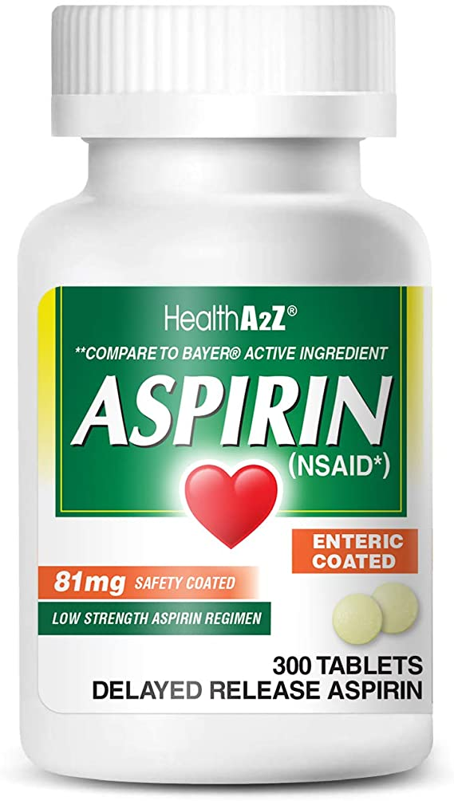

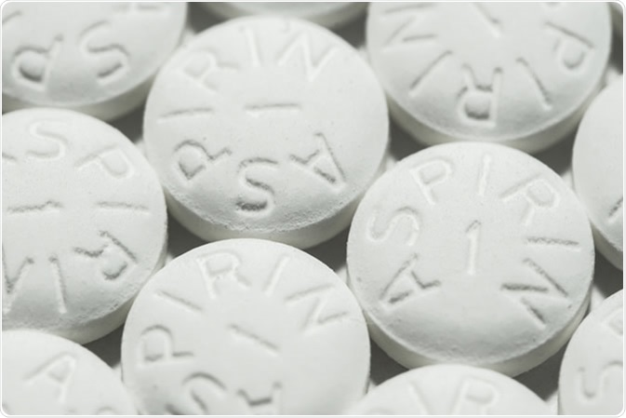
Notes:
-Aspirin is a very common non-steroidal anti-inflammatory drug (NSAID) that is available over-the-counter
-It can be used as a blood thinner to prevent heart attacks, strokes, and blood clots
-It can also be used for pain relief, fever reduction, or to treat a wide range of diseases
-It is a synthetic drug and its precursor is derived from the willow tree
-Compared to ibuprofen, which is another very common NSAID used for the same exact purpose, aspirin does not increase the risk of cardiovascular disease or side effects

Slide 3
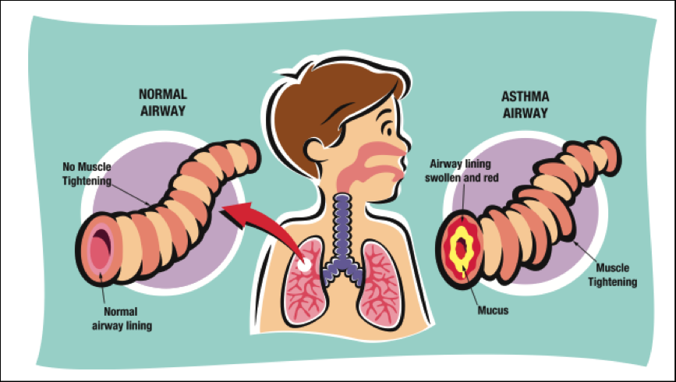
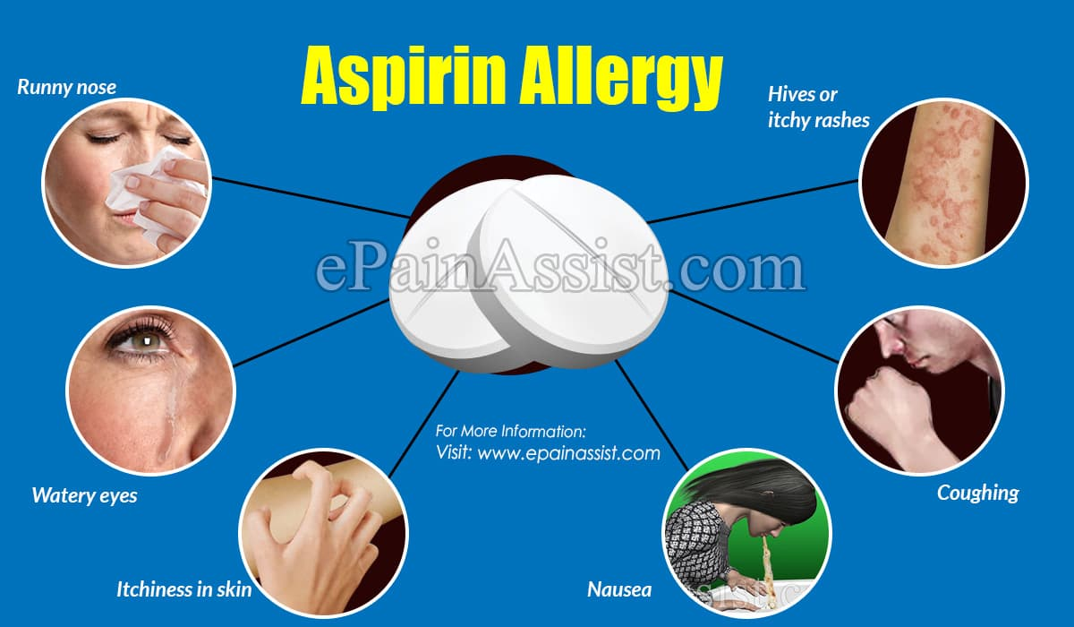
Aspirin Hypersensitivity (or “Allergy”)
About 1-3% of people have this phenotype
Individuals with this phenotype usually develop asthma, nasal polyps, or hives after taking aspirin
9% of adults with asthma have Aspirin-Exacerbated Respiratory Disease (AERD)
30% of adults with both asthma and nasal polyps have AERD
People with this phenotype avoid taking all NSAIDs in order to prevent adverse events
Symptoms persist after adverse reactions occur
Notes:
-Although the drug has many side effects, the most adverse effects are observed in about 1 percent of the population
-The main symptoms of aspirin hypersensitivity are asthma, nasal polyps, and sinusitis after taking the drug. Some people also develop hives or other adverse reactions.
-Asthma is a condition in which a person’s airways become inflamed, narrow and swell, and produce an excess of mucus, making it difficult to breathe
-Estimated proportion of adults with asthma who have AERD has risen over time
-Doctors advise people with this phenotype to simply stop taking all non-steroidal anti-inflammatory drugs, so that adverse reactions can be avoided. Instead, the patients are advised to take other anti-inflammatory drugs like paracetamol or codeine (the best way to prevent adverse reactions is to prevent people with this phenotype from taking aspirin. This project aims to facilitate this prevention by making predictions)
-However, after an adverse reaction to aspirin occurs, symptoms often persist and often have to be treated with medications to relieve their symptoms

Slide 4
Note from Chang et. al.
“Approximately 20% of patients are entirely unaware of suffering from aspirin intolerance,⁴ and we previously observed that one-third of AERD subjects do not have a history of aspirin hypersensitivity.⁵ In addition, 25% of those requiring emergency mechanical ventilation are aspirin intolerant.^{7, 8} Nevertheless, AERD remains widely under-diagnosed because of insufficient awareness of the relationship between aspirin ingestion and asthma exacerbation^{4, 5} and inadequate diagnostic tools.⁹ Thus, the identification of aspirin hypersensitivity is essential to avoid serious complications”

Slide 5
Goals of Project
Find genetic variants that are associated with aspirin hypersensitivity, using the data of cases and controls and various resources on OpenCravat
Use machine learning to determine whether a patient is at risk for aspirin hypersensitivity, based on their genetic data

Slide 6
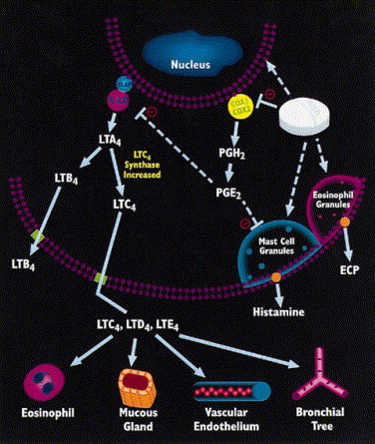
What Biological Mechanisms are Associated with Aspirin Hypersensitivity?
Consider aspirin’s main mechanism of action
Dysfunction of this mechanism can lead to eosinophilic and mast cell inflammation of nasal and bronchial tissues after aspirin ingestion
COX-1/COX-2, ALOX-5 (5-LO), LTC4 Synthase genes play a role in this interaction, variants in genes could affect this interaction
Could cause LTC4 to become over-expressed and result in over-production of cysteinyl-leukotrienes, which are known to directly cause asthma symptoms
There’s a debate over what enzyme (step of the mechanism) is most affected in patients with aspirin hypersensitivity
Variants that affect all 3 enzymes have been shown to increase likelihood of aspirin hypersensitivity
Notes:
-COX-1, COX-2: allelic variant affects structure of enzyme, affecting the extent to which aspirin interacts with the enzyme
-COX = cyclooxygenase
-LTC4 Synthase: allelic variants causes this enzyme to be over-expressed
-ALOX5: enzyme that transforms fatty acids into leukotrienes

Slide 7
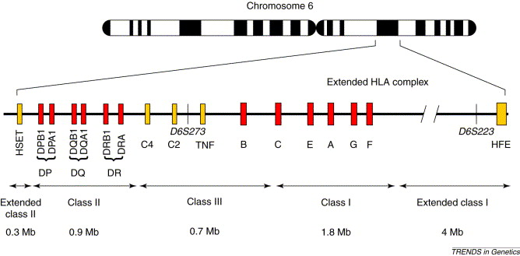
What Biological Mechanisms are Associated with Aspirin Hypersensitivity?
Human leukocyte antigen (HLA) is a system of proteins expressed in leukocytes that regulate the immune system by recognizing a foreign antigen
Increased frequency of variants in the HLA-DPB1 and HLA-DPBQ genes for AERD patients
Suggests that antigen recognition plays a role in AERD
Researchers found that HLA antigen recognition leads to increased release of Cys-leukotrienes

Slide 8
Other genes associated with aspirin hypersensitivity, based on biological mechanism
CYSLTR1and CYSLTR2: receptors which Cys-leukotrienes bind to, causing bronchoconstriction
TBXA2R: receptor for a potent bronchoconstrictor, could augment the bronchoconstrictive response to inhaled aspirin
FcεR1β : associated with asthma
Several other genes related to immune response and inflammatory pathways
Notes:
-”The cysteinyl-leukotrienes act at their cell-surface receptors CysLT1 and CysLT2 on target cells to contract bronchial and vascular smooth muscle, to increase permeability of small blood vessels, to enhance secretion of mucus in the airway and gut, and to recruit leukocytes to sites of inflammation.” (Wikipedia)

Slide 9
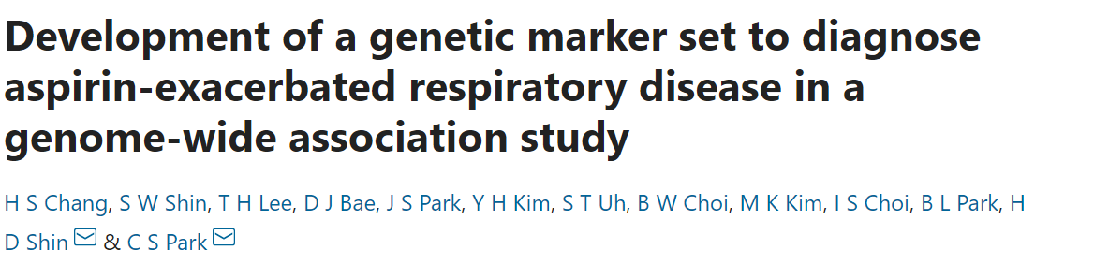
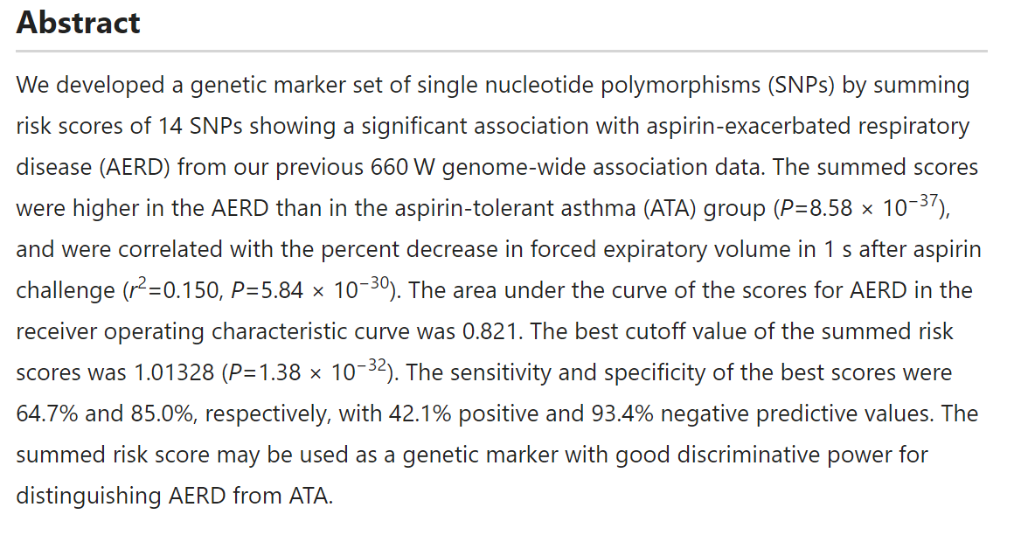
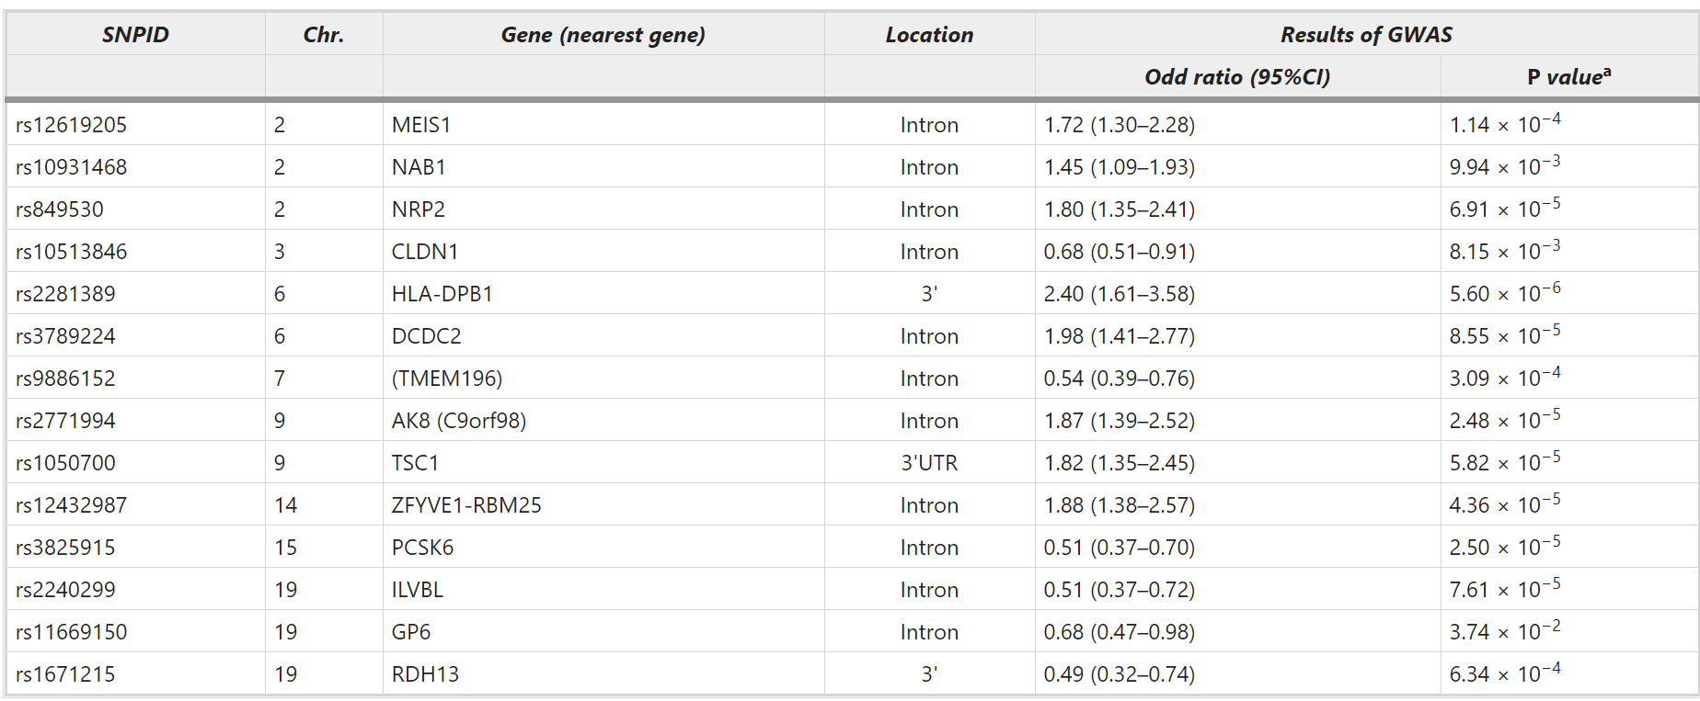

Notes:
Source: Chang et. al.
-14 variants associated with AERD were determined from GWAS

Slide 10
Method Summary
Collection of 23andMe Files from OpenSNP (cases and controls)
Use of OpenCravat Annotation Tools and Fisher’s Exact Test to find significant variants in cases
Development of several machine learning methods with R to build a classifier for this phenotype
Performance evaluation of methods in #3, determination of the most accurate classifier

Slide 11
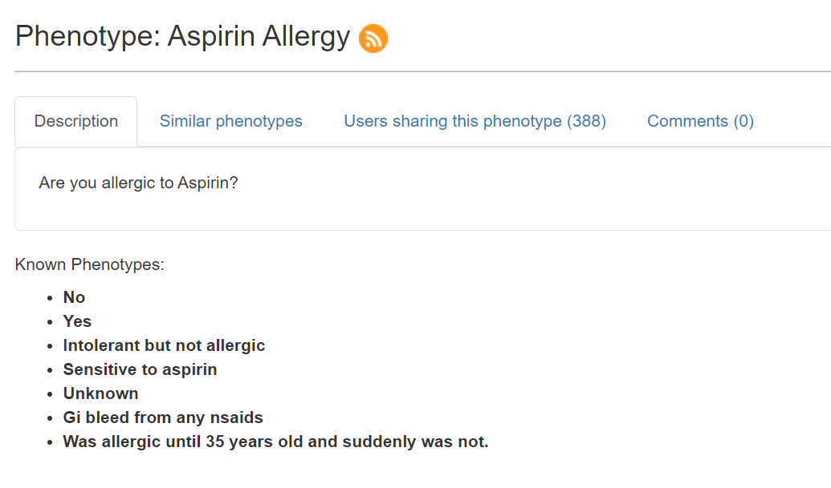
Collecting 23andMe Files from OpenSNP
25 Cases (“Yes” or “Sensitive to Aspirin”)
25 Controls (“No”)

Slide 12
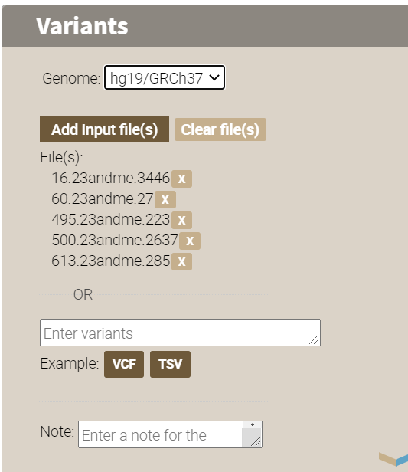

Annotating all files with OpenCravat to find related variants
All case and control files will be run in one OpenCravat job
The PharmGKB, GeneOntology, and GTEx eQTLs Annotators will be used to find variants related to:
Reactions to Aspirin
Immune System/Inflammatory response
Respiratory System
Possibly some others (e.g. skin rashes, etc.)

Slide 13

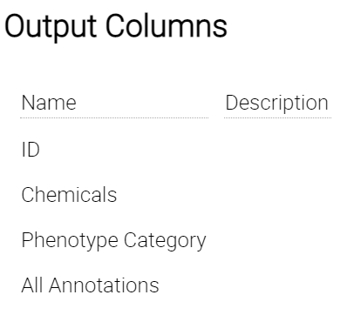
Annotating all files with OpenCravat to find related variants
Finds variants that are known to affect the body’s reaction to chemicals/drugs
Notes:
-this will be used to find variants associated with interactions with aspirin or other NSAIDs

Slide 14

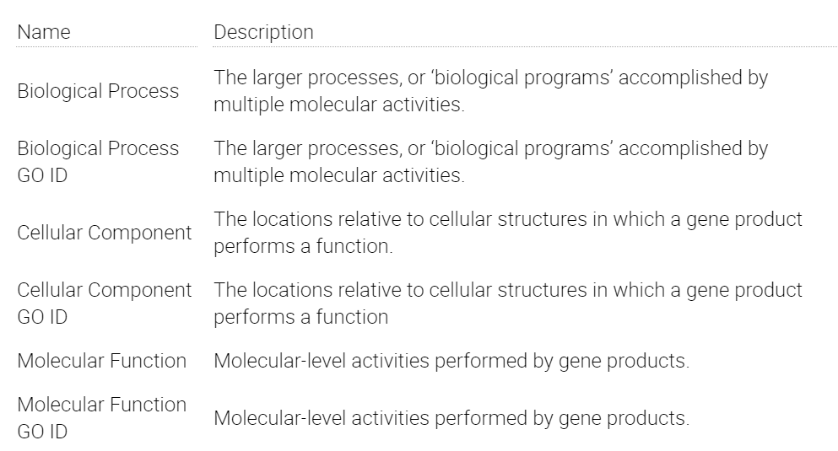
Annotating all files with OpenCravat to find related variants
This can help us find biological pathways that aspirin hypersensitivity is associated with
Might provide insight on how to treat dysfunction of pathways
Notes:
-this can help us find biological pathways that aspirin hypersensitivity is associated with
-might provide insight on how to treat dysfunction of pathways

Slide 15

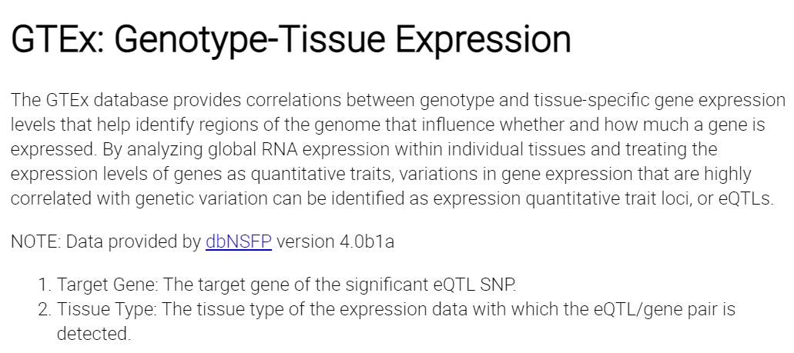
Annotating all files with OpenCravat to find related variants

Slide 16
After Annotation Job is Done
Filter to find related variants that have annotations from at least one of the three annotators
Export variant table as a csv
Use that table to create a matrix of binary values that shows in which individuals is each variant present
Rows: each individual (indices 0-24 are cases, 25-49 are controls)
Columns: each variant found on OpenCravat
Perform Fisher’s Exact Test to find most statistically significant variants from matrix
Conclude from the list of detected variants which biological pathways or processes contribute the most to aspirin hypersensitivity
Notes:
-VEST4 Score can calculate probability that variant is pathogenic

Slide 17
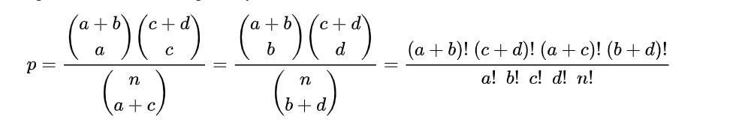
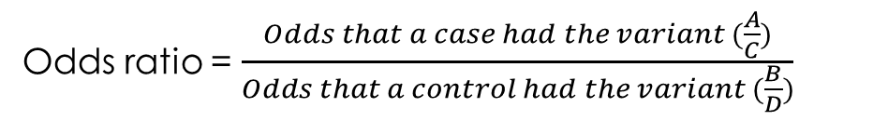
Fisher’s Exact Test to Determine Significant Variants
Contingency Table
 | Cases | Controls
Have Variant | A | B
Do Not Have Variant | C | D
(A, B, C, and D are counts)
P-value
Odds ratio = $\frac{Odds that a case had the variant (\frac{A}{C})}{Odds that a control had the variant (\frac{B}{D})}$
Fisher’s Exact Test determines whether odds ratio is statistically significant. That is, whether it rejects the null hypothesis that the odds ratio is 1, or that cases and controls have the same odds
R’s fisher.test function will be used to perform this test on many variants found on OpenCravat
This will help me choose what variants I will use to build machine learning models

Slide 18
Machine Learning Models to Classify Aspirin Hypersensitivity
Different models will be trained and tested based on:
Number and/or source of variants used to train model
Type of classifier used
Summed risk score thresholding used by Chang et. al.
Naïve Bayes
SVM
Decision tree
K Nearest Neighbors
All classifiers except risk score thresholding will involve using R’s logistic PCA for dimensionality reduction
Models will be tested using k-fold cross validation for different values of k
Average AUC for the ROC curve of each CV run will be calculated
Highest performing classifier will be identified

Slide 19
Additional Procedure: Estimating Percentage of People with Respiratory Disease who are Sensitve to Aspirin
Harvard PGP only has data from individuals with phenotypes “asthma, nasal polyps, etc.” (“aspirin allergy” is not included)
Use best performing classifier to predict whether individuals with these phenotypes have aspirin hypersensitivity
Estimate proportion of people with these phenotypes who are sensitive to aspirin

Slide 20
References
Chang, H., Shin, S., Lee, T. et al. Development of a genetic marker set to diagnose aspirin-exacerbated respiratory disease in a genome-wide association study. Pharmacogenomics J 15, 316–321 (2015). https://doi.org/10.1038/tpj.2014.78
Palikhe et. al. “Genetic Mechanisms in Aspirin-Exacerbated Respiratory Disease”. Journal of Allergy, 2012. Hindawi Publishing Corporation. https://doi.org/10.1155/2012/794890
Kim, Seung-Hyun, and Hae-Sim Park. “Genetic markers for differentiating aspirin-hypersensitivity.” Yonsei medical journal vol. 47,1 (2006): 15-21. doi:10.3349/ymj.2006.47.1.15
https://www.aaaai.org/conditions-and-treatments/library/asthma-library/aspirin-exacerbated-respiratory-disease
https://www.verywellhealth.com/aspirin-allergy-83065
https://www.jacionline.org/article/S0091-6749(99)70106-5/fulltext
Notes:
https://fcbbvirtualposter.wordpress.com/
https://medium.com/analytics-vidhya/feature-handling-in-machine-learning-de5525794b9c
https://www.pharmgkb.org/chemical/PA448497/variantAnnotation
https://towardsdatascience.com/pca-using-python-scikit-learn-e653f8989e60
https://cran.r-project.org/web/packages/logisticPCA/vignettes/logisticPCA.html
https://stats.stackexchange.com/questions/156861/how-to-calculate-the-p-value-of-an-odds-ratio-in-r/156862
https://www.rdocumentation.org/packages/stats/versions/3.6.2/topics/fisher.test

