Slide 1
Server Monitoring System
Bimal Gaire

Slide 2
Problem Statement
Difficult to find a simple Network Monitoring System
An application must be installed on the server computer.
Difficult to manage multiple servers.

Slide 3
Introduction
Server Monitoring System is a simple web application that monitors large number of servers simultaneously.
It shows the status of multiple servers remotely at the same time.
Shows graphs of resource usage (Disk, RAM and CPU)
Send Alert Notification to the admin in case of overload .

Slide 4
Literature Review
Large-Scale Autonomic Server Monitoring Using Process Query Systems (PQS)
Related Works:
Cacti
Nagios

Slide 5
Requirement Analysis
Fetch server data through system commands
Send the server data to the database
Display graph through php

Slide 6
Methodology
Data Collection
Fetch the data from server through system commands
Send the data to database through Json Dump
Data Selection
RAM usage and Disk Usage for graph

Slide 7
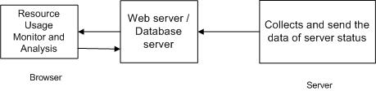
Methodology

Slide 8
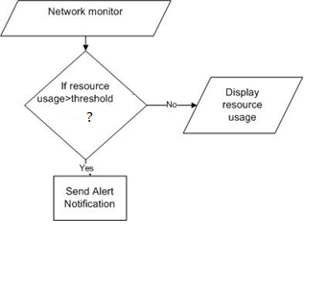
Methodology

Slide 9
Algorithm
Service Polling Algorithm:
To extract data from the server computer (through Json Dump)
Thresholding Algorithm
For alerting (warning and critical)

Slide 10
Implementation
Tools Used
Python: To fetch data from server
PHP: To display server status and graph
MySQL(Adminer): To store the server data (usage data)

Slide 11
Implementation
OpenShift:
Cloud Computing Tool (PaaS)
To host the web application
To store the data fetched from the servers
Status of remotely located servers can be monitored.

Slide 12
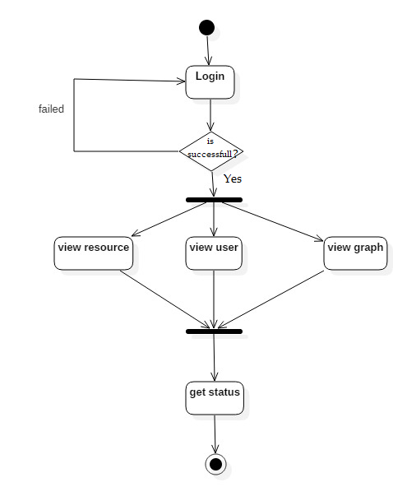
Activity Diagram:

Slide 13
Class Diagram

Slide 14
Major Modules
Data Fetching Module
Data Display Module
Alert Module

Slide 15
Testing
Test Cases
Test Case 1: Server Status is displayed correctly
Test Case 2: Clicking the name button displays the graph

Slide 16
Maintenance
Corrective
Perfective
Preventive

Slide 17
Conclusion
Successfully deployed in OpenShift
Can monitor several servers simultaneously
Admin can view the usage data of the servers along with graphs.

Slide 18
Recommendation
Can be implemented for Windows Servers.
Process and Network usage can be added.

Slide 19
Thank You!!!

