Slide 1
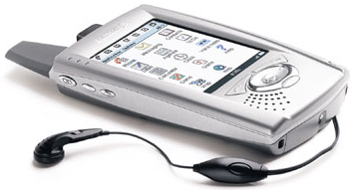
FX Palo Alto Laboratory
MobileDNA
10.08.2001

Slide 2
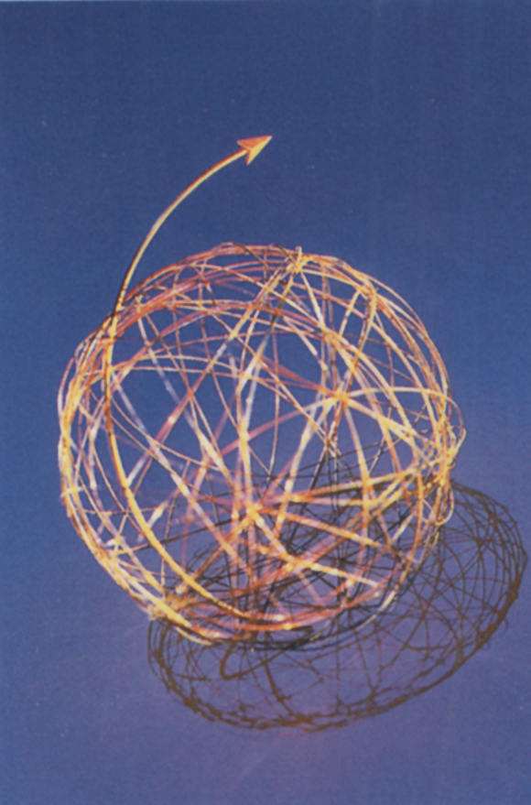
our mobile* devices*
* “changing easily in expression, mood, purpose”
– Webster’s Universal
* “invent from existing principles or ideas”
– Webster’s Universal

Slide 3
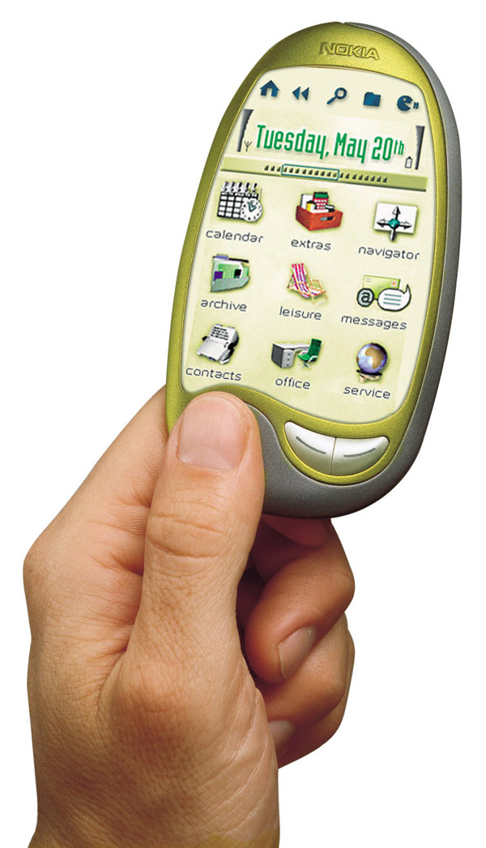
mobile devices are about place and time
a successful mobile device delivers immediacy, flexibility and personalization
– it need also deliver relevance
mobile devices should empower mobile users with the ability to choose the who, what, where, when and how
mobile is dynamic; so are its consumers
device assumptions are dangerous

Slide 4
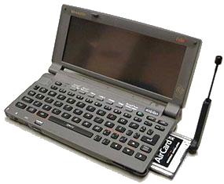
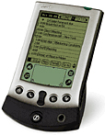
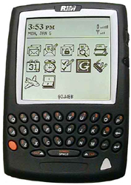
successful mobile devices are about…
24/7 time
work time
play time
sleep time
kids time
liminal time
travel time
anniversary time
study time
identifying “windows” in life patterns and stages
leveraging individual life patterns
mapping nodal points for mobile communications
recognizing the increased blurring of life/work
establishing real world business models
implication
we need to understand how mobile devices fit into our ‘many’ times

Slide 5
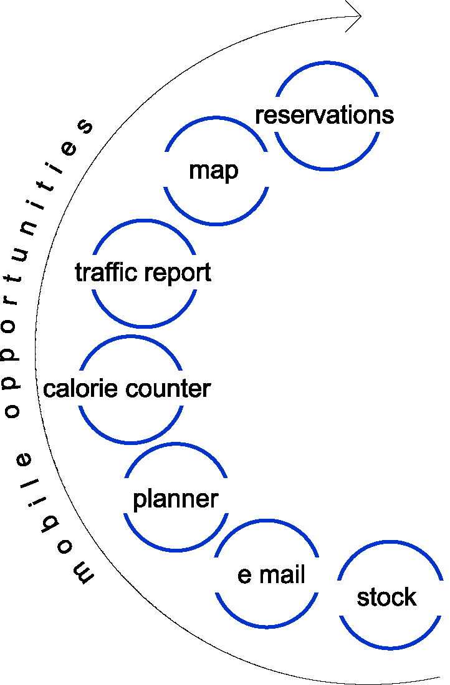
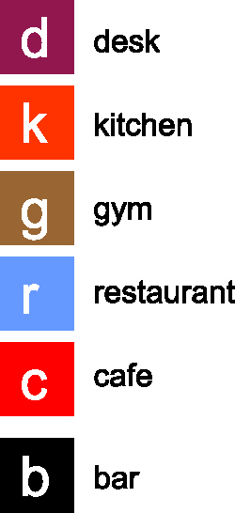
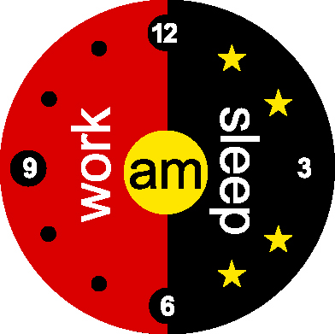
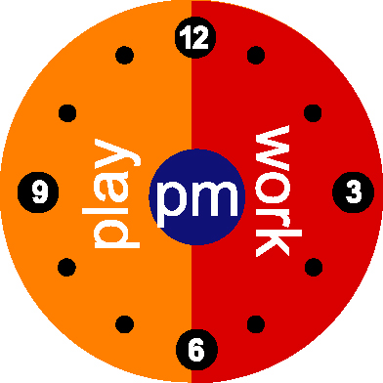
mobile devices are about place
and time...activity and application
It isn’t just location: am
general applications across time
general applications across time
location factors
location factors
r
d
k
c
g
lunch

Slide 6
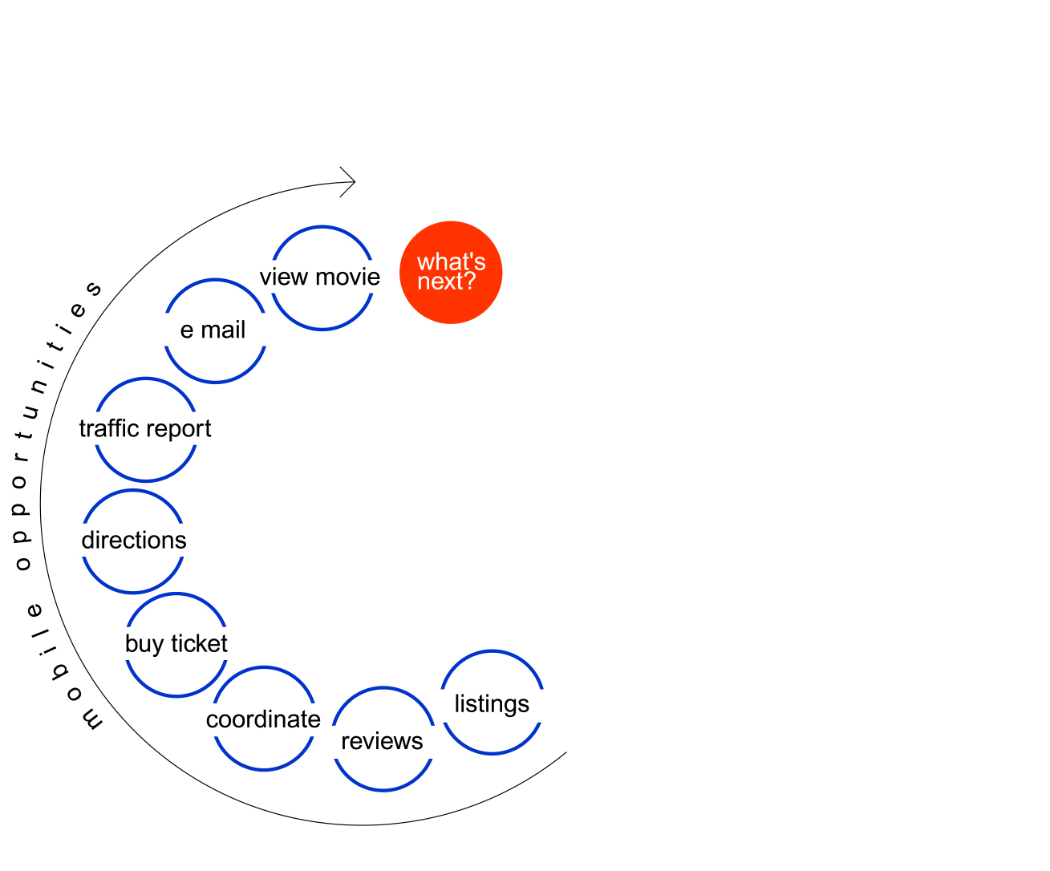
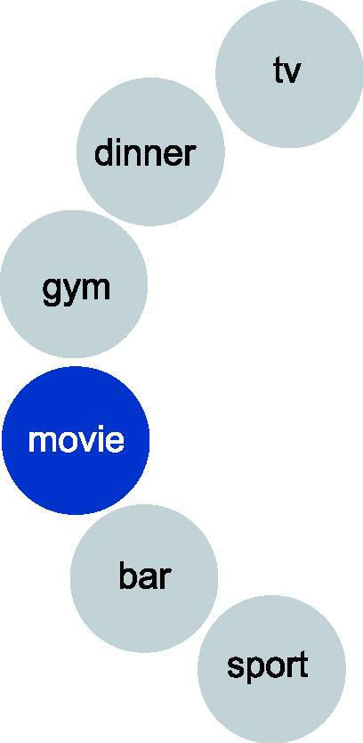
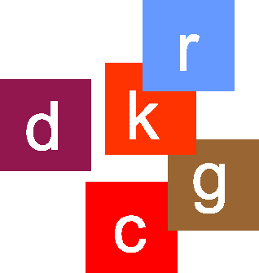
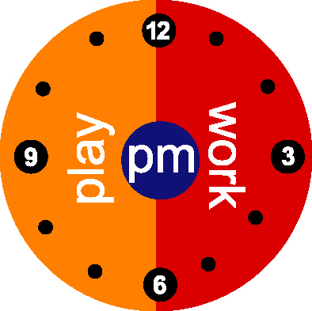
mapping mobile DNA
(time, activity, location, application, personality)
r
b

Slide 7
mobile questions
home
work
travel
play
city
suburb
campus
plane
car
café
restaurant
shop
mall
movies
gym
what are the key place/space/activity points?
at what times of day are they relevant?
what are the Application Spaces required by each “me” in these places, activities, and times?
what are the practical business models for these Application Spaces?

Slide 8
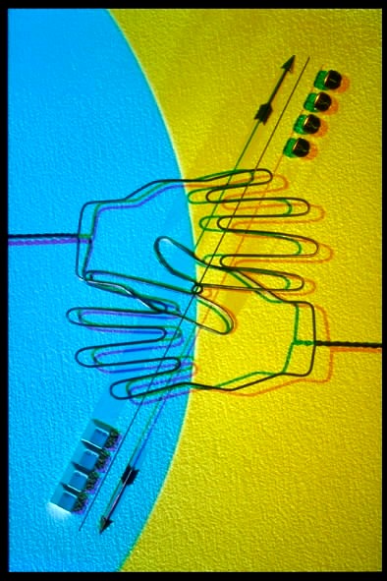
Mobile DNA Study
the code of mobile life

Slide 9
Mobile DNA study objectives
understand user needs and desires in the emerging mobile marketplace
identify emerging “spaces”, needs, features and benefits which are most important for consumers and business
shape and define the “optimal mobile experiences”, functionally,emotionally, temporally and spatially
identify the implications for brands in terms of opportunities, threats and awareness
develop real-world business models

Slide 10
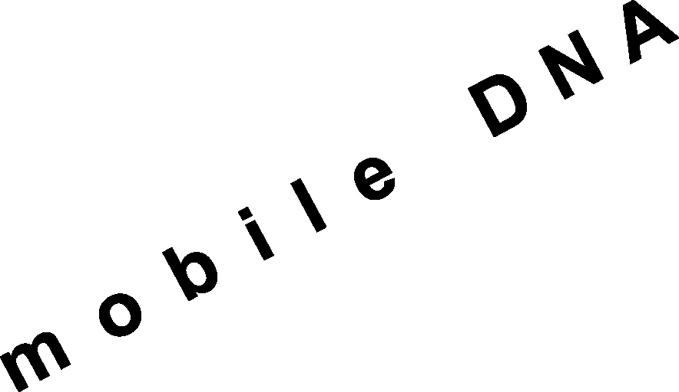
method of approach
mobile DNA
V. strategic
recommendations
IV. mobile DNA field study; quantitative confirmation of results
III. develop
applications stimuli
II. preliminary
customer research
I. create mobile
DNA diary

Slide 11
methodology overview
  London
  Tokyo
  Sao Paulo
  Bangalore
global – eight cities worldwide
  Helsinki
  San Francisco
  New York
  Singapore

Slide 12
methodology overview
stage one outputs
  one-on-one interviews
  (experts, executives and leaders along mobile value chain; architects, town planners)
  briefings with partners on specific needs and knowledge exchange
  identify target: high potential mainstream adopters
  (consumer and business)
  identify and map daily life “windows”
  create interactive mobile DNA diary template
  ideate potential application opportunities with partners
  issue comprehensive stage one report

Slide 13
methodology overview
stage two outputs
  field pre-test customer research
  four out of eight markets
  diary completion
  in-depth interviews
  observation of key life “windows”
  iterative process - refining approach throughout

Slide 14
methodology overview
stage three outputs
  leverage initial expert/customer feedback
  optimize Mobile DNA template and diary
  develop mobile applications stimuli protype
  partner with hardware, software, local content, communication providers
  share method with partners and refine
  pre-test stimuli with appropriate targets worldwide (e.g. global b2b, young urban professionals, kids/teens 12-17)

Slide 15
methodology overview
stage four outputs
  mobile DNA Study in field (eight markets)
  sterling individuals on site
  bi-monthly partner e-mail updates
  quantitative confirmation study - experts, target groups, and others in response to field work

Slide 16
methodology overview
stage five outputs
  strategic observations
  target group Mobile DNA profiles
  develop an objective mobile customer voice
  proprietary partner insights
  recommendations: identification of successful mobile Application Spaces
  topline business models for mobile Application Spaces
  publish The Code of Mobile Life

Slide 17

mobile DNA – the code of mobile life
mobilize now

Slide 18
half our life is spent trying to find something to do with the time we have rushed through life trying to save
– Will Rogers

