Slide 1

Pricing of home repairs prior to sale
Survey of housing sale data from Ames, Iowa

Slide 2
Feature Selection
Multi-pronged approach
Qualitative EDA
Comparing R² of each feature using simple linear regression
Comparing p-values of all features using f_regression
Comparing mutual information scores of all features
Feature importance using random forest regressor
Lasso and multicollinearity analysis

Slide 3
Qualitative EDA
Some features can be eliminated quickly from examining:
Feature distribution
Relationship vs. the target
# of NA values

Slide 4
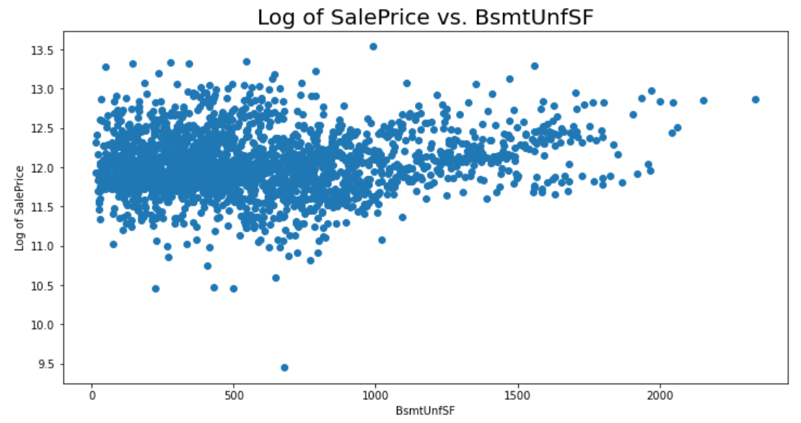
Qualitative EDA
For example,
BsmtUnfSF shows no relationship vs. log of price

Slide 5
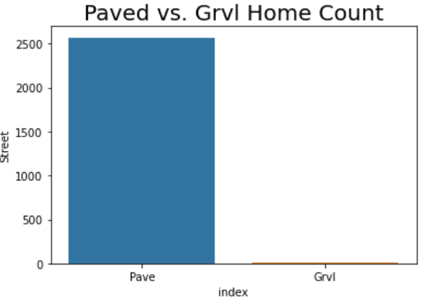
Qualitative EDA
For example,
Street feature is highly imbalanced.
LotFrontage has 462 NA values (out of 2580 homes).

Slide 6
Comparing R² From Simple Linear Regression
For each feature, fit a simple linear regression vs. log of price on the train set and compare the test R²
Categorical features were dummified prior to fitting.
Test R² ranged from as low as almost 0 to as high as almost 0.7.
Focused on features with test R² of at least 0.2

Slide 7
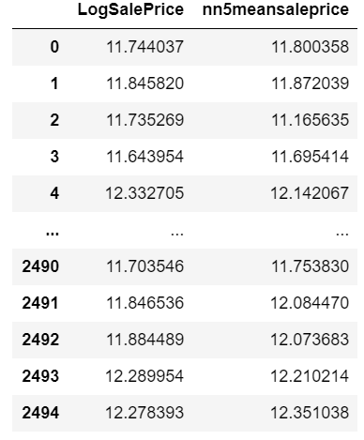
Comparing R² From Simple Linear Regression
For example,
nn5meansaleprice (a feature we created) has a high test R².
Train R²: 0.668
Test R²: 0.697

Slide 8
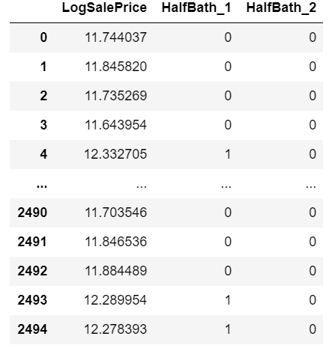
Comparing R² From Simple Linear Regression
For example,
HalfBath (dummified) has a low test R².
Train R²: 0.111
Test R²: 0.074

Slide 9
Comparing Mutual Information Scores and
p-values From f_regression For All Features
Extract top 25 features by using f_regression and mutual_info_regression
All appropriate NaN values were filled with ‘NA’ since they don’t equate to missing values.
Categorical features were dummified.

Slide 10
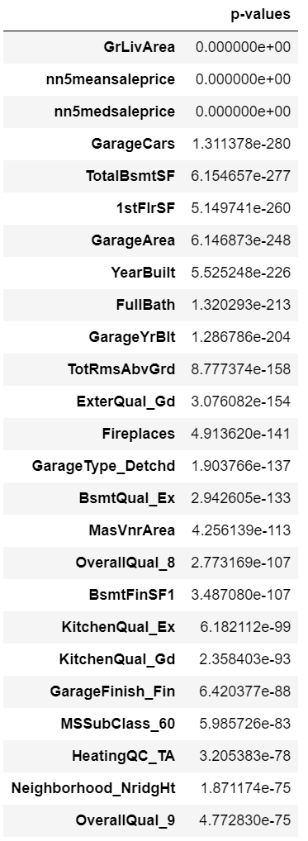
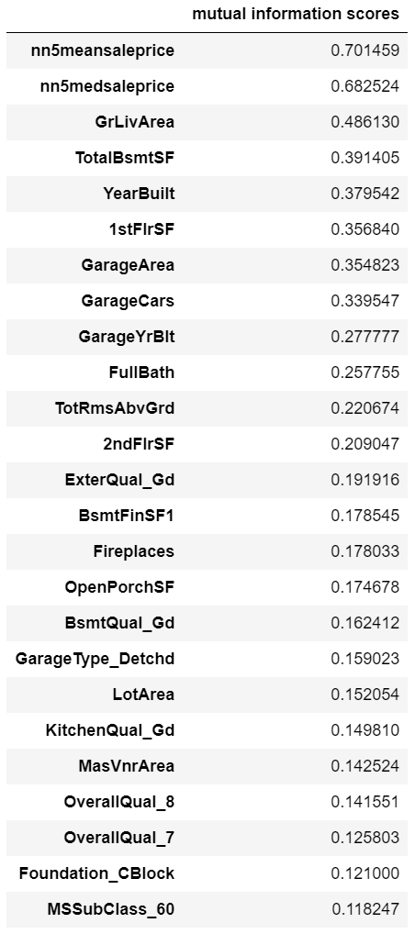
p-values
All 25 are statistically significant.
mutual information scores
Range is wide from 0.118 up to 0.7.

Slide 11
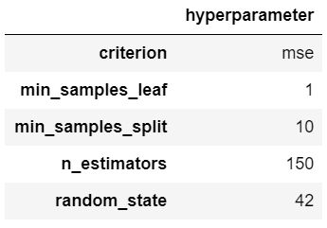
Feature Importance Using Random Forest Regressor
Similar to other methods, all appropriate NaN values were filled with ‘NA’.
Instead of dummifying, categorical features were encoded using LabelEncoder.
Grid search was used to find the best hyperparameters, which were

Slide 12
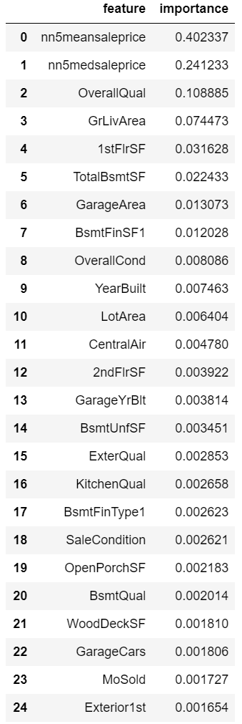
Interestingly, the model had a high score of almost 0.90, which implies it could be an useful tool for price prediction.
Top 10 features explained ~90% of the model.

Slide 13
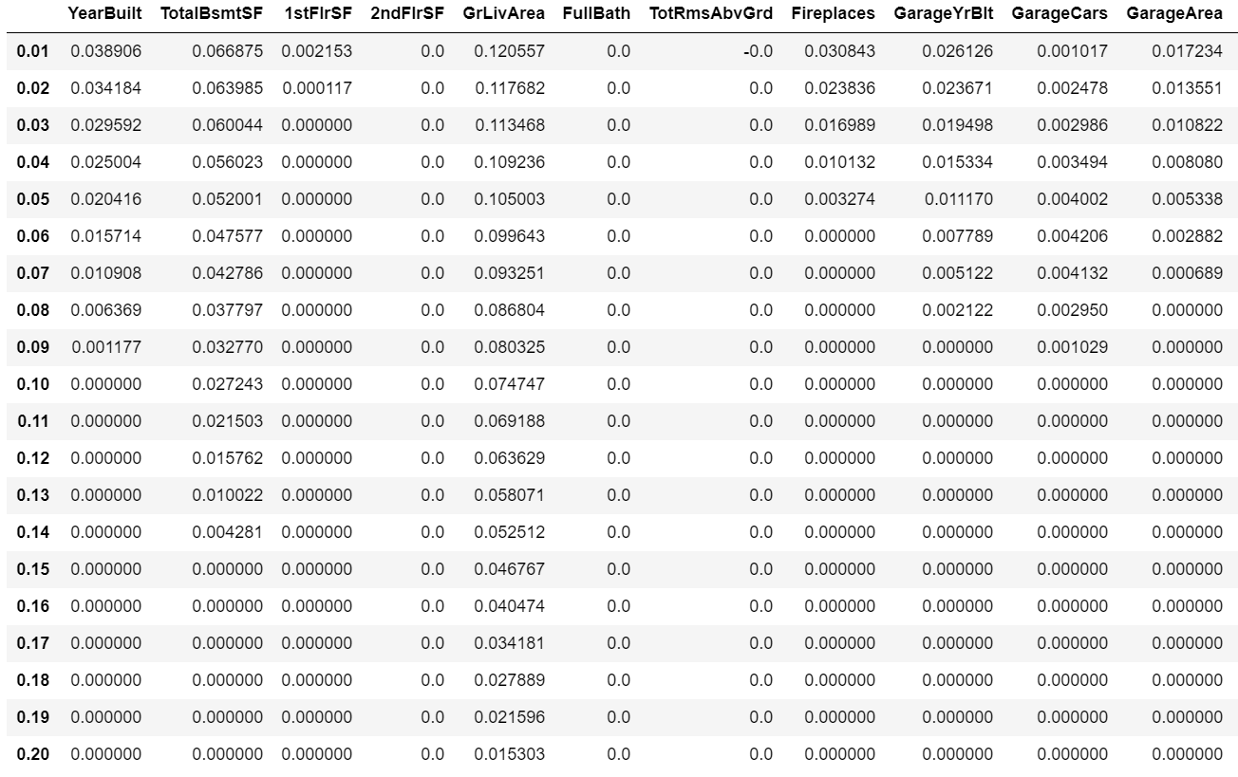
Final Elimination Using Lasso and Multicollinearity
Lasso penalization
Drop:
GarageArea
GarageYrBlt
2ndFlrSF

Slide 14
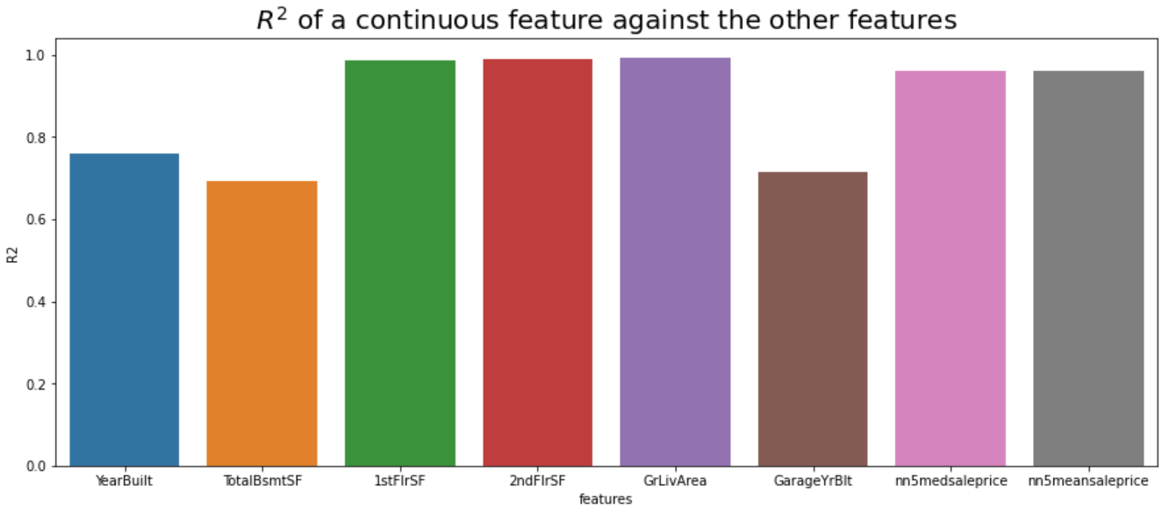
Final Elimination Using Lasso and Multicollinearity
Multicollinearity (fit a linear regression using a feature as a label and all the other features as predictors)
Drop:
GarageYrBlt
1stFlrSF, 2ndFlrSF
nn5medsaleprice

Slide 15
17 Final Features
MSSubClass_60
Neighborhood_NridgHt
YearBuilt
ExterQual_Gd
Foundation_Cblock
BsmtQual_Ex
TotalBsmtSF
HeatingQC_TA
GrLivArea
FullBath
TotRmsAbvGrd
KitchenQual_Gd
Fireplaces
GarageType_Detchd
GarageFinish_Fin
GarageCars
nn5meansaleprice

Slide 16
17 Final Features
MSSubClass_60
Neighborhood_NridgHt
YearBuilt
ExterQual_Gd
Foundation_Cblock
BsmtQual_Ex
TotalBsmtSF
HeatingQC_TA
GrLivArea
FullBath
TotRmsAbvGrd
KitchenQual_Gd
Fireplaces
GarageType_Detchd
GarageFinish_Fin
GarageCars
nn5meansaleprice
R2 = 0.855!

Slide 17

Final Regression
$$LogSalePrice=−0.017212MSSubClass_{−}60−0.001193Neighborhood_{−}NridgHt+0.002108YearBuilt+0.004004ExterQual_{−}Gd+0.021147Foundation_{−}Cblock+0.096119BsmtQual_{−}Ex+0.00016TotalBsmtSF−0.050784HeatingQC_{−}TA+0.000321GrLivArea−0.034077FullBath−0.012558TotRmsAbvGrd+0.051759KitchenQual_{−}Gd+0.050783Fireplaces−0.000436GarageType_{−}Detchd+0.019517GarageFinish_{−}Fin+0.052479GarageCars+0.311295nn5meansaleprice+3.461604$$

Slide 18
Features That Cannot Be Improved

Slide 19
Features That Can Be Improved

Slide 20
Conclusions

