Slide 1

Pricing of home repairs prior to sale
Survey of housing sale data from Ames, Iowa

Slide 2
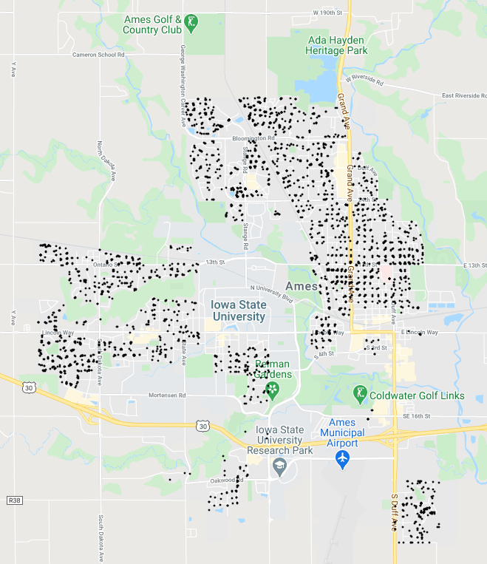
Ames, Iowa
Blmngtn
NridgHt
StoneBr
Gilbert
NoRidge
BrDale
Somerst
NPkVill
NWAmes
NAmes
SawyerW
Sawyer
Goal: determine impact of home refurbishments on sale price —
Is it worth modernizing kitchen?
Venture capital investors
Start-up companies looking to hire
Greens
BrkSide
ClearCr
OldTown
Landmrk
Veenker
CollgCr
Edwards
IDOTRR
SWISU
Crawfor
Mitchel
Timber
MeadowV

Slide 3
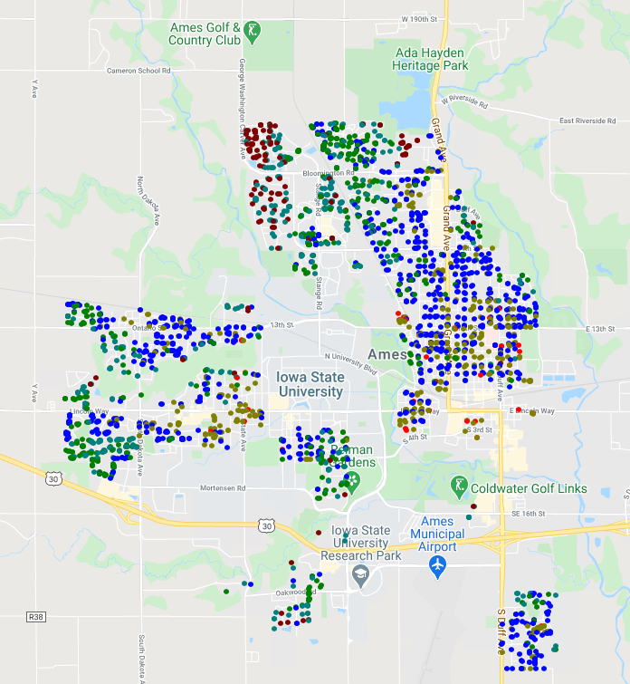
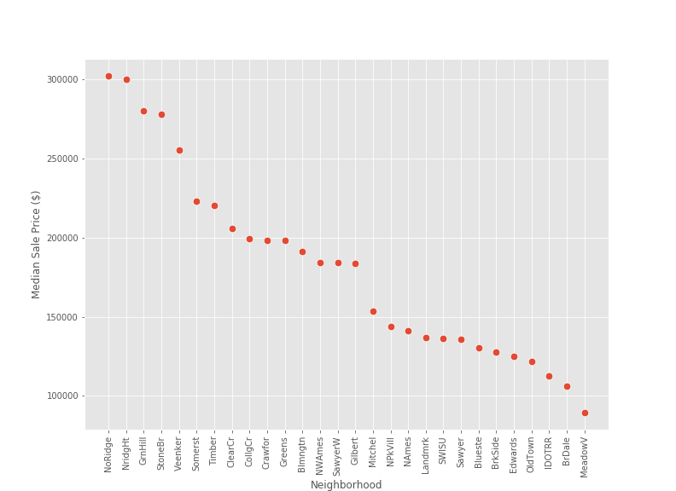

Slide 4
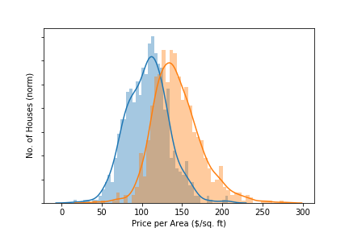
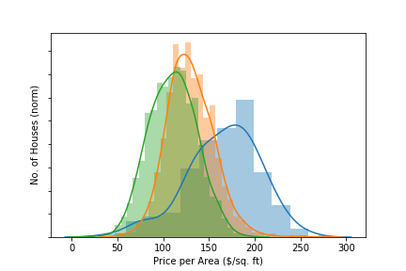
How much do home repair increase sale price?
Houses with better quality basements and kitchens have higher price per area
Includes impact of multiple other variables that might raise price (home size, year built, neighborhood, etc..)
Goal is to isolate impact of home repairs from other contributing variables

Slide 8
Conclusions

