Slide 1
Industry sector trends in NYC start-ups
Based on Data from BuiltinNYC.com

Slide 2

Builtinnyc.com has listings for almost 3,500 NYC start-ups and tech companies.
New industry trends and technologies often first tested out in start-up community
Goal: determine employment trends in the top tech sectors to help —
Job seekers
Venture capital investors
Start-up companies looking to hire

Slide 3
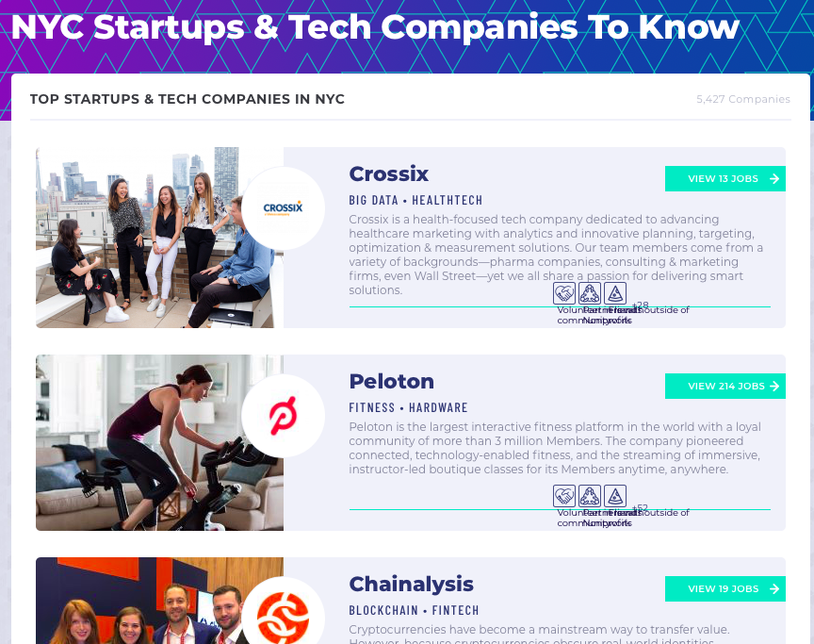

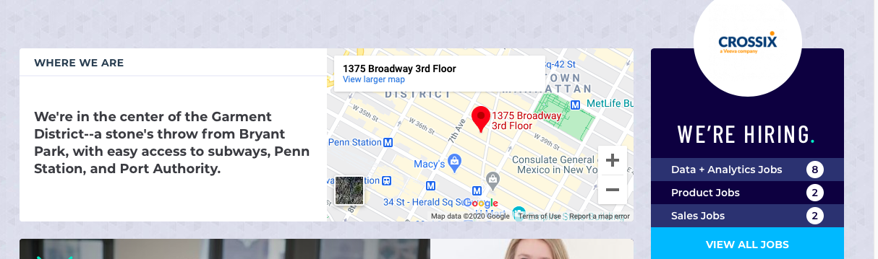
Click link to access info on individual companies
Information Scraped:
Company Name
Address
Date Founded
Industry Sector (1st, 2nd, 3rd )
Company Description
Total Jobs Available
Total Employees
Total NYC Employees
Investor Funding
Listing of 20 companies per page
.
.
.
250 pages
Scroll down for more
More detailed information on site for future scraping
3450 Unique Companies

Slide 4
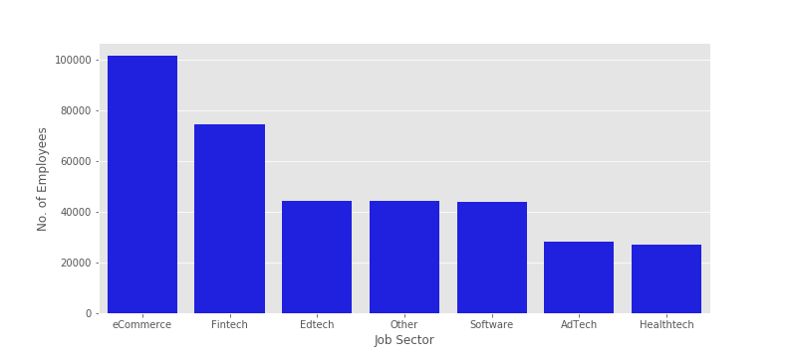
Top Job Sectors by Total Employees
Top Sector by Total Number of Companies Formed that Year
Year | Top Job Sector 1st | Top Job Sector 2nd
2011 | AdTech | Mobile
2012 | Software | Information Technology
2013 | AdTech | Software
2014 | Fintech | Software
2015 | eCommerce | Software
2016 | Fintech | Fintech
2017 | Artifiical Intelligence | Fintech
2018 | Artifiical Intelligence | Software
2019 | Healthtech | Information Technology
2020 | Artifiical Intelligence | Healthtech
eCommerce and Fintech are top tech employers in region
Recent trend is formation of companies in Artificial Intelligence and Healthtech

Slide 5
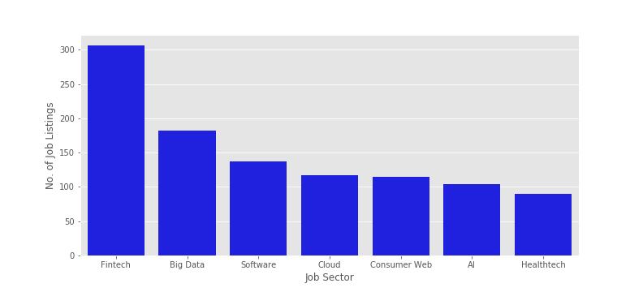
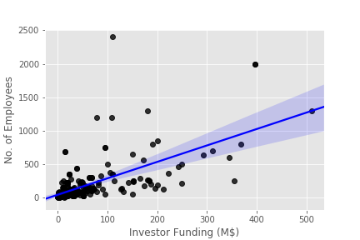
Top Sectors by Number of Job Listings
Total Employees vs. Investor Funding
Fintech tops job listings, but Big Data, Software, Cloud now appear
More investor funding means more employees => good sanity check

Slide 6
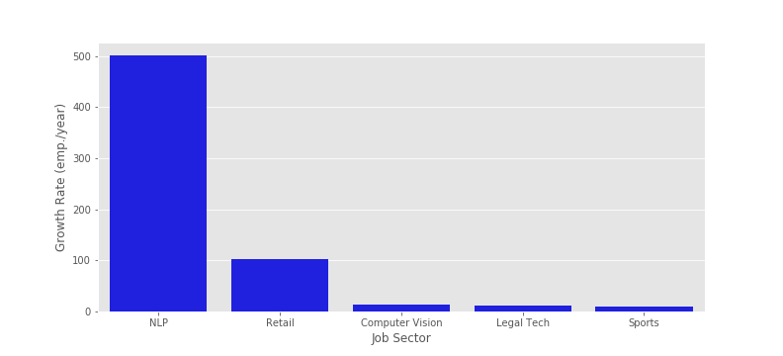
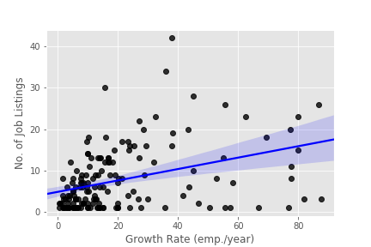
Total no. of Employees
Define new parameter “growth rate”
Growth rate =
(2021 – Year Founded)
Top Sectors by Growth Rate
Job Listings vs. Growth Rate
Natural Language Processing (NLP) dominates growth rate
Number of job listings correlates with growth rate
Be careful of outliers!

Slide 7
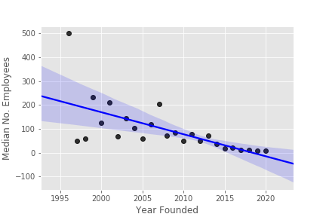
What is the lifetime of a start-up company?
Median number of employees vs. year founded
According to linear regression, number of employees increases with years since founding.
Confidence interval spreads with increasing years. Some companies are big success, others fail.
Stable number of employees peaks at about 10 years.

Slide 8
Conclusions
Data from start-up company listings provides size and growth information on tech sectors in NYC
Insights useful for job seekers, employers looking for workers, and investors identifying top trends.
Future work possibilities include NLP on company descriptions, companies by location, desirability of company perks, and other ”Builtin” city sites.

