Slide 2
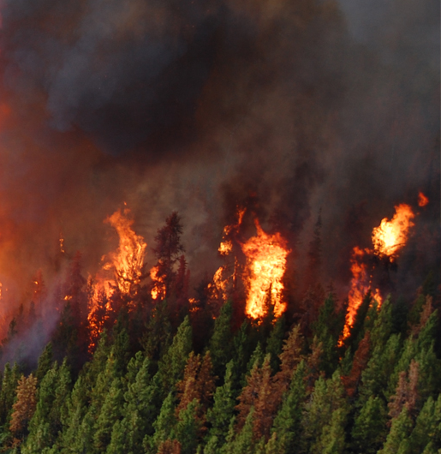

Slide 3
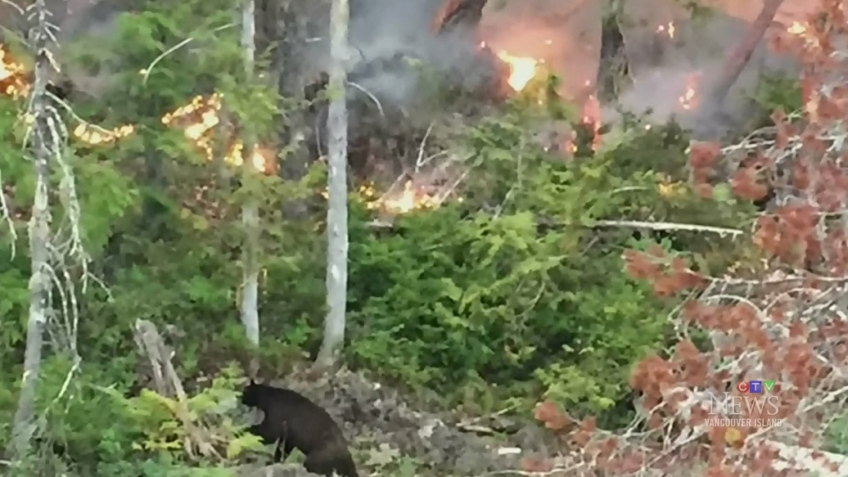
Notes:
A black bear is seen on the shores of Sproat Lake just metres away from a raging wildfire that hit 400 hectares in size Thursday, July 9, 2015. (Courtesy Steve Kendall)

Slide 5


Slide 6
TreeViz
2019 Hacking for Humanity
Girls in Tech
Motivating the future generation to take action on climate change by making them care more about it.

Slide 7
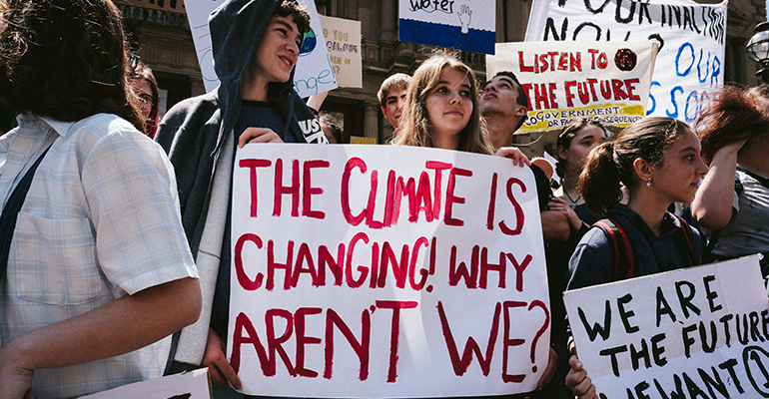

Slide 9
