Slide 1
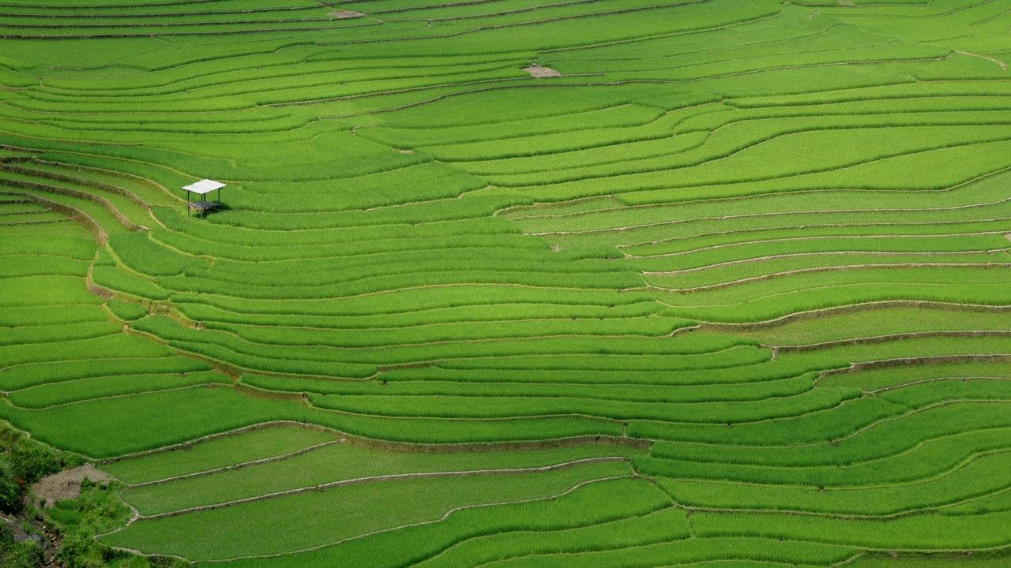
TreeViz
By: Bailey Lei, Alex Pak, Sabrina Tse, June Wu

Slide 2
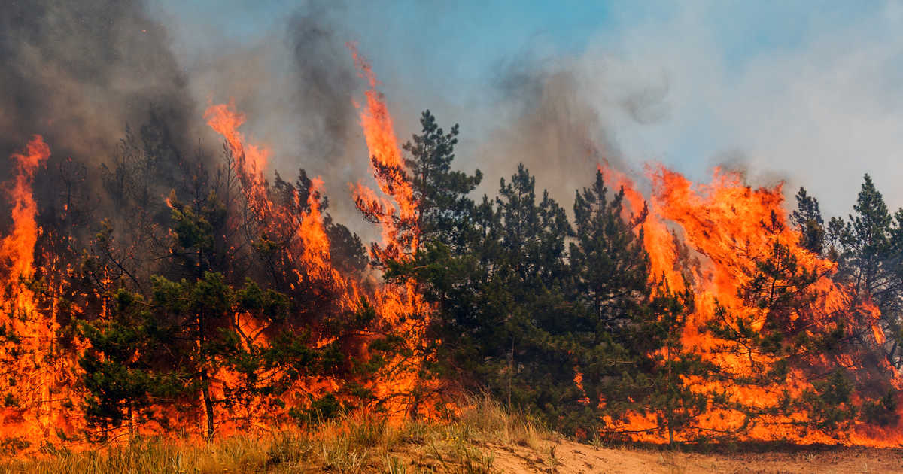

Slide 3
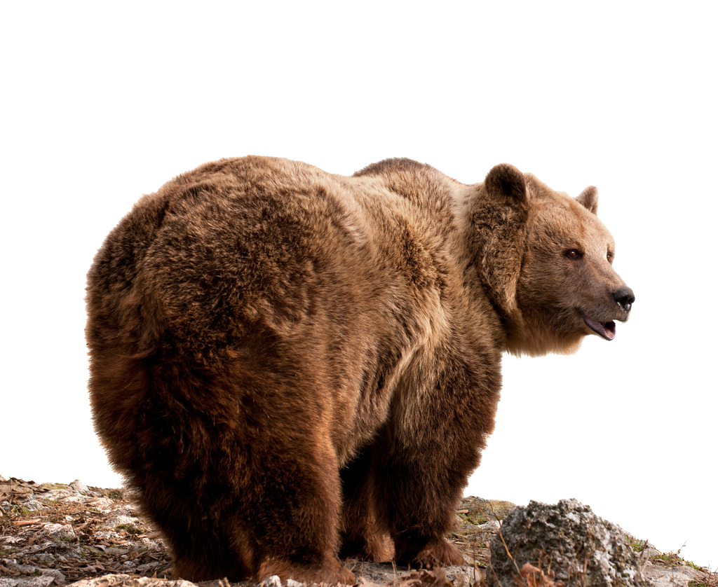

Slide 4
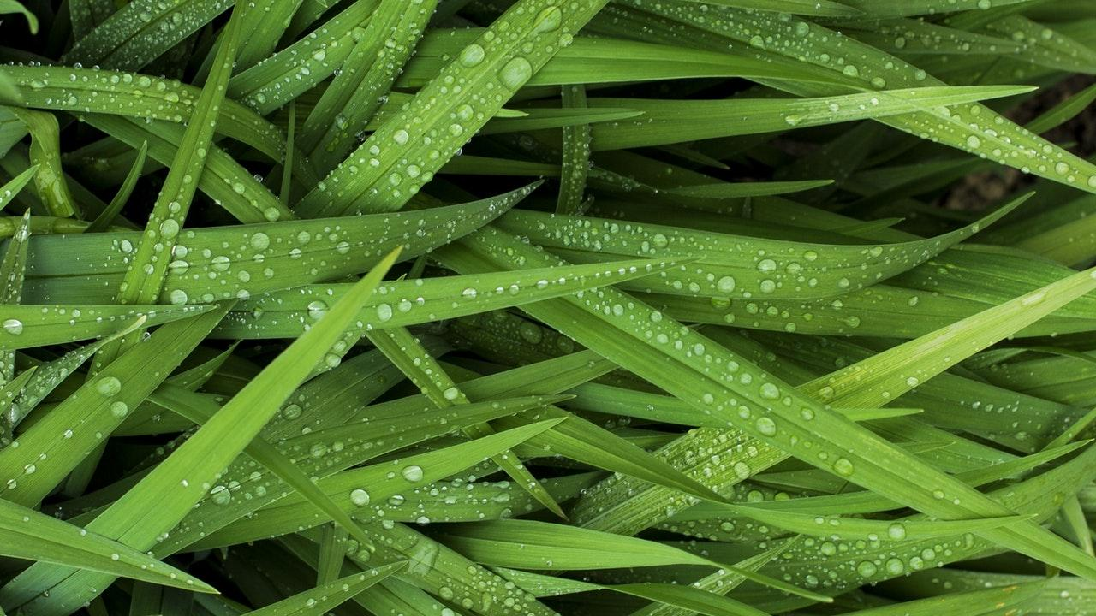
A squirrel dying in front of your house may be more relevant to your interests right now than people dying in Africa.

Slide 5
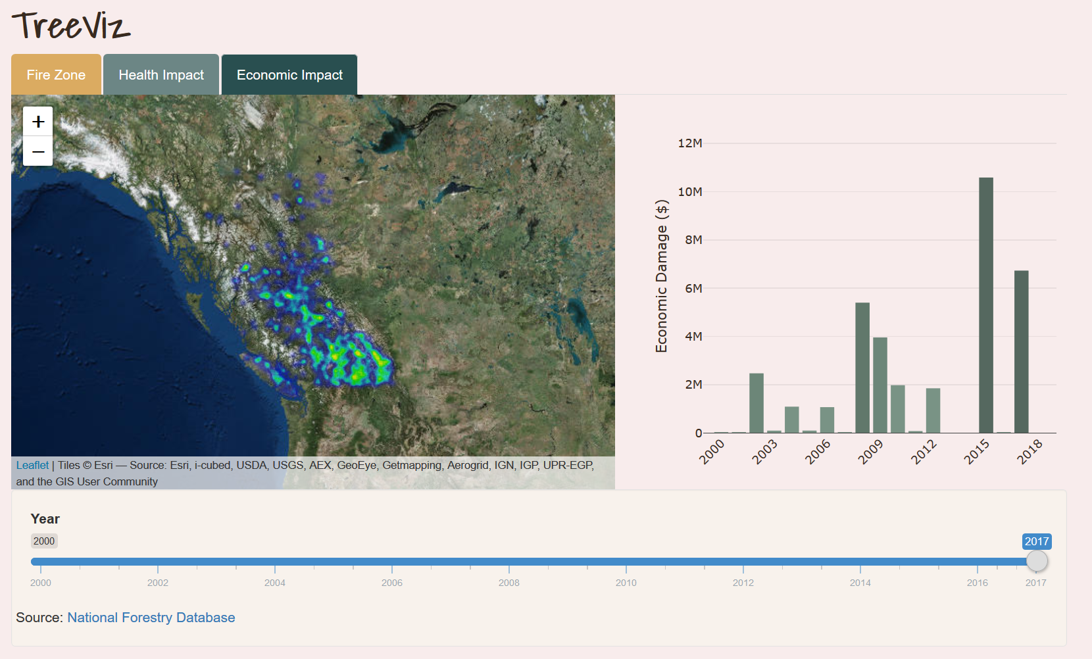

Slide 6
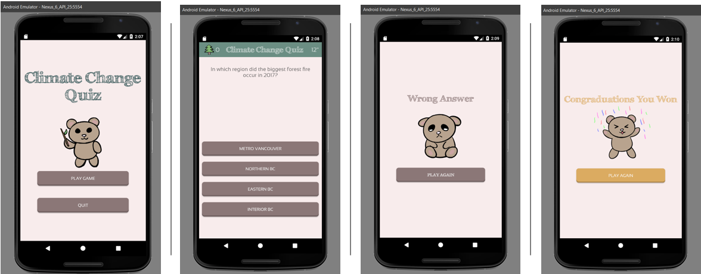

Slide 7
