Slide 1
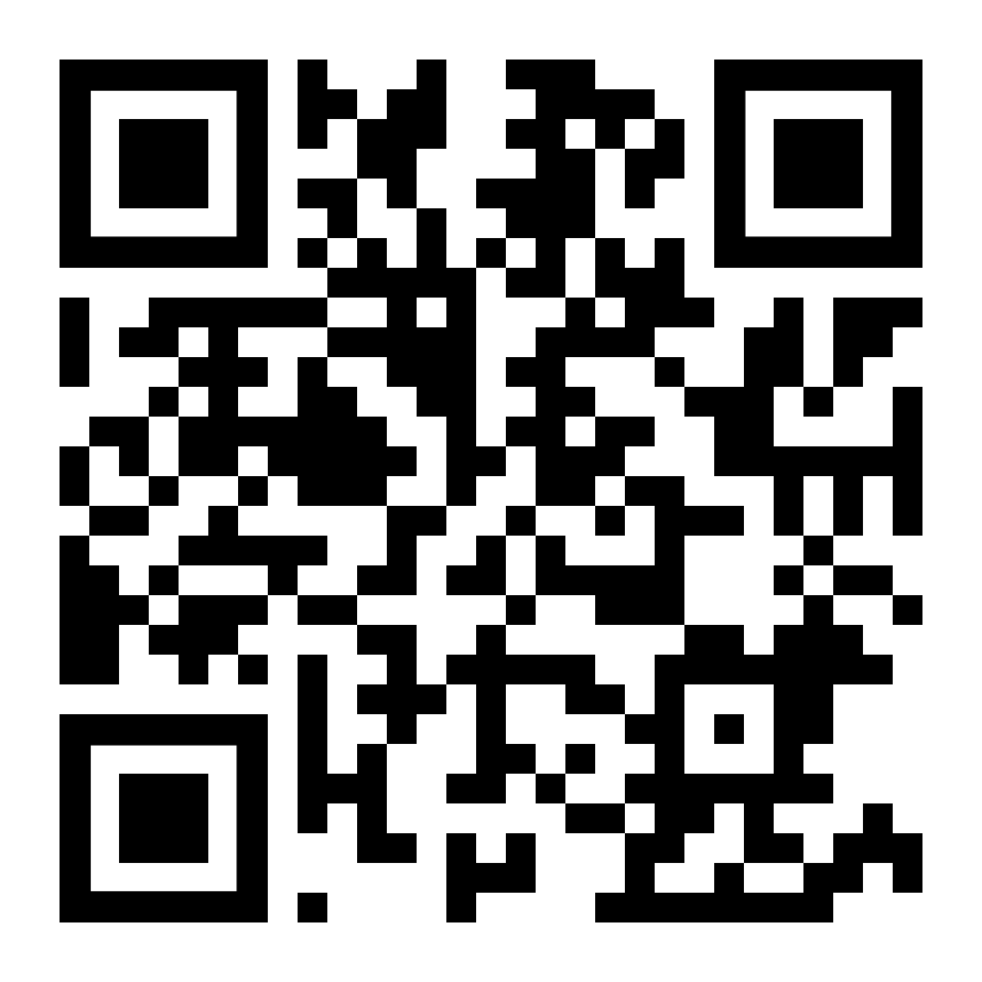
Emory’s Apporto
https://rsphemory.apporto.com/
Notes:
https://rsphemory.apporto.com/

Slide 2
Notes:
Welcome to the App Store Admin login | Apporto
Welcome to the App Store Admin login | Apporto

Slide 5
Uploading Materials

Slide 8
Downloading Data

