Slide 1
Project Outcome Biodiversity Capstone
codecademy username: bleikera

Slide 2
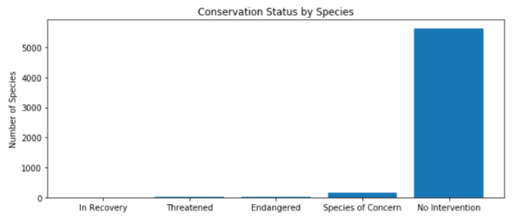
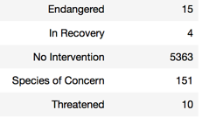
National Park Register with conservation status of various species
5541 different species in 7 categories Mammal, Bird, Reptile, Amphibian, Fish, Vascular Plant, Nonvascular Plant

Slide 3
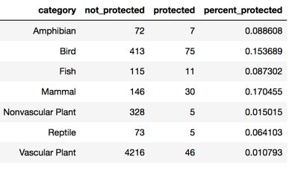
Protection Status of various Categories
Based on the above data, we checked whether mammals are more likely to be endangered than birds. → Based on available data, there is no statistically significant difference between the endangerement of mammals over birds (chisquare pval 0.69).
However, a statistically significant difference in the endangerement of reptiles and mammals was detected (Chisquare, pval 0.04).

Slide 4
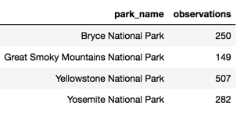
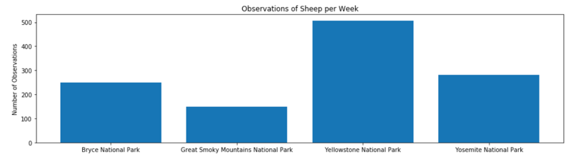
Analysis of Conservationists Data
23296 observations in 4 different National Parks during one week.
Focus of the analysis on sheep.

Slide 5
Foot & mouth disease Program
Background:
currently 15% of sheep in Bryce National Park suffer from the disease
Yellowstone National Park program to reduce the disease
Recommendation
In order to be 90% confident that the program is effective (i.e. 33% reduction of the concerned population), a sample of 510 sheep observations is required.
→ roughtly 2 weeks of observations in Bryce and 1 week in Yellowstone

